Slide 1
As of February 24, 2025
Introduction
Notes:
Delivery Type 1: Supplemental Extension begins here, on slide 1.
Delivery Type 2 : Supplemental Stand Alone begins on slide 40.

Slide 2
Welcome!
Please sign in and find a seat. We will begin soon.
If possible, please turn on your camera and enter your preferred name. We will begin soon.
Notes:
Choose one bullet point to display (the first bullet point is for in-person, the second is for virtual).
If in-person, greet participants as they come in the door and help them find a seat.
If virtual, give participants a heads up when you will be starting. For example, “Hi everyone, we will be starting in about one minute.”

Slide 3
AGENDA
Overview
Syllabus
Expectations
Registration
Homework
Notes:
Welcome: Introduce yourself and thank participants for choosing to be a part of the Grandfamilies Supplemental Parenting Program. Explain that Meeting 1 will provide an overview of the program, who is in our group, and what is expected of parents who participate. We will discuss the materials you received and provide instructions on how to use them.
Encourage participants to ask questions as they arise or to jot them down and ask at the end of the meeting.

Slide 4
Target Audience
Program Focus
Skill Building
Reflective Sharing
Program Structure
Goals
Notes:
Discuss the following topics with your participants:
Grandfamilies: PROSPERing with 10- to 14-Year-Olds is an online supplemental module for grandparents who are full-time caregivers of children between the ages of 10 and 14 years old.
This module is designed to help grandparents prepare for and overcome the difficulties that come with being a primary grandparent caregiver of an early adolescent child. While this module will discuss challenges encountered by many grandparent caregivers, each situation is unique. To help caregivers think about their unique situation, throughout the module, they will be asked to stop and consider how their individual situation compares to other grandparent caregiver situations. Topics like developing a positive caretaker relationship, understanding communication, and managing stress and health are examined. During the online supplemental module sessions and throughout the hybrid implementation meetings, information and parenting strategies that parents can use and adapt, as necessary, to fit their individual circumstances and family needs will be disseminated.
The supplemental module content is designed to help grandparents build on their existing skills and strategies, so they can effectively care for their grandchild.
Some of the content that is read and practiced in the supplemental module and discussed in the hybrid implementation meetings may be familiar to the parents, and they may already know about and use the disseminated information. Therefore, they may use the meeting time as an opportunity to realize, appreciate, and share what already works for them, their grandchild, and their family.
Grandfamilies: PROSPERing with 10- to 14-Year-Olds is an online supplemental module for grandparents who are the primary caregivers for their grandchildren ages 10 to 14 years old. It includes an introduction, four parts, and a wrap-up.
After participating in the online supplemental module sessions and the hybrid implementation meetings, parents and caregivers should be able to do the following:
• Find ways to deal with the challenges of being a grandparent caregiver
• Implement positive parenting techniques
• Plan for and value spending time with your grandchild
• Understand the developmental needs of your grandchild
• Communicate effectively with your grandchild
• Negotiate systems of care and ask others for help
• Identify useful coping and stress-management techniques.

Slide 5
Parent Workbook
Syllabus
Notes:
Provide copies or screen share a copy of the Parent Workbook and Syllabus for the Grandfamilies: PROSPERing with 10- to 14-Year-Olds supplemental module. Review the Summary of Training, and highlight the section where the participants can find pertinent information.

Slide 6
Expectations
Notes:
Overview of Expectations: Clearly define what is expected of participants in the Grandfamilies supplemental program.
Independent Completion: Inform families that they are expected to independently complete the online modules.
Full Engagement Required: Emphasize the importance of completing each module in full to maximize learning and benefit from the program.
Purpose of Meetings: Clarify that the in-person meetings are not for revisiting session content but for community building, reflecting on experiences, and discussing insights with other parents and caregivers who are trying to successfully navigate grandparenting.
Preparation for Discussions: Encourage participants to come to meetings prepared to share their thoughts and engage in discussions based on the content they've learned online.

Slide 7
REGISTER
Notes:
Explain how participants can access the supplemental module online. Offer support to help with any technological questions. All participants will have previously set up a Thrive account, but you need to ensure they can log in and find the information they need to get started or progress in the supplemental module.

Slide 8
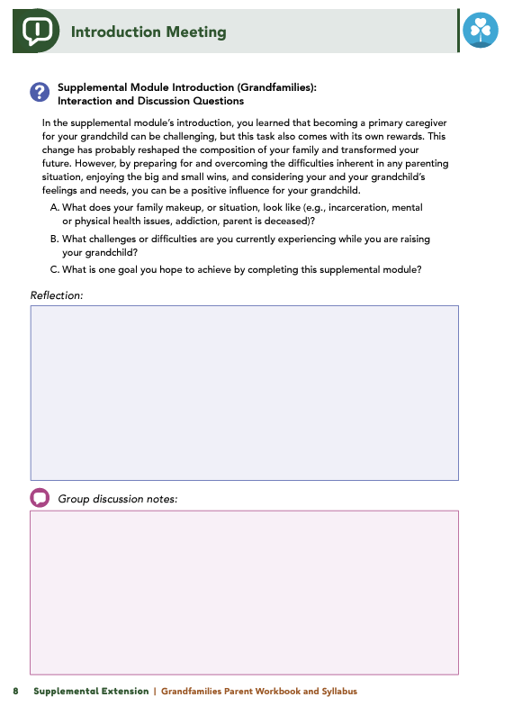
Homework
Complete the Introduction Module, Part 1: Cultivating the Relationship with your Grandchild, and Part 2: Communication
View online modules
Complete workbook questions
Notes:
Homework Tasks: Assign Introduction Module and Parts 1 & 2, Cultivating the Relationship with your Grandchild and Communication as homework.
Step 2 Clarification: Remind participants that this homework involves viewing online content and downloading necessary resources as part of Step 2. If time permits, show where to access these materials on the website.
Workbook Guidance: Show the specific pages in the Grandfamilies Parent Workbook and Syllabus related to these topics (D7)
Step 3 Clarification: Assign workbook discussion questions (beginning on page D8 in the parent workbook).
Format explanation: Explain the reason for 2 boxes per question (one for individual, one for group responses).
Encourage reflection and engagement: The more participants, think, reflect, and share the more meaningful the content becomes to each family.
Pro tip: Complete the workbook while viewing online modules.

Slide 9
Thank you for participating today.
Please reach out with any questions or concerns.
See you next week!
Notes:
Closing: Thank participants for their time and engagement.
Questions: Ask if there are any questions. (If someone needs personal assistance, ask them to speak with you individually after the group is dismissed).
Meeting 2: Remind participants of the date/time/location of the next meeting.
Homework: Remind participants to complete the homework.
Adjourn: Say goodbye to participants.

Slide 10
Meeting 1

Slide 11
Welcome back!
Please sign in and find a seat. We will begin soon.
If possible, please turn on your camera and enter your preferred name. We will begin soon.
Notes:
Choose one bullet point to display (the first bullet point is for in-person, the second is for virtual).
If in-person, greet participants as they come in the door and help them find a seat.
If virtual, give participants a heads up when you will be starting. For example, “Hi everyone, we will be starting in about one minute.”

Slide 12
Conversation Starter
Restate Ground Rules
Group Discussion
Homework
Notes:
Example language: Welcome back, families! We’re glad to see for our second meeting.
Review Meeting 2 Agenda:
Conversation Starters: We’ll get started with a quick question to get us all engaged and sharing.
Review of Ground Rules: A brief reminder of our ground rules to ensure our discussions remain respectful and productive.
Discussion and Homework: After our initial activities, we will discuss the workbook questions based on your experiences with the last set of homework followed by an explanation of the homework for our next meeting. Let’s get started!

Slide 13
Please answer one of the following questions:
What is one aspect of your grandparent-grandchild relationship that is working well?
What is a skill you use effectively in your parenting?
What is an activity you enjoy doing with your grandchild?
Notes:
Example language: "Let's open our session with a fun question that will give us all a chance to share something about ourselves. Review the list of questions provided on the slide. Select one question that resonates with you, or that you feel comfortable sharing. This activity is designed to ease us into the meeting and build a friendly, open atmosphere.

Slide 14
Basic Ground Rules:
Always start and end sessions on time.
Cell phones should be on vibrate; members can quietly excuse themselves if a call must be taken.
In virtual sessions, participants should mute themselves when taking calls outside the session.
Group-Specific Rules:
Avoid judgment regarding other participants' parenting practices or knowledge gaps.
One person speaks at a time to maintain order and clarity.
Assume positive intent in all interactions to foster a positive atmosphere.
Confidentiality- Please be respectful and discrete with the personal stories being shared. This is a safe space to grow and learn.
Notes:
Introduction of Ground Rules: Start by stating some basic ground rules to create a supportive environment where families feel safe to share their parenting experiences.
Basic Ground Rules:
Always start and end sessions on time.
Cell phones should be on vibrate; members can quietly excuse themselves if a call must be taken.
In virtual sessions, participants should mute themself when taking calls outside the session.
Developing Group-Specific Rules:
Discuss and agree on additional rules as a group, such as:
Avoid judgment regarding other participants' parenting practices or knowledge gaps.
Ensure one person speaks at a time to maintain order and clarity.
Assume positive intent in all interactions to foster a positive atmosphere.
Confidentiality Discussion: Use this time to reinforce the importance of confidentiality, outlining your organization’s specific confidentiality clauses regarding statements related to abuse or neglect mandated reporting..
Example language:
As we begin, it's crucial to emphasize the importance of confidentiality within our group. We need to agree to keep all shared information within these sessions, including personal stories and sensitive details. This ensures a safe space where everyone feels comfortable sharing their experiences. Please remember that details shared by participants are given in trust and should be treated with respect and discretion.
Additionally, it’s important to note our mandated reporting clause for suspected abuse or neglect:
Legal Obligation: Our staff and facilitators are legally required to report any suspicions of child abuse or neglect.
Scope of Reporting: We must report any signs of potential harm to a child or vulnerable adult that arise during our sessions.
Procedure for Reporting: We handle these situations sensitively, informing involved individuals about necessary actions, unless it poses further risk.
Support for Affected Individuals: We provide support and resources to help those involved in a reporting situation.
Our primary concern is the safety and well-being of all individuals. If you have any questions or concerns about this policy, feel free to discuss them privately with me.

Slide 15
Overview
Context &
Challenges
Strategies &
Support
Empowerment &
Adaptation
Notes:
Provide an overview of the supplemental module using the following points that are taught in the supplemental module:
• You are a proud grandparent, but, due to a difficult situation, you have become the primary caregiver for your grandchild. Whatever the situation, and whether it involves one or several factors, you are probably raising your grandchild with little to no assistance and involvement from the child’s parent(s).
• The absence of your grandchild’s parent in your life and in your grandchild’s life can have rewards and challenges. However, your grandchild is not alone. They have you. They have your love, dedication, influence, wisdom, and advice. You have been given the opportunity to be a positive influence in your grandchild’s life. You might be able to re-experience the joys of raising a child and take pride in their accomplishments, goals, and values that you help make possible. However, there will be challenges that you, and many other grandparents, face as a full-time caregiver of a young teen.
• You may have concerns about taking on the responsibilities (again) that come with being the primary caregiver of a child. You may be worried about the child’s parent. You may wonder how you might be able to help them and what their relationship with your grandchild will be like. You may feel isolated or alone. In this course, we will examine strategies that you can use to help you think through and address these concerns, and we will discuss approaches you can use to overcome negative thoughts and feelings that may cause you stress.

Slide 16
Goals
Goals
Strengthen Relationships & Communication
Build Support & Networks
Manage Well-Being & Future Planning
Notes:
After completing this learning module, you will be able to do the following:
• Develop a positive caretaker relationship with your grandchild
• Understand how to effectively communicate and interact positively with your grandchild
• Identify supports for your grandchild
• Establish relationships to help your grandchild thrive
• Manage your stress and your health
• Learn how to continue to meet your own needs while you plan for the future with your grandchild.

Slide 17
Discussion
What does your unique family situation look like?
What challenges are you facing as a grandparent caregiver?
What is one goal you hope to achieve through this module?
Notes:
Ask the participants the following questions to generate discussion:
What does your family make up, or situation, look like (e.g., incarceration, mental or physical health issues, addiction, parent is deceased)?
What challenges or difficulties are you currently experiencing while you are raising your grandchild?
Ask the following question, and solicit answers from a few participants to generate discussion:
What is one goal you hope to achieve by completing this supplemental module?

Slide 18
Positive Parenting Techniques
Can you recall a recent example of positive parenting from the past week?
What is one strategy you could try next week to support your grandchild?
Notes:
Review this section of the module with the participants by offering the following information:
• The way you act in your role as the primary caretaker of your grandchild impacts the interactions (positive and negative) you and your grandchild have and affects how your grandchild behaves. To enhance your role as the primary caretaker, you will probably want to practice positive parenting and adopt an effective parenting style. You completed a Stop and Think activity in which you were asked to consider positive parenting and how you may already use it.
• Remember that positive parenting is based on good communication and positive attention.
• Some ways to practice positive parenting are to be available, to encourage, to be supportive, to praise your grandchild when they accomplish tasks or overcome challenges, to demonstrate support and encouragement, and to show you are interested and invested in helping them problem solve.
• Remember the various strategies you learned in Branch Out, which include nonverbal language and actively listening to your grandchild.
Generate discussion among participants using the following questions:
Can you think of a time when you used positive parenting in the last week?
Would anyone like to share an idea or approach you could try in the next week to show positive support for your grandchild?

Slide 19
Parenting Styles
What authoritative parenting strategies have you recently used with your grandchild?
What authoritative parenting practice would you like to try in the coming week?
Notes:
Review this section of the module with the participants by offering the following information:
• In the supplemental module, you learned about four different styles of parenting.
• The module discussed authoritative parenting and its advantages.
• Adopting an authoritative parenting style and using positive parenting practices can benefit the grandparent and the grandchild. Using this parenting style contributes to the grandparent’s self-esteem and grandchild’s self-esteem. Using an authoritative style can help to clarify what the grandparent and grandchild expect from one another.
Generate discussion among participants using the following questions:
What are some of the ways you have used an authoritative parenting practice with your grandchild?
What is an authoritative practice that you would like to use with your grandchild in the next week?

Slide 20
Developmental
Needs
What areas should you learn more about to better understand and support your grandchild’s relationship with their parent(s)?
What opportunities or resources can help you gain that knowledge?
Notes:
Review this section of the module with the participants by offering the following information:
• In addition to being an authoritative grandparent and adopting a positive approach to parenting your grandchild, you should be up to date on the developmental needs of your grandchild and the cultural factors that might influence them.
• Understanding current circumstances (or at least making an effort to) can make you a more effective and educated grandparent, and it will also show your grandchild that you are paying attention to people, situations, and feelings that are important to them.
• To understand where your grandchild might be developmentally, be sure to refer to the Developmental Expectations Chart (10- to 14-year-olds).
• Be sure to consider what might be best for your grandchild and their developmental needs when making decisions or setting guidelines and expectations.
• Remember to openly listen and discuss your grandchild’s feelings about their parents.
Generate discussion among participants using the following questions:
Consider your grandchild and their relationship with their parents. What topics should you educate yourself on to understand and support your grandchild better?
What opportunities do you know of that can help you educate yourself in those areas?

Slide 21
Spending Time
with your
Grandchild
What activities do you and your grandchild enjoy?
What activities can you plan to do together?
Which activities will you try in the coming week?
What activities might you schedule for the next month?
Notes:
Review this section of the module with the participants by offering the following information:
• With all of the time and dedication you spend building strategies and strengths to engage and work through challenges with your grandchild, don’t forget to have fun!
Building upon your strengths and providing your grandchild with a loving, safe, and engaging home environment will help your grandchild feel safe, loved, and secure about the future.
By cultivating your relationship with your grandchild, you will help them become resilient and develop skills that will empower them to think positively about themself and about their life.
Generate discussion among participants using all, or some, of the following questions:
The module provided you with an outline that can help you plan for time to bond with your grandchild by finding activities you can do together. What are some activities that you like and/or your grandchild likes to do?
What are some activities that you and your grandchild could do together?
Over the next week, what are some activities you are going to try with your grandchild?
What activities are you going to try over the next month?

Slide 22
Communication Approaches
Which communication style do you identify with most?
How do you typically communicate with teachers or health professionals?
What communication style do you use with family members and friends?
How would you like to communicate with your grandchild about their behaviors and needs?
Notes:
Review this section of the module with the participants by offering the following information:
• Everyone’s communication styles differ. The module discussed passive, aggressive, and assertive communication styles. An assertive style of communication is the most effective form of communication and recognizes that communication is a two-way process. When you use an assertive style, you clearly communicate your feelings, needs, and opinions. Using this communication style can help you make your needs clear without insulting, criticizing, or talking down to others.
Generate discussion among participants using all, or some, of the following questions:
In the module, you completed a reflection activity in which you identified what type of communication you use in different situations. What style of communication did you identify with the most?
What style of communication do you use with teachers or health professionals?
What style of communication do you use with family members and friends?
What style of communication do you want to use with your grandchild regarding their behaviors and needs?

Slide 23
Assertive Communication Techniques
Has anyone already tried any of the communication methods from the module? Which ones?
How does using these techniques improve interactions with your grandchild?
Which new techniques would you like to incorporate, and why?
How might assertive communication techniques help you when asking for support from family or friends who may be reluctant to assist?
Notes:
Review this section of the module with the participants by offering the following information:
• This module examined some assertive communication techniques including VCR, I Statements, problem-solving, breaking it down, and fogging. In addition, it provided activities for you to think about and to help you consider when and how you might use these techniques as you interact with your grandchild.
Facilitator Tip Briefly review the five assertive communication techniques, and revisit the examples provided in the module if needed.
VCR
• Validate the person's feelings
• Challenge them to address the situation
• Reward (get the outcome)
I Statements
• Put the problems in terms of your own feelings.
• Differentiate between opinions and facts.
• “When you do ____ I feel ____.”
Problem-solving
• Work toward a compromise. Try to find a solution in which you both win.
Break it down
• Try to find small things that you can agree to or get the other person to agree to.
Fogging
• When someone criticizes you, agree with it to a small degree.
• Doing this can take the sting out of the remarks.
Generate discussion among participants using all, or some, of the following questions:
Does anyone currently use any of the communication techniques discussed in the module? Which ones?
How does using that technique help your interactions with your grandchild?
Which of those techniques would you like to start to incorporate into your communication with your grandchild? Why?
You were asked to think of a specific situation from your past, or one that you could foresee in the future, in which you have asked or want to ask for help or support from a family member/friend, and they were reluctant to agree. How could you use these assertive communication techniques to better communicate in a situation like that?

Slide 24
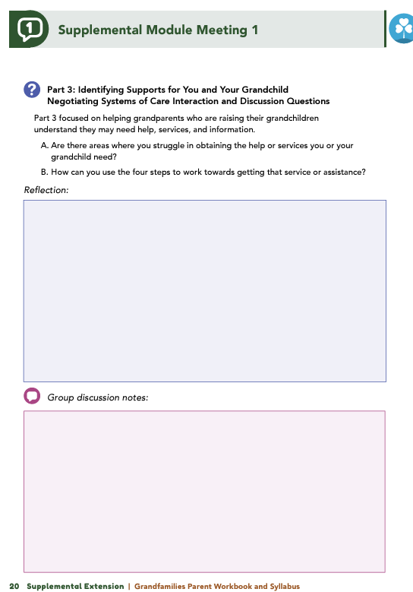
Homework
Complete Part 3: Identifying Supports for You and your Grandchild, Part 4: Caring for Yourself, and the Wrap Up
View online modules
Complete workbook questions
Notes:
Homework Tasks: Assign Parts 3 & 4: Identifying Supports for You and your Grandchild and Caring for Yourself and Wrap Up Module as homework.
Step 2 Clarification: Remind participants that this homework involves viewing online content and downloading necessary resources as part of Step 2. If time permits, show where to access these materials on the website.
Workbook Guidance: Show the specific pages in the Grandfamilies Parent Workbook and Syllabus related to these topics (D19)
Step 3 Clarification: Assign workbook discussion questions (beginning on page D20 in the parent workbook).
Format explanation: Explain the reason for 2 boxes per question (one for individual, one for group responses).
Encourage reflection and engagement: The more participants, think, reflect, and share the more meaningful the content becomes to each family.
Pro tip: Complete the workbook while viewing online modules.

Slide 25
Thank you for participating today.
Please reach out with any questions or concerns.
See you next week!
Notes:
Closing: Thank participants for their time and engagement.
Questions: Ask if there are any questions. (If someone needs personal assistance, ask them to speak with you individually after the group is dismissed).
Meeting 2: Remind participants of the date/time/location of the next meeting.
Homework: Remind participants to complete the homework.
Adjourn: Say goodbye to participants.

Slide 26
Meeting 2

Slide 27
Please sign in and find a seat.
We will begin soon.
If possible, please turn on your camera.
We will begin soon.
Notes:
Choose one bullet point to display (the first bullet point is for in-person, the second is for virtual).
If in-person, greet participants as they come in the door and help them find a seat.
If virtual, give participants a heads up when you will be starting. For example, “Hi everyone, we will be starting in about one minute.”

Slide 28
Conversation Starters
Group Discussion
Thrive Programming
Notes:
Example language: Welcome back, everyone! We're glad to see you for our third and final meeting.
*Optional Sections: Please note that the conversation starters are optional. If you prefer to skip these, simply remove the first bullet point from this slide and proceed to the next relevant slide in the deck.
Example language if omitting: We'll dive straight into discussing the key questions from our last session’s homework. We’ll wrap up with a discussion on additional Thrive programs that may interest you
Example language if not omitting:
Conversation Starters: We’ll get started with a quick question to get us all engaged and sharing.
Review of Ground Rules: A brief reminder of our ground rules to ensure our discussions remain respectful and productive.
Discussion and Homework: After our initial activities, we will discuss the workbook questions based on your experiences with the last set of homework followed by an explanation of the homework for our next meeting. Let’s get started!

Slide 29
Please answer one of the following questions:
What activity do you love to do that helps you unwind after a busy day of caregiving?
If you could give one piece of advice to a new grandparent caregiver, what would it be?
Notes:
Example language: "Let's open our session with a fun question that will give us all a chance to share something about ourselves. Review the list of questions provided on the slide. Select one question that resonates with you, or that you feel comfortable sharing. This activity is designed to ease us into the meeting and build a friendly, open atmosphere.

Slide 30
Basic Ground Rules:
Always start and end sessions on time.
Cell phones should be on vibrate; members can quietly excuse themselves if a call must be taken.
In virtual sessions, participants should mute themselves when taking calls outside the session.
Group-Specific Rules:
Avoid judgment regarding other participants' parenting practices or knowledge gaps.
One person speaks at a time to maintain order and clarity.
Assume positive intent in all interactions to foster a positive atmosphere.
Confidentiality- Please be respectful and discrete with the personal stories being shared. This is a safe space to grow and learn.
Notes:
Introduction of Ground Rules: Start by stating some basic ground rules to create a supportive environment where families feel safe to share their parenting experiences.
Basic Ground Rules:
Always start and end sessions on time.
Cell phones should be on vibrate; members can quietly excuse themselves if a call must be taken.
In virtual sessions, participants should mute themself when taking calls outside the session.
Developing Group-Specific Rules:
Discuss and agree on additional rules as a group, such as:
Avoid judgment regarding other participants' parenting practices or knowledge gaps.
Ensure one person speaks at a time to maintain order and clarity.
Assume positive intent in all interactions to foster a positive atmosphere.
Confidentiality Discussion: Use this time to reinforce the importance of confidentiality, outlining your organization’s specific confidentiality clauses regarding statements related to abuse or neglect mandated reporting..
Example language:
As we begin, it's crucial to emphasize the importance of confidentiality within our group. We need to agree to keep all shared information within these sessions, including personal stories and sensitive details. This ensures a safe space where everyone feels comfortable sharing their experiences. Please remember that details shared by participants are given in trust and should be treated with respect and discretion.
Additionally, it’s important to note our mandated reporting clause for suspected abuse or neglect:
Legal Obligation: Our staff and facilitators are legally required to report any suspicions of child abuse or neglect.
Scope of Reporting: We must report any signs of potential harm to a child or vulnerable adult that arise during our sessions.
Procedure for Reporting: We handle these situations sensitively, informing involved individuals about necessary actions, unless it poses further risk.
Support for Affected Individuals: We provide support and resources to help those involved in a reporting situation.
Our primary concern is the safety and well-being of all individuals. If you have any questions or concerns about this policy, feel free to discuss them privately with me.

Slide 31
Negotiating Systems of Care
Are there areas where it’s difficult for you to get the help or services you or your grandchild need?
How can you use the four steps (determine needs, find sources, set goals, evaluate) to move closer to securing those services or assistance?
Notes:
Review this section of the module with the participants by offering the following information:
• Part 3 focused on helping grandparents who are raising their grandchildren understand they may need help, services, and information.
• Knowing how to navigate the healthcare system, getting legal assistance, working with your grandchild’s school, or finding sources of support in the community are important skills you will need as you create a positive and loving environment for your grandchild.
• Navigating systems of care can be difficult, but breaking these systems down into manageable steps can help you help your grandchild when they need specific services.
Generate discussion among participants by asking the following question:
The four steps of getting help, assistance, and services involve determining what is needed, finding sources and information, setting goals, and evaluating your experiences.
Are there areas where you struggle in obtaining the help or services you or your grandchild need?
How can you use the four steps to work towards getting that service or assistance?
*Facilitator Tip Have scenarios/examples prepared in case caregivers are not prepared to or willing to discuss their own examples. A scenario based around Louisa (grandparent) and Fabine (grandchild) can be found within the module.

Slide 32
Caring
For Yourself
Are you taking care of your own needs and well-being? Why or why not?
What steps can you take—such as keeping medical appointments, asking for support, exercising, or socializing—to better meet your current needs?
Notes:
Review this section of the module with the participants by sharing the following information:
• Part 4 highlighted that grandparents who are raising grandchildren are more likely to experience poorer physical and mental health than non-caregivers. Such health concerns may cause custodial grandparents to fear for their grandchildren’s well-being in the event of their own disability or death.
• Therefore, grandparents need to focus on caring for themselves as well!
Generate discussion among participants using all, or some, of the following questions:
Consider how the demands of raising a grandchild impact you and your health.
Are you meeting your own needs? Why or why not?
What can you do better to meet your current needs (e.g., attend doctor’s appointments, leverage circle of support, exercise, socialize)?

Slide 33
Grief and Loss
Would anyone like to share their experiences with grief and loss?
What kinds of losses have you faced, and do they relate to the past, the future, or both?
Can you identify any positive growth or understanding you’ve gained through experiencing grief and loss?
Notes:
Review this section of the module with the participants by offering the following information:
• Grandparent caregivers often must cope with a variety of losses or challenges caused by adverse family events that have necessitated their need to raise a grandchild.
Loss of normalcy
Change in relationship with grandchild’s parent
Change in life plans
Change in other relationships
• Ideas to keep in mind when coping with grief and loss:
Have patience and confidence in your ability to cope and adjust
Coping with loss is easier when you have someone you can share your feelings, fears, and experiences with
People grieve in their own ways; you will have good and bad days
Grief is an ongoing process
Give your grandchild opportunities to share their feelings
Join a grief support group
Generate discussion among participants using all, or some, of the following questions:
Would anyone like to share their experience with grief and loss?
What types of losses have you experienced? Do these losses stem from what used to be or what is yet to come or both?
What are some of the positive takeaways you have found as a result of the grief and loss you have experienced?

Slide 34
What does your grandchild do that causes you stress, and how do you currently manage it?
What do you most enjoy about being a grandparent caregiver, and what’s your least favorite part? How can you reframe that challenging aspect into something more positive?
Who could you ask for help, and how do you think they might respond?
Caregiver Stress
Notes:
Review this section of the module with the participants by offering the following information:
• Parenting can be a source of stress, and it can be influenced by a grandparent’s energy, health, and psychological distress, like depression and anxiety. You should understand there is no single right way to cope with stress, and there are several ways that individuals can and do cope with stress. Some common styles of coping include the following:
Appraisal-focused: This type of coping uses logic and mental preparation by reframing or redefining the situation.
Problem-focused: An individual using this type of coping seeks information and support, acts, and identifies new rewards.
Emotion-focused: Using this type of coping, the individual recognizes and finds ways to regulate their own emotional reactions to stress.
Within each of these three categories of strategies, there are a variety of healthy techniques you can use to manage stress.
Generate discussion among participants using all, or some, of the following questions:
What is something that your grandchild does that causes you stress? How do you manage that stress?
What do you most enjoy about being a grandparent caregiver? What is your least favorite part? How can you reframe that thought into something positive?
Whom in your life could you ask for help? How do you think they would react to you asking?

Slide 35
Planning
for the Future
What do you need or want to plan for in the near future?
What do you need or want to plan for in the more distant future?
Notes:
Review this section of the module with the participants by offering the following information:
• Families often delay making important decisions until a crisis occurs. However, making decisions when you are under stress is not recommended. Planning before a crisis can help your family prepare for potentially difficult decisions. You may need to face issues with planning for the future such as examine your current and future financial situations, consider how caregiving may impact your marriage and relationships, make a plan for your and your grandchild’s future should you become sick, and determine how much and how often you and your grandchild want your grandchild’s parents to be involved in your and your grandchild’s lives.
Generate discussion among participants using all, or some, of the following questions:
What do you want or need to plan for regarding the short term?
What do you want or need to plan for regarding the long term?

Slide 36
Which supplemental module topic was most helpful to you as a caregiver, and why?
What strategies or skills did you learn that will help you reach your goals for yourself, your grandchild, or your family?
How have your interactions with your grandchild or family changed since starting the module? Have you noticed a difference in how your grandchild responds to your parenting?
Wrap-Up
Notes:
Indicate to participants that you are wrapping up, and generate discussion among participants using all, or some, of the following questions:
Which topic discussed in the supplemental model was the most beneficial to you as a caregiver? Why?
What strategies or skills did you learn in the supplemental module that will help you achieve the goals you have for you, your grandchild, and/or your family?
What has changed with your interactions with your grandchild or family since before you started to completed the supplemental module?
Have you noticed a difference in the way your grandchild is responding to your parenting?

Slide 37
Additional Thrive Programs
Take Root is available for parents and caregivers of children who are between 0 and 3 years old.
Sprout is available for parents and caregivers of children who are between 3 and 5 years old.
Grow is available for parents and caregivers of children who are between 5 and 10 years old.
Branch Out is available for parents and caregivers of children who are between 10 and 18 years old.
Notes:
Provide support and encouragement to your participants to explore other Thrive Initiative programming. Share and/or register participants for any additional hybrid implementation options that you plan to offer. Thrive Initiative programming may include any of the following:
Universal Programs
• Take Root is available for parents and caregivers of children who are between 0 and 3 years old.
• Sprout is available for parents and caregivers of children who are between 3 and 5 years old.
• Grow is available for parents and caregivers of children who are between 5 and 10 years old.
• Branch Out is available for parents and caregivers of children who are between the ages of 10 and 18 years old.

Slide 38
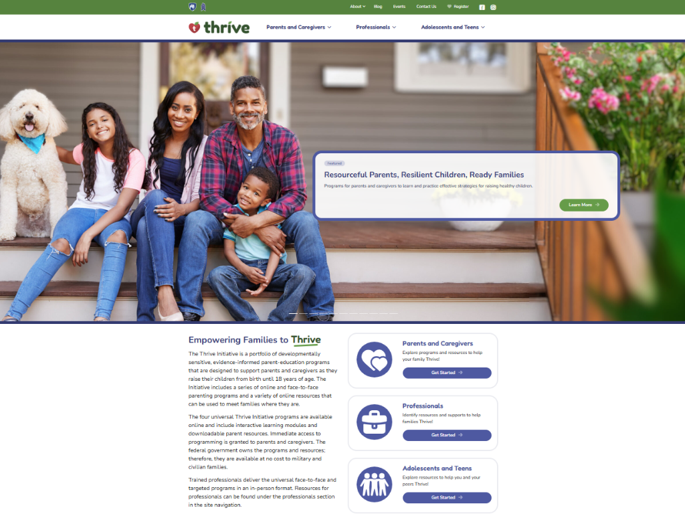
Notes:
Additional supplemental modules are available on a variety of topics and can be accessed online at https://thrive.psu.edu/modules/supplemental/.
Encourage participants to continue to visit the Thrive website, https://thrive.psu.edu, as their child develops and grows.
They can access additional resources and materials like mini-booster modules, blog postings, parenting handouts and guides, an inclusivity toolkit, and newsletters.

Slide 39
Thank you all for your dedication and participation. Every effort you make significantly impacts your child's future success.
Notes:
Example language:
Thank you, parents and caregivers, for your active participation. Please continue to visit the Thrive website as your child develops and grows—it's a valuable resource that can support you through every stage of their growth.
Supplemental Extension ENDS HERE.

Slide 40
Introduction
Notes:
Delivery Type 2: Supplemental Stand Alone begins here.

Slide 41
Welcome!
Please sign in and find a seat. We will begin soon.
If possible, please turn on your camera and enter your preferred name. We will begin soon.
Notes:
Choose one bullet point to display (the first bullet point is for in-person, the second is for virtual).
If in-person, greet participants as they come in the door and help them find a seat.
If virtual, give participants a heads up when you will be starting. For example, “Hi everyone, we will be starting in about one minute.”

Slide 42
Overview
Ice Breaker
Ground Rules
Syllabus
Expectations
Registration
Homework
Notes:
Welcome: Introduce yourself and thank participants for choosing to be a part of the Grandfamilies Supplemental Parenting Program. Explain that Meeting 1 will provide an overview of the program, who is in our group, and what is expected of parents who participate. We will discuss the materials you received and provide instructions on how to use them.
Encourage participants to ask questions as they arise or to jot them down and ask at the end of the meeting.

Slide 43
Target Audience
Program Focus
Skill Building
Reflective Sharing
Program Structure
Goals
Notes:
Discuss the following topics with your participants:
Grandfamilies: PROSPERing with 10- to 14-Year-Olds is an online supplemental module for grandparents who are full-time caregivers of children between the ages of 10 and 14 years old.
This module is designed to help grandparents prepare for and overcome the difficulties that come with being a primary grandparent caregiver of an early adolescent child. While this module will discuss challenges encountered by many grandparent caregivers, each situation is unique. To help caregivers think about their unique situation, throughout the module, they will be asked to stop and consider how their individual situation compares to other grandparent caregiver situations. Topics like developing a positive caretaker relationship, understanding communication, and managing stress and health are examined. During the online supplemental module sessions and throughout the hybrid implementation meetings, information and parenting strategies that parents can use and adapt, as necessary, to fit their individual circumstances and family needs will be disseminated.
The supplemental module content is designed to help grandparents build on their existing skills and strategies, so they can effectively care for their grandchild.
Some of the content that is read and practiced in the supplemental module and discussed in the hybrid implementation meetings may be familiar to the parents, and they may already know about and use the disseminated information. Therefore, they may use the meeting time as an opportunity to realize, appreciate, and share what already works for them, their grandchild, and their family.
Grandfamilies: PROSPERing with 10- to 14-Year-Olds is an online supplemental module for grandparents who are the primary caregivers for their grandchildren ages 10 to 14 years old. It includes an introduction, four parts, and a wrap-up.
After participating in the online supplemental module sessions and the hybrid implementation meetings, parents and caregivers should be able to do the following:
• Find ways to deal with the challenges of being a grandparent caregiver
• Implement positive parenting techniques
• Plan for and value spending time with your grandchild
• Understand the developmental needs of your grandchild
• Communicate effectively with your grandchild
• Negotiate systems of care and ask others for help
• Identify useful coping and stress-management techniques.

Slide 44
Tell us your name, your coparent’s name, your grandchild’s name, your grandchild’s age, and one of the following:
What you enjoy most about parenting
A word you could use to describe one of your grandchild’s strengths
Notes:
Personal Introduction: Start with a brief introduction of yourself, highlighting your expertise in child development and any personal affiliations (e.g., community, organization, military) that connect you to the audience.
Combining Introductions: Merge the participants' introductions with an icebreaker activity to create a more engaging and efficient session.
Icebreaker Questions: Ask each participant to share their name, their coparent’s name, their grandchild’s name, and age. Additional questions to choose:
What you enjoy most about parenting
A word you could use to describe one of your grandchild’s strengths
Future Use: Note the icebreaker questions used; consider revisiting unused ones in future sessions as needed.
You can also start each meeting with an icebreaker if you find your group is reserved. Use your judgment and avoid controversial topics.

Slide 45
Basic Ground Rules:
Always start and end sessions on time.
Cell phones should be on vibrate; members can quietly excuse themselves if a call must be taken.
In virtual sessions, participants should mute themselves when taking calls outside the session.
Group-Specific Rules:
Avoid judgment regarding other participants' parenting practices or knowledge gaps.
One person speaks at a time to maintain order and clarity.
Assume positive intent in all interactions to foster a positive atmosphere.
Confidentiality- Please be respectful and discrete with the personal stories being shared. This is a safe space to grow and learn.
Notes:
Introduction of Ground Rules: Start by stating some basic ground rules to create a supportive environment where families feel safe to share their parenting experiences.
Basic Ground Rules:
Always start and end sessions on time.
Cell phones should be on vibrate; members can quietly excuse themselves if a call must be taken.
In virtual sessions, participants should mute themself when taking calls outside the session.
Developing Group-Specific Rules:
Discuss and agree on additional rules as a group, such as:
Avoid judgment regarding other participants' parenting practices or knowledge gaps.
Ensure one person speaks at a time to maintain order and clarity.
Assume positive intent in all interactions to foster a positive atmosphere.
Confidentiality Discussion: Use this time to reinforce the importance of confidentiality, outlining your organization’s specific confidentiality clauses regarding statements related to abuse or neglect mandated reporting..
Example language:
As we begin, it's crucial to emphasize the importance of confidentiality within our group. We need to agree to keep all shared information within these sessions, including personal stories and sensitive details. This ensures a safe space where everyone feels comfortable sharing their experiences. Please remember that details shared by participants are given in trust and should be treated with respect and discretion.
Additionally, it’s important to note our mandated reporting clause for suspected abuse or neglect:
Legal Obligation: Our staff and facilitators are legally required to report any suspicions of child abuse or neglect.
Scope of Reporting: We must report any signs of potential harm to a child or vulnerable adult that arise during our sessions.
Procedure for Reporting: We handle these situations sensitively, informing involved individuals about necessary actions, unless it poses further risk.
Support for Affected Individuals: We provide support and resources to help those involved in a reporting situation.
Our primary concern is the safety and well-being of all individuals. If you have any questions or concerns about this policy, feel free to discuss them privately with me.

Slide 46
Parent Workbook
Syllabus
Notes:
Provide copies or screen share a copy of the Parent Workbook and Syllabus for the Grandfamilies: PROSPERing with 10- to 14-Year-Olds supplemental module. Review the Summary of Training, and highlight the section where the participants can find pertinent information.

Slide 47
Expectations
Notes:
Overview of Expectations: Clearly define what is expected of participants in the Grandfamilies supplemental program.
Independent Completion: Inform families that they are expected to independently complete the online modules.
Full Engagement Required: Emphasize the importance of completing each module in full to maximize learning and benefit from the program.
Purpose of Meetings: Clarify that the in-person meetings are not for revisiting session content but for community building, reflecting on experiences, and discussing insights with other parents and caregivers who are trying to successfully navigate grandparenting.
Preparation for Discussions: Encourage participants to come to meetings prepared to share their thoughts and engage in discussions based on the content they've learned online.

Slide 48
REGISTER
Notes:
Complete any registration requirements for your organization. Then, explain how participants can access the supplemental module online. Offer support to help with any technological questions. All participants will have previously set up a Thrive Initiative account, but you need to ensure they can log in and find the information they need to get started or progress in the supplemental module.

Slide 49
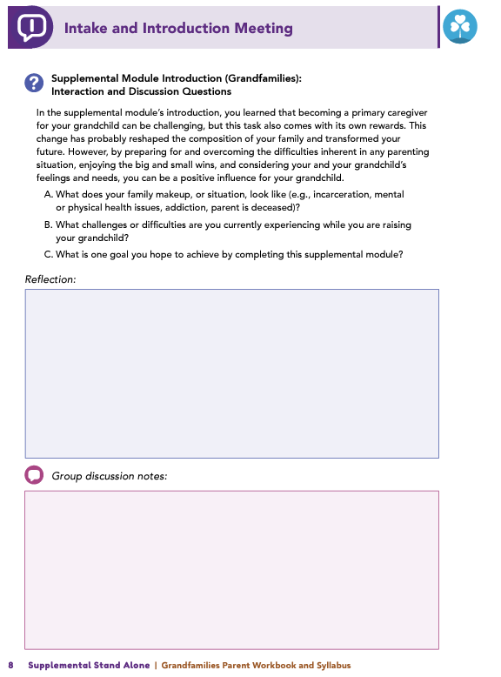
Homework
Complete the Welcome and Introduction, Part 1: Parenting Styles: Why They Matter, and Part 2: Using Praise and Encouragement to Help Children Thrive
View online modules
Complete workbook questions
Notes:
Homework Tasks: Assign the Welcome and Introduction Module and Modules 1 & 2, Cultivating the Relationship with your Grandchild and Communication as homework.
Step 2 Clarification: Remind participants that this homework involves viewing online content and downloading necessary resources as part of Step 2. If time permits, show where to access these materials on the website.
Workbook Guidance: Show the specific pages in the Grandfamilies Parent Workbook and Syllabus related to these topics (D7)
Step 3 Clarification: Assign workbook discussion questions (beginning on page D8 in the parent workbook).
Format explanation: Explain the reason for 2 boxes per question (one for individual, one for group responses).
Encourage reflection and engagement: The more participants, think, reflect, and share the more meaningful the content becomes to each family.
Pro tip: Complete the workbook while viewing online modules.

Slide 50
Thank you for participating today.
Please reach out with any questions or concerns.
See you next week!
Notes:
Closing: Thank participants for their time and engagement.
Questions: Ask if there are any questions. (If someone needs personal assistance, ask them to speak with you individually after the group is dismissed).
Meeting 2: Remind participants of the date/time/location of the next meeting.
Homework: Remind participants to complete the homework.
Adjourn: Say goodbye to participants.

Slide 51
Meeting 1

Slide 52
Welcome back!
Please sign in and find a seat. We will begin soon.
If possible, please turn on your camera and enter your preferred name. We will begin soon.
Notes:
Choose one bullet point to display (the first bullet point is for in-person, the second is for virtual).
If in-person, greet participants as they come in the door and help them find a seat.
If virtual, give participants a heads up when you will be starting. For example, “Hi everyone, we will be starting in about one minute.”

Slide 53
Conversation Starter
Restate Ground Rules
Group Discussion
Homework
Notes:
Example language: Welcome back, families! We’re glad to see for our second meeting.
Review Meeting 2 Agenda:
Conversation Starters: We’ll get started with a quick question to get us all engaged and sharing.
Review of Ground Rules: A brief reminder of our ground rules to ensure our discussions remain respectful and productive.
Discussion and Homework: After our initial activities, we will discuss the workbook questions based on your experiences with the last set of homework followed by an explanation of the homework for our next meeting. Let’s get started!

Slide 54
Please answer one of the following questions:
What activity do you love to do that helps you unwind after a busy day of caregiving?
If you could give one piece of advice to a new grandparent caregiver, what would it be?
Notes:
Example language: "Let's open our session with a fun question that will give us all a chance to share something about ourselves. Review the list of questions provided on the slide. Select one question that resonates with you, or that you feel comfortable sharing. This activity is designed to ease us into the meeting and build a friendly, open atmosphere.

Slide 55
Basic Ground Rules:
Always start and end sessions on time.
Cell phones should be on vibrate; members can quietly excuse themselves if a call must be taken.
In virtual sessions, participants should mute themselves when taking calls outside the session.
Group-Specific Rules:
Avoid judgment regarding other participants' parenting practices or knowledge gaps.
One person speaks at a time to maintain order and clarity.
Assume positive intent in all interactions to foster a positive atmosphere.
Confidentiality- Please be respectful and discrete with the personal stories being shared. This is a safe space to grow and learn.
Notes:
Introduction of Ground Rules: Start by stating some basic ground rules to create a supportive environment where families feel safe to share their parenting experiences.
Basic Ground Rules:
Always start and end sessions on time.
Cell phones should be on vibrate; members can quietly excuse themselves if a call must be taken.
In virtual sessions, participants should mute themself when taking calls outside the session.
Developing Group-Specific Rules:
Discuss and agree on additional rules as a group, such as:
Avoid judgment regarding other participants' parenting practices or knowledge gaps.
Ensure one person speaks at a time to maintain order and clarity.
Assume positive intent in all interactions to foster a positive atmosphere.
Confidentiality Discussion: Use this time to reinforce the importance of confidentiality, outlining your organization’s specific confidentiality clauses regarding statements related to abuse or neglect mandated reporting..
Example language:
As we begin, it's crucial to emphasize the importance of confidentiality within our group. We need to agree to keep all shared information within these sessions, including personal stories and sensitive details. This ensures a safe space where everyone feels comfortable sharing their experiences. Please remember that details shared by participants are given in trust and should be treated with respect and discretion.
Additionally, it’s important to note our mandated reporting clause for suspected abuse or neglect:
Legal Obligation: Our staff and facilitators are legally required to report any suspicions of child abuse or neglect.
Scope of Reporting: We must report any signs of potential harm to a child or vulnerable adult that arise during our sessions.
Procedure for Reporting: We handle these situations sensitively, informing involved individuals about necessary actions, unless it poses further risk.
Support for Affected Individuals: We provide support and resources to help those involved in a reporting situation.
Our primary concern is the safety and well-being of all individuals. If you have any questions or concerns about this policy, feel free to discuss them privately with me.

Slide 56
Overview
Context &
Challenges
Strategies &
Support
Empowerment &
Adaptation
Notes:
Provide an overview of the supplemental module using the following points that are taught in the supplemental module:
• You are a proud grandparent, but, due to a difficult situation, you have become the primary caregiver for your grandchild. Whatever the situation, and whether it involves one or several factors, you are probably raising your grandchild with little to no assistance and involvement from the child’s parent(s).
• The absence of your grandchild’s parent in your life and in your grandchild’s life can have rewards and challenges. However, your grandchild is not alone. They have you. They have your love, dedication, influence, wisdom, and advice. You have been given the opportunity to be a positive influence in your grandchild’s life. You might be able to re-experience the joys of raising a child and take pride in their accomplishments, goals, and values that you help make possible. However, there will be challenges that you, and many other grandparents, face as a full-time caregiver of a young teen.
• You may have concerns about taking on the responsibilities (again) that come with being the primary caregiver of a child. You may be worried about the child’s parent. You may wonder how you might be able to help them and what their relationship with your grandchild will be like. You may feel isolated or alone. In this course, we will examine strategies that you can use to help you think through and address these concerns, and we will discuss approaches you can use to overcome negative thoughts and feelings that may cause you stress.

Slide 57
Goals
Goals
Strengthen Relationships & Communication
Build Support & Networks
Manage Well-Being & Future Planning
Notes:
After completing this learning module, you will be able to do the following:
• Develop a positive caretaker relationship with your grandchild
• Understand how to effectively communicate and interact positively with your grandchild
• Identify supports for your grandchild
• Establish relationships to help your grandchild thrive
• Manage your stress and your health
• Learn how to continue to meet your own needs while you plan for the future with your grandchild.

Slide 58
Discussion
What does your unique family situation look like?
What challenges are you facing as a grandparent caregiver?
What is one goal you hope to achieve through this module?
Notes:
Ask the participants the following questions to generate discussion:
What does your family make up, or situation, look like (e.g., incarceration, mental or physical health issues, addiction, parent is deceased)?
What challenges or difficulties are you currently experiencing while you are raising your grandchild?
Ask the following question, and solicit answers from a few participants to generate discussion:
What is one goal you hope to achieve by completing this supplemental module?

Slide 59
Positive Parenting Techniques
Can you recall a recent example of positive parenting from the past week?
What is one strategy you could try next week to support your grandchild?
Notes:
Review this section of the module with the participants by offering the following information:
• The way you act in your role as the primary caretaker of your grandchild impacts the interactions (positive and negative) you and your grandchild have and affects how your grandchild behaves. To enhance your role as the primary caretaker, you will probably want to practice positive parenting and adopt an effective parenting style. You completed a Stop and Think activity in which you were asked to consider positive parenting and how you may already use it.
• Remember that positive parenting is based on good communication and positive attention.
• Some ways to practice positive parenting are to be available, to encourage, to be supportive, to praise your grandchild when they accomplish tasks or overcome challenges, to demonstrate support and encouragement, and to show you are interested and invested in helping them problem solve.
• Remember the various strategies you learned in Branch Out, which include nonverbal language and actively listening to your grandchild.
Generate discussion among participants using the following questions:
Can you think of a time when you used positive parenting in the last week?
Would anyone like to share an idea or approach you could try in the next week to show positive support for your grandchild?

Slide 60
Parenting Styles
What authoritative parenting strategies have you recently used with your grandchild?
What authoritative parenting practice would you like to try in the coming week?
Notes:
Review this section of the module with the participants by offering the following information:
• In the supplemental module, you learned about four different styles of parenting.
• The module discussed authoritative parenting and its advantages.
• Adopting an authoritative parenting style and using positive parenting practices can benefit the grandparent and the grandchild. Using this parenting style contributes to the grandparent’s self-esteem and grandchild’s self-esteem. Using an authoritative style can help to clarify what the grandparent and grandchild expect from one another.
Generate discussion among participants using the following questions:
What are some of the ways you have used an authoritative parenting practice with your grandchild?
What is an authoritative practice that you would like to use with your grandchild in the next week?

Slide 61
Developmental
Needs
What areas should you learn more about to better understand and support your grandchild’s relationship with their parent(s)?
What opportunities or resources can help you gain that knowledge?
Notes:
Review this section of the module with the participants by offering the following information:
• In addition to being an authoritative grandparent and adopting a positive approach to parenting your grandchild, you should be up to date on the developmental needs of your grandchild and the cultural factors that might influence them.
• Understanding current circumstances (or at least making an effort to) can make you a more effective and educated grandparent, and it will also show your grandchild that you are paying attention to people, situations, and feelings that are important to them.
• To understand where your grandchild might be developmentally, be sure to refer to the Developmental Expectations Chart (10- to 14-year-olds).
• Be sure to consider what might be best for your grandchild and their developmental needs when making decisions or setting guidelines and expectations.
• Remember to openly listen and discuss your grandchild’s feelings about their parents.
Generate discussion among participants using the following questions:
Consider your grandchild and their relationship with their parents. What topics should you educate yourself on to understand and support your grandchild better?
What opportunities do you know of that can help you educate yourself in those areas?

Slide 62
Spending Time
with your
Grandchild
What activities do you and your grandchild enjoy?
What activities can you plan to do together?
Which activities will you try in the coming week?
What activities might you schedule for the next month?
Notes:
Review this section of the module with the participants by offering the following information:
• With all of the time and dedication you spend building strategies and strengths to engage and work through challenges with your grandchild, don’t forget to have fun!
Building upon your strengths and providing your grandchild with a loving, safe, and engaging home environment will help your grandchild feel safe, loved, and secure about the future.
By cultivating your relationship with your grandchild, you will help them become resilient and develop skills that will empower them to think positively about themself and about their life.
Generate discussion among participants using all, or some, of the following questions:
The module provided you with an outline that can help you plan for time to bond with your grandchild by finding activities you can do together. What are some activities that you like and/or your grandchild likes to do?
What are some activities that you and your grandchild could do together?
Over the next week, what are some activities you are going to try with your grandchild?
What activities are you going to try over the next month?

Slide 63
Communication Approaches
Which communication style do you identify with most?
How do you typically communicate with teachers or health professionals?
What communication style do you use with family members and friends?
How would you like to communicate with your grandchild about their behaviors and needs?
Notes:
Review this section of the module with the participants by offering the following information:
• Everyone’s communication styles differ. The module discussed passive, aggressive, and assertive communication styles. An assertive style of communication is the most effective form of communication and recognizes that communication is a two-way process. When you use an assertive style, you clearly communicate your feelings, needs, and opinions. Using this communication style can help you make your needs clear without insulting, criticizing, or talking down to others.
Generate discussion among participants using all, or some, of the following questions:
In the module, you completed a reflection activity in which you identified what type of communication you use in different situations. What style of communication did you identify with the most?
What style of communication do you use with teachers or health professionals?
What style of communication do you use with family members and friends?
What style of communication do you want to use with your grandchild regarding their behaviors and needs?

Slide 64
Assertive Communication Techniques
Has anyone already tried any of the communication methods from the module? Which ones?
How does using these techniques improve interactions with your grandchild?
Which new techniques would you like to incorporate, and why?
How might assertive communication techniques help you when asking for support from family or friends who may be reluctant to assist?
Notes:
Review this section of the module with the participants by offering the following information:
• This module examined some assertive communication techniques including VCR, I Statements, problem-solving, breaking it down, and fogging. In addition, it provided activities for you to think about and to help you consider when and how you might use these techniques as you interact with your grandchild.
Facilitator Tip Briefly review the five assertive communication techniques, and revisit the examples provided in the module if needed.
VCR
• Validate the person's feelings
• Challenge them to address the situation
• Reward (get the outcome)
I Statements
• Put the problems in terms of your own feelings.
• Differentiate between opinions and facts.
• “When you do ____ I feel ____.”
Problem-solving
• Work toward a compromise. Try to find a solution in which you both win.
Break it down
• Try to find small things that you can agree to or get the other person to agree to.
Fogging
• When someone criticizes you, agree with it to a small degree.
• Doing this can take the sting out of the remarks.
Generate discussion among participants using all, or some, of the following questions:
Does anyone currently use any of the communication techniques discussed in the module? Which ones?
How does using that technique help your interactions with your grandchild?
Which of those techniques would you like to start to incorporate into your communication with your grandchild? Why?
You were asked to think of a specific situation from your past, or one that you could foresee in the future, in which you have asked or want to ask for help or support from a family member/friend, and they were reluctant to agree. How could you use these assertive communication techniques to better communicate in a situation like that?

Slide 65
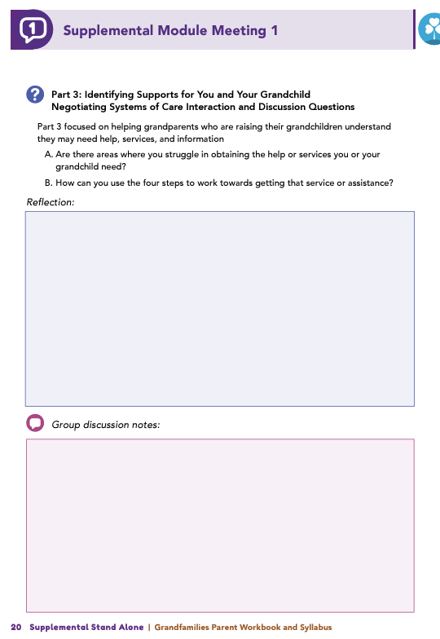
Homework
Complete Part 3: Identifying Supports for You and your Grandchild, Part 4: Caring for Yourself , and the Wrap Up
View online modules
Complete workbook questions
Notes:
Homework Tasks: Assign Parts 3 & 4: Identifying Supports for You and your Grandchild and Caring for Yourself and Wrap Up Module as homework.
Step 2 Clarification: Remind participants that this homework involves viewing online content and downloading necessary resources as part of Step 2. If time permits, show where to access these materials on the website.
Workbook Guidance: Show the specific pages in the Grandfamilies Parent Workbook and Syllabus related to these topics (D19)
Step 3 Clarification: Assign workbook discussion questions (beginning on page D20 in the parent workbook).
Format explanation: Explain the reason for 2 boxes per question (one for individual, one for group responses).
Encourage reflection and engagement: The more participants, think, reflect, and share the more meaningful the content becomes to each family.
Pro tip: Complete the workbook while viewing online modules.

Slide 66
Thank you for participating today.
Please reach out with any questions or concerns.
See you next week!
Notes:
Closing: Thank participants for their time and engagement.
Questions: Ask if there are any questions. (If someone needs personal assistance, ask them to speak with you individually after the group is dismissed).
Meeting 2: Remind participants of the date/time/location of the next meeting.
Homework: Remind participants to complete the homework.
Adjourn: Say goodbye to participants.

Slide 67
Meeting 2

Slide 68
Please sign in and find a seat.
We will begin soon.
If possible, please turn on your camera.
We will begin soon.
Notes:
Choose one bullet point to display (the first bullet point is for in-person, the second is for virtual).
If in-person, greet participants as they come in the door and help them find a seat.
If virtual, give participants a heads up when you will be starting. For example, “Hi everyone, we will be starting in about one minute.”

Slide 69
Conversation Starters
Group Discussion
Thrive Programming
Notes:
Example language: Welcome back, everyone! We're glad to see you for our third and final meeting.
*Optional Sections: Please note that the conversation starters are optional. If you prefer to skip these, simply remove the first bullet point from this slide and proceed to the next relevant slide in the deck.
Example language if omitting: We'll dive straight into discussing the key questions from our last session’s homework. We’ll wrap up with a discussion on additional Thrive programs that may interest you
Example language if not omitting:
Conversation Starters: We’ll get started with a quick question to get us all engaged and sharing.
Review of Ground Rules: A brief reminder of our ground rules to ensure our discussions remain respectful and productive.
Discussion and Homework: After our initial activities, we will discuss the workbook questions based on your experiences with the last set of homework followed by an explanation of the homework for our next meeting. Let’s get started!

Slide 70
Please answer one of the following questions:
What activity do you love to do that helps you unwind after a busy day of caregiving?
If you could give one piece of advice to a new grandparent caregiver, what would it be?
Notes:
Example language: "Let's open our session with a fun question that will give us all a chance to share something about ourselves. Review the list of questions provided on the slide. Select one question that resonates with you, or that you feel comfortable sharing. This activity is designed to ease us into the meeting and build a friendly, open atmosphere.

Slide 71
Basic Ground Rules:
Always start and end sessions on time.
Cell phones should be on vibrate; members can quietly excuse themselves if a call must be taken.
In virtual sessions, participants should mute themselves when taking calls outside the session.
Group-Specific Rules:
Avoid judgment regarding other participants' parenting practices or knowledge gaps.
One person speaks at a time to maintain order and clarity.
Assume positive intent in all interactions to foster a positive atmosphere.
Confidentiality- Please be respectful and discrete with the personal stories being shared. This is a safe space to grow and learn.
Notes:
Introduction of Ground Rules: Start by stating some basic ground rules to create a supportive environment where families feel safe to share their parenting experiences.
Basic Ground Rules:
Always start and end sessions on time.
Cell phones should be on vibrate; members can quietly excuse themselves if a call must be taken.
In virtual sessions, participants should mute themself when taking calls outside the session.
Developing Group-Specific Rules:
Discuss and agree on additional rules as a group, such as:
Avoid judgment regarding other participants' parenting practices or knowledge gaps.
Ensure one person speaks at a time to maintain order and clarity.
Assume positive intent in all interactions to foster a positive atmosphere.
Confidentiality Discussion: Use this time to reinforce the importance of confidentiality, outlining your organization’s specific confidentiality clauses regarding statements related to abuse or neglect mandated reporting..
Example language:
As we begin, it's crucial to emphasize the importance of confidentiality within our group. We need to agree to keep all shared information within these sessions, including personal stories and sensitive details. This ensures a safe space where everyone feels comfortable sharing their experiences. Please remember that details shared by participants are given in trust and should be treated with respect and discretion.
Additionally, it’s important to note our mandated reporting clause for suspected abuse or neglect:
Legal Obligation: Our staff and facilitators are legally required to report any suspicions of child abuse or neglect.
Scope of Reporting: We must report any signs of potential harm to a child or vulnerable adult that arise during our sessions.
Procedure for Reporting: We handle these situations sensitively, informing involved individuals about necessary actions, unless it poses further risk.
Support for Affected Individuals: We provide support and resources to help those involved in a reporting situation.
Our primary concern is the safety and well-being of all individuals. If you have any questions or concerns about this policy, feel free to discuss them privately with me.

Slide 72
Negotiating Systems of Care
Are there areas where it’s difficult for you to get the help or services you or your grandchild need?
How can you use the four steps (determine needs, find sources, set goals, evaluate) to move closer to securing those services or assistance?
Notes:
Review this section of the module with the participants by offering the following information:
• Part 3 focused on helping grandparents who are raising their grandchildren understand they may need help, services, and information.
• Knowing how to navigate the healthcare system, getting legal assistance, working with your grandchild’s school, or finding sources of support in the community are important skills you will need as you create a positive and loving environment for your grandchild.
• Navigating systems of care can be difficult, but breaking these systems down into manageable steps can help you help your grandchild when they need specific services.
Generate discussion among participants by asking the following question:
The four steps of getting help, assistance, and services involve determining what is needed, finding sources and information, setting goals, and evaluating your experiences.
Are there areas where you struggle in obtaining the help or services you or your grandchild need?
How can you use the four steps to work towards getting that service or assistance?
*Facilitator Tip Have scenarios/examples prepared in case caregivers are not prepared to or willing to discuss their own examples. A scenario based around Louisa (grandparent) and Fabine (grandchild) can be found within the module.

Slide 73
Caring
For Yourself
Are you taking care of your own needs and well-being? Why or why not?
What steps can you take—such as keeping medical appointments, asking for support, exercising, or socializing—to better meet your current needs?
Notes:
Review this section of the module with the participants by sharing the following information:
• Part 4 highlighted that grandparents who are raising grandchildren are more likely to experience poorer physical and mental health than non-caregivers. Such health concerns may cause custodial grandparents to fear for their grandchildren’s well-being in the event of their own disability or death.
• Therefore, grandparents need to focus on caring for themselves as well!
Generate discussion among participants using all, or some, of the following questions:
Consider how the demands of raising a grandchild impact you and your health.
Are you meeting your own needs? Why or why not?
What can you do better to meet your current needs (e.g., attend doctor’s appointments, leverage circle of support, exercise, socialize)?

Slide 74
Grief and Loss
Would anyone like to share their experiences with grief and loss?
What kinds of losses have you faced, and do they relate to the past, the future, or both?
Can you identify any positive growth or understanding you’ve gained through experiencing grief and loss?
Notes:
Review this section of the module with the participants by offering the following information:
• Grandparent caregivers often must cope with a variety of losses or challenges caused by adverse family events that have necessitated their need to raise a grandchild.
Loss of normalcy
Change in relationship with grandchild’s parent
Change in life plans
Change in other relationships
• Ideas to keep in mind when coping with grief and loss:
Have patience and confidence in your ability to cope and adjust
Coping with loss is easier when you have someone you can share your feelings, fears, and experiences with
People grieve in their own ways; you will have good and bad days
Grief is an ongoing process
Give your grandchild opportunities to share their feelings
Join a grief support group
Generate discussion among participants using all, or some, of the following questions:
Would anyone like to share their experience with grief and loss?
What types of losses have you experienced? Do these losses stem from what used to be or what is yet to come or both?
What are some of the positive takeaways you have found as a result of the grief and loss you have experienced?

Slide 75
What does your grandchild do that causes you stress, and how do you currently manage it?
What do you most enjoy about being a grandparent caregiver, and what’s your least favorite part? How can you reframe that challenging aspect into something more positive?
Who could you ask for help, and how do you think they might respond?
Caregiver Stress
Notes:
Review this section of the module with the participants by offering the following information:
• Parenting can be a source of stress, and it can be influenced by a grandparent’s energy, health, and psychological distress, like depression and anxiety. You should understand there is no single right way to cope with stress, and there are several ways that individuals can and do cope with stress. Some common styles of coping include the following:
Appraisal-focused: This type of coping uses logic and mental preparation by reframing or redefining the situation.
Problem-focused: An individual using this type of coping seeks information and support, acts, and identifies new rewards.
Emotion-focused: Using this type of coping, the individual recognizes and finds ways to regulate their own emotional reactions to stress.
Within each of these three categories of strategies, there are a variety of healthy techniques you can use to manage stress.
Generate discussion among participants using all, or some, of the following questions:
What is something that your grandchild does that causes you stress? How do you manage that stress?
What do you most enjoy about being a grandparent caregiver? What is your least favorite part? How can you reframe that thought into something positive?
Whom in your life could you ask for help? How do you think they would react to you asking?

Slide 76
Planning
for the Future
What do you need or want to plan for in the near future?
What do you need or want to plan for in the more distant future?
Notes:
Review this section of the module with the participants by offering the following information:
• Families often delay making important decisions until a crisis occurs. However, making decisions when you are under stress is not recommended. Planning before a crisis can help your family prepare for potentially difficult decisions. You may need to face issues with planning for the future such as examine your current and future financial situations, consider how caregiving may impact your marriage and relationships, make a plan for your and your grandchild’s future should you become sick, and determine how much and how often you and your grandchild want your grandchild’s parents to be involved in your and your grandchild’s lives.
Generate discussion among participants using all, or some, of the following questions:
What do you want or need to plan for regarding the short term?
What do you want or need to plan for regarding the long term?

Slide 77
Which supplemental module topic was most helpful to you as a caregiver, and why?
What strategies or skills did you learn that will help you reach your goals for yourself, your grandchild, or your family?
How have your interactions with your grandchild or family changed since starting the module? Have you noticed a difference in how your grandchild responds to your parenting?
Wrap-Up
Notes:
Indicate to participants that you are wrapping up, and generate discussion among participants using all, or some, of the following questions:
Which topic discussed in the supplemental model was the most beneficial to you as a caregiver? Why?
What strategies or skills did you learn in the supplemental module that will help you achieve the goals you have for you, your grandchild, and/or your family?
What has changed with your interactions with your grandchild or family since before you started to completed the supplemental module?
Have you noticed a difference in the way your grandchild is responding to your parenting?

Slide 78
Additional Thrive Programs
Take Root is available for parents and caregivers of children who are between 0 and 3 years old.
Sprout is available for parents and caregivers of children who are between 3 and 5 years old.
Grow is available for parents and caregivers of children who are between 5 and 10 years old.
Branch Out is available for parents and caregivers of children who are between 10 and 18 years old.
Notes:
Provide support and encouragement to your participants to explore other Thrive Initiative programming. Share and/or register participants for any additional hybrid implementation options that you plan to offer. Thrive Initiative programming may include any of the following:
Universal Programs
• Take Root is available for parents and caregivers of children who are between 0 and 3 years old.
• Sprout is available for parents and caregivers of children who are between 3 and 5 years old.
• Grow is available for parents and caregivers of children who are between 5 and 10 years old.
• Branch Out is available for parents and caregivers of children who are between the ages of 10 and 18 years old.

Slide 79
Notes:
Additional supplemental modules are available on a variety of topics and can be accessed online at https://thrive.psu.edu/modules/supplemental/.
Encourage participants to continue to visit the Thrive website, https://thrive.psu.edu, as their child develops and grows.
They can access additional resources and materials like mini-booster modules, blog postings, parenting handouts and guides, an inclusivity toolkit, and newsletters.

Slide 80
Thank you all for your dedication and participation. Every effort you make significantly impacts your child's future success.
Notes:
Example language:
Thank you, parents and caregivers, for your active participation. Please continue to visit the Thrive website as your child develops and grows—it's a valuable resource that can support you through every stage of their growth.

