Slide 1
As of February 24, 2025
Introduction
Notes:
Delivery Type 1: Supplemental Extension begins here, on slide 1.
Delivery Type 2 : Supplemental Stand Alone begins on slide 43.

Slide 2
Welcome!
Please sign in and find a seat. We will begin soon.
If possible, please turn on your camera and enter your preferred name. We will begin soon.
Notes:
Choose one bullet point to display (the first bullet point is for in-person, the second is for virtual).
If in-person, greet participants as they come in the door and help them find a seat.
If virtual, give participants a heads up when you will be starting. For example, “Hi everyone, we will be starting in about one minute.”

Slide 3
AGENDA
Overview
Syllabus
Expectations
Registration
Homework
Notes:
Welcome: Introduce yourself and thank participants for choosing to be a part of the Raising Siblings Supplemental Parenting Program. Explain that Meeting 1 will provide an overview of the program, who is in our group, and what is expected of parents who participate. We will discuss the materials you received and provide instructions on how to use them.
Encourage participants to ask questions as they arise or to jot them down and ask at the end of the meeting.

Slide 4
Target Audience
Program Focus
Skill Building
Reflective Sharing
Program Structure
Goals
Notes:
Raising Siblings: Fostering Positive Relationships is an online supplemental module for parents (and caregivers), of multiple children or those who are planning to increase their family size.
This supplemental module intends to help parents and caregivers better understand how sibling relationships change as their children grow older and how parenting multiple children will change because of their children’s development. This module will encourage you to think about your own experiences with your siblings, look at how siblings can influence your children’s lives and recognize how you can help your children develop their own siblings’ relationships that can benefit them long term.
During the online supplemental module sessions and throughout the hybrid implementation meetings, information and parenting strategies that parents can use and adapt, as necessary, to fit their individual circumstances and family needs will be disseminated. The supplemental module content is designed to help parents build on their existing skills and strategies, so they can effectively parent multiple children either now or in the future.
Some of the content that is read and practiced in the supplemental module and discussed in the hybrid implementation meetings might be familiar to the parents, and they may already know about and use the disseminated information. Therefore, they may use the meeting time as an opportunity to realize, appreciate, and share what already works for them, their child, and their family.
Raising Siblings: Fostering Positive Relationships is an online supplemental module that can help you think about the experience of having multiple children, who, in turn, will then have siblings, and what raising siblings might look like including the “highs” and “lows” involved. It includes a welcome and introduction, three sessions, and a wrap-up.
After participating in the online supplemental module sessions and the hybrid implementation meetings, parents and caregivers should be able to do the following:
• Understand the dynamics of a sibling relationship and how it is unique from other close relationships.
• Examine how parenting and co-parental relationships can influence sibling dynamics.
• Identify the difference between favoritism and differential treatment in your inactions with your children, and understand how these behaviors can impact sibling relationships.
• Incorporate parenting practices that can improve sibling relationships, such as sensitive responding, establishing rules and boundaries, and holding family meetings.
• Use strategies to resolve common sibling conflicts.
• Recognize red flags in sibling conflicts and determine how you can intervene to prevent adverse outcomes in your children.
• Promote positive interactions among siblings to foster warm and supportive relationships.

Slide 5
Parent Workbook
Syllabus
Notes:
Provide copies or screen share a copy of the Parent Workbook and Syllabus for the Raising Siblings: Fostering Positive Relationships supplemental module. Review the Summary of Training, and highlight the section where the participants can find pertinent information.

Slide 6
Expectations
Notes:
Overview of Expectations: Clearly define what is expected of participants in the Raising Siblings supplemental program.
Independent Completion: Inform families that they are expected to independently complete the online modules.
Full Engagement Required: Emphasize the importance of completing each module in full to maximize learning and benefit from the program.
Purpose of Meetings: Clarify that the in-person meetings are not for revisiting session content but for community building, reflecting on experiences, and discussing insights with other parents and caregivers who are trying to successfully navigate parenting.
Preparation for Discussions: Encourage participants to come to meetings prepared to share their thoughts and engage in discussions based on the content they've learned online.

Slide 7
REGISTER
Notes:
Explain how participants can access the supplemental module online. Offer support to help with any technological questions. All participants will have previously set up a Thrive account, but you need to ensure they can log in and find the information they need to get started or progress in the supplemental module.

Slide 8
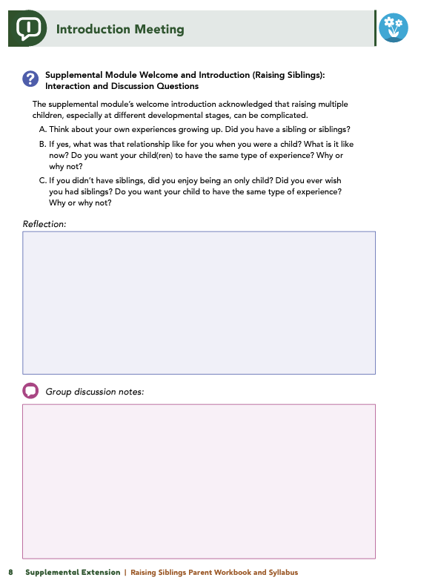
Homework
Complete the Introduction Module and Session 1: Introduction to the Sibling Relationship
View online modules
Complete workbook questions
Notes:
Homework Tasks: Assign Introduction Module and Session 1: Introduction to the Sibling Relationship as homework.
Step 2 Clarification: Remind participants that this homework involves viewing online content and downloading necessary resources as part of Step 2. If time permits, show where to access these materials on the website.
Workbook Guidance: Show the specific pages in the Raising Siblings Parent Workbook and Syllabus related to these topics (D7)
Step 3 Clarification: Assign workbook discussion questions (beginning on page D8 in the parent workbook).
Format explanation: Explain the reason for 2 boxes per question (one for individual, one for group responses).
Encourage reflection and engagement: The more participants, think, reflect, and share the more meaningful the content becomes to each family.
Pro tip: Complete the workbook while viewing online modules.

Slide 9
Thank you for participating today.
Please reach out with any questions or concerns.
See you next week!
Notes:
Closing: Thank participants for their time and engagement.
Questions: Ask if there are any questions. (If someone needs personal assistance, ask them to speak with you individually after the group is dismissed).
Meeting 2: Remind participants of the date/time/location of the next meeting.
Homework: Remind participants to complete the homework.
Adjourn: Say goodbye to participants.

Slide 10
Meeting 1

Slide 11
Welcome back!
Please sign in and find a seat. We will begin soon.
If possible, please turn on your camera and enter your preferred name. We will begin soon.
Notes:
Choose one bullet point to display (the first bullet point is for in-person, the second is for virtual).
If in-person, greet participants as they come in the door and help them find a seat.
If virtual, give participants a heads up when you will be starting. For example, “Hi everyone, we will be starting in about one minute.”

Slide 12
Conversation Starter
Restate Ground Rules
Group Discussion
Homework
Notes:
Example language: Welcome back, families! We’re glad to see for our second meeting.
Review Meeting 2 Agenda:
Conversation Starters: We’ll get started with a quick question to get us all engaged and sharing.
Review of Ground Rules: A brief reminder of our ground rules to ensure our discussions remain respectful and productive.
Discussion and Homework: After our initial activities, we will discuss the workbook questions based on your experiences with the last set of homework followed by an explanation of the homework for our next meeting. Let’s get started!

Slide 13
Please answer one of the following questions:
What is one aspect of your parent-child relationship that is working well?
What is a skill you use effectively in your parenting?
Notes:
Example language: "Let's open our session with a fun question that will give us all a chance to share something about ourselves. Review the list of questions provided on the slide. Select one question that resonates with you, or that you feel comfortable sharing. This activity is designed to ease us into the meeting and build a friendly, open atmosphere.

Slide 14
Basic Ground Rules:
Always start and end sessions on time.
Cell phones should be on vibrate; members can quietly excuse themselves if a call must be taken.
In virtual sessions, participants should mute themselves when taking calls outside the session.
Group-Specific Rules:
Avoid judgment regarding other participants' parenting practices or knowledge gaps.
One person speaks at a time to maintain order and clarity.
Assume positive intent in all interactions to foster a positive atmosphere.
Confidentiality- Please be respectful and discrete with the personal stories being shared. This is a safe space to grow and learn.
Notes:
Introduction of Ground Rules: Start by stating some basic ground rules to create a supportive environment where families feel safe to share their parenting experiences.
Basic Ground Rules:
Always start and end sessions on time.
Cell phones should be on vibrate; members can quietly excuse themselves if a call must be taken.
In virtual sessions, participants should mute themself when taking calls outside the session.
Developing Group-Specific Rules:
Discuss and agree on additional rules as a group, such as:
Avoid judgment regarding other participants' parenting practices or knowledge gaps.
Ensure one person speaks at a time to maintain order and clarity.
Assume positive intent in all interactions to foster a positive atmosphere.
Confidentiality Discussion: Use this time to reinforce the importance of confidentiality, outlining your organization’s specific confidentiality clauses regarding statements related to abuse or neglect mandated reporting..
Example language:
As we begin, it's crucial to emphasize the importance of confidentiality within our group. We need to agree to keep all shared information within these sessions, including personal stories and sensitive details. This ensures a safe space where everyone feels comfortable sharing their experiences. Please remember that details shared by participants are given in trust and should be treated with respect and discretion.
Additionally, it’s important to note our mandated reporting clause for suspected abuse or neglect:
Legal Obligation: Our staff and facilitators are legally required to report any suspicions of child abuse or neglect.
Scope of Reporting: We must report any signs of potential harm to a child or vulnerable adult that arise during our sessions.
Procedure for Reporting: We handle these situations sensitively, informing involved individuals about necessary actions, unless it poses further risk.
Support for Affected Individuals: We provide support and resources to help those involved in a reporting situation.
Our primary concern is the safety and well-being of all individuals. If you have any questions or concerns about this policy, feel free to discuss them privately with me.

Slide 15
Sibling
Dynamics
Parenting
Strategies
Notes:
Provide an overview of the supplemental module using the following points that are taught in the supplemental module:
• Raising multiple children—especially when they are at different developmental stages—can be a positive experience for a family and, at the same time, complicated! Understanding the uniqueness of sibling relationships and how these relationships change over time can help parents and caregivers foster the positive development of their children’s relationships with one another.
• This module intends to help you, as parents and caregivers, understand how sibling relationships change as children grow older and enter different developmental stages and how parenting multiple children will change because of their children’s development. You will learn about sibling relationships and what makes a sibling relationship unique. You will also learn about the role you can take in fostering positive sibling relationships through behaviors such as modeling positive interactions, establishing boundaries, and practicing a parenting strategy called “sensitive responding.” Throughout the module, you will explore communication and conflict-management strategies that can help you navigate common sibling-related challenges and promote positive sibling relationships.

Slide 16
Understand sibling dynamics
Examine parenting influence
Differentiate favoritism vs. treatment
Apply positive parenting practices
Resolve sibling conflicts
Identify conflict red flags
Promote positive interactions
Notes:
After completing this learning module, you will be able to do the following:
• Understand the dynamics of a sibling relationship and how it is unique from other close relationships.
• Examine how parenting and co-parental relationships can influence sibling dynamics.
• Identify the difference between favoritism and differential treatment in your interactions with your children, and understand how these behaviors can impact sibling relationships.
• Incorporate parenting practices that can improve sibling relationships, such as sensitive responding, establishing rules and boundaries, and holding family meetings.
• Use strategies to resolve common sibling conflicts.
• Recognize red flags in sibling conflicts, and determine how you can intervene to prevent adverse outcomes in your children.
• Promote positive interactions among siblings to foster warm and supportive relationships.

Slide 17
Do you have siblings? What was your relationship like as a child and now?
Do you want the same experience for your child(ren)? Why or why not?
If no siblings, did you enjoy being an only child or wish for siblings?
Notes:
Ask some, or all of, the following questions and solicit answers from participants to generate discussion:
Think about your own experiences growing up.
Do you have a sibling or siblings? If yes, what was that relationship like for you when you were a child? What is it like now?
Do you want the same experience for your own child(ren)? Why or why not?
If you didn’t have siblings, did you enjoy being an only child? Did you ever wish you had siblings? Do you want the same experience for your own child(ren)? Why or why not?

Slide 18
Siblings
Unique Relationship
Do you see “love-hate” dynamics in your sibling or your children’s sibling relationships?
If no siblings, have you noticed siblings who fight but defend each other against outsiders?
Notes:
Review this section of the module with the participants by offering the following information:
• Understanding the uniqueness of the sibling relationship and how it changes over time can help you, as a parent or caregiver, foster the positive development or your child’s relationships with their siblings(s).
• Things to remember:
A sibling relationship is typically the longest close relationship an individual will have throughout their life.
A sibling relationship has a unique combination of features that make it similar and different from their relationship with their parents and their friends or romantic partners.
Siblings have shared experiences and non-shared experiences, even when they are raised in the same family.
The module talked about two types of close relationships–closed-field and open-field relationships.
Close-field relationships are those that are constrained by genetics, social norms, or laws. These relationships can withstand more conflict. Examples are parent-child, sibling or marital relationships.
Open-field relationships are those that are voluntary and they can form and dissolve quickly. Examples are friendships and dating relationships.
Siblings can also be in a ‘love-hate’ relationship where feelings of positivity and negativity coexist due to the close-field nature. These can also be defined as ambivalent relationships.
Ask the following questions, and solicit answers from a few participants to generate discussion:
If you have siblings or your children have siblings: Do you see relational ambivalence – that “love-hate” relationship – within your own sibling relationships or within your children’s relationships with each other?
If you don’t have siblings or your child doesn’t have siblings: Do you know siblings who drive each other crazy because they know what buttons to push, but, if someone else outside of the family were to pick on one of them, they would immediately stick up for their brother or sister?

Slide 19
Different Types of Sibling Relationships
How would you define the relationship between your children?
If adding another child, what do you hope their relationship will be like?
Notes:
Review this section of the module with the participants by offering the following information:
• As explored in the module, there are different types of sibling relationships, including biological, adoptive, half-, or step-siblings. These different sibling types can vary in terms of the amount of contact the siblings have with each other, their age spacing, and their relationship qualities.
Ask the following questions, and solicit answers from participants to generate discussion:
If you have more than one child, how would you define the relationship between your children?
If you are a parent of one child and are considering adding another child, or awaiting the arrival of another child, what do you want their relationship to look like?

Slide 20
Development and Change in the Sibling Relationships
How did you prepare your child(ren) for a new sibling?
Did you start any rituals, and are they still part of your routine?
Notes:
Review this section of the module with the participants by offering the following information:
• As mentioned in Session 1, the sibling relationship begins when one child becomes aware of the existence of another child. This usually occurs with the birth of a second child. There can be adjustment periods that the older sibling needs to go through, but when parents prepare for this change the adjustment can be made much easier. For example, you could spend time talking about the new sibling with your existing child and sharing expectations, you could establish a ritual with your existing child that can continue after the new sibling arrives, or you could involve your child in preparations for the new sibling, like setting up their bedroom.
Facilitator Tip: Reference the Preparing Your Child for Their Sibling’s Arrival downloadable parent toolkit resource.
Ask the following questions, and solicit answers from a few participants to generate discussion:
Would anyone like to share what they are doing, or what they did, to prepare existing children form the arrival of a new sibling?
Did anyone start a ritual with their existing child(ren)? If so, are you still doing that same ritual?

Slide 21
Siblings in
Early Childhood
What skills did you learn from or teach your siblings?
What skills have your children learned from or taught each other?
Were these experiences positive or negative?
Notes:
Review this section of the module with the participants by offering the following information:
• During the toddler and preschool years, older siblings tend to serve more as leaders in their interactions with their younger siblings. This can be a positive influence for both the older and the younger siblings. Older siblings learn leadership skills and prosocial behaviors, like helping and cooperation. Younger siblings gain many skills by imitating older siblings in terms of social interactions and cognitive or academic skills, like saying new words, starting to count, and learning the names of colors.
Ask some, or all of, the following questions and solicit answers from participants to generate discussion:
If you have siblings, what skills did you learn from your siblings, or what skills did you teach your siblings?
What skills have you seen your own children learn from one another or teach one another?
Were these positive or negative learning experiences?

Slide 22
Sibling Relationships: Gender and
Age-Spacing
Are you closest with a sibling based on gender or age? How does this compare to others?
Do you notice gender or age differences in your children’s or others’ sibling relationships?
Are there more conflicts with certain siblings? What do you observe?
Notes:
Review this section of the module with the participants by offering the following information:
• The dynamics between siblings will continue to change as siblings enter their elementary school years and into adolescence. When the first-born older sibling goes to school, they may become wrapped up in new friendships, and younger siblings can feel left behind. But, once the younger sibling starts elementary school, older siblings often reclaim their leadership status and act as a guide for the new-to-school younger siblings.
• During adolescence sibling relationships see changes that include increased school demands; more interest in peers outside of the family, like friends; and, sometimes, romantic partners. In early adolescence siblings spend less time together than they did in previous years; however, they still spend more non-school hours together than with any other person—friends and parents included. The sibling relationship is still very important! However, with all of that time spent together, sibling conflict often peaks in early adolescence.
Ask the following questions, and solicit answers from participants to generate discussion:
If you have a sibling, are you closest with your brother, your sister, or your sibling who is closer, or further apart, in age? How does this compare to your spouse/partner’s sibling relationships or other sibling relationships you’ve seen?
Do you notice gender or age differences in your children's relationships with one another or in the sibling relationships of other families you know? For families with multiple children, do you notice more conflicts with any one sibling compared to another? What do you notice?

Slide 23
How do the sibling experiences discussed compare to yours or your child(ren)’s?
What factors (e.g., gender, age, development) influenced your sibling relationships or your child(ren)’s?
Siblings Becoming Adults Together
Share one word that represents your key takeaway from Session 1.
Notes:
Review this section of the module with the participants by offering the following information:
• When siblings become adults, their relationship will again, change, but they may be able to maintain (and even grow) their relationship by making decisions together about their aging parents or asking each other for relationship or parenting advice. During older age, siblings who have a close and positive relationship with one another tend to experience much lower rates of depression than older adults who do not have a close and supportive sibling relationship.
Ask the following questions, and solicit answers from participants to generate discussion:
How have the sibling experiences described in this session been similar or different than your own experience or your experience with your child(ren)?
What factors (i.e., gender, age spacing, developmental) do you think may have influenced your relationship with your siblings? What factors are influencing your child(ren)’s relationships now?
Would anyone like to share the one word that came to their mind that represents what you learned in Session 1 of the module?

Slide 24
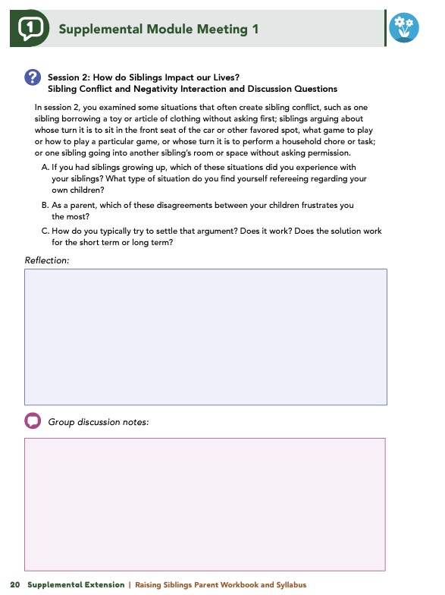
Homework
Complete Session 2: How Do Siblings Impact Our Lives?, Session 3: External Influences on Sibling Relationships, and the Wrap Up
View online modules
Complete workbook questions
Notes:
Homework Tasks: Assign Session 2 & 3: How Do Siblings Impact our Lives, External Influences on Sibling Relationships, and Wrap Up Module as homework.
Step 2 Clarification: Remind participants that this homework involves viewing online content and downloading necessary resources as part of Step 2. If time permits, show where to access these materials on the website.
Workbook Guidance: Show the specific pages in the Raising Siblings Parent Workbook and Syllabus related to these topics (D19)
Step 3 Clarification: Assign workbook discussion questions (beginning on page D20 in the parent workbook).
Format explanation: Explain the reason for 2 boxes per question (one for individual, one for group responses).
Encourage reflection and engagement: The more participants, think, reflect, and share the more meaningful the content becomes to each family.
Pro tip: Complete the workbook while viewing online modules.

Slide 25
Thank you for participating today.
Please reach out with any questions or concerns.
See you next week!
Notes:
Closing: Thank participants for their time and engagement.
Questions: Ask if there are any questions. (If someone needs personal assistance, ask them to speak with you individually after the group is dismissed).
Meeting 2: Remind participants of the date/time/location of the next meeting.
Homework: Remind participants to complete the homework.
Adjourn: Say goodbye to participants.

Slide 26
Meeting 2

Slide 27
Please sign in and find a seat.
We will begin soon.
If possible, please turn on your camera.
We will begin soon.
Notes:
Choose one bullet point to display (the first bullet point is for in-person, the second is for virtual).
If in-person, greet participants as they come in the door and help them find a seat.
If virtual, give participants a heads up when you will be starting. For example, “Hi everyone, we will be starting in about one minute.”

Slide 28
Conversation Starters
Group Discussion
Thrive Programming
Notes:
Example language: Welcome back, everyone! We're glad to see you for our third and final meeting.
*Optional Sections: Please note that the conversation starters are optional. If you prefer to skip these, simply remove the first bullet point from this slide and proceed to the next relevant slide in the deck.
Example language if omitting: We'll dive straight into discussing the key questions from our last session’s homework. We’ll wrap up with a discussion on additional Thrive programs that may interest you
Example language if not omitting:
Conversation Starters: We’ll get started with a quick question to get us all engaged and sharing.
Review of Ground Rules: A brief reminder of our ground rules to ensure our discussions remain respectful and productive.
Discussion and Homework: After our initial activities, we will discuss the workbook questions based on your experiences with the last set of homework followed by an explanation of the homework for our next meeting. Let’s get started!

Slide 29
Please answer one of the following questions:
What is an activity you enjoy doing with your child?
If you could relive one moment with your child, what would it be?
Notes:
Example language: "Let's open our session with a fun question that will give us all a chance to share something about ourselves. Review the list of questions provided on the slide. Select one question that resonates with you, or that you feel comfortable sharing. This activity is designed to ease us into the meeting and build a friendly, open atmosphere.

Slide 30
Basic Ground Rules:
Always start and end sessions on time.
Cell phones should be on vibrate; members can quietly excuse themselves if a call must be taken.
In virtual sessions, participants should mute themselves when taking calls outside the session.
Group-Specific Rules:
Avoid judgment regarding other participants' parenting practices or knowledge gaps.
One person speaks at a time to maintain order and clarity.
Assume positive intent in all interactions to foster a positive atmosphere.
Confidentiality- Please be respectful and discrete with the personal stories being shared. This is a safe space to grow and learn.
Notes:
Introduction of Ground Rules: Start by stating some basic ground rules to create a supportive environment where families feel safe to share their parenting experiences.
Basic Ground Rules:
Always start and end sessions on time.
Cell phones should be on vibrate; members can quietly excuse themselves if a call must be taken.
In virtual sessions, participants should mute themself when taking calls outside the session.
Developing Group-Specific Rules:
Discuss and agree on additional rules as a group, such as:
Avoid judgment regarding other participants' parenting practices or knowledge gaps.
Ensure one person speaks at a time to maintain order and clarity.
Assume positive intent in all interactions to foster a positive atmosphere.
Confidentiality Discussion: Use this time to reinforce the importance of confidentiality, outlining your organization’s specific confidentiality clauses regarding statements related to abuse or neglect mandated reporting..
Example language:
As we begin, it's crucial to emphasize the importance of confidentiality within our group. We need to agree to keep all shared information within these sessions, including personal stories and sensitive details. This ensures a safe space where everyone feels comfortable sharing their experiences. Please remember that details shared by participants are given in trust and should be treated with respect and discretion.
Additionally, it’s important to note our mandated reporting clause for suspected abuse or neglect:
Legal Obligation: Our staff and facilitators are legally required to report any suspicions of child abuse or neglect.
Scope of Reporting: We must report any signs of potential harm to a child or vulnerable adult that arise during our sessions.
Procedure for Reporting: We handle these situations sensitively, informing involved individuals about necessary actions, unless it poses further risk.
Support for Affected Individuals: We provide support and resources to help those involved in a reporting situation.
Our primary concern is the safety and well-being of all individuals. If you have any questions or concerns about this policy, feel free to discuss them privately with me.

Slide 31
Siblings Conflict and Negativity
Which sibling situations did you experience growing up? Which do you referee with your children?
Which disagreements frustrate you most as a parent, and how do you handle them?
Do your strategies work short term or long term?
Notes:
Review this section of the module with the participants by offering the following information:
• As mentioned in Session 1, the sibling relationship is often considered the quintessential “love-hate relationship” because it frequently bounces back-andforth between bouts of conflict to moments of support and affection.
• Research indicates that, on average, siblings between 3 and 7 years old engage in some kind of conflict 3.5 times per hour. Children who are 2 to 4 years old experience about 6.3 conflicts per hour - or more than one clash every 10 minutes. This conflict peaks in early adolescence and then begins to decline. The teen years can feel like there is always conflict with someone in the house!
• Conflict can be a sign of healthy development, but too much and larger conflict between siblings can be associated with greater depression, anxiety and problem behaviors in the child. These sibling relationships also have a greater influence on individuals than the impact of marital or parent-child conflict.
• If there are conflicts that are heated, intense, and consistent over time or physically unsafe can be signs of unhealthy conflict. Also be on the lookout for conflicts where one sibling is always ‘winning’ and the other ‘losing’.
• Constructive conflicts are helpful and healthy for children to learn, especially in a situation with a sibling. The characteristics of the sibling relationship can be a safe space for siblings to rest their conflict-resolution skills when disputes occur.
Ask some, or all of, the following questions and solicit answers from a few participants to generate discussion:
Session 2 had you examine some issues of frequent conflict between siblings (i.e., one sibling borrowing a toy or article of clothing without asking first, whose turn it is to sit in the front seat of the car or other favored spot, what game to play or how to play a particular game, whose turn it is to perform a household chore or task, going into another sibling’s room or space without knocking or asking permission).
If you had siblings growing up, which of these situations did you experience with your siblings? Which do you find yourself refereeing with your own children?
As a parent, which of these disagreements between your children, frustrates you the most?
How do you typically try to settle that argument? Does it work? For the short term or long term?

Slide 32
Sibling Warmth and Conflict
What are your favorite memories with your siblings or your children together?
Are there new experiences you hope your children will create as they grow?
Notes:
Review this section of the module with the participants by offering the following information:
• While conflict may be common in sibling relationships, positive qualities such as warmth, support, play, help, and disclosure are also characteristics of these relationships. Children with warm and supportive sibling relationships tend to have better mental and emotional well-being and may have stronger relationships with other people outside of the family compared to children who do not have siblings.
Ask some, or all of, the following questions and solicit answers from a few participants to generate discussion:
Think about your own siblings growing up. Would anyone like to share what some of your favorite memories with them? Was it playing a particular game? Was it a special family vacation? Was it when they helped you to learn a new skill?
If you did not have siblings growing up, consider the special memories your children are making together. Are there any new experiences or memories you would like your children to create with each other as they grow up together?

Slide 33
The Impact of Warmth on Sibling Relationships
How would you classify your children’s sibling relationships? Do they differ between siblings?
How would you classify your own sibling relationships growing up? Did they change over time?
If you didn’t have siblings, how would you classify sibling relationships you’ve observed (friends, family, media)? What stands out about them?
Notes:
Review this section of the module with the participants by offering the following information:
• Session 2 described four types of sibling relationships and told us that the best sibling relationships are high in warmth and support, regardless of how much conflict they have.
Facilitator Tip -Reference graphic of the Sibling Warmth and Conflict Chart.
Ask some or all of the following questions and solicit answers from a few participants to generate discussion:
Of the four types of relationships described in the module, would anyone like to share the sibling relationship your children have with each other? If you have multiple children, do you see differences between one sibling relationship and another?
If you had siblings growing up, how would you classify your relationship(s)? Are there differences between one sibling relationship and another? In other words, would you classify your relationship with your older brother as high in warmth and high in conflict and your relationship with your younger sister as high in warmth and low in conflict? Did your relationship move between quadrants as you grew into adulthood?
If you did not have siblings as a child, are there examples of sibling relationships that you remember from your friends, other family members (i.e., cousins), or books or movies? How would you classify these relationships? What do you notice about these relationships? Does one sibling relationship appear or feel closer or more disconnected compared to the other?

Slide 34
Promoting Positive Sibling Relationships
What activities made you feel close to your siblings as a child?
What have you done or might you try to promote a positive relationship between your children?
What have your children said they enjoyed most about these efforts?
Notes:
Review this section of the module with the participants by offering the following information:
• As a parent, how can you help to encourage and promote positive sibling relationships. The module talks about a few ways: nurture mutual interests, incorporate or establish family traditions, complete household responsibilities together, and enjoying special experiences together.
Ask some, or all of, the following questions and solicit answers from participants to generate discussion:
Would anyone like to share as a child what they did together with their siblings that made them feel close to their sibling?
What have you done, or what might you do or try, to help promote a positive relationship between your children? What did your children tell you they enjoyed the most about what you did or tried?

Slide 35
How Parents Influence Siblings
Have you noticed your child imitating a positive behavior of yours? How did it make you feel?
Have you noticed your child imitating an unflattering behavior? How did it make you feel?
Notes:
Review this section of the module with the participants by offering the following information:
• As parents, you may feel like your children are best friends one minute and the worst enemies the next. This is normal! Many siblings act this way and as parents we can significantly influence their relationships with one another in both positive and negative ways. You can influence your children’s relationship by how you treat your spouse and/ or co-parent as well as how you treat each individual child. If your family have warm and supportive marital relationships, your children’s sibling relationships will also be warm and supportive.
• Remember that this doesn’t mean you should never fight in front of your children. Children of parents who model behaviors that represent constructive conflict- behaviors that include reasons and explanations for and attempts at resolution- are more likely to try to handle conflicts constructively. Couples who model loud, angry, name-calling or physical-conflict styles are more likely to have children who handle conflicts destructively.
Ask some, or all of, the following questions and solicit answers from participants to generate discussion:
Have you ever noticed your child imitating something you’ve said or done that was positive? How did seeing this behavior in your child make you feel?
How about a behavior that was unflattering (we’ve all been there)? How did seeing this behavior in your child make you feel?

Slide 36
Fair and Equal Parenting Through Sensitive Responding
Do your words or actions differ between your children?
How might your children perceive these differences?
Could any behavior be seen as favoritism?
Notes:
Review this section of the module with the participants by offering the following information:
Favoritism, especially when dealing with a conflict, is associated with more youth depression, anxiety and problem behavior as well as poorer sibling relationships. An exception to this would be if your child knows why you are treating a sibling differently. An example of this would be if the sibling had a disability or if household chores were sorted based on gender- the key here is that they understand the WHY.
If a child doesn’t know why they are being treated differently than another sibling, they are more likely to experience depressing and problematic behavior outbursts. The favored child can also begin to feel more anxious and uncomfortable due to the special attention.
Ask some, or all of, the following questions and solicit answers from participants to generate discussion:
Consider your interactions with your children. Are there words you say or actions you do with one child that differ from what you say or do with another child? How do you think your children perceive these differences? Is there anything you say or do that may be perceived as favoritism?

Slide 37
Parenting for Stronger Sibling Relationships
How does your current conflict-resolution method align with strategies from this module?
How does it differ?
What new strategies might you incorporate?
Notes:
Review this section of the module with the participants by offering the following information:
• We have learned that sibling relationships can be influenced by the other relationships within a family—including co-parental and parent-child relationships. Children observe and interpret these relationships and apply what they learn to their own sibling relationships. With this in mind, parents could consider how they can directly impact sibling relationships through how they deal with sibling conflicts.
• The module talked about 4 steps to conflict-resolution with siblings:
Create space for siblings to calm down. They could sit on opposite sides of the room, go to different rooms but they need a second to remove themselves from whatever is causing them to be frustrated.
Gather the information from both siblings. Sit down with them and ask each child to tell their side of the story. After hearing each side, you could repeat back and state your understanding of their perspectives.
Encourage perspective-taking from both sides. Help them to see why the other was feeling the way they were and bring together the disconnect. It’s an effort to understand the other’s side, but that understanding is helpful for resolution.
Brainstorm solutions together. Ask each child how they would fix the situation and if there is no resolve in playing together, they might need to change what they are playing or play separately.
Ask some, or all of, the following questions and solicit answers from a few participants to generate discussion:
How is your current method of resolving conflicts with your children similar to the conflict-resolution strategies shared in this module? How are they different?
What new or learned strategies might you plan to incorporate into your conflict resolution with your children?

Slide 38
The
Family
Meeting
Does anyone do family meetings, or did they try a family meeting? How did that go for you and your family?
Notes:
Review this section of the module with the participants by offering the following information:
• Over 95% of conflicts between siblings are about property, especially in young children. With older-aged siblings, family or household rules help to proactively avoid conflict. Household chore calendars are one way to help disputes between older siblings. Other rules put in place could address respecting each other’s privacy and property, but everyone in the house including parents need to follow these rules along with the children.
• Session 3 talked about the many benefits of family meetings, including:
Teach children (and parents) how to listen without judgment
Learn how to see other people’s perspectives and respect them
Learn how to give time to others even when they are busy
Recognize that each person is an individual but they are also part of a unit.
Ask the following questions and solicit answers from a few participants to generate discussion:
Does anyone do family meetings, or did they try a family meeting? How did that go for you and your family?

Slide 39
Summary
Questions
Which topic from the module was most beneficial to you as a parent? Why?
What strategies or skills will help you achieve your family goals?
What changes have you noticed in your interactions with your child?
Has your child’s response to your parenting changed?
Notes:
Review this section of the module with the participants by offering the following information:
• Look at how impactful sibling relationships can be in our lives! This dynamic relationship can be quite an amazing topic to explore.
• In this module, we learned how sibling relationships are unlike any other relationships we may experience. The sibling relationship can impact us positively and negatively. Siblings can offer support and comfort to each other, and they can also engage in and create conflict and strife! Furthermore, we explored how parents and caregivers can influence the sibling relationship by how they interact with their children and how they interact with their spouse, partner, or coparent. Practices such as modeling positive behaviors; building positive relationships through shared activities; encouraging constructive conflict resolution; and incorporating parenting strategies, such as sensitive responding and regular family meetings, can benefit the sibling relationship.
Tell participants you are wrapping up, and generate discussion among participants using all, or some, of the following questions:
Which topic discussed in the supplemental module was the most beneficial to you as a parent? Why?
What strategies or skills did you learn in the supplemental module that will help you achieve the goals you have for your child or your family?
What has changed in your interactions with your child since before completing the supplemental module?
Have you noticed a difference in the way your child is responding to your parenting?

Slide 40
Additional Thrive Programs
Take Root is available for parents and caregivers of children who are between 0 and 3 years old.
Sprout is available for parents and caregivers of children who are between 3 and 5 years old.
Grow is available for parents and caregivers of children who are between 5 and 10 years old.
Branch Out is available for parents and caregivers of children who are between 10 and 18 years old.
Notes:
Provide support and encouragement to your participants to explore other Thrive Initiative programming. Share and/or register participants for any additional hybrid implementation options that you plan to offer. Thrive Initiative programming may include any of the following:
Universal Programs
• Take Root is available for parents and caregivers of children who are between 0 and 3 years old.
• Sprout is available for parents and caregivers of children who are between 3 and 5 years old.
• Grow is available for parents and caregivers of children who are between 5 and 10 years old.
• Branch Out is available for parents and caregivers of children who are between the ages of 10 and 18 years old.

Slide 41
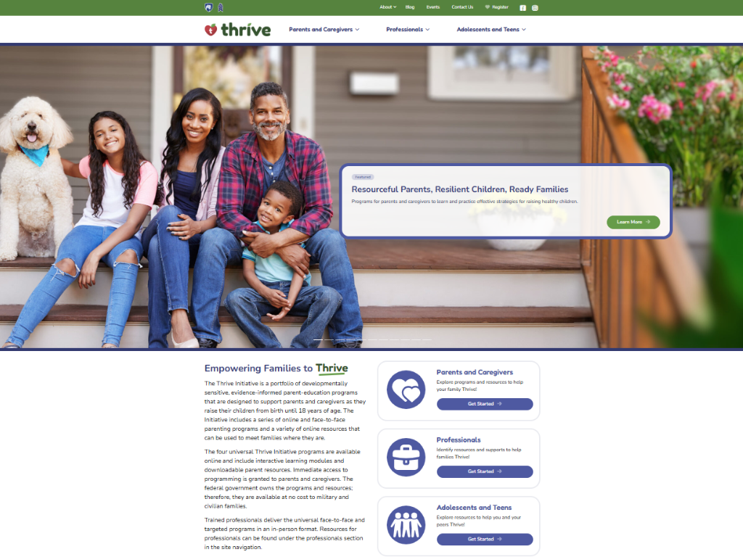
Notes:
Additional supplemental modules are available on a variety of topics and can be accessed online at https://thrive.psu.edu/modules/supplemental/.
Encourage participants to continue to visit the Thrive website, https://thrive.psu.edu, as their child develops and grows.
They can access additional resources and materials like mini-booster modules, blog postings, parenting handouts and guides, an inclusivity toolkit, and newsletters.

Slide 42
Thank you all for your dedication and participation. Every effort you make significantly impacts your child's future success.
Notes:
Example language:
Thank you, parents and caregivers, for your active participation. Please continue to visit the Thrive website as your child develops and grows—it's a valuable resource that can support you through every stage of their growth.
Supplemental Extension ENDS HERE.

Slide 43
Introduction
Notes:
Delivery Type 2: Supplemental Stand Alone begins here.

Slide 44
Welcome!
Please sign in and find a seat. We will begin soon.
If possible, please turn on your camera and enter your preferred name. We will begin soon.
Notes:
Choose one bullet point to display (the first bullet point is for in-person, the second is for virtual).
If in-person, greet participants as they come in the door and help them find a seat.
If virtual, give participants a heads up when you will be starting. For example, “Hi everyone, we will be starting in about one minute.”

Slide 45
AGENDA
Overview
Ice Breaker
Ground Rules
Syllabus
Expectations
Registration
Homework
Notes:
Welcome: Introduce yourself and thank participants for choosing to be a part of the Raising Siblings Supplemental Parenting Program. Explain that Meeting 1 will provide an overview of the program, who is in our group, and what is expected of parents who participate. We will discuss the materials you received and provide instructions on how to use them.
Encourage participants to ask questions as they arise or to jot them down and ask at the end of the meeting.

Slide 46
Target Audience
Program Focus
Skill Building
Reflective Sharing
Program Structure
Goals
Notes:
Raising Siblings: Fostering Positive Relationships is an online supplemental module for parents (and caregivers), of multiple children or those who are planning to increase their family size.
This supplemental module intends to help parents and caregivers better understand how sibling relationships change as their children grow older and how parenting multiple children will change because of their children’s development. This module will encourage you to think about your own experiences with your siblings, look at how siblings can influence your children’s lives and recognize how you can help your children develop their own siblings’ relationships that can benefit them long term.
During the online supplemental module sessions and throughout the hybrid implementation meetings, information and parenting strategies that parents can use and adapt, as necessary, to fit their individual circumstances and family needs will be disseminated. The supplemental module content is designed to help parents build on their existing skills and strategies, so they can effectively parent multiple children either now or in the future.
Some of the content that is read and practiced in the supplemental module and discussed in the hybrid implementation meetings might be familiar to the parents, and they may already know about and use the disseminated information. Therefore, they may use the meeting time as an opportunity to realize, appreciate, and share what already works for them, their child, and their family.
Raising Siblings: Fostering Positive Relationships is an online supplemental module that can help you think about the experience of having multiple children, who, in turn, will then have siblings, and what raising siblings might look like including the “highs” and “lows” involved. It includes a welcome and introduction, three sessions, and a wrap-up.
After participating in the online supplemental module sessions and the hybrid implementation meetings, parents and caregivers should be able to do the following:
• Understand the dynamics of a sibling relationship and how it is unique from other close relationships.
• Examine how parenting and co-parental relationships can influence sibling dynamics.
• Identify the difference between favoritism and differential treatment in your inactions with your children, and understand how these behaviors can impact sibling relationships.
• Incorporate parenting practices that can improve sibling relationships, such as sensitive responding, establishing rules and boundaries, and holding family meetings.
• Use strategies to resolve common sibling conflicts.
• Recognize red flags in sibling conflicts and determine how you can intervene to prevent adverse outcomes in your children.
• Promote positive interactions among siblings to foster warm and supportive relationships.

Slide 47
Tell us your name, your coparent’s name, your child’s name(s), your child’s age(s), and one of the following:
What you enjoy most about parenting
A word you could use to describe one of your child’s strengths
Notes:
Personal Introduction: Start with a brief introduction of yourself, highlighting your expertise in child development and any personal affiliations (e.g., community, organization, military) that connect you to the audience.
Combining Introductions: Merge the participants' introductions with an icebreaker activity to create a more engaging and efficient session.
Icebreaker Questions: Ask each participant to share their name, their coparent’s name, their child’s name, and age. Additional questions to choose:
What you enjoy most about parenting
A word you could use to describe one of your child’s strengths
Future Use: Note the icebreaker questions used; consider revisiting unused ones in future sessions as needed.
You can also start each meeting with an icebreaker if you find your group is reserved. Use your judgment and avoid controversial topics.

Slide 48
Basic Ground Rules:
Always start and end sessions on time.
Cell phones should be on vibrate; members can quietly excuse themselves if a call must be taken.
In virtual sessions, participants should mute themselves when taking calls outside the session.
Group-Specific Rules:
Avoid judgment regarding other participants' parenting practices or knowledge gaps.
One person speaks at a time to maintain order and clarity.
Assume positive intent in all interactions to foster a positive atmosphere.
Confidentiality- Please be respectful and discrete with the personal stories being shared. This is a safe space to grow and learn.
Notes:
Introduction of Ground Rules: Start by stating some basic ground rules to create a supportive environment where families feel safe to share their parenting experiences.
Basic Ground Rules:
Always start and end sessions on time.
Cell phones should be on vibrate; members can quietly excuse themselves if a call must be taken.
In virtual sessions, participants should mute themself when taking calls outside the session.
Developing Group-Specific Rules:
Discuss and agree on additional rules as a group, such as:
Avoid judgment regarding other participants' parenting practices or knowledge gaps.
Ensure one person speaks at a time to maintain order and clarity.
Assume positive intent in all interactions to foster a positive atmosphere.
Confidentiality Discussion: Use this time to reinforce the importance of confidentiality, outlining your organization’s specific confidentiality clauses regarding statements related to abuse or neglect mandated reporting..
Example language:
As we begin, it's crucial to emphasize the importance of confidentiality within our group. We need to agree to keep all shared information within these sessions, including personal stories and sensitive details. This ensures a safe space where everyone feels comfortable sharing their experiences. Please remember that details shared by participants are given in trust and should be treated with respect and discretion.
Additionally, it’s important to note our mandated reporting clause for suspected abuse or neglect:
Legal Obligation: Our staff and facilitators are legally required to report any suspicions of child abuse or neglect.
Scope of Reporting: We must report any signs of potential harm to a child or vulnerable adult that arise during our sessions.
Procedure for Reporting: We handle these situations sensitively, informing involved individuals about necessary actions, unless it poses further risk.
Support for Affected Individuals: We provide support and resources to help those involved in a reporting situation.
Our primary concern is the safety and well-being of all individuals. If you have any questions or concerns about this policy, feel free to discuss them privately with me.

Slide 49
Parent Workbook
Syllabus
Notes:
Provide copies or screen share a copy of the Parent Workbook and Syllabus for the Raising Siblings: Fostering Positive Relationships module. Review the Summary of Training, and highlight the section where the participants can find pertinent information.

Slide 50
Expectations
Notes:
Overview of Expectations: Clearly define what is expected of participants in the Raising Siblings supplemental program.
Independent Completion: Inform families that they are expected to independently complete the online modules.
Full Engagement Required: Emphasize the importance of completing each module in full to maximize learning and benefit from the program.
Purpose of Meetings: Clarify that the in-person meetings are not for revisiting session content but for community building, reflecting on experiences, and discussing insights with other parents and caregivers who are trying to successfully navigate parenting.
Preparation for Discussions: Encourage participants to come to meetings prepared to share their thoughts and engage in discussions based on the content they've learned online.

Slide 51
REGISTER
Notes:
Complete any registration requirements for your organization. Then, explain how participants can access the supplemental module online. Offer support to help with any technological questions. All participants will have previously set up a Thrive Initiative account, but you need to ensure they can log in and find the information they need to get started or progress in the supplemental module.

Slide 52
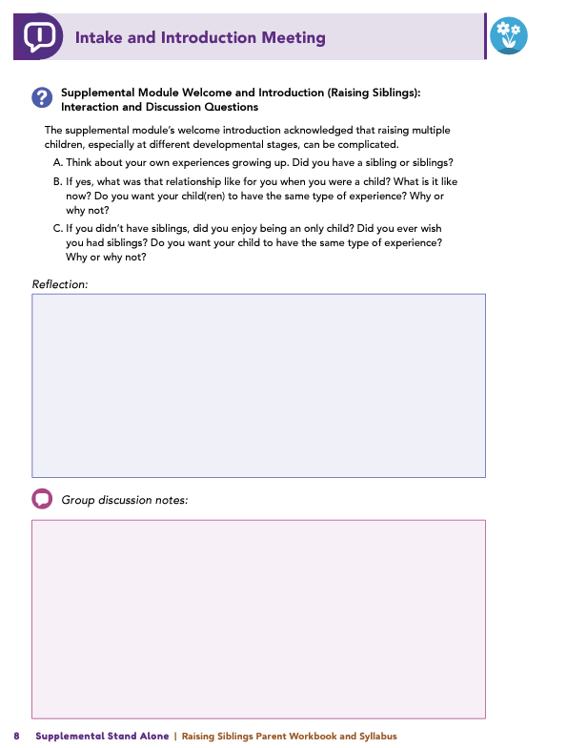
Homework
Complete the Introduction Module and Session 1: Introduction to the Sibling Relationship
View online modules
Complete workbook questions
Notes:
Homework Tasks: Assign Introduction Module and Session 1: Introduction to the Sibling Relationship as homework.
Step 2 Clarification: Remind participants that this homework involves viewing online content and downloading necessary resources as part of Step 2. If time permits, show where to access these materials on the website.
Workbook Guidance: Show the specific pages in the Raising Siblings Parent Workbook and Syllabus related to these topics (D7)
Step 3 Clarification: Assign workbook discussion questions (beginning on page D8 in the parent workbook).
Format explanation: Explain the reason for 2 boxes per question (one for individual, one for group responses).
Encourage reflection and engagement: The more participants, think, reflect, and share the more meaningful the content becomes to each family.
Pro tip: Complete the workbook while viewing online modules.

Slide 53
Thank you for participating today.
Please reach out with any questions or concerns.
See you next week!
Notes:
Closing: Thank participants for their time and engagement.
Questions: Ask if there are any questions. (If someone needs personal assistance, ask them to speak with you individually after the group is dismissed).
Meeting 2: Remind participants of the date/time/location of the next meeting.
Homework: Remind participants to complete the homework.
Adjourn: Say goodbye to participants.

Slide 54
Meeting 1

Slide 55
Welcome back!
Please sign in and find a seat. We will begin soon.
If possible, please turn on your camera and enter your preferred name. We will begin soon.
Notes:
Choose one bullet point to display (the first bullet point is for in-person, the second is for virtual).
If in-person, greet participants as they come in the door and help them find a seat.
If virtual, give participants a heads up when you will be starting. For example, “Hi everyone, we will be starting in about one minute.”

Slide 56
Conversation Starter
Restate Ground Rules
Group Discussion
Homework
Notes:
Example language: Welcome back, families! We’re glad to see for our second meeting.
Review Meeting 2 Agenda:
Conversation Starters: We’ll get started with a quick question to get us all engaged and sharing.
Review of Ground Rules: A brief reminder of our ground rules to ensure our discussions remain respectful and productive.
Discussion and Homework: After our initial activities, we will discuss the workbook questions based on your experiences with the last set of homework followed by an explanation of the homework for our next meeting. Let’s get started!

Slide 57
Please answer one of the following questions:
What is one aspect of your parent-child relationship that is working well?
What is a skill you use effectively in your parenting?
Notes:
Example language: "Let's open our session with a fun question that will give us all a chance to share something about ourselves. Review the list of questions provided on the slide. Select one question that resonates with you, or that you feel comfortable sharing. This activity is designed to ease us into the meeting and build a friendly, open atmosphere.

Slide 58
Basic Ground Rules:
Always start and end sessions on time.
Cell phones should be on vibrate; members can quietly excuse themselves if a call must be taken.
In virtual sessions, participants should mute themselves when taking calls outside the session.
Group-Specific Rules:
Avoid judgment regarding other participants' parenting practices or knowledge gaps.
One person speaks at a time to maintain order and clarity.
Assume positive intent in all interactions to foster a positive atmosphere.
Confidentiality- Please be respectful and discrete with the personal stories being shared. This is a safe space to grow and learn.
Notes:
Introduction of Ground Rules: Start by stating some basic ground rules to create a supportive environment where families feel safe to share their parenting experiences.
Basic Ground Rules:
Always start and end sessions on time.
Cell phones should be on vibrate; members can quietly excuse themselves if a call must be taken.
In virtual sessions, participants should mute themself when taking calls outside the session.
Developing Group-Specific Rules:
Discuss and agree on additional rules as a group, such as:
Avoid judgment regarding other participants' parenting practices or knowledge gaps.
Ensure one person speaks at a time to maintain order and clarity.
Assume positive intent in all interactions to foster a positive atmosphere.
Confidentiality Discussion: Use this time to reinforce the importance of confidentiality, outlining your organization’s specific confidentiality clauses regarding statements related to abuse or neglect mandated reporting..
Example language:
As we begin, it's crucial to emphasize the importance of confidentiality within our group. We need to agree to keep all shared information within these sessions, including personal stories and sensitive details. This ensures a safe space where everyone feels comfortable sharing their experiences. Please remember that details shared by participants are given in trust and should be treated with respect and discretion.
Additionally, it’s important to note our mandated reporting clause for suspected abuse or neglect:
Legal Obligation: Our staff and facilitators are legally required to report any suspicions of child abuse or neglect.
Scope of Reporting: We must report any signs of potential harm to a child or vulnerable adult that arise during our sessions.
Procedure for Reporting: We handle these situations sensitively, informing involved individuals about necessary actions, unless it poses further risk.
Support for Affected Individuals: We provide support and resources to help those involved in a reporting situation.
Our primary concern is the safety and well-being of all individuals. If you have any questions or concerns about this policy, feel free to discuss them privately with me.

Slide 59
Sibling
Dynamics
Parenting
Strategies
Notes:
Provide an overview of the supplemental module using the following points that are taught in the supplemental module:
• Raising multiple children—especially when they are at different developmental stages—can be a positive experience for a family and, at the same time, complicated! Understanding the uniqueness of sibling relationships and how these relationships change over time can help parents and caregivers foster the positive development of their children’s relationships with one another.
• This module intends to help you, as parents and caregivers, understand how sibling relationships change as children grow older and enter different developmental stages and how parenting multiple children will change because of their children’s development. You will learn about sibling relationships and what makes a sibling relationship unique. You will also learn about the role you can take in fostering positive sibling relationships through behaviors such as modeling positive interactions, establishing boundaries, and practicing a parenting strategy called “sensitive responding.” Throughout the module, you will explore communication and conflict-management strategies that can help you navigate common sibling-related challenges and promote positive sibling relationships.

Slide 60
Understand sibling dynamics
Examine parenting influence
Differentiate favoritism vs. treatment
Apply positive parenting practices
Resolve sibling conflicts
Identify conflict red flags
Promote positive interactions
Notes:
After completing this learning module, you will be able to do the following:
• Understand the dynamics of a sibling relationship and how it is unique from other close relationships.
• Examine how parenting and co-parental relationships can influence sibling dynamics.
• Identify the difference between favoritism and differential treatment in your interactions with your children, and understand how these behaviors can impact sibling relationships.
• Incorporate parenting practices that can improve sibling relationships, such as sensitive responding, establishing rules and boundaries, and holding family meetings.
• Use strategies to resolve common sibling conflicts.
• Recognize red flags in sibling conflicts, and determine how you can intervene to prevent adverse outcomes in your children.
• Promote positive interactions among siblings to foster warm and supportive relationships.

Slide 61
Do you have siblings? What was your relationship like as a child and now?
Do you want the same experience for your child(ren)? Why or why not?
If no siblings, did you enjoy being an only child or wish for siblings?
Notes:
Ask some, or all of, the following questions and solicit answers from participants to generate discussion:
Think about your own experiences growing up.
Do you have a sibling or siblings? If yes, what was that relationship like for you when you were a child? What is it like now?
Do you want the same experience for your own child(ren)? Why or why not?
If you didn’t have siblings, did you enjoy being an only child? Did you ever wish you had siblings? Do you want the same experience for your own child(ren)? Why or why not?

Slide 62
Siblings
Unique Relationship
Do you see “love-hate” dynamics in your sibling or your children’s sibling relationships?
If no siblings, have you noticed siblings who fight but defend each other against outsiders?
Notes:
Review this section of the module with the participants by offering the following information:
• Understanding the uniqueness of the sibling relationship and how it changes over time can help you, as a parent or caregiver, foster the positive development or your child’s relationships with their siblings(s).
• Things to remember:
A sibling relationship is typically the longest close relationship an individual will have throughout their life.
A sibling relationship has a unique combination of features that make it similar and different from their relationship with their parents and their friends or romantic partners.
Siblings have shared experiences and non-shared experiences, even when they are raised in the same family.
The module talked about two types of close relationships–closed-field and open-field relationships.
Close-field relationships are those that are constrained by genetics, social norms, or laws. These relationships can withstand more conflict. Examples are parent-child, sibling or marital relationships.
Open-field relationships are those that are voluntary and they can form and dissolve quickly. Examples are friendships and dating relationships.
Siblings can also be in a ‘love-hate’ relationship where feelings of positivity and negativity coexist due to the close-field nature. These can also be defined as ambivalent relationships.
Ask the following questions, and solicit answers from a few participants to generate discussion:
If you have siblings or your children have siblings: Do you see relational ambivalence – that “love-hate” relationship – within your own sibling relationships or within your children’s relationships with each other?
If you don’t have siblings or your child doesn’t have siblings: Do you know siblings who drive each other crazy because they know what buttons to push, but, if someone else outside of the family were to pick on one of them, they would immediately stick up for their brother or sister?

Slide 63
Different Types of Sibling Relationships
How would you define the relationship between your children?
If adding another child, what do you hope their relationship will be like?
Notes:
Review this section of the module with the participants by offering the following information:
• As explored in the module, there are different types of sibling relationships, including biological, adoptive, half-, or step-siblings. These different sibling types can vary in terms of the amount of contact the siblings have with each other, their age spacing, and their relationship qualities.
Ask the following questions, and solicit answers from participants to generate discussion:
If you have more than one child, how would you define the relationship between your children?
If you are a parent of one child and are considering adding another child, or awaiting the arrival of another child, what do you want their relationship to look like?

Slide 64
Development and Change in the Sibling Relationships
How did you prepare your child(ren) for a new sibling?
Did you start any rituals, and are they still part of your routine?
Notes:
Review this section of the module with the participants by offering the following information:
• As mentioned in Session 1, the sibling relationship begins when one child becomes aware of the existence of another child. This usually occurs with the birth of a second child. There can be adjustment periods that the older sibling needs to go through, but when parents prepare for this change the adjustment can be made much easier. For example, you could spend time talking about the new sibling with your existing child and sharing expectations, you could establish a ritual with your existing child that can continue after the new sibling arrives, or you could involve your child in preparations for the new sibling, like setting up their bedroom.
Facilitator Tip: Reference the Preparing Your Child for Their Sibling’s Arrival downloadable parent toolkit resource.
Ask the following questions, and solicit answers from a few participants to generate discussion:
Would anyone like to share what they are doing, or what they did, to prepare existing children form the arrival of a new sibling?
Did anyone start a ritual with their existing child(ren)? If so, are you still doing that same ritual?

Slide 65
Siblings in
Early Childhood
What skills did you learn from or teach your siblings?
What skills have your children learned from or taught each other?
Were these experiences positive or negative?
Notes:
Review this section of the module with the participants by offering the following information:
• During the toddler and preschool years, older siblings tend to serve more as leaders in their interactions with their younger siblings. This can be a positive influence for both the older and the younger siblings. Older siblings learn leadership skills and prosocial behaviors, like helping and cooperation. Younger siblings gain many skills by imitating older siblings in terms of social interactions and cognitive or academic skills, like saying new words, starting to count, and learning the names of colors.
Ask some, or all of, the following questions and solicit answers from participants to generate discussion:
If you have siblings, what skills did you learn from your siblings, or what skills did you teach your siblings?
What skills have you seen your own children learn from one another or teach one another?
Were these positive or negative learning experiences?

Slide 66
Sibling Relationships: Gender and
Age-Spacing
Are you closest with a sibling based on gender or age? How does this compare to others?
Do you notice gender or age differences in your children’s or others’ sibling relationships?
Are there more conflicts with certain siblings? What do you observe?
Notes:
Review this section of the module with the participants by offering the following information:
• The dynamics between siblings will continue to change as siblings enter their elementary school years and into adolescence. When the first-born older sibling goes to school, they may become wrapped up in new friendships, and younger siblings can feel left behind. But, once the younger sibling starts elementary school, older siblings often reclaim their leadership status and act as a guide for the new-to-school younger siblings.
• During adolescence sibling relationships see changes that include increased school demands; more interest in peers outside of the family, like friends; and, sometimes, romantic partners. In early adolescence siblings spend less time together than they did in previous years; however, they still spend more non-school hours together than with any other person—friends and parents included. The sibling relationship is still very important! However, with all of that time spent together, sibling conflict often peaks in early adolescence.
Ask the following questions, and solicit answers from participants to generate discussion:
If you have a sibling, are you closest with your brother, your sister, or your sibling who is closer, or further apart, in age? How does this compare to your spouse/partner’s sibling relationships or other sibling relationships you’ve seen?
Do you notice gender or age differences in your children's relationships with one another or in the sibling relationships of other families you know? For families with multiple children, do you notice more conflicts with any one sibling compared to another? What do you notice?

Slide 67
How do the sibling experiences discussed compare to yours or your child(ren)’s?
What factors (e.g., gender, age, development) influenced your sibling relationships or your child(ren)’s?
Siblings Becoming Adults Together
Share one word that represents your key takeaway from Session 1.
Notes:
Review this section of the module with the participants by offering the following information:
• When siblings become adults, their relationship will again, change, but they may be able to maintain (and even grow) their relationship by making decisions together about their aging parents or asking each other for relationship or parenting advice. During older age, siblings who have a close and positive relationship with one another tend to experience much lower rates of depression than older adults who do not have a close and supportive sibling relationship.
Ask the following questions, and solicit answers from participants to generate discussion:
How have the sibling experiences described in this session been similar or different than your own experience or your experience with your child(ren)?
What factors (i.e., gender, age spacing, developmental) do you think may have influenced your relationship with your siblings? What factors are influencing your child(ren)’s relationships now?
Would anyone like to share the one word that came to their mind that represents what you learned in Session 1 of the module?

Slide 68
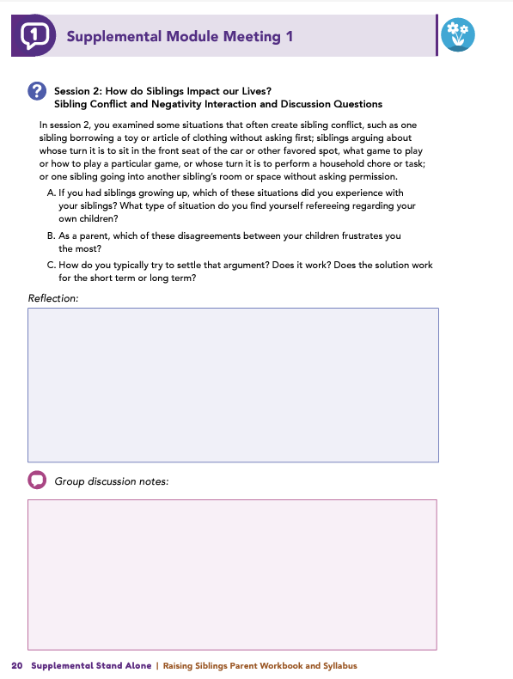
Homework
Complete Session 2: How Do Siblings Impact Our Lives?, Session 3: External Influences on Sibling Relationships, and the Wrap Up
View online modules
Complete workbook questions
Notes:
Homework Tasks: Assign Session 2 & 3: How Do Siblings Impact our Lives, External Influences on Sibling Relationships, and Wrap Up Module as homework.
Step 2 Clarification: Remind participants that this homework involves viewing online content and downloading necessary resources as part of Step 2. If time permits, show where to access these materials on the website.
Workbook Guidance: Show the specific pages in the Raising Siblings Parent Workbook and Syllabus related to these topics (D19)
Step 3 Clarification: Assign workbook discussion questions (beginning on page D20 in the parent workbook).
Format explanation: Explain the reason for 2 boxes per question (one for individual, one for group responses).
Encourage reflection and engagement: The more participants, think, reflect, and share the more meaningful the content becomes to each family.
Pro tip: Complete the workbook while viewing online modules.

Slide 69
Thank you for participating today.
Please reach out with any questions or concerns.
See you next week!
Notes:
Closing: Thank participants for their time and engagement.
Questions: Ask if there are any questions. (If someone needs personal assistance, ask them to speak with you individually after the group is dismissed).
Meeting 2: Remind participants of the date/time/location of the next meeting.
Homework: Remind participants to complete the homework.
Adjourn: Say goodbye to participants.

Slide 70
Meeting 2

Slide 71
Please sign in and find a seat.
We will begin soon.
If possible, please turn on your camera.
We will begin soon.
Notes:
Choose one bullet point to display (the first bullet point is for in-person, the second is for virtual).
If in-person, greet participants as they come in the door and help them find a seat.
If virtual, give participants a heads up when you will be starting. For example, “Hi everyone, we will be starting in about one minute.”

Slide 72
Conversation Starters
Group Discussion
Thrive Programming
Notes:
Example language: Welcome back, everyone! We're glad to see you for our third and final meeting.
*Optional Sections: Please note that the conversation starters are optional. If you prefer to skip these, simply remove the first bullet point from this slide and proceed to the next relevant slide in the deck.
Example language if omitting: We'll dive straight into discussing the key questions from our last session’s homework. We’ll wrap up with a discussion on additional Thrive programs that may interest you
Example language if not omitting:
Conversation Starters: We’ll get started with a quick question to get us all engaged and sharing.
Review of Ground Rules: A brief reminder of our ground rules to ensure our discussions remain respectful and productive.
Discussion and Homework: After our initial activities, we will discuss the workbook questions based on your experiences with the last set of homework followed by an explanation of the homework for our next meeting. Let’s get started!

Slide 73
Please answer one of the following questions:
What is an activity you enjoy doing with your child?
If you could relive one moment with your child, what would it be?
Notes:
Example language: "Let's open our session with a fun question that will give us all a chance to share something about ourselves. Review the list of questions provided on the slide. Select one question that resonates with you, or that you feel comfortable sharing. This activity is designed to ease us into the meeting and build a friendly, open atmosphere.

Slide 74
Basic Ground Rules:
Always start and end sessions on time.
Cell phones should be on vibrate; members can quietly excuse themselves if a call must be taken.
In virtual sessions, participants should mute themselves when taking calls outside the session.
Group-Specific Rules:
Avoid judgment regarding other participants' parenting practices or knowledge gaps.
One person speaks at a time to maintain order and clarity.
Assume positive intent in all interactions to foster a positive atmosphere.
Confidentiality- Please be respectful and discrete with the personal stories being shared. This is a safe space to grow and learn.
Notes:
Introduction of Ground Rules: Start by stating some basic ground rules to create a supportive environment where families feel safe to share their parenting experiences.
Basic Ground Rules:
Always start and end sessions on time.
Cell phones should be on vibrate; members can quietly excuse themselves if a call must be taken.
In virtual sessions, participants should mute themself when taking calls outside the session.
Developing Group-Specific Rules:
Discuss and agree on additional rules as a group, such as:
Avoid judgment regarding other participants' parenting practices or knowledge gaps.
Ensure one person speaks at a time to maintain order and clarity.
Assume positive intent in all interactions to foster a positive atmosphere.
Confidentiality Discussion: Use this time to reinforce the importance of confidentiality, outlining your organization’s specific confidentiality clauses regarding statements related to abuse or neglect mandated reporting..
Example language:
As we begin, it's crucial to emphasize the importance of confidentiality within our group. We need to agree to keep all shared information within these sessions, including personal stories and sensitive details. This ensures a safe space where everyone feels comfortable sharing their experiences. Please remember that details shared by participants are given in trust and should be treated with respect and discretion.
Additionally, it’s important to note our mandated reporting clause for suspected abuse or neglect:
Legal Obligation: Our staff and facilitators are legally required to report any suspicions of child abuse or neglect.
Scope of Reporting: We must report any signs of potential harm to a child or vulnerable adult that arise during our sessions.
Procedure for Reporting: We handle these situations sensitively, informing involved individuals about necessary actions, unless it poses further risk.
Support for Affected Individuals: We provide support and resources to help those involved in a reporting situation.
Our primary concern is the safety and well-being of all individuals. If you have any questions or concerns about this policy, feel free to discuss them privately with me.

Slide 75
Siblings Conflict and Negativity
Which sibling situations did you experience growing up? Which do you referee with your children?
Which disagreements frustrate you most as a parent, and how do you handle them?
Do your strategies work short term or long term?
Notes:
Review this section of the module with the participants by offering the following information:
• As mentioned in Session 1, the sibling relationship is often considered the quintessential “love-hate relationship” because it frequently bounces back-andforth between bouts of conflict to moments of support and affection.
• Research indicates that, on average, siblings between 3 and 7 years old engage in some kind of conflict 3.5 times per hour. Children who are 2 to 4 years old experience about 6.3 conflicts per hour - or more than one clash every 10 minutes. This conflict peaks in early adolescence and then begins to decline. The teen years can feel like there is always conflict with someone in the house!
• Conflict can be a sign of healthy development, but too much and larger conflict between siblings can be associated with greater depression, anxiety and problem behaviors in the child. These sibling relationships also have a greater influence on individuals than the impact of marital or parent-child conflict.
• If there are conflicts that are heated, intense, and consistent over time or physically unsafe can be signs of unhealthy conflict. Also be on the lookout for conflicts where one sibling is always ‘winning’ and the other ‘losing’.
• Constructive conflicts are helpful and healthy for children to learn, especially in a situation with a sibling. The characteristics of the sibling relationship can be a safe space for siblings to rest their conflict-resolution skills when disputes occur.
Ask some, or all of, the following questions and solicit answers from a few participants to generate discussion:
Session 2 had you examine some issues of frequent conflict between siblings (i.e., one sibling borrowing a toy or article of clothing without asking first, whose turn it is to sit in the front seat of the car or other favored spot, what game to play or how to play a particular game, whose turn it is to perform a household chore or task, going into another sibling’s room or space without knocking or asking permission).
If you had siblings growing up, which of these situations did you experience with your siblings? Which do you find yourself refereeing with your own children?
As a parent, which of these disagreements between your children, frustrates you the most?
How do you typically try to settle that argument? Does it work? For the short term or long term?

Slide 76
Sibling Warmth and Conflict
What are your favorite memories with your siblings or your children together?
Are there new experiences you hope your children will create as they grow?
Notes:
Review this section of the module with the participants by offering the following information:
• While conflict may be common in sibling relationships, positive qualities such as warmth, support, play, help, and disclosure are also characteristics of these relationships. Children with warm and supportive sibling relationships tend to have better mental and emotional well-being and may have stronger relationships with other people outside of the family compared to children who do not have siblings.
Ask some, or all of, the following questions and solicit answers from a few participants to generate discussion:
Think about your own siblings growing up. Would anyone like to share what some of your favorite memories with them? Was it playing a particular game? Was it a special family vacation? Was it when they helped you to learn a new skill?
If you did not have siblings growing up, consider the special memories your children are making together. Are there any new experiences or memories you would like your children to create with each other as they grow up together?

Slide 77
The Impact of Warmth on Sibling Relationships
How would you classify your children’s sibling relationships? Do they differ between siblings?
How would you classify your own sibling relationships growing up? Did they change over time?
If you didn’t have siblings, how would you classify sibling relationships you’ve observed (friends, family, media)? What stands out about them?
Notes:
Review this section of the module with the participants by offering the following information:
• Session 2 described four types of sibling relationships and told us that the best sibling relationships are high in warmth and support, regardless of how much conflict they have.
Facilitator Tip -Reference graphic of the Sibling Warmth and Conflict Chart.
Ask some or all of the following questions and solicit answers from a few participants to generate discussion:
Of the four types of relationships described in the module, would anyone like to share the sibling relationship your children have with each other? If you have multiple children, do you see differences between one sibling relationship and another?
If you had siblings growing up, how would you classify your relationship(s)? Are there differences between one sibling relationship and another? In other words, would you classify your relationship with your older brother as high in warmth and high in conflict and your relationship with your younger sister as high in warmth and low in conflict? Did your relationship move between quadrants as you grew into adulthood?
If you did not have siblings as a child, are there examples of sibling relationships that you remember from your friends, other family members (i.e., cousins), or books or movies? How would you classify these relationships? What do you notice about these relationships? Does one sibling relationship appear or feel closer or more disconnected compared to the other?

Slide 78
Promoting Positive Sibling Relationships
What activities made you feel close to your siblings as a child?
What have you done or might you try to promote a positive relationship between your children?
What have your children said they enjoyed most about these efforts?
Notes:
Review this section of the module with the participants by offering the following information:
• As a parent, how can you help to encourage and promote positive sibling relationships. The module talks about a few ways: nurture mutual interests, incorporate or establish family traditions, complete household responsibilities together, and enjoying special experiences together.
Ask some, or all of, the following questions and solicit answers from participants to generate discussion:
Would anyone like to share as a child what they did together with their siblings that made them feel close to their sibling?
What have you done, or what might you do or try, to help promote a positive relationship between your children? What did your children tell you they enjoyed the most about what you did or tried?

Slide 79
How Parents Influence Siblings
Have you noticed your child imitating a positive behavior of yours? How did it make you feel?
Have you noticed your child imitating an unflattering behavior? How did it make you feel?
Notes:
Review this section of the module with the participants by offering the following information:
• As parents, you may feel like your children are best friends one minute and the worst enemies the next. This is normal! Many siblings act this way and as parents we can significantly influence their relationships with one another in both positive and negative ways. You can influence your children’s relationship by how you treat your spouse and/ or co-parent as well as how you treat each individual child. If your family have warm and supportive marital relationships, your children’s sibling relationships will also be warm and supportive.
• Remember that this doesn’t mean you should never fight in front of your children. Children of parents who model behaviors that represent constructive conflict- behaviors that include reasons and explanations for and attempts at resolution- are more likely to try to handle conflicts constructively. Couples who model loud, angry, name-calling or physical-conflict styles are more likely to have children who handle conflicts destructively.
Ask some, or all of, the following questions and solicit answers from participants to generate discussion:
Have you ever noticed your child imitating something you’ve said or done that was positive? How did seeing this behavior in your child make you feel?
How about a behavior that was unflattering (we’ve all been there)? How did seeing this behavior in your child make you feel?

Slide 80
Fair and Equal Parenting Through Sensitive Responding
Do your words or actions differ between your children?
How might your children perceive these differences?
Could any behavior be seen as favoritism?
Notes:
Review this section of the module with the participants by offering the following information:
Favoritism, especially when dealing with a conflict, is associated with more youth depression, anxiety and problem behavior as well as poorer sibling relationships. An exception to this would be if your child knows why you are treating a sibling differently. An example of this would be if the sibling had a disability or if household chores were sorted based on gender- the key here is that they understand the WHY.
If a child doesn’t know why they are being treated differently than another sibling, they are more likely to experience depressing and problematic behavior outbursts. The favored child can also begin to feel more anxious and uncomfortable due to the special attention.
Ask some, or all of, the following questions and solicit answers from participants to generate discussion:
Consider your interactions with your children. Are there words you say or actions you do with one child that differ from what you say or do with another child? How do you think your children perceive these differences? Is there anything you say or do that may be perceived as favoritism?

Slide 81
Parenting for Stronger Sibling Relationships
How does your current conflict-resolution method align with strategies from this module?
How does it differ?
What new strategies might you incorporate?
Notes:
Review this section of the module with the participants by offering the following information:
• We have learned that sibling relationships can be influenced by the other relationships within a family—including co-parental and parent-child relationships. Children observe and interpret these relationships and apply what they learn to their own sibling relationships. With this in mind, parents could consider how they can directly impact sibling relationships through how they deal with sibling conflicts.
• The module talked about 4 steps to conflict-resolution with siblings:
Create space for siblings to calm down. They could sit on opposite sides of the room, go to different rooms but they need a second to remove themselves from whatever is causing them to be frustrated.
Gather the information from both siblings. Sit down with them and ask each child to tell their side of the story. After hearing each side, you could repeat back and state your understanding of their perspectives.
Encourage perspective-taking from both sides. Help them to see why the other was feeling the way they were and bring together the disconnect. It’s an effort to understand the other’s side, but that understanding is helpful for resolution.
Brainstorm solutions together. Ask each child how they would fix the situation and if there is no resolve in playing together, they might need to change what they are playing or play separately.
Ask some, or all of, the following questions and solicit answers from a few participants to generate discussion:
How is your current method of resolving conflicts with your children similar to the conflict-resolution strategies shared in this module? How are they different?
What new or learned strategies might you plan to incorporate into your conflict resolution with your children?

Slide 82
The
Family
Meeting
Does anyone do family meetings, or did they try a family meeting? How did that go for you and your family?
Notes:
Review this section of the module with the participants by offering the following information:
• Over 95% of conflicts between siblings are about property, especially in young children. With older-aged siblings, family or household rules help to proactively avoid conflict. Household chore calendars are one way to help disputes between older siblings. Other rules put in place could address respecting each other’s privacy and property, but everyone in the house including parents need to follow these rules along with the children.
• Session 3 talked about the many benefits of family meetings, including:
Teach children (and parents) how to listen without judgment
Learn how to see other people’s perspectives and respect them
Learn how to give time to others even when they are busy
Recognize that each person is an individual but they are also part of a unit.
Ask the following questions and solicit answers from a few participants to generate discussion:
Does anyone do family meetings, or did they try a family meeting? How did that go for you and your family?

Slide 83
Summary
Questions
Which topic from the module was most beneficial to you as a parent? Why?
What strategies or skills will help you achieve your family goals?
What changes have you noticed in your interactions with your child?
Has your child’s response to your parenting changed?
Notes:
Review this section of the module with the participants by offering the following information:
• Look at how impactful sibling relationships can be in our lives! This dynamic relationship can be quite an amazing topic to explore.
• In this module, we learned how sibling relationships are unlike any other relationships we may experience. The sibling relationship can impact us positively and negatively. Siblings can offer support and comfort to each other, and they can also engage in and create conflict and strife! Furthermore, we explored how parents and caregivers can influence the sibling relationship by how they interact with their children and how they interact with their spouse, partner, or coparent. Practices such as modeling positive behaviors; building positive relationships through shared activities; encouraging constructive conflict resolution; and incorporating parenting strategies, such as sensitive responding and regular family meetings, can benefit the sibling relationship.
Tell participants you are wrapping up, and generate discussion among participants using all, or some, of the following questions:
Which topic discussed in the supplemental module was the most beneficial to you as a parent? Why?
What strategies or skills did you learn in the supplemental module that will help you achieve the goals you have for your child or your family?
What has changed in your interactions with your child since before completing the supplemental module?
Have you noticed a difference in the way your child is responding to your parenting?

Slide 84
Additional Thrive Programs
Take Root is available for parents and caregivers of children who are between 0 and 3 years old.
Sprout is available for parents and caregivers of children who are between 3 and 5 years old.
Grow is available for parents and caregivers of children who are between 5 and 10 years old.
Branch Out is available for parents and caregivers of children who are between 10 and 18 years old.
Notes:
Provide support and encouragement to your participants to explore other Thrive Initiative programming. Share and/or register participants for any additional hybrid implementation options that you plan to offer. Thrive Initiative programming may include any of the following:
Universal Programs
• Take Root is available for parents and caregivers of children who are between 0 and 3 years old.
• Sprout is available for parents and caregivers of children who are between 3 and 5 years old.
• Grow is available for parents and caregivers of children who are between 5 and 10 years old.
• Branch Out is available for parents and caregivers of children who are between the ages of 10 and 18 years old.

Slide 85
Notes:
Additional supplemental modules are available on a variety of topics and can be accessed online at https://thrive.psu.edu/modules/supplemental/.
Encourage participants to continue to visit the Thrive website, https://thrive.psu.edu, as their child develops and grows.
They can access additional resources and materials like mini-booster modules, blog postings, parenting handouts and guides, an inclusivity toolkit, and newsletters.

Slide 86
Thank you all for your dedication and participation. Every effort you make significantly impacts your child's future success.
Notes:
Example language:
Thank you, parents and caregivers, for your active participation. Please continue to visit the Thrive website as your child develops and grows—it's a valuable resource that can support you through every stage of their growth.

