Slide 1
As of June 4, 2025
A program for parents and caregivers of adolescents ages 10 to 18 years old
Meeting 1

Slide 2
Welcome!
Please sign in and find a seat. We will begin soon.
If possible, please turn on your camera and enter your preferred name. We will begin soon.
Notes:
Choose one bullet point to display (the first bullet point is for in-person, the second is for virtual).
If in-person, greet participants as they come in the door and help them find a seat.
If virtual, give participants a heads up when you will be starting. For example, “Hi everyone, we will be starting in about one minute.”

Slide 3
Agenda
Overview
Introductions
Ground Rules
Expectations
Review Syllabus
Homework
Q & A
Notes:
Welcome: Introduce yourself and thank participants for choosing to be a part of the Sprout Parenting Program. Explain that Meeting 1 will provide an overview of the program, who is in our group, and what is expected of parents who participate. We will discuss the materials you received and provide instructions on how to use them.
Encourage participants to ask questions as they arise or to jot them down and ask at the end of the meeting.

Slide 4
Overview
Target
Audience
Goals
Content
Modules
Notes:
Welcome to Branch Out! This program is designed for parents and caregivers of adolescents aged 10-18. Adolescence is a time full of changes, excitement, and sometimes anxiety, not just for teens but for parents too.
What You’ll Get: We’ll provide you with information and parenting strategies tailored to your child’s unique needs. Our goal is to help you enhance your communication skills and build a relationship with your teen that’s based on respect and trust.
What You’ll Find: Some of the content might be familiar to you. That’s okay! This is a great opportunity to reflect on what’s already working well for you and your child.
How It Works: Branch Out is divided into 8 modules. We start with an introduction, followed by a communication module to help you connect better with your teen. We’ll also dive into the developmental milestones your adolescent is going through, focusing on their mental health. The remaining modules are scenario-based, giving you the chance to apply what you’ve learned in real-life situations that reflect different family dynamics.

Slide 5
Improved Communication
Supporting Growth
Understanding Your Teen
Setting Boundaries
Modeling Relationships
Building Connections
Safety First
Digital Awareness
Notes:
What We Hope This Program Can Offer You:
Improved Communication: The ability to engage in more open and honest conversations with your adolescent.
Support for Growth and Development: New strategies to help support your teen’s growth and independence.
Deeper Understanding: A better understanding that your adolescent is their own person, along with tools to acknowledge and respect their viewpoints.
Setting Boundaries: Guidance on when and how to set developmentally appropriate boundaries and guidelines.
Positive Relationship Modeling: Opportunities to cultivate and model positive relationships for your teen.
Stronger Connections: Ways to help your adolescent build positive relationships with others.
Safety Measures: Insight into establishing appropriate safety measures for your adolescent and family.
Digital Awareness: A balanced perspective on the benefits and risks of digital-media engagement.
Our Plan: After you’ve worked through the modules on your own, we’ll come together as a group to discuss questions and share experiences related to the content.

Slide 6
Tell us your name, partner’s name, child’s name, and one of the following:
The hospital/state/country where your child was born.
Your child’s birthday.
Your child’s favorite book.
A favorite thing about your child.
Notes:
Personal Introduction: Start with a brief introduction of yourself, highlighting your expertise in child development and any personal affiliations (e.g., community, organization, military) that connect you to the audience.
Combining Introductions: Merge the participants' introductions with an icebreaker activity to create a more engaging and efficient session.
Icebreaker Questions: Ask each participant to share their name, their partner’s name, their child’s name, and age. Additional questions to choose:
The location of their child’s birth (hospital/state/country),
child’s birthday,
child’s favorite book,
or a favorite thing about their child.
Future Use: Note the icebreaker questions used; consider revisiting unused ones in future sessions as needed.
Additional icebreaker questions:
What was your least favorite food as a child? Do you still dislike it?
What’s the best piece of advice you’ve ever been given?
What is your favorite item that you’ve purchased this year?
What fictional family would you like to be a member of?
What’s your favorite tradition or holiday?
What was your favorite game to play as a child?
If you could rename yourself, what name would you pick?
Would you rather be able to run at 100 miles per hour or fly at 10 miles per hour?
What are you most excited about this year?
You can also start each meeting with an icebreaker if you find your group is reserved. Use your judgment and avoid controversial topics.

Slide 7
Basic Ground Rules:
Always start and end sessions on time.
Cell phones should be on vibrate; members can quietly excuse themselves if a call must be taken.
In virtual sessions, participants should mute themselves when taking calls outside the session.
Group-Specific Rules:
Avoid judgment regarding other participants' parenting practices or knowledge gaps.
One person speaks at a time to maintain order and clarity.
Assume positive intent in all interactions to foster a positive atmosphere.
Confidentiality- Please be respectful and discrete with the personal stories being shared. This is a safe space to grow and learn.
Notes:
Introduction of Ground Rules: Start by stating some basic ground rules to create a supportive environment where families feel safe to share their parenting experiences.
Basic Ground Rules:
Always start and end sessions on time.
Cell phones should be on vibrate; members can quietly leave if a call must be taken.
In virtual sessions, participants should mute when taking calls outside the session.
Developing Group-Specific Rules:
Discuss and agree on additional rules as a group, such as:
Avoid judgment regarding other participants' parenting practices or knowledge gaps.
Ensure one person speaks at a time to maintain order and clarity.
Assume positive intent in all interactions to foster a positive atmosphere.
Confidentiality Discussion: Use this time to reinforce the importance of confidentiality, outlining your organization’s specific confidentiality clauses regarding statements related to abuse or neglect mandated reporting..
Example language:
As we begin, it's crucial to emphasize the importance of confidentiality within our group. We need to agree to keep all shared information within these sessions, including personal stories and sensitive details. This ensures a safe space where everyone feels comfortable sharing their experiences. Please remember that details shared by participants are given in trust and should be treated with respect and discretion.
Additionally, it’s important to note our mandated reporting clause for suspected abuse or neglect:
Legal Obligation: Our staff and facilitators are legally required to report any suspicions of child abuse or neglect.
Scope of Reporting: We must report any signs of potential harm to a child or vulnerable adult that arise during our sessions.
Procedure for Reporting: We handle these situations sensitively, informing involved individuals about necessary actions, unless it poses further risk.
Support for Affected Individuals: We provide support and resources to help those involved in a reporting situation.
Our primary concern is the safety and well-being of all individuals. If you have any questions or concerns about this policy, feel free to discuss them privately with me.

Slide 8
Expectations
Notes:
Overview of Expectations: Clearly define what is expected of participants in the Branch Out program.
Independent Completion: Inform families that they are expected to independently complete the online modules.
Full Engagement Required: Emphasize the importance of completing each module in full to maximize learning and benefit from the program.
Purpose of Meetings: Clarify that the in-person meetings are not for revisiting session content but for community building, reflecting on experiences, and discussing insights with other parents and caregivers of adolescents ages 10-18.
Preparation for Discussions: Encourage participants to come to meetings prepared to share their thoughts and engage in discussions based on the content they've learned online.

Slide 9
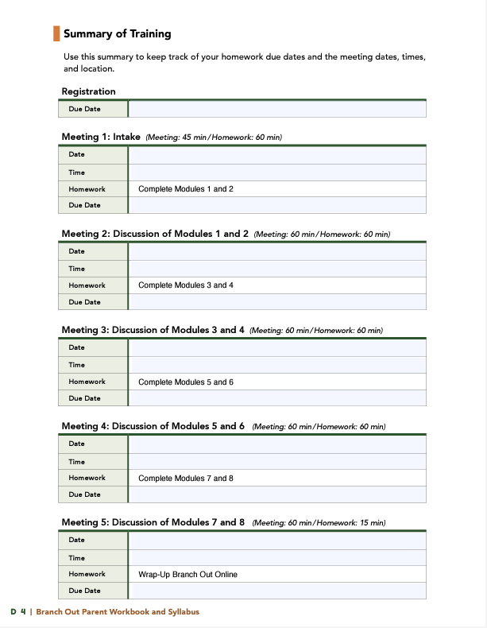
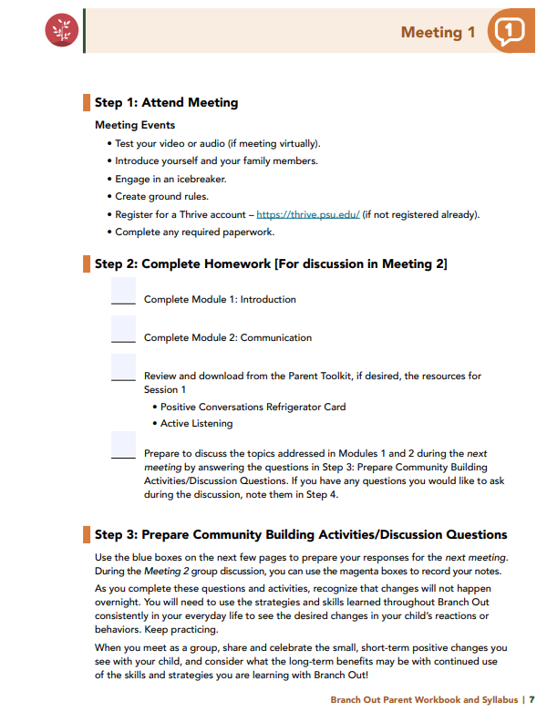
Notes:
Distribute Materials: Provide copies or screen share the Branch Out Parent Workbook and Syllabus to all participants.
Syllabus Overview: Review the Summary of Training, focusing on sections with pertinent information for families (homework due dates, meeting dates, times, and location).
Engagement Encouragement: Urge families to complete all exercises and discussion questions provided for each meeting session.
Example language: I encourage everyone to complete all the exercises and discussion questions in your workbooks before each session. These activities are designed to deepen your understanding and enhance our group discussions. Active participation is essential for maximizing the benefits of our meetings. Please do your best to come prepared to share and learn from each other’s experiences!

Slide 10
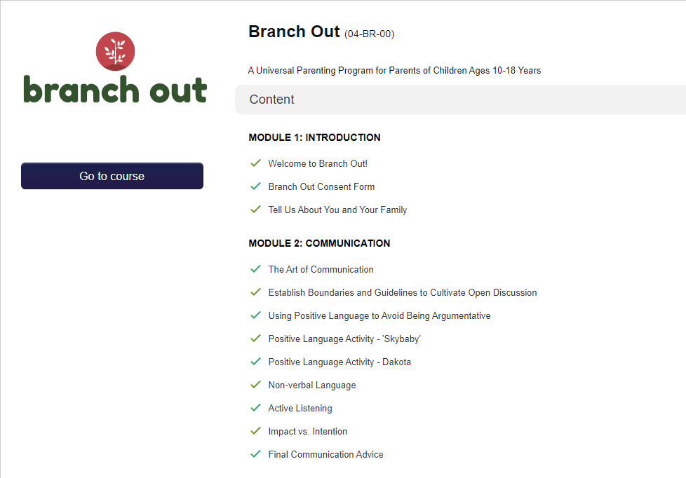
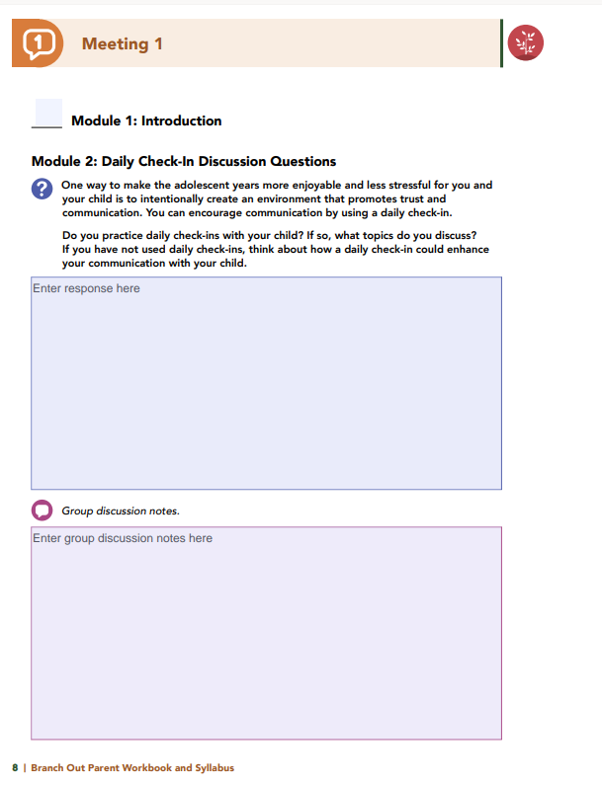
Homework
Complete Modules 1 and 2: Introduction & Communication
View online modules
Complete workbook questions
Notes:
Homework Tasks: Assign Modules 1 & 2, “Introduction and Communication," as homework.
Step 2 Clarification: Remind participants that this homework involves viewing online content and downloading necessary resources as part of Step 2. If time permits, show where to access these materials on the website.
Workbook Guidance: Show the specific pages in the Branch Out Parent Workbook and Syllabus related to these topics
Step 3 Clarification: Assign workbook discussion questions
Format explanation: Explain the reason for 2 boxes per question (one for individual, one for group responses).
Encourage reflection and engagement: The more participants, think, reflect, and share the more meaningful the content becomes to each family.
Pro tip: Complete the workbook while viewing online modules.

Slide 11
Thank you for participating today.
Please reach out with any questions or concerns.
See you next week!
Notes:
Closing: Thank participants for their time and engagement.
Questions: Ask if there are any questions. (If someone needs personal assistance, ask them to speak with you individually after the group is dismissed).
Meeting 2: Remind participants of the date/time/location of the next meeting.
Homework: Remind participants to complete the homework.
Adjourn: Say goodbye to participants.
*If any of your participants are not registered, walk them through the process. Ensure they can log in and find the information they need to get started. Detailed instructions for creating a Thrive account and registering for Sprout are in Appendix D: Sprout Parent Workbook and Syllabus.

Slide 12
A program for parents and caregivers of adolescents ages 10 to 18 years old
Meeting 2

Slide 13
Welcome back!
Please sign in and find a seat. We will begin soon.
If possible, please turn on your camera and enter your preferred name. We will begin soon.
Notes:
Choose one bullet point to display (the first bullet point is for in-person, the second is for virtual).
If in-person, greet participants as they come in the door and help them find a seat.
If virtual, give participants a heads up when you will be starting. For example, “Hi everyone, we will be starting in about one minute.”

Slide 14
Conversation Starter
Restate Ground Rules
Group Discussion
Homework
Notes:
Example language: Welcome back, families! We’re glad to see for our second meeting.
Review Meeting 2 Agenda:
Conversation Starters: We’ll get started with a quick question to get us all engaged and sharing.
Review of Ground Rules: A brief reminder of our ground rules to ensure our discussions remain respectful and productive.
Discussion and Homework: After our initial activities, we will discuss the workbook questions based on your experiences with the last set of homework followed by an explanation of the homework for our next meeting. Let’s get started!

Slide 15
Please answer one of the following questions:
What was your least favorite food as a child? Do you still dislike it?
What’s the best piece of advice you’ve ever been given?
What is your favorite item that you’ve purchased this year?
Notes:
Example language: "Let's open our session with a fun question that will give us all a chance to share something about ourselves. Review the list of questions provided on the slide. Select one question that resonates with you, or that you feel comfortable sharing. This activity is designed to ease us into the meeting and build a friendly, open atmosphere.

Slide 16
Basic Ground Rules:
Always start and end sessions on time.
Cell phones should be on vibrate; members can quietly excuse themselves if a call must be taken.
In virtual sessions, participants should mute themselves when taking calls outside the session.
Group-Specific Rules:
Avoid judgment regarding other participants' parenting practices or knowledge gaps.
One person speaks at a time to maintain order and clarity.
Assume positive intent in all interactions to foster a positive atmosphere.
Confidentiality- Please be respectful and discrete with the personal stories being shared. This is a safe space to grow and learn.
Notes:
Example language:
Before we dive into today’s discussion, let’s quickly review our ground rules to ensure our meeting runs smoothly and everyone feels comfortable sharing. (Restate rules). Does anyone want to add anything or suggest another rule?

Slide 17
Patience is Essential
Consistency is key
Explore Alternatives
Notes:
Example language: Before we begin, let’s take a moment to remind ourselves of three important principles:
Patience is essential: Meaningful changes take time to manifest. Behaviors do not change overnight, which is why (move to next point)
Consistency is key: Regularly applying the strategies ensures the best chance for success.
Explore alternatives: If one approach isn’t working, try something else. We will discuss many strategies throughout the program, some may work better than others for you.
The best thing to do is keep trying!

Slide 18
Daily Check-In
Discussion Questions
Do you do daily check-ins? What topics come up?
If new, did you try it? Use the Daily Agenda? How did it go?
What benefits could daily check-ins bring to your family?
Notes:
One way to make the adolescent years more enjoyable and less stressful for you and
your child is to intentionally create an environment that promotes trust and communication. You can encourage communication by using a daily check-in.
Do you practice daily check-ins with your child? If so, what topics do you
discuss?
For those of you who are new to the concept of a daily check-in, did you try it
with your child? Did you use the Daily Agenda template? How did your child
respond?
What are the potential benefits your family might experience by incorporating
a daily check-in into your household routine?

Slide 19
What activities does your family do together?
Any new activities you'd like to try as a family?
Create an Environment
that Encourages
Open Communication
Discussion Questions
Notes:
Module 2 describes additional strategies you can use to create an environment that promotes trust and communication such as planned family activities; rituals; and routines, like family meals, Friday movie nights, and family hikes.
What kinds of activities does your family participate in together?
Are there any new or additional activities you would like to start doing together as a family?

Slide 20
Establishing Boundaries Discussion Questions
Have you talked about confidentiality boundaries with your child?
Does your child understand when and why you might break confidentiality?
Are there "non-negotiable" rules in your house? What’s the reason for them?
Notes:
Trust within communication is very important - especially to an adolescent. As a parent, you may increase the likelihood that your child will discuss difficult topics with you if your child understands and are comfortable with the boundaries you establish regarding your conversations.
Confidentiality is one boundary that was discussed in the module.
Have you discussed your confidentiality boundaries with your child? If so, is your child aware of the steps that will be followed if you need to break confidentiality? Does your child understand the reason for and the importance of breaking that confidentiality?
The module also introduced the concept of “non-negotiable” rules in your home.
Are there rules in your house that you consider “non-negotiable”? What is your reasoning behind those rules?

Slide 21
Positive Communication Discussion Questions
I-Statement Formula
I (Emotion) — when (Behavior) — I (How the Behavior Affects Me)…..and I Need (Requested Behavior).
Did you rephrase a statement into an "I-Statement"? Anyone want to share?
Notes:
I-statements are a great way to start a conversation in a positive manner.
The I-statement formula is: I (Emotion) — when (Behavior) — I (How the Behavior Affects Me)…..and I Need (Requested Behavior). In the parent workbook, you were asked to rephrase a statement you made to your child that was not well received.
Does anyone want to share how they would rephrase something they said to their child into an I-Statement?

Slide 22
Your room is such a mess!
Why can’t you clean up after yourself?
Hurry up! We are always
waiting on you to get out the door.
How many times do I need to
remind you to do your homework?
Notes:
Let's practice positive communication by rephrasing a few statements using I-statements.
Your room is such a mess! Why can’t you clean up after yourself? (Example: I feel disappointed to see your new clothes on the floor in your room. Money is tight right now, and I want to make sure we make the most of what we buy. Can I get your help to make sure your clothes maintain their good condition by putting them away in your closet?)
Hurry up! We are always waiting on you to get out the door. (Example: I feel stressed when we run behind schedule. I worry that if you’re late to school, you’ll miss something important. What can we do to make our morning run more smoothly, so we can get out the door on time?)
How many times do I need to remind you to do your homework? (Example: I feel worried about your commitment to getting your homework done on your own. If your grades suffer, you may need to do extra work or even summer school. What can I do to help you get started on your homework without reminders?)

Slide 23
Active Listening
Discussion Questions
Did you practice active listening with your child? How did it feel? How did your child respond?
Were any steps easier or harder for you?
Notes:
Active listening can help you build trust in your parent-child relationship, can help you better understand what your child needs, and can help you find solutions together. Active listening can also prevent or diffuse conflicts.
The Parent Toolkit in this section contains a resource that outlines four steps to help you actively listen to your adolescent.
The four steps are as follows:
Be present and limit distractions
Listen with intent
Withhold judgment
Paraphrase what was said
Was anyone able to practice active listening with their child this week?
How did you feel when conversing with your child while using active listening?
How did your child respond?
Did you find any of the steps to be easier or more challenging than others?

Slide 24
Did anyone have a conversation that didn't go as intended? Want to share?
How could you have said it better?
What impact do you think the revised statement might have had?
Impact vs. Intention
Discussion Questions
Notes:
Module 2 shares multiple examples of parent statements, information regarding the parent’s intent, and explanations for how the phrase that was spoken may have impacted the child. When you are communicating with your adolescent, sometimes, what you mean – your intent – and what your child hears – the impact – are two different things. You were asked to think about a recent conversation with your child in which you may have said something that was not received the way in which you intended.
Does anyone want to share about their experience?
How could you have said it better?
What impact do you think the revised statement might have had on your child?

Slide 25
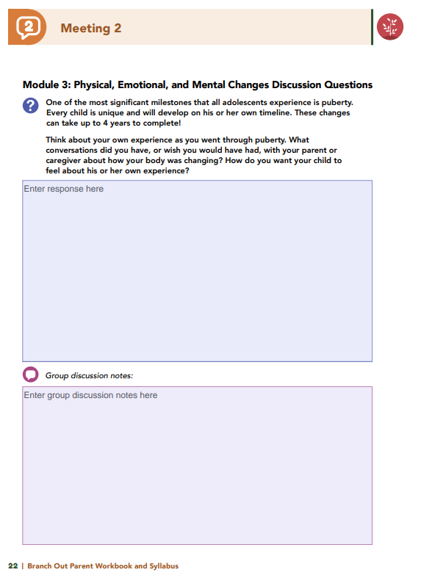
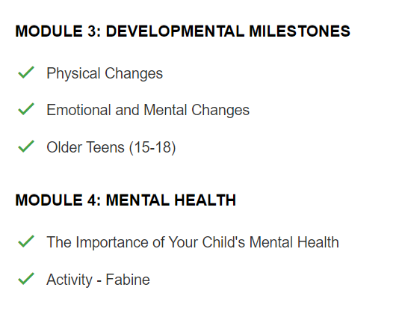
Homework
Complete Modules 3 and 4: Developmental Milestones & Mental Health
View online modules
Complete workbook questions
Notes:
Homework Tasks: Assign Modules 3 & 4, “Developmental Milestones & Mental Health," as homework.
Step 2 Clarification: Remind participants that this homework involves viewing online content and downloading necessary resources as part of Step 2. If time permits, show where to access these materials on the website.
Workbook Guidance: Show the specific pages in the Branch Out Parent Workbook and Syllabus related to these topics
Step 3 Clarification: Assign workbook discussion questions.
Format explanation: Explain the reason for 2 boxes per question (one for individual, one for group responses).
Encourage reflection and engagement: The more participants think, reflect, and share, the more meaningful the content becomes to each family.
Pro tip: Complete the workbook while viewing online modules.

Slide 26
Thank you for participating today.
Please reach out with any questions or concerns.
See you next week!
Notes:
Closing: Thank participants for their time and engagement.
Questions: Ask if there are any questions. (If someone needs personal assistance, ask them to speak with you individually after the group is dismissed).
Meeting 2: Remind participants of the date/time/location of the next meeting.
Homework: Remind participants to complete the homework.
Adjourn: Say goodbye to participants.

Slide 27
A program for parents and caregivers of adolescents ages 10 to 18 years old
Meeting 3

Slide 28
Please sign in and find a seat.
We will begin soon.
If possible, please turn on your camera.
We will begin soon.
Notes:
Choose one bullet point to display (the first bullet point is for in-person, the second is for virtual).
If in-person, greet participants as they come in the door and help them find a seat.
If virtual, give participants a heads up when you will be starting. For example, “Hi everyone, we will be starting in about one minute.”

Slide 29
Conversation Starters
Review Ground Rules
Group Discussion
Homework
Notes:
Example language: Welcome back, everyone! We're glad to see you for our third meeting.
*Optional Sections: Please note that the conversation starters and review of ground rules are optional for today's session. If you prefer to skip these, simply remove the first bullet points from this slide and proceed to the next relevant slide in the deck.
Example language if omitting: We'll dive straight into discussing the key questions from our last session’s homework. We'll also outline and assign the homework for our next meeting, ensuring everyone is prepared and clear on the expectations.
Example language if not omitting:
Conversation Starters: We’ll get started with a quick question to get us all engaged and sharing.
Review of Ground Rules: A brief reminder of our ground rules to ensure our discussions remain respectful and productive.
Today's Agenda: After our initial activities, we will discuss the workbook questions based on your experiences with the last set of homework followed by an explanation of the homework for our next meeting. Let’s get started!

Slide 30
Please answer one of the following questions:
What fictional family would you like to be a member of?
What’s your favorite tradition or holiday?
What was your favorite game to play as a child?
Notes:
Example language: "Let's open our session with a fun question that will give us all a chance to share something about ourselves. Review the list of questions provided on the slide. Select one question that resonates with you, or that you feel comfortable sharing. This activity is designed to ease us into the meeting and build a friendly, open atmosphere.

Slide 31
Basic Ground Rules:
Always start and end sessions on time.
Cell phones should be on vibrate; members can quietly excuse themselves if a call must be taken.
In virtual sessions, participants should mute themselves when taking calls outside the session.
Group-Specific Rules:
Avoid judgment regarding other participants' parenting practices or knowledge gaps.
One person speaks at a time to maintain order and clarity.
Assume positive intent in all interactions to foster a positive atmosphere.
Confidentiality- Please be respectful and discrete with the personal stories being shared. This is a safe space to grow and learn.
Notes:
Example language:
Before we dive into today’s discussion, let’s quickly review our ground rules to ensure our meeting runs smoothly and everyone feels comfortable sharing. (Restate rules). Does anyone want to add anything or suggest another rule?

Slide 32
Patience is Essential
Consistency is key
Explore Alternatives
Notes:
Example language: Before we begin, let’s take a moment to remind ourselves of three important principles:
Patience is essential: Meaningful changes take time to manifest. Behaviors do not change overnight, which is why (move to next point)
Consistency is key: Regularly applying the strategies ensures the best chance for success.
Explore alternatives: If one approach isn’t working, try something else. We will discuss many strategies throughout the program, some may work better than others for you.
The best thing to do is keep trying!

Slide 33
Physical, Emotional,
and Mental Changes
Discussion Questions
What conversations did you have, or wish you had, with your parent about puberty?
How do you want your child to feel about their own experience?
How can you support your child through the emotional changes of puberty?
Notes:
One of the most significant milestones that all adolescents experience is puberty. Every child is unique and will develop on their own timeline. These changes can take up to 4 years to complete! Think about your own experience as you went through puberty.
What conversations did you have, or wish you would have had, with your parent or caregiver about how your body was changing?
How do you want your child to feel about their own experience?
Adolescents experience multiple emotional changes as they develop, and these may include aggression, cognitive changes, depression, low self-esteem, and mood swings. Complex feelings and emotions may arise as they become interested in romantic relationships, build independence, and explore their own identity.
How can you support your child through the array of feelings and challenging emotional changes your child may experience?

Slide 34
The Importance of Your Child’s Mental Health
Discussion Questions
In which areas is your child succeeding?
Are there areas where your child may be struggling or need extra support?
Notes:
Mental health includes our emotional, psychological, and social well-being and affects how we think, feel, and act.
Module 4 describes children with good mental health as children who can do the following: interact positively with family members and friends, meet and achieve educational milestones, and actively participate in their community.
In which of the areas do you feel your child is currently experiencing success?
Are there areas in which your child may be struggling or in which your child could benefit from additional support?

Slide 35
Did you list adults you can check in with about your child's mental health?
Early Warning Signs
Discussion Questions
Who's on your list—teachers, coaches, family?
Did anyone check in with them this week?
Notes:
Module 4 shares a list of potential risks for mental health problems and early warning signs. You were asked to review the list and consider whether your child may be exhibiting any of the behaviors listed. Although we will not discuss your thoughts here, the following resources are available to you for further exploration.
[Note to Facilitator]: Prepare a list of local resources to share with parents and caregivers. • Local mental health hospital/facility numbers • Military and Family Counselor (MFLC) contact information • Military OneSource Non-Medical Counseling information • SAMHSA’s National Helpline: 1-800-662-HELP (4357)
One of the first steps parents can take if they are worried about their teen’s mental health is to talk to the child about the child's emotions, feelings, and behaviors in a non-confrontational way. Talking to the other adults in your child’s life, such as your child’s school counselor, pediatrician, or spiritual leader, can also be important.
Were you able to list adults in your child’s life whom you can check in with about your child’s mental health?
Who is on your list - teachers, coaches, youth group leaders, family members?
Did anyone try to check in with any of these individuals regarding their child this week?
Would anyone like to share his or her experience?

Slide 36
Ways to Support Your Child's Mental Health:
Early Warning Signs
Discussion Questions
(continued)
Show love and affection
Spend focused, undistracted time together
Encourage open conversations about feelings
Take interest in their daily life
Promote physical activity
Provide nutritious meals
Ensure they get enough sleep
Which of these do you often practice with your child?
How would you like to offer more mental health support?
Notes:
As a parent, you can help your child feel happy and positive about himself or herself. Module 4 lists examples of ways in which you can support your child’s mental health:
show love and affection,
spend undistracted or focused time with your child,
encourage your child to talk with you about your child's feelings,
be interested in what’s happening in your child’s life
encourage your child to engage in physical activity
provide your child with nutritious foods, and
encourage your child to get enough sleep.
Which of these examples do you practice often with your child?
How would you like to show, or offer, more mental health support to your child?

Slide 37
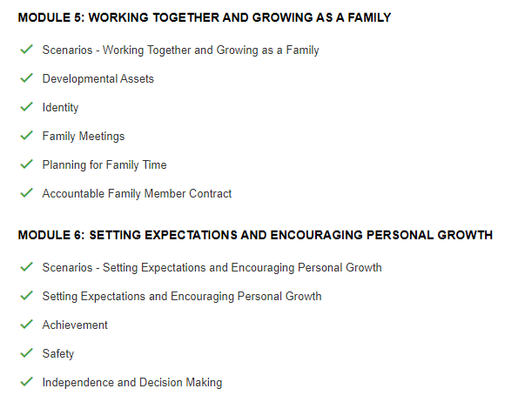
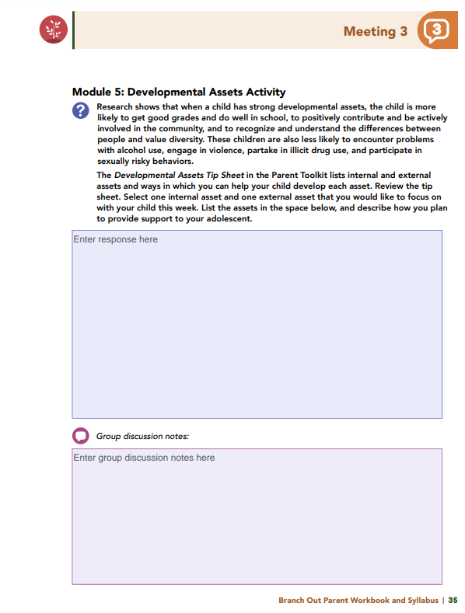
Homework
Complete Modules 5 and 6: Working Together and Growing as a Family &
Setting Expectations and Encouraging Personal Growth
View online modules
Complete workbook questions
Notes:
Homework Tasks: Assign Modules 5 & 6, “Working Together and Growing as a Family and Setting Expectations and Encouraging Personal Growth," as homework.
Step 2 Clarification: Remind participants that this homework involves viewing online content and downloading necessary resources as part of Step 2. If time permits, show where to access these materials on the website.
Workbook Guidance: Show the specific pages in the Branch Out Parent Workbook and Syllabus related to these topic.
Step 3 Clarification: Assign workbook discussion questions.
Format explanation: Explain the reason for 2 boxes per question (one for individual, one for group responses).
Encourage reflection and engagement: The more participants, think, reflect, and share the more meaningful the content becomes to each family.
Pro tip: Complete the workbook while viewing online modules.

Slide 38
Thank you for participating today.
Please reach out with any questions or concerns.
See you next week!
Notes:
Closing: Thank participants for their time and engagement.
Questions: Ask if there are any questions. (If someone needs personal assistance, ask them to speak with you individually after the group is dismissed).
Meeting 2: Remind participants of the date/time/location of the next meeting.
Homework: Remind participants to complete the homework.
Adjourn: Say goodbye to participants.

Slide 39
A program for parents and caregivers of adolescents ages 10 to 18 years old
Meeting 4

Slide 40
Please sign in and find a seat.
We will begin soon.
Notes:
If in-person, greet participants as they come in the door and help them find a seat.
If virtual, give participants a heads up when you will be starting. For example, “Hi everyone, we will be starting in about one minute.”
Replace text on screen with : If possible, please turn on your camera and enter your preferred name. We will begin soon.

Slide 41
Conversation Starters
Review of Ground Rules
Group Discussion
Homework
Notes:
Example language: Welcome back, everyone! We're glad to see you for our fourth meeting.
*Optional Sections: Please note that the conversation starters and review of ground rules are optional for today's session. If you prefer to skip these, simply remove the first bullet points from this slide and proceed to the next relevant slide in the deck.
Example language if omitting: We'll dive straight into discussing the key questions from our last session’s homework. We'll also outline and assign the homework for our next meeting, ensuring everyone is prepared and clear on the expectations.
Example language if not omitting:
Conversation Starters: We’ll get started with a quick question to get us all engaged and sharing.
Review of Ground Rules: A brief reminder of our ground rules to ensure our discussions remain respectful and productive.
Discussion and Homework: After our initial activities, we will discuss the workbook questions based on your experiences with the last set of homework followed by an explanation of the homework for our next meeting. Let’s get started!

Slide 42
Please answer one of the following questions:
If you could rename yourself, what name would you pick?
Would you rather be able to run at 100 miles per hour or fly at 10 miles per hour?
What are you most excited about this year?
Notes:
Example language: "Let's open our session with a fun question that will give us all a chance to share something about ourselves. Review the list of questions provided on the slide. Select one question that resonates with you, or that you feel comfortable sharing. This activity is designed to ease us into the meeting and build a friendly, open atmosphere.

Slide 43
Basic Ground Rules:
Always start and end sessions on time.
Cell phones should be on vibrate; members can quietly excuse themselves if a call must be taken.
In virtual sessions, participants should mute themselves when taking calls outside the session.
Group-Specific Rules:
Avoid judgment regarding other participants' parenting practices or knowledge gaps.
One person speaks at a time to maintain order and clarity.
Assume positive intent in all interactions to foster a positive atmosphere.
Confidentiality- Please be respectful and discrete with the personal stories being shared. This is a safe space to grow and learn.
Notes:
Example language:
Before we dive into today’s discussion, let’s quickly review our ground rules to ensure our meeting runs smoothly and everyone feels comfortable sharing. (Restate rules). Does anyone want to add anything or suggest another rule?

Slide 44
Patience is Essential
Consistency is key
Explore Alternatives
Notes:
Example language: Before we begin, let’s take a moment to remind ourselves of three important principles:
Patience is essential: Meaningful changes take time to manifest. Behaviors do not change overnight, which is why (move to next point)
Consistency is key: Regularly applying the strategies ensures the best chance for success.
Explore alternatives: If one approach isn’t working, try something else. We will discuss many strategies throughout the program, some may work better than others for you.
The best thing to do is keep trying!

Slide 45
Developmental Assets
Activity
Which assets did you select?
What actions have you taken or plan to take to help your child develop that asset?
Notes:
Research shows that when a child has strong developmental assets, the child is more likely to get good grades and do well in school, to positively contribute and be actively involved in the community, and to recognize and understand the differences between people and value diversity. The child is also less likely to encounter problems with alcohol use, engage in violence, partake in illicit drug use, and participate in sexually risky behaviors.
You were asked to select one internal asset and one external asset that you would like to focus on with your child.
What assets did you select?
What actions have you taken, or do you plan to take, to support your child in developing that asset?

Slide 46
Family Meetings Discussion Question and Activity
Do you have regular family meetings? Who attends, how often, and what topics come up?
If new to family meetings, did you try one? How did it go, and will you continue?
Notes:
One way to provide a supportive environment for your child is to establish a routine of holding family meetings. Family meetings are a safe way for children to discuss topics and concerns openly with their parents, and they offer opportunities for parents to learn more about each family member’s needs and desires.
Does your family regularly hold family meetings? If so, what does your family meeting look like (e.g., who attends, how often do you hold the meetings, what topics do you discuss)?
For those of you who are new to family meetings, did you try holding one or more? What topics did you discuss? How did your family members react to the meeting?
Will you continue to hold family meetings in the future?

Slide 47
How do you plan family activities?
Planning for
Family Time
Discussion Questions
Did anyone plan a new activity this week?
How did your family react to being involved?
Notes:
Spending planned quality time with your child promotes an emotionally healthy parent-child attachment and models good behaviors for your child as your child forms friendships and romantic relationships.
How do you typically plan for family activities? Do you involve your child and your family in the planning process? What does that process look like?
Did anyone plan for a new activity with their child or family this week?
How did your child or your family react to being a part of the planning process? Were you able to develop a successful plan?

Slide 48
Setting Expectations and Encouraging Personal Growth
Discussion Questions
Would anyone like to share their rule for their child's friends visiting?
How might this rule change as your child grows older?
Notes:
Let’s talk about friendships. Adolescence is a time when friendships become especially important, and your teen’s friends can have a significant influence on your teen's choices and behaviors. As friendships become a bigger part of your adolescent’s life, your child may ask you more frequently if their friends can visit your home and if your child can visit a friend’s home. You will want to be prepared for these situations, so your adolescent knows your expectations for those visits.
Let’s do an exercise together. Remember, in this module, you learned that for boundaries, limits, rules, and expectations to help children become successful adults, these restrictions and opportunities need to be developmentally appropriate. For this exercise, think of a rule you have in your household that is related to your child having friends over at your home. For example, some families do not allow friends over when a parent is not home. Some families may require that a bedroom door remains open when friends are visiting.
Raise your hand if your adolescent understands the rule.
Raise your hand if your child was involved in the development of the rule.
Raise your hand if the expectations of the rule can be met by your child.
Would anyone like to share their rule or expectation regarding their child’s friends visiting their home?
How do you think this rule might change as your child gets older?

Slide 49
How can you better support your child with homework or school feelings?
Achievement Discussion Questions
Does your child have a homework routine?
What does it look like?
Notes:
All teens will have homework. Although many adolescents dread doing schoolwork at home, completing homework is important because it helps your child relearn information and retain what your child is learning over longer periods of time. This module outlines ways in which you can support your child as your child completes homework.
Does your child have a homework routine?
What does it look like?
What can you do to better support your child with your child's homework or overall feelings regarding school?

Slide 50
Safety
Discussion Questions
Have you talked to your child about the safety issues in this module? Any specific rules?
If not, why haven’t you had these conversations or set rules?
If the issues don’t apply yet, when will you address them?
What safety rules could you start enforcing now?
Notes:
As adolescents build their social circles, they may be exposed to unsafe behaviors, or may even engage in behaviors that are known to have safety issues, such as risky driving and exposure to drugs and alcohol. Establishing rules to promote good choices and having discussions about the dangers of various topics are important because they can help keep your child safe and healthy.
Have you spoken with your child about any of the safety issues addressed in this module? Have you developed any specific rules about any of these issues?
If you have not had conversations or set rules regarding these safety issues, why haven’t you?
If you feel that some of these safety issues do not apply to your child (e.g., your child is still too young), when do you plan to have these conversations with your child?
What safety-related rules might be beneficial for you to begin enforcing with your child?

Slide 51
Cohesion Examples
Knows each other's close friends.
Enjoys spending free time together.
Knows who handles specific tasks.
Sets and achieves goals together.
Has clear, consistent consequences for breaking rules.
Trusts each other to help resolve problems.
Can talk through disagreements and find positive solutions.
Independence and Decision-Making
Discussion Questions
Other examples of family cohesion in your family?
Areas for improvement?
What actions can you take to improve cohesion soon?
Notes:
Learning to make appropriate and healthy decisions can help children establish independence and autonomy. Parents can help teens learn to be independent in emotional, behavioral, and values-based ways. Remember, in Module 6, you learned that one of the ways you can help your teenager develop emotional autonomy is to ensure that your household has family cohesion. Family cohesion exists when there is warmth and affection, closeness, and support in family relationships.
Let’s review some examples of family cohesion . Raise your hand if you feel your family is experiencing success with any of the following:
Family members know each other’s close friends.
Family members enjoy spending some amount of their free time together.
Family members know who in the household is responsible for specific roles and tasks.
Family sets, and accomplishes, goals together.
There are clear and consistent consequences when a family member breaks a rule.
If someone has a problem, he or she knows he or she can trust family members to help them resolve it.
Family members can talk through disagreements and come to a positive resolution.
What are some other examples of family cohesion in your family?
Are there areas where you can improve your family cohesion?
What action(s) can you initiate in the near future to improve your family cohesion?

Slide 52
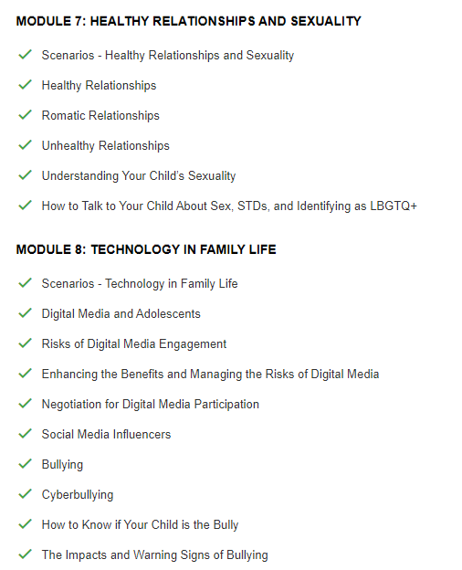
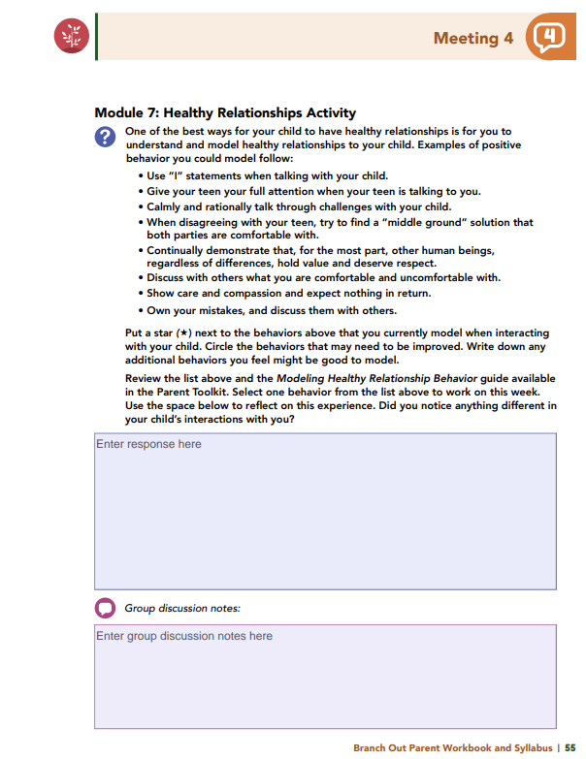
Homework
Complete Modules 7 and 8: Healthy Relationships and Sexuality & Technology in Family Life
View online modules
Complete workbook questions
Notes:
Homework Tasks: Assign Modules 7 & 8, “Healthy Relationships and Sexuality & Technology in Family Life," as homework.
Step 2 Clarification: Remind participants that this homework involves viewing online content and downloading necessary resources as part of Step 2. If time permits, show where to access these materials on the website.
Workbook Guidance: Show the specific pages in the Branch Out Parent Workbook and Syllabus related to these topics.
Step 3 Clarification: Assign workbook discussion questions.
Format explanation: Explain the reason for 2 boxes per question (one for individual, one for group responses).
Encourage reflection and engagement: The more participants, think, reflect, and share the more meaningful the content becomes to each family.
Pro tip: Complete the workbook while viewing online modules.

Slide 53
Thank you for participating today.
Please reach out with any questions or concerns.
See you next week!
Notes:
Closing: Thank participants for their time and engagement.
Questions: Ask if there are any questions. (If someone needs personal assistance, ask them to speak with you individually after the group is dismissed).
Meeting 2: Remind participants of the date/time/location of the next meeting.
Homework: Remind participants to complete the homework.
Adjourn: Say goodbye to participants.

Slide 54
A program for parents and caregivers of adolescents ages 10 to 18 years old
Meeting 5

Slide 55
Please sign in and find a seat.
We will begin soon.
Notes:
If in-person, greet participants as they come in the door and help them find a seat.
If virtual, give participants a heads up when you will be starting. For example, “Hi everyone, we will be starting in about one minute.”
Replace text on screen with : If possible, please turn on your camera and enter your preferred name. We will begin soon.

Slide 56
Conversation Starters
Review of Ground Rules
Group Discussion
Homework
Notes:
Example language: Welcome back, everyone! We're glad to see you for our fifth meeting.
*Optional Sections: Please note that the conversation starters are optional. If you prefer to skip these, simply remove the first bullet point from this slide and proceed to the next relevant slide in the deck.
Example language if omitting: We'll dive straight into discussing the key questions from our last session’s homework. We'll also outline and assign the homework for our next meeting, ensuring everyone is prepared and clear on the expectations.
Example language if not omitting:
Conversation Starters: We’ll get started with a quick question to get us all engaged and sharing.
Review of Ground Rules: A brief reminder of our ground rules to ensure our discussions remain respectful and productive.
Discussion and Homework: After our initial activities, we will discuss the workbook questions based on your experiences with the last set of homework followed by an explanation of the homework for our next meeting. Let’s get started!

Slide 57
Please answer one of the following questions:
What is your favorite time of the day and why?
Where would you time travel, if it were possible?
What movie can you rewatch over and over again?
Notes:
Example language: "Let's open our session with a fun question that will give us all a chance to share something about ourselves. Review the list of questions provided on the slide. Select one question that resonates with you, or that you feel comfortable sharing. This activity is designed to ease us into the meeting and build a friendly, open atmosphere.

Slide 58
Basic Ground Rules:
Always start and end sessions on time.
Cell phones should be on vibrate; members can quietly excuse themselves if a call must be taken.
In virtual sessions, participants should mute themselves when taking calls outside the session.
Group-Specific Rules:
Avoid judgment regarding other participants' parenting practices or knowledge gaps.
One person speaks at a time to maintain order and clarity.
Assume positive intent in all interactions to foster a positive atmosphere.
Confidentiality- Please be respectful and discrete with the personal stories being shared. This is a safe space to grow and learn.
Notes:
Example language:
Before we dive into today’s discussion, let’s quickly review our ground rules to ensure our meeting runs smoothly and everyone feels comfortable sharing. (Restate rules). Does anyone want to add anything or suggest another rule?

Slide 59
Patience is Essential
Consistency is key
Explore Alternatives
Notes:
Example language: Before we begin, let’s take a moment to remind ourselves of three important principles:
Patience is essential: Meaningful changes take time to manifest. Behaviors do not change overnight, which is why (move to next point)
Consistency is key: Regularly applying the strategies ensures the best chance for success.
Explore alternatives: If one approach isn’t working, try something else. We will discuss many strategies throughout the program, some may work better than others for you.
The best thing to do is keep trying!

Slide 60
Healthy
Relationships
Activity
Which behavior did you choose to focus on this week?
Did you notice any changes in your child's interactions with you?
Notes:
One of the best ways for your child to have healthy relationships is for you to understand and model healthy relationships to your child. Examples of positive behavior you could model follow:
• Use “I” statements when talking with your child.
• Give your teen your full attention when your teen is talking to you.
• Calmly and rationally talk through challenges with your child.
• When disagreeing with your teen, try to find a “middle ground” solution that
both parties are comfortable with.
• Continually demonstrate that, for the most part, other human beings, regardless
of differences, hold value and deserve respect.
• Discuss with others what behaviors you are comfortable and uncomfortable with.
• Show care and compassion and expect nothing in return.
• Own your mistakes, and discuss them with others.
You were encouraged to select one behavior from the list above to focus on for the week.
What behavior did you choose?
Did you notice anything different in your child’s interactions with you?

Slide 61
Do you feel aware of the resources to support your child in these areas?
If not, where would you like more support?
Risky Behaviors in Teen Romantic Relationships Discussion Questions
Notes:
Healthy relationships in the adolescent years can help promote trust and security, but they may also promote risk-taking behaviors and lead to other challenges. Module 7 introduces
topics such as sexting, teen dating violence, teen pregnancy, and sexually transmitted diseases.
Depending on your child’s age and maturity, you may feel that you are years away from encountering these risks, or you may be navigating one or more of these challenges now.
Based on the information shared in the module, do you feel you are aware of the available resources that can help you provide guidance and support for your child in these areas?
If not, in what areas would you like additional support?
Note to Facilitator]: Prepare a list of resources for parents. Suggested resources are listed below.
Healthy Relationships and Sexuality resources from the Parent Toolkit:
• Credible Resources for Teen Relationships and Teen Domestic Violence
• Credible Resources for Your Teen Sex, Pregnancy, and STDs
Local Resources:
• Suggestions may include school professionals, installation programs and professionals, community programs and professionals.

Slide 62
The CDC says important factors in talking with teens about sex include:
HOW you talk about it
HOW OFTEN you talk about it
Whether your TEEN FEELS he or she is IMPORTANT AND LOVED by you
WHAT is said
How to Talk to Your Child About
Sex and STDs
Discussion Questions
How did your conversations (or lack of) about sex with your parent impact you?
Any positive takeaways?
What would you do differently with your child?
Have you talked with your teen about sex and risks? Why or why not?
What topics would help in future conversations?
Notes:
Having ongoing open and honest discussions about relationships, sex, and associated risks with your teen is extremely important. These discussions can help your child stay safe and grow into
a confident, caring, and compassionate adult. Although these conversations can be difficult, it is critical that you to talk with your child early and often.
According to the Centers for Disease Control and Prevention (CDC), some factors that can make a difference as you talk with your teen about matters related to sex and relationships include
the following:
• HOW you talk about it
• HOW OFTEN you talk about it
• If the TEEN FEELS he or she is IMPORTANT and LOVED by his or her parents, and
• WHAT is said
Think about your conversations, or lack of conversations, about sex and the associated risks with your own parent or caregiver when you were an adolescent.
What impact did these conversations, or lack of them, have on you?
If relevant, what were the positive take-aways from these conversations?
What would you say or do differently in your conversations with your child?

Slide 63
Module 8
• Acronyms and Teen Codes
• Tips for Online Safety at Home
• Talking Tips to Protect your Child from Online Predators and Grooming
• Screen Time Recommendations
• Physical Activity Guidelines
• Resources to Navigate Appropriate Media
• Harmful Digital Footprint Impacts
• Parent Guide: Internet Safety
• Safety and Social Media
• Internet Safety Pledge
• Helping Kids Fight Cyberbullying
• Tips to Assist with Cyberbullying
• Respectful Communication for Pre-Teens and Teens
• Teaching Teens about Hate Speech
Parent Toolkit Resources
Module 7
• Modeling Healthy Relationships
• Parental Self Care
• Credible Resources for Teen Relationships and Teen Domestic Violence
• Credible Resources for Your Teen Sex, Pregnancy, and STDs
• Preventing Sexually Transmitted Diseases
Notes:
Multiple resources are available in the Parent Toolkits throughout this module to help parents and caregivers navigate these difficult and important topics.
Encourage parents to explore the following resources from the Parent Toolkit. If possible, have printed versions available for participants to take home.
Module 7:
• Modeling Healthy Relationships
• Parental Self Care
• Credible Resources for Teen Relationships and Teen Domestic Violence
• Credible Resources for Your Teen Sex, Pregnancy, and STDs
• Preventing Sexually Transmitted Diseases
Module 8:
• Acronyms and Teen Codes
• Tips for Online Safety at Home
• Talking Tips to Protect your Child from Online Predators and Grooming
• Screen Time Recommendations
• Physical Activity Guidelines
• Resources to Navigate Appropriate Media
• Harmful Digital Footprint Impacts
• Parent Guide: Internet Safety
• Safety and Social Media
• Internet Safety Pledge
• Helping Kids Fight Cyberbullying
• Tips to Assist with Cyberbullying
• Respectful Communication for Pre-Teens and Teens
• Teaching Teens about Hate Speech

Slide 64
How is your child using technology? Have you discussed your child’s digital habits?
Were you surprised by how much or how your child uses it?
What safeguards do you have in place to protect against negative effects?
What additional safeguards or actions could you add now that you're aware of the risks?
Technology in
Family Life
Discussion Questions
Notes:
Remember, in Module 8, you learned that the appropriate use of technology and digital media can positively affect adolescent self-image; peer engagement; aspirational, career engagement; and entrepreneurial spirit. However, it also comes with risks such as obesity, sleep disturbances, isolation, and exposure to inappropriate content. Using technology and digital media can also increase your child’s potential for forming inappropriate relationships or becoming the target of grooming.
How is your child engaging with technology?
Did you speak with your child about your child’s digital use to better understand how, why, and when your child is using technology?
Were you surprised to find out how your child is using it or how much time your child spends on their devices?
What safeguards do you have in place to protect against negative situations that may arise out of digital media use?
Safeguards may include setting screen-time limits, putting screens down - or turning them off - during family dinner time, storing screens overnight in a common area like the kitchen, and/or encouraging your child to participate in physical activity each day.
Now that you are aware of the potential risks of digital media, what additional safeguards, actions, or conversations could you incorporate into your family’s interactions with and use of technology?

Slide 65
Family Media Plan
Discussion Questions
Does your family have a media plan?
How’s it working for you?
Are you interested in creating one?
How might it impact your family’s tech use?
Notes:
Family Media Plans are a great way to negotiate expectations and rules and set goals.
Does your family have a Family Media Plan?
How is this plan working for you and your family?
After completing Module 8, are you interested in creating a Family Media Plan?
How do you think this plan will impact your family’s use of digital technology?

Slide 66
Branch Out Resources
Bullying
Discussion Questions
Have you talked to your child about bullying?
What did you discuss, and how did they respond?
Notes:
Parents need to be aware of the possibility that their child may be bullied (or may be bullying) and the effects the child may experience because of the bullying. Bullying, like many other youth topics, should be openly discussed with your child.
Have you had conversations with your child about bullying?
What did you discuss, and how did your child respond?
Additional Branch Out Resources:
Warning Signs of Cyberbullying:
• The child suddenly wants to stop using social media on any type of device.
• The child wants to avoid school or other activities.
• The child wants to hide his or her social media from you.
• The child refuses to meet the requirements of the family contract (requirements the child met before).
• The child seems to have increased anxiety or depression.
• The child has changes in his or her mood, behavior, sleep, or appetite.
• The child seems nervous or jumpy after getting an instant message, text, or email
and avoids discussions about computer or phone activities.
CDC Warning Signs Your Child May be Bullied:
• Unexplainable injuries. Lost or destroyed clothing, books, electronics, or jewelry.
• Frequent headaches or stomach aches or feeling sick or faking illness.
• Changes in eating habits, like suddenly skipping meals or binge eating. Kids may come home from school hungry because they did not eat lunch.
• Difficulty sleeping or frequent nightmares.
• Declining grades, loss of interest in schoolwork, or not wanting to go to school.
• Sudden loss of friends or avoidance of social situations.
• Feelings of helplessness or decreased self-esteem. Self-destructive behaviors such as running away from home, harming himself or herself, or talking about suicide.
CDC Warning Signs Your Child May Be Bullying Others:
• Gets into physical or verbal fights.
• Has friends who bully others.
• Is increasingly aggressive.
• Is sent to the principal’s office or to detention frequently.
• Has unexplained extra money or new belongings.
• Blames others for their problems.
• Doesn’t accept responsibility for their actions.
• Is competitive and worries about their reputation or popularity
*** If you have any concerns about your child after reviewing the bullying warning signs shared in Module 8, please consider reaching out for additional support.

Slide 67
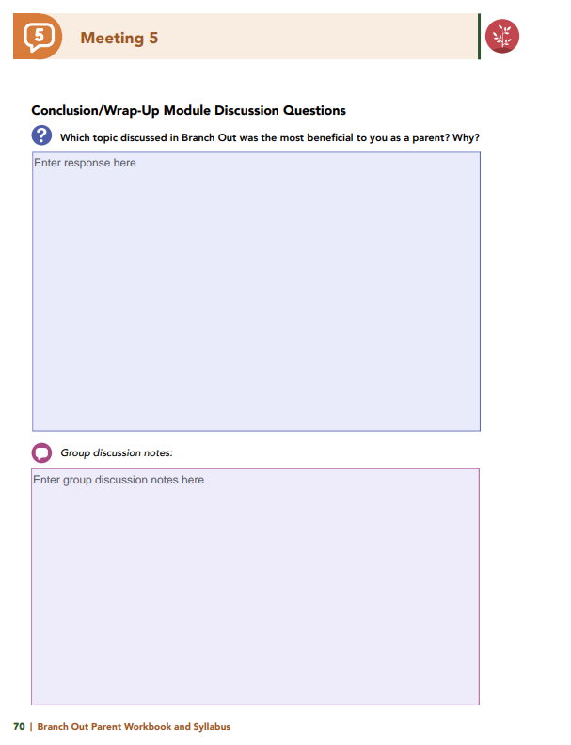
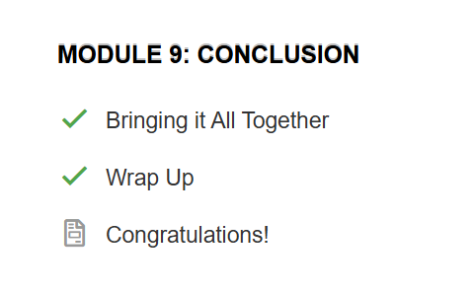
Homework
Complete Module 9: Conclusion/Wrap Up
View online modules
Complete workbook questions
Notes:
Homework Tasks: Assign Module 9, “Conclusion/Wrap Up” as homework.
Step 2 Clarification: Remind participants that this homework involves viewing online content and downloading necessary resources as part of Step 2. If time permits, show where to access these materials on the website.
Workbook Guidance: Show the specific pages in the Branch Out Parent Workbook and Syllabus related to these topics.
Step 3 Clarification: Assign workbook discussion questions.
Format explanation: Explain the reason for 2 boxes per question (one for individual, one for group responses).
Encourage reflection and engagement: The more participants, think, reflect, and share the more meaningful the content becomes to each family.
Pro tip: Complete the workbook while viewing online modules.

Slide 68
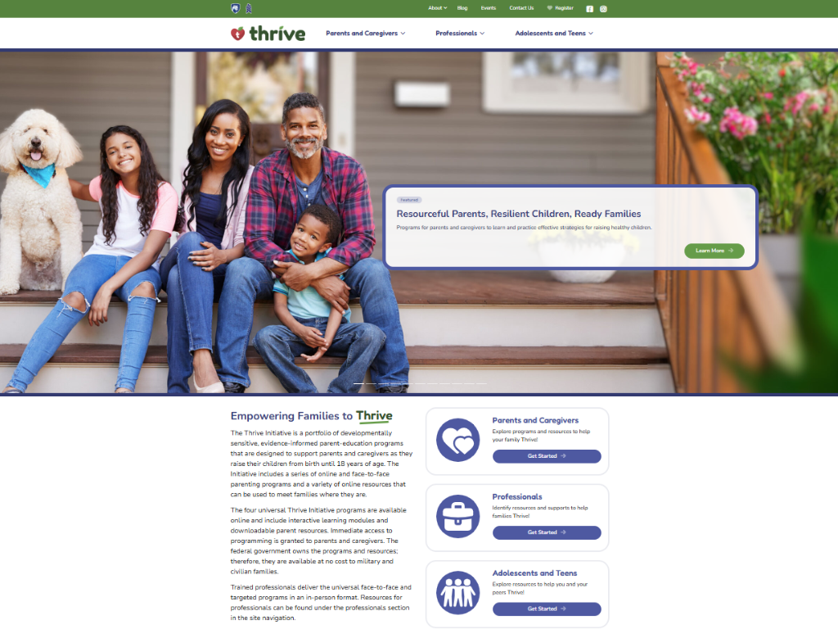
Notes:
Website Walkthrough: Guide participants through the Thrive website, highlighting key resources like mini video modules, supplemental modules, and additional program options.
Program Exploration: Encourage parents to explore other programs that may benefit another child or support different age groups.
Planning for Growth: Emphasize the value of these resources for ongoing planning in their child’s development.
Adolescent Focus: Point out supplemental modules specific to teens and adolescents and suggest families review these for targeted support.

Slide 69
Thank you for participating today.
Please reach out with any questions or concerns.
See you next week!
Notes:
Closing: Thank participants for their time and engagement.
Questions: Ask if there are any questions. (If someone needs personal assistance, ask them to speak with you individually after the group is dismissed).
Meeting 2: Remind participants of the date/time/location of the next meeting.
Homework: Remind participants to complete the homework.
Adjourn: Say goodbye to participants.

Slide 70
A program for parents and caregivers of adolescents ages 10 to 18 years old
Meeting 6

Slide 71
Please sign in and find a seat.
We will begin soon.
Notes:
If in-person, greet participants as they come in the door and help them find a seat.
If virtual, give participants a heads up when you will be starting. For example, “Hi everyone, we will be starting in about one minute.”
Replace text on screen with : If possible, please turn on your camera and enter your preferred name. We will begin soon.

Slide 72
Conversation Starters
Group Discussion
Thrive Programming
Notes:
Example language: Welcome back, everyone! We're glad to see you for our fifth meeting.
*Optional Sections: Please note that the conversation starters are optional. If you prefer to skip these, simply remove the first bullet point from this slide and proceed to the next relevant slide in the deck.
Example language if omitting: We'll dive straight into discussing the key questions from our last session’s homework. We'll also outline and assign the homework for our next meeting, ensuring everyone is prepared and clear on the expectations.
Example language if not omitting:
Conversation Starters: We’ll get started with a quick question to get us all engaged and sharing.
Review of Ground Rules: A brief reminder of our ground rules to ensure our discussions remain respectful and productive.
Discussion and Homework: After our initial activities, we will discuss the workbook questions based on your experiences with the last set of homework followed by an explanation of the homework for our next meeting. Let’s get started!

Slide 73
Please answer one of the following questions:
What is your favorite time of the day and why?
Where would you time travel, if it were possible?
What movie can you rewatch over and over again?
Notes:
Example language: "Let's open our session with a fun question that will give us all a chance to share something about ourselves. Review the list of questions provided on the slide. Select one question that resonates with you, or that you feel comfortable sharing. This activity is designed to ease us into the meeting and build a friendly, open atmosphere.

Slide 74
Basic Ground Rules:
Always start and end sessions on time.
Cell phones should be on vibrate; members can quietly excuse themselves if a call must be taken.
In virtual sessions, participants should mute themselves when taking calls outside the session.
Group-Specific Rules:
Avoid judgment regarding other participants' parenting practices or knowledge gaps.
One person speaks at a time to maintain order and clarity.
Assume positive intent in all interactions to foster a positive atmosphere.
Confidentiality- Please be respectful and discrete with the personal stories being shared. This is a safe space to grow and learn.
Notes:
Example language:
Before we dive into today’s discussion, let’s quickly review our ground rules to ensure our meeting runs smoothly and everyone feels comfortable sharing. (Restate rules). Does anyone want to add anything or suggest another rule?

Slide 75
Patience is Essential
Consistency is key
Explore Alternatives
Notes:
Example language: Before we begin, let’s take a moment to remind ourselves of three important principles:
Patience is essential: Meaningful changes take time to manifest. Behaviors do not change overnight, which is why (move to next point)
Consistency is key: Regularly applying the strategies ensures the best chance for success.
Explore alternatives: If one approach isn’t working, try something else. We will discuss many strategies throughout the program, some may work better than others for you.
The best thing to do is keep trying!

Slide 76
Wrap-Up Module
Discussion Questions
Which Branch Out topic was most helpful to you as a parent? Why?
Which family situation did you relate to most and why?
What strategies or skills from Branch Out will help you achieve your family goals?
Notes:
Which topic discussed in Branch Out was the most beneficial to you as a parent? Why?
You were introduced to multiple families throughout Branch Out, and each family encountered a different challenging situation or developmental milestone. Which family or families’ situation did you most relate to and why?
What strategies or skills did you learn in Branch Out that will help you achieve the goals you have for your family?

Slide 77
Have your interactions with your child changed since starting the program?
Do you notice a difference in how your child responds to you?
Would anyone like to share a moment when they used a Branch Out strategy and compare it to how they would’ve responded before?
What was different? How did your child respond?
Do you notice a difference in how you respond to your child’s behaviors?
Notes:
Do you notice a difference in the way you respond to your child’s behaviors?
Do you notice a difference in the way your child responds to you?
Would anyone like to share a moment when they used a strategy learned in Branch Out and discuss how their current reaction compares to how they may have reacted prior to engaging in Branch Out training?
What was different? How did your child respond?

Slide 78
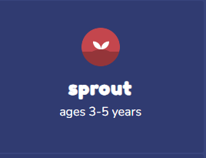
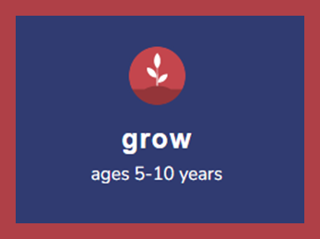
Additional Thrive Programs
Take Root is available for parents and caregivers of children who are between 0 and 3 years old.
Sprout is available for parents and caregivers of children who are between 3 and 5 years old.
Grow is available for parents and caregivers of children who are between 5 and 10 years old.
Notes:
Additional Thrive Program Options for Different Ages:
Take Root: For parents and caregivers of children aged 0 to 3 years.
Sprout: Designed for parents and caregivers of children aged 3 to 5 years.
Grow: Suitable for parents and caregivers of children aged 5 to 10 years.
Next Steps: Encourage participants to explore these programs to continue supporting their children's development at various stages.

Slide 79
Notes:
Thrive Website: Encourage participants to visit the Thrive website for additional resources.
Program Exploration: Suggest exploring other programs that may be beneficial for another child.
Continued Growth: Encourage using these resources to plan the next steps in their child’s growth and development.
For an in-depth exploration of specified topics related to teens and adolescents, suggest families visit the Thrive website (https://thrive.psu.edu/supplemental-modules/), and review the supplemental module content for the most up-to-date offerings.

Slide 80
Thank you all for your dedication and participation. Every effort you make significantly impacts your child's future success.
Notes:
Example language:
Thank you, parents and caregivers, for your active participation. Please continue to visit the Thrive website as your child develops and grows—it's a valuable resource that can support you through every stage of their growth.

