Slide 1
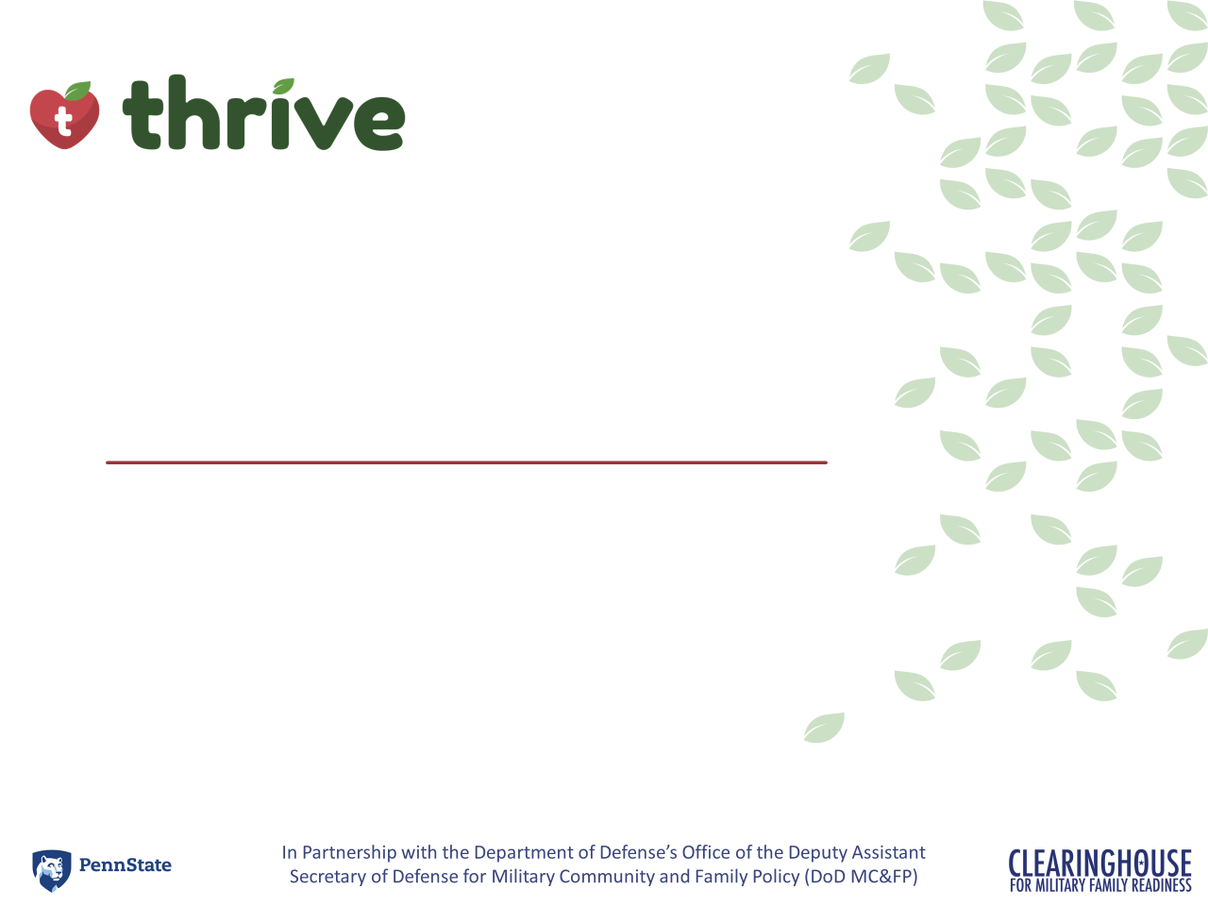


As of February 24, 2025
Introduction
Notes:
Delivery Type 1: Supplemental Extension begins here, on slide 1.
Delivery Type 2 : Supplemental Stand Alone begins on slide 39.

Slide 2


Welcome!
Please sign in and find a seat. We will begin soon.
If possible, please turn on your camera and enter your preferred name. We will begin soon.
Notes:
Choose one bullet point to display (the first bullet point is for in-person, the second is for virtual).
If in-person, greet participants as they come in the door and help them find a seat.
If virtual, give participants a heads up when you will be starting. For example, “Hi everyone, we will be starting in about one minute.”

Slide 3

AGENDA
  Overview
  Syllabus
  Expectations
  Registration
  Homework
Notes:
Welcome: Introduce yourself and thank participants for choosing to be a part of the Anger Management Supplemental Parenting Program. Explain that Meeting 1 will provide an overview of the program, who is in our group, and what is expected of parents who participate. We will discuss the materials you received and provide instructions on how to use them.
Encourage participants to ask questions as they arise or to jot them down and ask at the end of the meeting.

Slide 4







  Target Audience
  Program Focus
  Skill Building
  Reflective Sharing
  Program Structure
  Goals
Notes:
Anger Management-Family Conflict: Mindfully Creating Positivity is an online supplemental module that is designed to help parents (and caregivers) understand and reduce anger and conflict in everyday moments and situations. This supplemental module focuses on addressing specific concerns individuals might have about how to navigate anger.
In order to reach your full potential as a parent, sometimes, you also have to parent yourself and manage your own emotions. When we feel emotions—like anger—or experience conflict with others, we must remember that our response in these moments could serve as a teaching tool for our children. Taking the time to tap into and understand your own feelings of anger and exploring areas of conflict in your life can help you become the best parent you can be and a positive role model for your child.
During the online supplemental module sessions and throughout the hybrid implementation meetings, information and parenting strategies that parents can use and adapt, as necessary, to fit their individual circumstances and family needs will be disseminated. The supplemental module content is designed to help parents build on their existing anger-management and conflict-resolution skills and strategies, so they can effectively parent their child(ren).
Some of the content that is read and practiced in the supplemental module and discussed in the hybrid implementation meetings might be familiar to the parents, and they may already know about and use the disseminated information. Therefore, they may use the meeting time as an opportunity to realize, appreciate, and share what already works for them, their child, and their family.
Anger Management-Family Conflict: Mindfully Creating Positivity is an online supplemental module for parents and caregivers of children of any age. It includes an introduction and four sessions. The module also has an Action Plan worksheet that can be completed as participants engage in the module. This worksheet is especially useful if the participant would like to develop an action plan to keep themself accountable and/or share with others to highlight their progress.
After participating in the online supplemental module sessions and the hybrid implementation meetings, parents and caregivers should be able to do the following:
Understand how anger impacts you and those around you
Tap into underlying emotions that may contribute to your feelings of anger
Identify strategies and techniques to help you manage your anger
Focus on framing your thoughts in a more positive and productive way
Approach conflict in a healthy and constructive manner
Use identified strategies and techniques to change your behaviors
Put together an Action Plan for success!

Slide 5
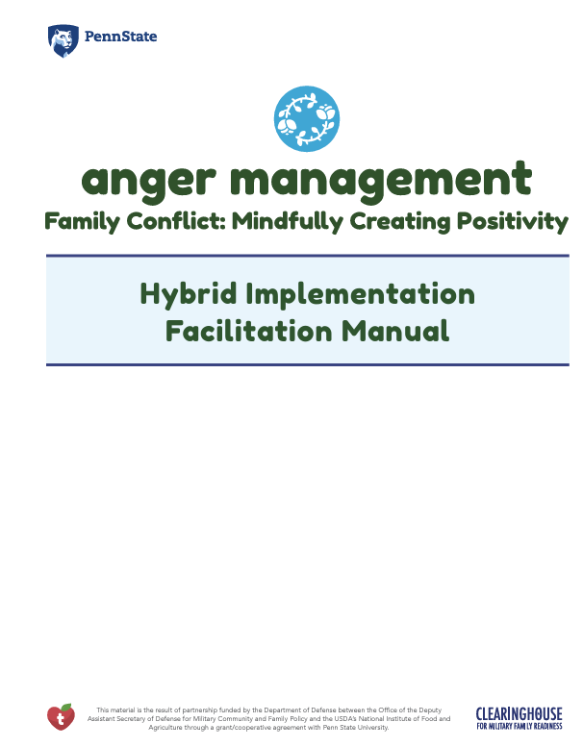
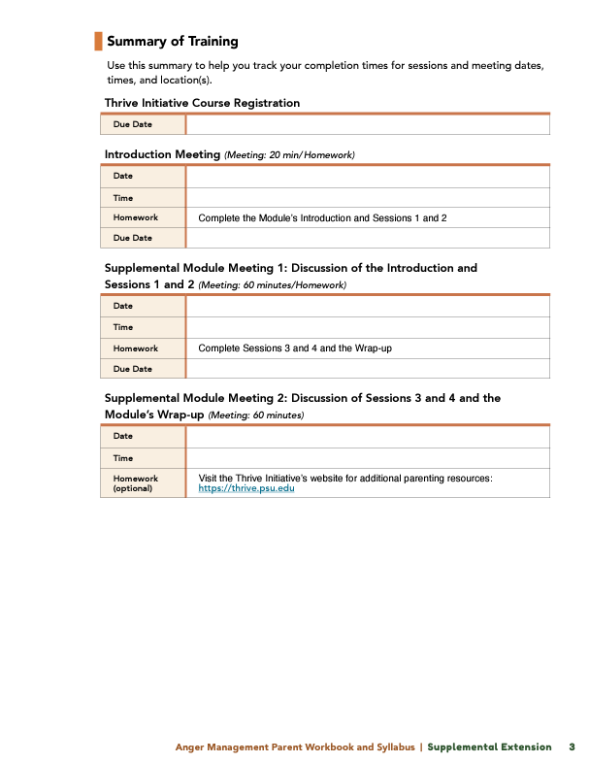
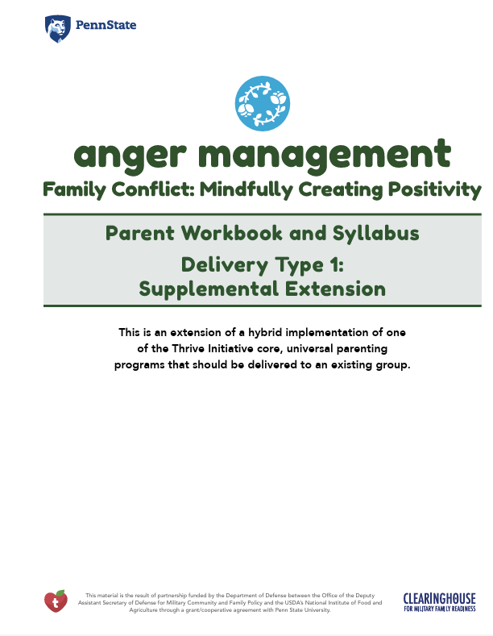

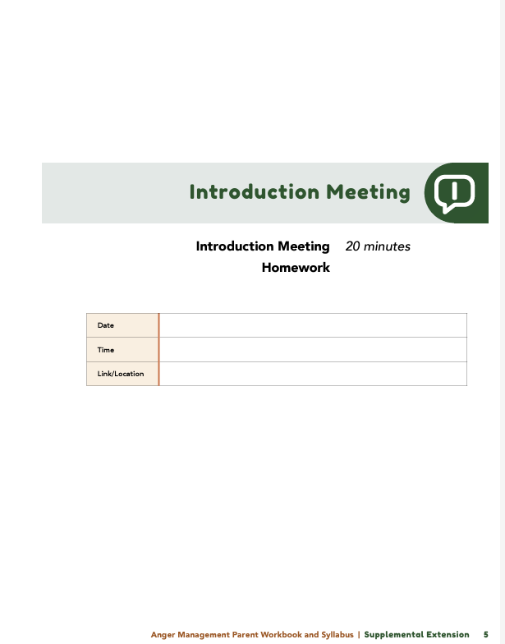
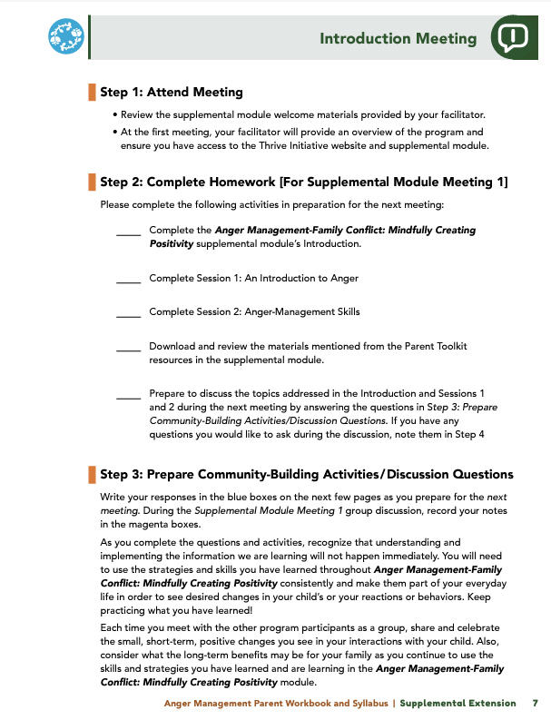

Parent Workbook
Syllabus
Notes:
Provide copies or screen share a copy of the Parent Workbook and Syllabus for the Anger Management-Family Conflict: Mindfully Creating Positivity supplemental module. Review the Summary of Training, and highlight the section where the participants can find pertinent information.

Slide 6
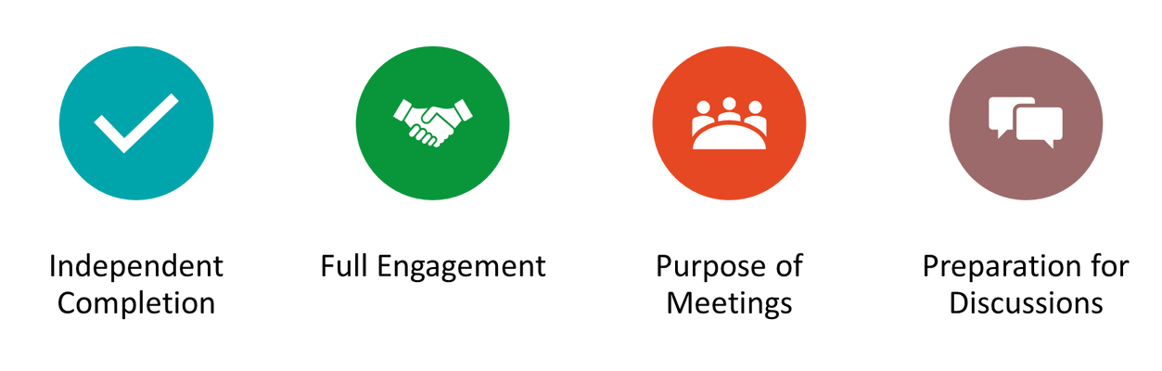
Expectations
Notes:
Overview of Expectations: Clearly define what is expected of participants in the Anger Management supplemental program.
Independent Completion: Inform families that they are expected to independently complete the online modules.
Full Engagement Required: Emphasize the importance of completing each module in full to maximize learning and benefit from the program.
Purpose of Meetings: Clarify that the in-person meetings are not for revisiting session content but for community building, reflecting on experiences, and discussing insights with other participants who are trying to successfully navigate anger and conflict.
Preparation for Discussions: Encourage participants to come to meetings prepared to share their thoughts and engage in discussions based on the content they've learned online.

Slide 7


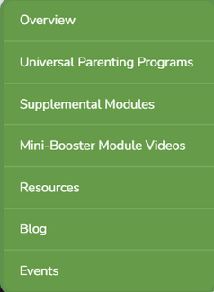
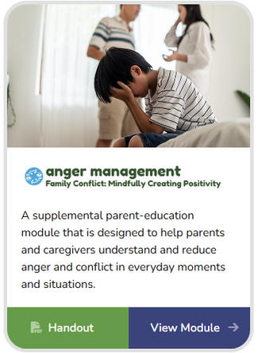

REGISTER
Notes:
Explain how participants can access the supplemental module online. Offer support to help with any technological questions. All participants will have previously set up a Thrive account, but you need to ensure they can log in and find the information they need to get started or progress in the supplemental module.

Slide 8
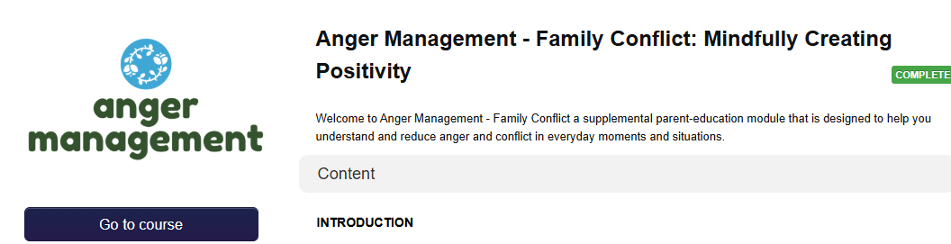
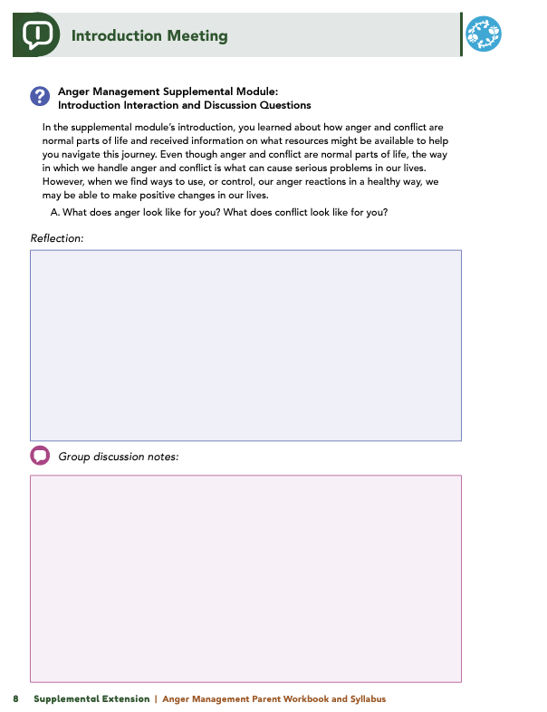





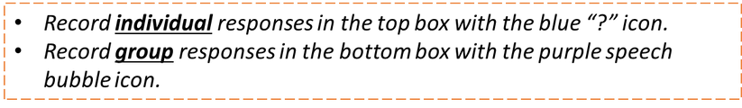
Homework
Complete the Introduction Module, Session 1: An Introduction to Anger, and
Session 2: Anger-Management Skills
View online modules
Complete workbook questions
Notes:
Homework Tasks: Assign Introduction Module, Session 1: An Introduction to Anger, and Session 2: Anger-Management Skills as homework.
Step 2 Clarification: Remind participants that this homework involves viewing online content and downloading necessary resources as part of Step 2. If time permits, show where to access these materials on the website.
Workbook Guidance: Show the specific pages in the Anger Management Parent Workbook and Syllabus related to these topics (D7)
Step 3 Clarification: Assign workbook discussion questions (beginning on page D8 in the parent workbook).
Format explanation: Explain the reason for 2 boxes per question (one for individual, one for group responses).
Encourage reflection and engagement: The more participants, think, reflect, and share the more meaningful the content becomes to each family.
Pro tip: Complete the workbook while viewing online modules.

Slide 9


Thank you for participating today.
Please reach out with any questions or concerns.
See you next week!
Notes:
Closing: Thank participants for their time and engagement.
Questions: Ask if there are any questions. (If someone needs personal assistance, ask them to speak with you individually after the group is dismissed).
Meeting 2: Remind participants of the date/time/location of the next meeting.
Homework: Remind participants to complete the homework.
Adjourn: Say goodbye to participants.

Slide 10
Meeting 1

Slide 11

Welcome back!
Please sign in and find a seat. We will begin soon.
If possible, please turn on your camera and enter your preferred name. We will begin soon.
Notes:
Choose one bullet point to display (the first bullet point is for in-person, the second is for virtual).
If in-person, greet participants as they come in the door and help them find a seat.
If virtual, give participants a heads up when you will be starting. For example, “Hi everyone, we will be starting in about one minute.”

Slide 12

  Conversation Starter
  Restate Ground Rules
  Group Discussion
  Homework
Notes:
Example language: Welcome back, families! We’re glad to see for our second meeting.
Review Meeting 2 Agenda:
Conversation Starters: We’ll get started with a quick question to get us all engaged and sharing.
Review of Ground Rules: A brief reminder of our ground rules to ensure our discussions remain respectful and productive.
Discussion and Homework: After our initial activities, we will discuss the workbook questions based on your experiences with the last set of homework followed by an explanation of the homework for our next meeting. Let’s get started!

Slide 13

Please answer one of the following questions:
  What is one aspect of your parent-child relationship that is working well?
  What is a skill you use effectively in your parenting?
Notes:
Example language: "Let's open our session with a fun question that will give us all a chance to share something about ourselves. Review the list of questions provided on the slide. Select one question that resonates with you, or that you feel comfortable sharing. This activity is designed to ease us into the meeting and build a friendly, open atmosphere.

Slide 14


Basic Ground Rules:
  Always start and end sessions on time.
  Cell phones should be on vibrate; members can quietly excuse themselves if a call must be taken.
  In virtual sessions, participants should mute themselves when taking calls outside the session.
Group-Specific Rules:
  Avoid judgment regarding other participants' parenting practices or knowledge gaps.
  One person speaks at a time to maintain order and clarity.
  Assume positive intent in all interactions to foster a positive atmosphere.
Confidentiality- Please be respectful and discrete with the personal stories being shared. This is a safe space to grow and learn.
Notes:
Introduction of Ground Rules: Start by stating some basic ground rules to create a supportive environment where families feel safe to share their parenting experiences.
Basic Ground Rules:
Always start and end sessions on time.
Cell phones should be on vibrate; members can quietly excuse themselves if a call must be taken.
In virtual sessions, participants should mute themself when taking calls outside the session.
Developing Group-Specific Rules:
Discuss and agree on additional rules as a group, such as:
Avoid judgment regarding other participants' parenting practices or knowledge gaps.
Ensure one person speaks at a time to maintain order and clarity.
Assume positive intent in all interactions to foster a positive atmosphere.
Confidentiality Discussion: Use this time to reinforce the importance of confidentiality, outlining your organization’s specific confidentiality clauses regarding statements related to abuse or neglect mandated reporting..
Example language:
As we begin, it's crucial to emphasize the importance of confidentiality within our group. We need to agree to keep all shared information within these sessions, including personal stories and sensitive details. This ensures a safe space where everyone feels comfortable sharing their experiences. Please remember that details shared by participants are given in trust and should be treated with respect and discretion.
Additionally, it’s important to note our mandated reporting clause for suspected abuse or neglect:
Legal Obligation: Our staff and facilitators are legally required to report any suspicions of child abuse or neglect.
Scope of Reporting: We must report any signs of potential harm to a child or vulnerable adult that arise during our sessions.
Procedure for Reporting: We handle these situations sensitively, informing involved individuals about necessary actions, unless it poses further risk.
Support for Affected Individuals: We provide support and resources to help those involved in a reporting situation.
Our primary concern is the safety and well-being of all individuals. If you have any questions or concerns about this policy, feel free to discuss them privately with me.

Slide 15
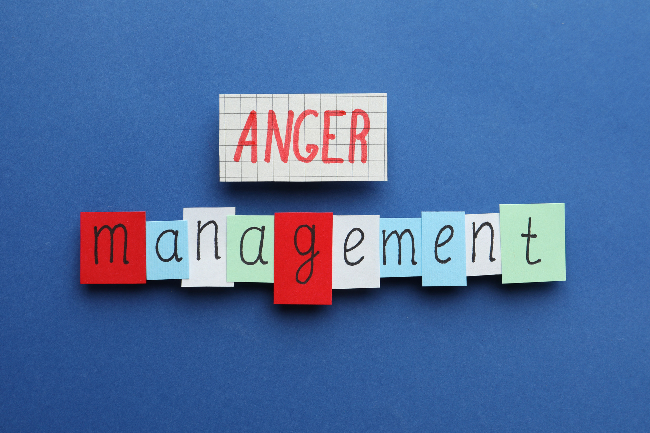




Anger
& Conflict
Self-Awareness
& Growth
Managing
Anger
Notes:
Provide an overview of the supplemental module using the following points that are taught in the supplemental module:
• Anger and conflict are normal parts of life, and every person will experience these emotions and challenges.
• When we experience anger and conflict, understanding how these emotions and the situation(s) that has created these emotions make us feel can help us realize certain characteristics or traits in ourselves. We may find that the emotional response we exhibit when we feel anger or conflict highlights issues, behaviors, or situations that we should consider changing, so we can be a positive role model for our children and be a loving and thoughtful parent.
• This module intends to support you as the parents and caregivers by helping you learn about anger management, what causes anger, and how to navigate your anger effectively.

Slide 16
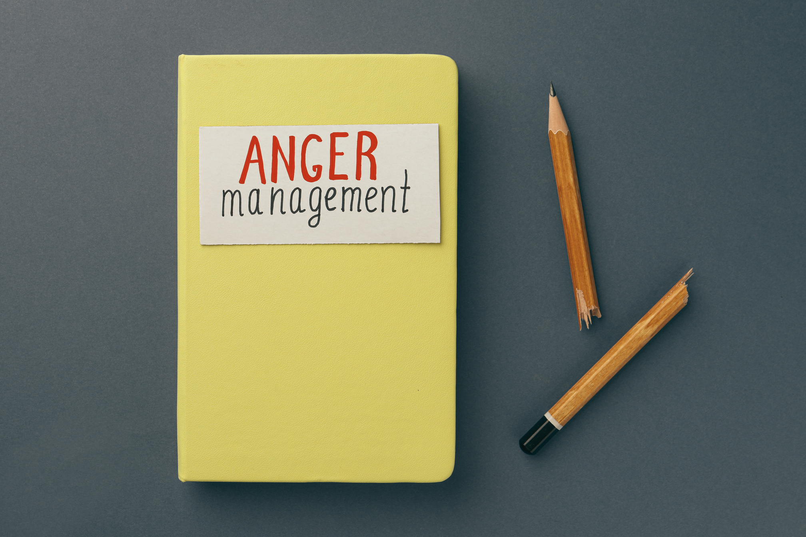
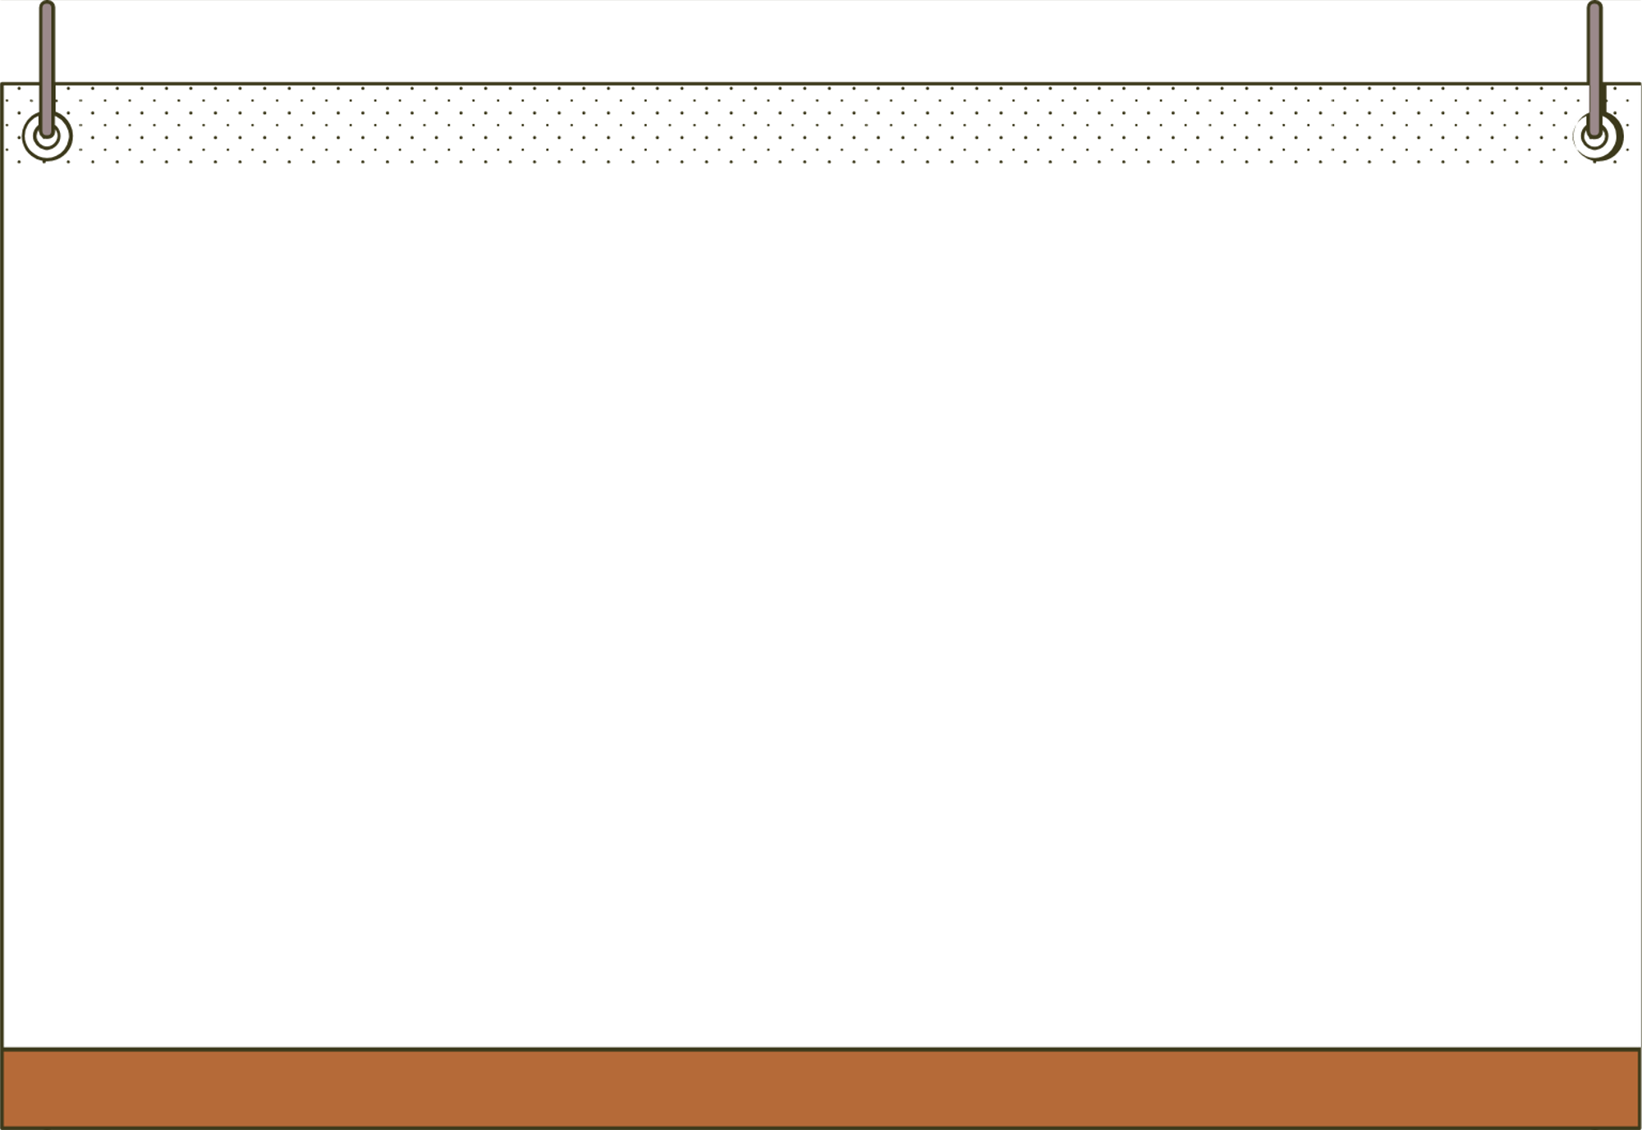
An Introduction to Anger
  Think about the reasons that brought you here.
    What is your goal for managing anger and conflict?
    What does success look like for you?
Notes:
Review this section of the module with the participants by offering the following information:
• Even though anger and conflict are normal parts of life, how we handle our anger and conflict could cause serious problems in our lives. When we express our anger negatively—like yelling, throwing things, or using violence—we can make our lives, and the lives of our loved ones, unpleasant. However, when we find ways to use, or control, our anger reactions in a healthy way, we may be able to make positive changes in our lives.
• Managing anger and conflict in a positive way can be difficult. The stressors and challenges we encounter can make it hard for us to remain calm.
• Please look at the Action Plan Worksheet. You can use this worksheet to help you build and implement a plan and, then, use it as a tool as you complete the module.
Generate discussion among participants using the following questions:
Think about the reasons/situations that brought you here. What is your goal for yourself related to managing your anger and conflict?
Think about that goal. What does success look like?

Slide 17



Consequences of Anger
  What impact has your anger had on your life?
Notes:
Review this section of the module with the participants by offering the following information:
• Everyone experiences anger; however, when you negatively respond to the anger you feel, difficult consequences for you and for those around you may arise. The module talks about what uncontrolled or unhealthy anger may look like.
• Uncontrolled or unhealthy anger can produce negative reactions in people, and these reactions could produce consequences that may impact these individuals’ physical health, such as headaches or sleep problems; mental health, such as increased anxiety and/or depression; and relationships, such as yelling or shouting at others or name calling. In addition, consequences could affect finances, life stability, or sense of self.
Generate discussion among participants using the following questions:
What consequences have you experienced, or are you presently experiencing, due to your reactions from feeling anger? (Solicit responses such as physical health, mental health, relationship, and career consequences.)

Slide 18



Identifying Triggers
  What are some common anger triggers you’ve learned about?
  What are your personal triggers?
Notes:
Review this section of the module with the participants by offering the following information:
• Anger is often referred to as a “secondary emotion,” which means that anger is a reaction to a different, underlying emotion.
• In other words, we may show anger because we are trying to mask other emotions that we are experiencing, such as disappointment or humiliation. Consider this analogy: you can see the top of an iceberg, but most of the iceberg is below the surface of the water. Anger is like the top of the iceberg, and other feelings, such as sadness or embarrassment that drive the anger, lay under the surface.
• The Anger Cycle shows us the cyclical nature of anger. Understanding this cycle can help us manage our feelings of anger. (Facilitator Tip: See and/or share graphic of the Anger Cycle.)
Typically, the cycle begins with a triggering event. This is when you experience a situation or event that is unpleasant or that does not feel good or upsets you. You cannot avoid all situations that distress you.
After experiencing the trigger event, you may start to experience negative thoughts about yourself, other people, or the world in general.
When you focus on negative thoughts that have been generated by a triggering event, you may begin to feel an intense emotional response. This emotional response will likely be produced by secondary emotions.
Your reactions to your emotional responses can produce physical symptoms. Physical symptoms of feeling anger include experiencing an increased heart rate, shortness of breath, or feeling hot.
The last part of the cycle is your behavioral response. During this aspect of the cycle, you may exhibit negative behaviors, such as yelling, shouting, making poor choices, or frightening others. This is the part of the anger cycle you should avoid!
Generate discussion among participants using the following questions:
What are some examples of anger triggers that you learned about (Solicit responses such as encountering people who are rude, disrespectful, or loud; visiting places that are associated with bad memories; being stuck in traffic; having conversations about polarizing topics (e.g., politics; being late to an event; or having to clean up after others.)
What are some of your personal triggers (e.g., people, places, conversations, situations)?

Slide 19
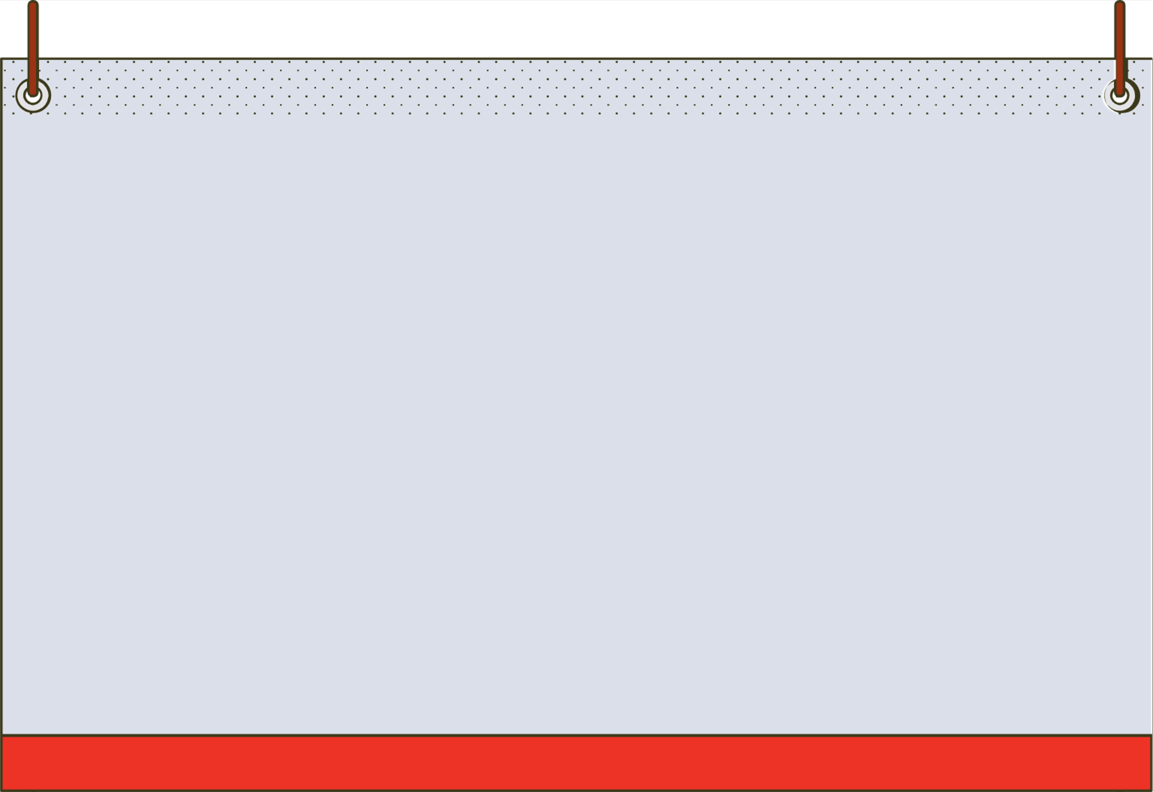




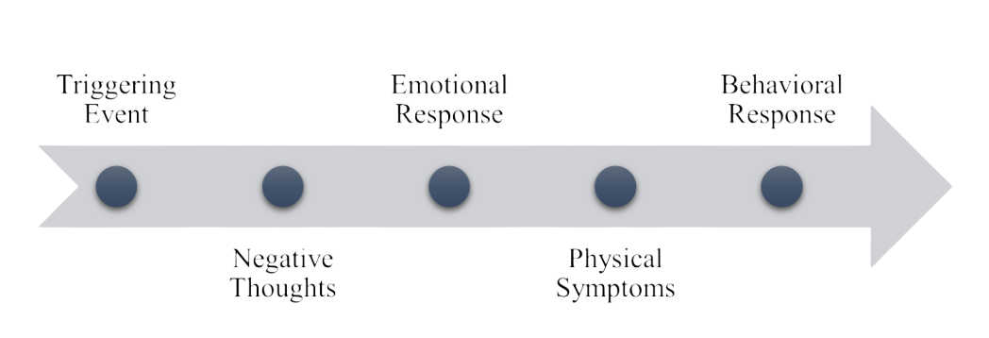

Anger Warning Signs
  What were Ophelia’s anger warning signs?
  What are your anger warning signs?
  Do you notice negative thoughts, emotional responses, physical symptoms, or specific behaviors?
Notes:
Review this section of the module with the participants by offering the following information:
• One way to break the anger cycle is for you to identify when you are becoming angry before your emotions become too intense, and a blow-up or angry outburst (reaction) ensues. The first step in stopping an angry outburst or letting your anger take control of your actions and reactions is to identify that you are feeling angry.
• To do this, at each step in the Anger Cycle, you can stop and examine your thoughts and reactions. Are your thoughts negative? Are you having emotional responses or physical symptoms? Are you engaging in negative, distressing, or regrettable behaviors?
Facilitator Tip: Provide some of the following examples of what constitutes negative thoughts, emotional responses, physical symptoms, and behaviors.
• Negative thoughts: “Stupid,” “Worthless,” “Selfish,” “Bad Person,” “Horrible,” “Disgusting,” “Hate,” or “Evil.”
• Emotional Responses: Humiliated, Frustrated, Guilty, Jealous, Disrespected, Helpless, Powerless, Confused, Embarrassed, Anxious, Ashamed, Offended, Insecure, Hurt, Weak, Broken, Alone, or Betrayed.
• Physical Symptoms: increased heart rate, flushed cheeks, heavy breathing, sweating, light headedness, nausea, feeling hot, tense muscles, tearfulness, throat tightness, dizziness, or clenched jaw/grinding teeth.
• Behaviors: Pacing, yelling/talking loudly, arguing, only responding with short answers, becoming critical of others or yourself, crying, throwing things, clenching fists, increasing your use of curse words, or shutting down.
Generate discussion among participants using the following questions:
In the module, Ophelia initially had negative thoughts after her friends made a joke about her appearance, then she felt ashamed, her cheeks began to flush, and she shut down. What were her [Ophelia’s] anger warning signs? (Solicit the following responses: Negative Thoughts – I’m so disgusting; Emotional Response – ashamed; Physical symptoms – flushed cheeks; Behaviors – shut down.)
Think about yourself. Do you know your anger warning signs? What are some of the common experiences you have when you’re angry?
Do you have negative thoughts, emotional responses, or physical symptoms? Do you engage in certain behaviors?

Slide 20




Cognitive Distortions
Do you use any of these
cognitive distortions?
  All or Nothing Thinking
  Catastrophizing
  Minimizing
  Mind-Reading
  Overgeneralizing
  Disqualifying the Positive
  Labeling
  Fortune Telling
  Which ones show up most often in your thoughts?
Notes:
Review this section of the module with the participants by offering the following information:
• We all experience negative thoughts that can make us feel angry. There are tools and methods you can use to help you decrease the time you think about negative thoughts.
• To pick the right tool to overcome a negative thought, you need to recognize the negative thinking patterns you are having. These patterns are called cognitive distortions. There are several cognitive distortions discussed in the module, including All or Nothing Thinking, Catastrophizing, Minimizing, Disqualifying the Positive, Fortune Telling, Labeling, Mind Reading, and Overgeneralizing.
Facilitator Tip: Review one or two distortions to get the conversation going.
Generate discussion among participants using the following questions:
Do you tend to use any of the cognitive distortions discussed in the module?
Which ones pop up the most in your thought processes?

Slide 21



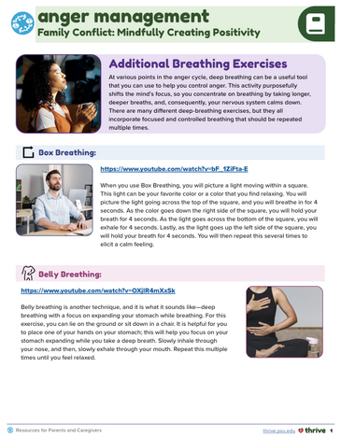
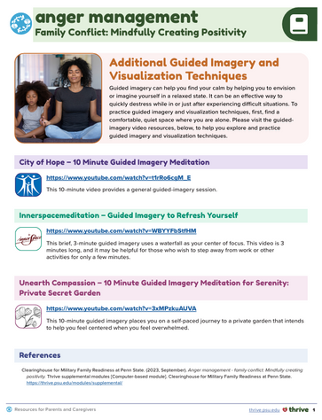
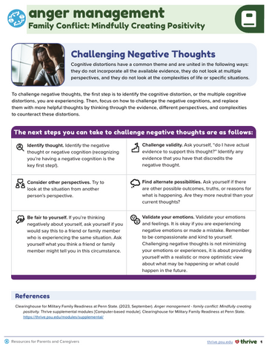
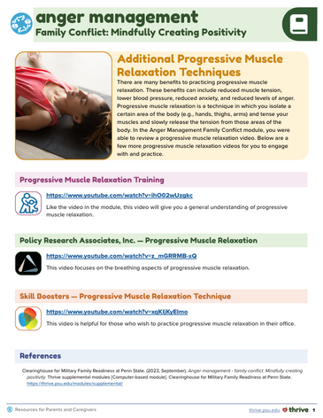
Challenging Negative Thoughts
Did you try any of the breathing, visualization, or relaxation techniques?
Notes:
Review this section of the module with the participants by offering the following information:
• Cognitive distortions have a common theme and are united in the following ways: they do not incorporate all of the available evidence, they do not look at multiple perspectives, and they do not look at the complexities of life or specific situations.
• If and when you have cognitive distortions, you need to focus on how to replace them with more helpful thoughts by thinking through the evidence, different perspectives, and the complexities to counteract the distortions.
• You can challenge your negative thoughts by identifying the thought and recognizing you’re having a negative cognition, challenging the validity of your thoughts, considering other perspectives, being fair to yourself, and validating your emotions.
Generate discussion among participants using all, or some, of the following questions:
In the module, you had a chance to examine some examples you could use to challenge negative thoughts. Practicing techniques, like mindfulness exercises or breathing exercises, can also help you relax, manage stress, and ultimately challenge those negative thoughts. Did anyone try a breathing technique—Box Breathing, Belly Breathing, Bumblebee Breathing, Alternative Nostril Breathing—that was mentioned in the module? If so, which one? When can you imagine yourself using that technique?
Did anyone try the guided imagery and visualization strategy or the Calm, Safe Place Visualization Technique? When can you imagine yourself using these techniques?
Did anyone try the Progressive Muscle Relaxation Technique? Did you like it? Why or why not?

Slide 22


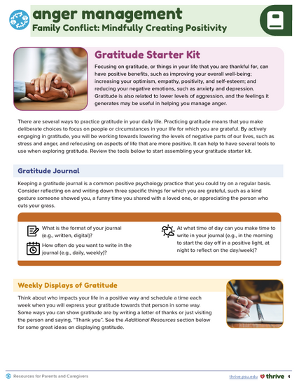
Gratitude
  Do you use a Gratitude Journal or journal in general?
  How does it help you?
  Would you be interested in starting a Gratitude Journal?
Notes:
Review this section of the module with the participants by offering the following information:
• You may have heard individuals say that they “practice gratitude.” Practicing gratitude means that you make deliberate choices to focus on people or circumstances in your life for which you are grateful. Sometimes, when you are stressed, upset, unhappy, or angry, you may find it difficult to focus on the people or circumstances for which we are grateful.
• The feelings you can get from practicing gratitude may be useful to you as you manage your anger.
• Focusing on gratitude, or people or circumstances in your life that you are thankful for, can have positive benefits, such as improving your overall well-being; increasing your optimism, empathy, positivity, and self-esteem; and reducing your negative emotions, such as anxiety and depression. Practicing gratitude is also related to having lower levels of aggression, and the feelings gratitude generates may be useful in helping you manage anger.
Generate discussion among participants using all, or some, of the following questions:
The module mentioned that you could use a Gratitude Journal as a positive practice to help you alter your mindset.
Does anyone currently use a Gratitude Journal, or does anyone journal in general? How does it help you?
Is anyone who doesn’t already journal interested in starting a Gratitude Journal?

Slide 23
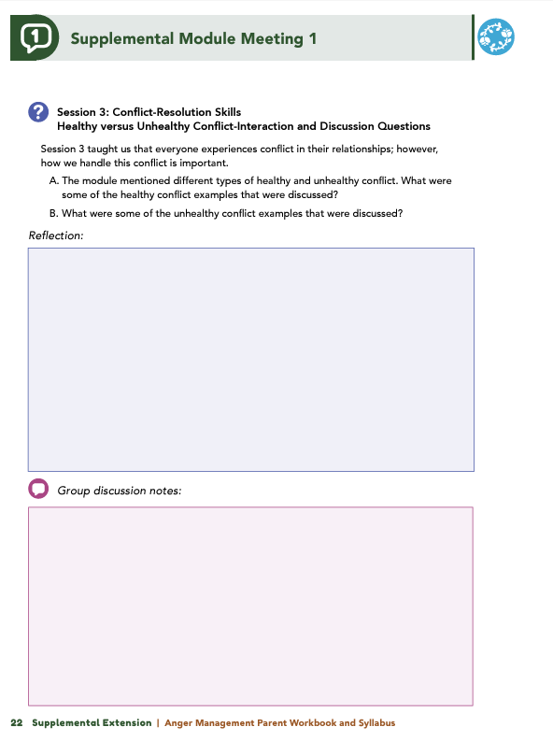


Homework
Complete Session 3: Conflict Resolution Skills and the Wrap Up
View online modules
Complete workbook questions
Notes:
Homework Tasks: Assign Session 3: Conflict Resolution Skills and Wrap Up Module as homework.
Step 2 Clarification: Remind participants that this homework involves viewing online content and downloading necessary resources as part of Step 2. If time permits, show where to access these materials on the website.
Workbook Guidance: Show the specific pages in the Anger Management Parent Workbook and Syllabus related to these topics (D21)
Step 3 Clarification: Assign workbook discussion questions (beginning on page D22 in the parent workbook).
Format explanation: Explain the reason for 2 boxes per question (one for individual, one for group responses).
Encourage reflection and engagement: The more participants, think, reflect, and share the more meaningful the content becomes to each family.
Pro tip: Complete the workbook while viewing online modules.

Slide 24
Thank you for participating today.
Please reach out with any questions or concerns.
See you next week!
Notes:
Closing: Thank participants for their time and engagement.
Questions: Ask if there are any questions. (If someone needs personal assistance, ask them to speak with you individually after the group is dismissed).
Meeting 2: Remind participants of the date/time/location of the next meeting.
Homework: Remind participants to complete the homework.
Adjourn: Say goodbye to participants.

Slide 25
Meeting 2

Slide 26

Please sign in and find a seat.
We will begin soon.
If possible, please turn on your camera.
We will begin soon.
Notes:
Choose one bullet point to display (the first bullet point is for in-person, the second is for virtual).
If in-person, greet participants as they come in the door and help them find a seat.
If virtual, give participants a heads up when you will be starting. For example, “Hi everyone, we will be starting in about one minute.”

Slide 27

Conversation Starters
Group Discussion
Thrive Programming
Notes:
Example language: Welcome back, everyone! We're glad to see you for our third and final meeting.
*Optional Sections: Please note that the conversation starters are optional. If you prefer to skip these, simply remove the first bullet point from this slide and proceed to the next relevant slide in the deck.
Example language if omitting: We'll dive straight into discussing the key questions from our last session’s homework. We’ll wrap up with a discussion on additional Thrive programs that may interest you
Example language if not omitting:
Conversation Starters: We’ll get started with a quick question to get us all engaged and sharing.
Review of Ground Rules: A brief reminder of our ground rules to ensure our discussions remain respectful and productive.
Discussion and Homework: After our initial activities, we will discuss the workbook questions based on your experiences with the last set of homework followed by an explanation of the homework for our next meeting. Let’s get started!

Slide 28
Please answer one of the following questions:
What is an activity you enjoy doing with your child?
If you could relive one moment with your child, what would it be?
Notes:
Example language: "Let's open our session with a fun question that will give us all a chance to share something about ourselves. Review the list of questions provided on the slide. Select one question that resonates with you, or that you feel comfortable sharing. This activity is designed to ease us into the meeting and build a friendly, open atmosphere.

Slide 29
Basic Ground Rules:
  Always start and end sessions on time.
  Cell phones should be on vibrate; members can quietly excuse themselves if a call must be taken.
  In virtual sessions, participants should mute themselves when taking calls outside the session.
Group-Specific Rules:
  Avoid judgment regarding other participants' parenting practices or knowledge gaps.
  One person speaks at a time to maintain order and clarity.
  Assume positive intent in all interactions to foster a positive atmosphere.
Confidentiality- Please be respectful and discrete with the personal stories being shared. This is a safe space to grow and learn.
Notes:
Introduction of Ground Rules: Start by stating some basic ground rules to create a supportive environment where families feel safe to share their parenting experiences.
Basic Ground Rules:
Always start and end sessions on time.
Cell phones should be on vibrate; members can quietly excuse themselves if a call must be taken.
In virtual sessions, participants should mute themself when taking calls outside the session.
Developing Group-Specific Rules:
Discuss and agree on additional rules as a group, such as:
Avoid judgment regarding other participants' parenting practices or knowledge gaps.
Ensure one person speaks at a time to maintain order and clarity.
Assume positive intent in all interactions to foster a positive atmosphere.
Confidentiality Discussion: Use this time to reinforce the importance of confidentiality, outlining your organization’s specific confidentiality clauses regarding statements related to abuse or neglect mandated reporting..
Example language:
As we begin, it's crucial to emphasize the importance of confidentiality within our group. We need to agree to keep all shared information within these sessions, including personal stories and sensitive details. This ensures a safe space where everyone feels comfortable sharing their experiences. Please remember that details shared by participants are given in trust and should be treated with respect and discretion.
Additionally, it’s important to note our mandated reporting clause for suspected abuse or neglect:
Legal Obligation: Our staff and facilitators are legally required to report any suspicions of child abuse or neglect.
Scope of Reporting: We must report any signs of potential harm to a child or vulnerable adult that arise during our sessions.
Procedure for Reporting: We handle these situations sensitively, informing involved individuals about necessary actions, unless it poses further risk.
Support for Affected Individuals: We provide support and resources to help those involved in a reporting situation.
Our primary concern is the safety and well-being of all individuals. If you have any questions or concerns about this policy, feel free to discuss them privately with me.

Slide 30




Healthy versus Unhealthy Conflict
  What are some examples of healthy conflict?
  What are some examples of unhealthy conflict?
Notes:
Review this section of the module with the participants by offering the following information:
• Everyone experiences conflict in their relationships; however, how we handle this conflict is important. Healthy conflict can look different in different relationships, but healthy conflict always includes both of the people involved working toward a positive outcome together.
• We may experience unhealthy conflict in our lives that can be damaging for our relationships. Although we can’t control how others handle conflict, we can work on how we handle conflict and how we can learn to resolve concerns in a healthy way.
Generate discussion among participants using the following questions:
The module mentioned different types of healthy and unhealthy conflict. What were some of the healthy conflict examples that were discussed? (Solicit the following responses: Compromising, trying to resolve a problem as a team, expressing emotions, finding a win-win solution, and sharing experiences.)
What were some of the unhealthy conflict examples that were discussed? (Solicit the following responses: Trying to make the other person look stupid, minimizing other’s experiences, viewing conflict as a battle, shouting or yelling, belittling someone, name calling, trying to “beat” the other person in the argument, or pushing or shoving.)

Slide 31


Consequences of Unhealthy Conflict
  What consequences have you experienced from conflict?
Notes:
Review this section of the module with the participants by offering the following information:
• Much like anger, participating in unhealthy conflict or conflict too frequently can have many negative consequences for you and your relationships. Unhealthy conflict can impact you in a variety of ways. For example, it can have physical and mental health consequences, relationship consequences, and other consequences. Some examples mentioned in the module include the following:
Physical Health Consequences: I struggle with high blood pressure because I am in constant conflict.
Mental Health Consequences: I often think of myself in a negative light because I am in constant conflict with my partner.
Relationship Consequences: When I was arguing with my partner, in anger, I said something I didn’t mean, and I hurt them. I think they may still be a bit upset with me.
Career Consequences: After that day when I was having a lot of problems and I exploded at Devon, it has been much harder to work with them.
Other Consequences: I yelled at our waiter one time at my favorite restaurant and got kicked out. My partner has been too embarrassed to go back.
Generate discussion among participants using the following questions:
When you’re in conflict with another, what are some of the consequences you have experienced? (Solicit responses like experiencing sleeping problems, having conflict take over thoughts, feeling unwell, or not talking to others.)

Slide 32





Consequences of Unhealthy Conflict
  Did any cognitive distortions resonate with you in past conflicts?
  Which ones do you tend to use?
  What is your plan for managing them next time?
"The next time I notice I am using [distortion], I will [strategy]."
Notes:
Review this section of the module with the participants by offering the following information:
• Earlier in the module, we identified some common cognitive distortions people experience in collaboration with feeling anger. Although cognitive distortions can be focused on ourselves, they can also be focused on other people in our lives. These cognitive distortions can increase our chances of becoming angry or experiencing unhealthy conflict with someone.
Generate discussion among participants using all, or some, of the following questions:
The module asked you to complete an activity in which you had to consider different cognitive distortions that you might experience and that could contribute to unhealthy conflict. (Facilitator Tip: Review one or two cognitive distortions to get the conversation going.) Did any of the cognitive distortions resonate with you as you thought about past conflicts in your life?
Are there any you tend to use?
Now that you know more about yourself and the cognitive distortion(s) you often use, would anyone like to share what their plan is for the next time they notice themselves using that distortion(s)?
The next time I notice I am using the distortion of___________, I will ________________________ (Example: The next time I notice I am using overgeneralization, I will try to remember a time when the generalization wasn’t true.)

Slide 33




Taking an Anger Time Out
Steps for Taking a Timeout
  Recognize your anger signs
  Acknowledge the need for a break
  Communicate your timeout
  Ensure understanding
  Set a time limit
  Relax during the break
  Return when ready
  Have you ever regretted something said in an argument?
  How might a timeout have changed the outcome?
Notes:
Review this section of the module with the participants by offering the following information:
Earlier in the module, you identified some of your personal anger warning signs. If you notice yourself experiencing any of your personal warning signs, an additional skill or strategy you could use is to take an anger timeout. The module discusses seven steps for taking the timeout.
• Step 1: Recognize your internal warning signs that indicate you are becoming angry.
• Step 2: Recognize the need for a timeout.
• Step 3: Communicate to the other person that you need a timeout.
• Step 4: Do your best to ensure the other individual understands you need to take a break.
• Step 5: Determine how long the timeout will be.
• Step 6: Use relaxation techniques during the break.
• Step 7: Return to the conversation.
Taking a timeout allows you time to work on managing your anger and behaviors, so you can return to the conversation in a calmer manner.
Generate discussion among participants using the following questions:
Have you ever had an argument and regretted something that you said in the heat of the moment?
How might that interaction have gone differently if you had paused and taken a timeout?

Slide 34

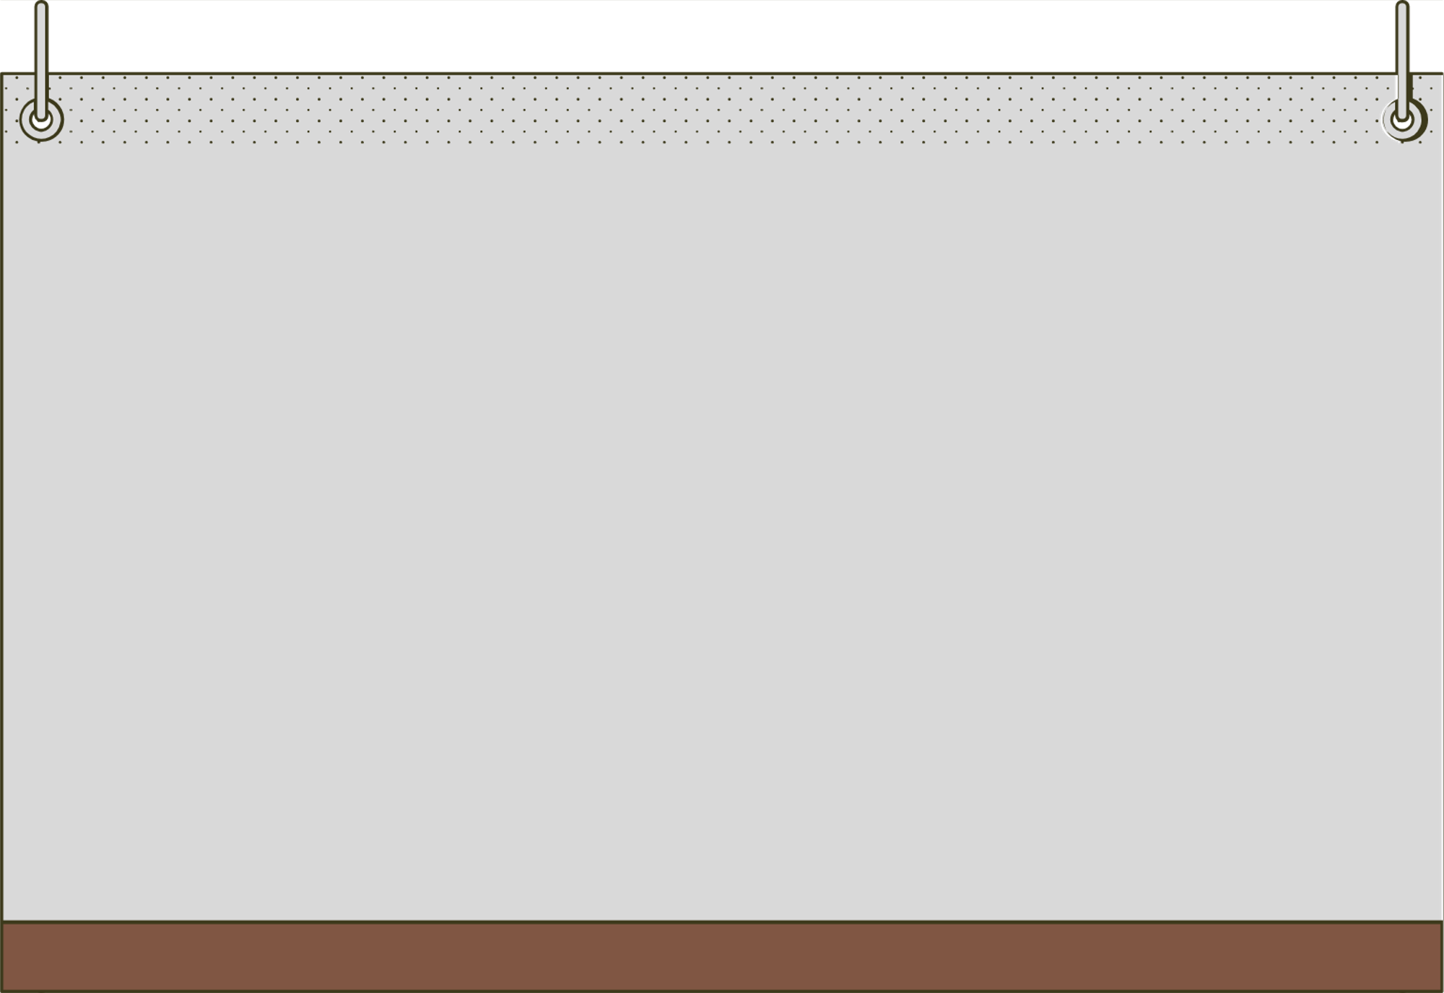



Positive Conflict Resolution Strategies
  Do you use any of these strategies?
  Which ones would you like to start?
  Which might be the most challenging and why?
    Reflective Listening – Show you truly understand.
    "I" Statements – Focus on your feelings, not blame.
    Understanding Emotions – Identify deeper issues behind conflicts.
    Setting Boundaries – Protect your well-being while respecting others.
    Changing Behaviors – Use strategies like waiting to talk, writing, therapy, or apologizing.
Notes:
Review this section of the module with the participants by offering the following information:
• Session 3 mentions additional positive conflict-resolution strategies that you can use when you are engaged in conflict with another person. Those strategies include reflective listening, using “I” Statements, understanding the underlying emotions of conflict, setting healthy boundaries, and changing your behaviors.
• Review each strategy as follows:
Reflective Listening. Reflective listening is not just repeating what the other person says, but it is also trying to demonstrate that you really listened and heard what the other person was trying to communicate to you.
“I” Statements. An “I” statement is when you start your sentence with “I” and focus on your emotions and experiences. The concept of using “I” statements can help you avoid using “you” statements during conflict. “You” statements can make others feel defensive or as if you are blaming them, which can halt positive conversations and stop healthy conflict.
Understanding the Underlying Emotions of Conflict. Have you ever found yourself very irritated over something seemingly small? We all have, and, typically, there is a deeper hurt, or the small action is part of a larger pattern that is causing you hurt or distress. You need to try to discover either the (1) underlying emotion of the conflict or (2) the larger pattern of behavior that is causing you distress. Taking these actions can help you engage in a healthy conversation about what is truly bothering you!
Setting Healthy Boundaries. A healthy boundary involves creating a limit or rule that protects yourself while also allowing the other person to make decisions about their life. Setting a healthy boundary is NOT telling another person what to do or how to live their life. A healthy boundary is when you determine a limit of what you will and won’t do or tolerate. You may express this limit or limits to others, and, if anyone does not respect a boundary you set, you need to be clear that consequences may occur.
Changing your Behaviors. There are many behavioral strategies that you can use to help reduce conflict in your life. Some of those mentioned in the module include waiting and talking in person, writing a letter to explore your feelings, attending therapy, practicing gratitude, communicating about issues before they grow, and apologizing when warranted.
Generate discussion among participants using all, or some, of the following questions:
Consider these strategies. Are there any you currently use?
Are there any strategies that you’d like to start using?
Which strategies might be the most challenging for you to use and why?

Slide 35



Wrap-Up
Questions
  What topic from the module was most helpful to you as a parent? Why?
  What strategies or skills will help you reach your parenting goals?
  Has anyone used an anger-management strategy from the module? How did it compare to before?
  What has changed in your interactions with your child?
  Have you noticed a difference in how your child responds to your parenting?
Notes:
Tell participants you are wrapping up, and generate discussion among participants using all, or some, of the following questions:
Which topic discussed in the supplemental module was the most beneficial to you as a parent? Why?
What strategies or skills did you learn in the supplemental module that will help you achieve the goals you have for yourself as a parent?
Would anyone like to share a moment when you used an anger-management strategy that you learned in the supplemental module and how your actions compared to your actions prior to engaging in the supplemental module?
What has changed in your interactions with your child since before completing the supplemental module?
Have you noticed a difference in the way your child is responding to your parenting?

Slide 36
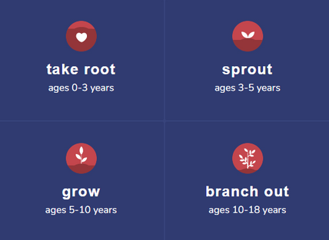
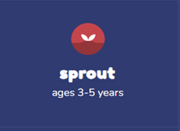
Additional Thrive Programs
  Take Root is available for parents and caregivers of children who are between 0 and 3 years old.
  Sprout is available for parents and caregivers of children who are between 3 and 5 years old.
  Grow is available for parents and caregivers of children who are between 5 and 10 years old.
  Branch Out is available for parents and caregivers of children who are between 10 and 18 years old.
Notes:
Provide support and encouragement to your participants to explore other Thrive Initiative programming. Share and/or register participants for any additional hybrid implementation options that you plan to offer. Thrive Initiative programming may include any of the following:
Universal Programs
• Take Root is available for parents and caregivers of children who are between 0 and 3 years old.
• Sprout is available for parents and caregivers of children who are between 3 and 5 years old.
• Grow is available for parents and caregivers of children who are between 5 and 10 years old.
• Branch Out is available for parents and caregivers of children who are between the ages of 10 and 18 years old.

Slide 37
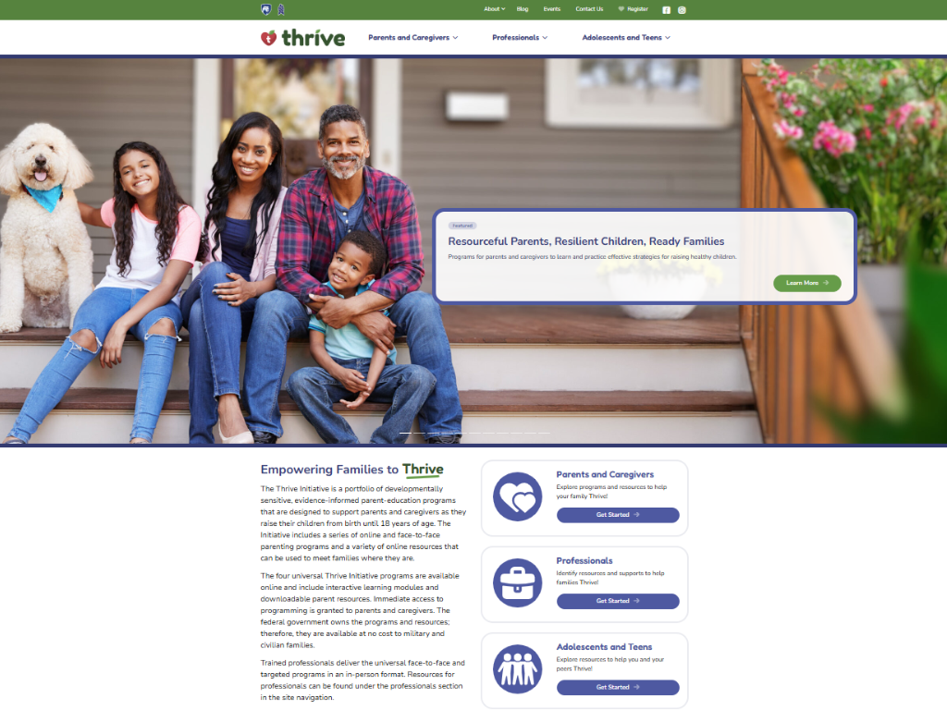
Notes:
Additional supplemental modules are available on a variety of topics and can be accessed online at https://thrive.psu.edu/modules/supplemental/.
Encourage participants to continue to visit the Thrive website, https://thrive.psu.edu, as their child develops and grows.
They can access additional resources and materials like mini-booster modules, blog postings, parenting handouts and guides, an inclusivity toolkit, and newsletters.

Slide 38


Thank you all for your dedication and participation. Every effort you make significantly impacts your child's future success.
Notes:
Example language:
Thank you, parents and caregivers, for your active participation. Please continue to visit the Thrive website as your child develops and grows—it's a valuable resource that can support you through every stage of their growth.
Supplemental Extension ENDS HERE.

Slide 39
Introduction
Notes:
Delivery Type 2: Supplemental Stand Alone begins here.

Slide 40
Welcome!
Please sign in and find a seat. We will begin soon.
If possible, please turn on your camera and enter your preferred name. We will begin soon.
Notes:
Choose one bullet point to display (the first bullet point is for in-person, the second is for virtual).
If in-person, greet participants as they come in the door and help them find a seat.
If virtual, give participants a heads up when you will be starting. For example, “Hi everyone, we will be starting in about one minute.”

Slide 41
AGENDA
  Overview
  Ice Breaker
  Ground Rules
  Syllabus
  Expectations
  Registration
  Homework
Notes:
Welcome: Introduce yourself and thank participants for choosing to be a part of the Anger Management Supplemental Parenting Program. Explain that Meeting 1 will provide an overview of the program, who is in our group, and what is expected of parents who participate. We will discuss the materials you received and provide instructions on how to use them.
Encourage participants to ask questions as they arise or to jot them down and ask at the end of the meeting.

Slide 42
  Target Audience
  Program Focus
  Skill Building
  Reflective Sharing
  Program Structure
  Goals
Notes:
Anger Management-Family Conflict: Mindfully Creating Positivity is an online supplemental module that is designed to help parents (and caregivers) understand and reduce anger and conflict in everyday moments and situations. This supplemental module focuses on addressing specific concerns individuals might have about how to navigate anger.
In order to reach your full potential as a parent, sometimes, you also have to parent yourself and manage your own emotions. When we feel emotions—like anger—or experience conflict with others, we must remember that our response in these moments could serve as a teaching tool for our children. Taking the time to tap into and understand your own feelings of anger and exploring areas of conflict in your life can help you become the best parent you can be and a positive role model for your child.
During the online supplemental module sessions and throughout the hybrid implementation meetings, information and parenting strategies that parents can use and adapt, as necessary, to fit their individual circumstances and family needs will be disseminated. The supplemental module content is designed to help parents build on their existing anger-management and conflict-resolution skills and strategies, so they can effectively parent their child(ren).
Some of the content that is read and practiced in the supplemental module and discussed in the hybrid implementation meetings might be familiar to the parents, and they may already know about and use the disseminated information. Therefore, they may use the meeting time as an opportunity to realize, appreciate, and share what already works for them, their child, and their family.
Anger Management-Family Conflict: Mindfully Creating Positivity is an online supplemental module for parents and caregivers of children of any age. It includes an introduction and four sessions. The module also has an Action Plan worksheet that can be completed as participants engage in the module. This worksheet is especially useful if the participant would like to develop an action plan to keep themself accountable and/or share with others to highlight their progress.
After participating in the online supplemental module sessions and the hybrid implementation meetings, parents and caregivers should be able to do the following:
Understand how anger impacts you and those around you
Tap into underlying emotions that may contribute to your feelings of anger
Identify strategies and techniques to help you manage your anger
Focus on framing your thoughts in a more positive and productive way
Approach conflict in a healthy and constructive manner
Use identified strategies and techniques to change your behaviors
Put together an Action Plan for success!

Slide 43



  Tell us your name, your coparent’s name, your child’s name(s), your child’s age(s), and one of the following:
  What you enjoy most about parenting
  A word you could use to describe one of your child’s strengths
Notes:
Personal Introduction: Start with a brief introduction of yourself, highlighting your expertise in child development and any personal affiliations (e.g., community, organization, military) that connect you to the audience.
Combining Introductions: Merge the participants' introductions with an icebreaker activity to create a more engaging and efficient session.
Icebreaker Questions: Ask each participant to share their name, their coparent’s name, their child’s name, and age. Additional questions to choose:
What you enjoy most about parenting
A word you could use to describe one of your child’s strengths
Future Use: Note the icebreaker questions used; consider revisiting unused ones in future sessions as needed.
You can also start each meeting with an icebreaker if you find your group is reserved. Use your judgment and avoid controversial topics.

Slide 44
Basic Ground Rules:
  Always start and end sessions on time.
  Cell phones should be on vibrate; members can quietly excuse themselves if a call must be taken.
  In virtual sessions, participants should mute themselves when taking calls outside the session.
Group-Specific Rules:
  Avoid judgment regarding other participants' parenting practices or knowledge gaps.
  One person speaks at a time to maintain order and clarity.
  Assume positive intent in all interactions to foster a positive atmosphere.
Confidentiality- Please be respectful and discrete with the personal stories being shared. This is a safe space to grow and learn.
Notes:
Introduction of Ground Rules: Start by stating some basic ground rules to create a supportive environment where families feel safe to share their parenting experiences.
Basic Ground Rules:
Always start and end sessions on time.
Cell phones should be on vibrate; members can quietly excuse themselves if a call must be taken.
In virtual sessions, participants should mute themself when taking calls outside the session.
Developing Group-Specific Rules:
Discuss and agree on additional rules as a group, such as:
Avoid judgment regarding other participants' parenting practices or knowledge gaps.
Ensure one person speaks at a time to maintain order and clarity.
Assume positive intent in all interactions to foster a positive atmosphere.
Confidentiality Discussion: Use this time to reinforce the importance of confidentiality, outlining your organization’s specific confidentiality clauses regarding statements related to abuse or neglect mandated reporting..
Example language:
As we begin, it's crucial to emphasize the importance of confidentiality within our group. We need to agree to keep all shared information within these sessions, including personal stories and sensitive details. This ensures a safe space where everyone feels comfortable sharing their experiences. Please remember that details shared by participants are given in trust and should be treated with respect and discretion.
Additionally, it’s important to note our mandated reporting clause for suspected abuse or neglect:
Legal Obligation: Our staff and facilitators are legally required to report any suspicions of child abuse or neglect.
Scope of Reporting: We must report any signs of potential harm to a child or vulnerable adult that arise during our sessions.
Procedure for Reporting: We handle these situations sensitively, informing involved individuals about necessary actions, unless it poses further risk.
Support for Affected Individuals: We provide support and resources to help those involved in a reporting situation.
Our primary concern is the safety and well-being of all individuals. If you have any questions or concerns about this policy, feel free to discuss them privately with me.

Slide 45
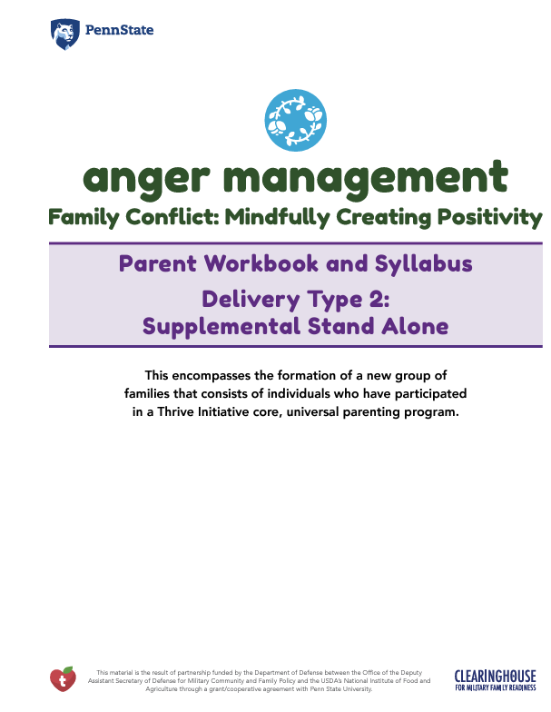
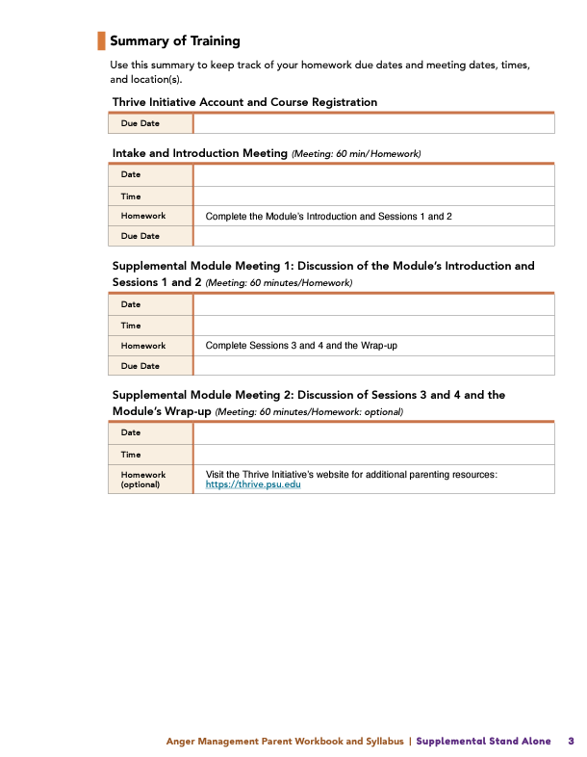
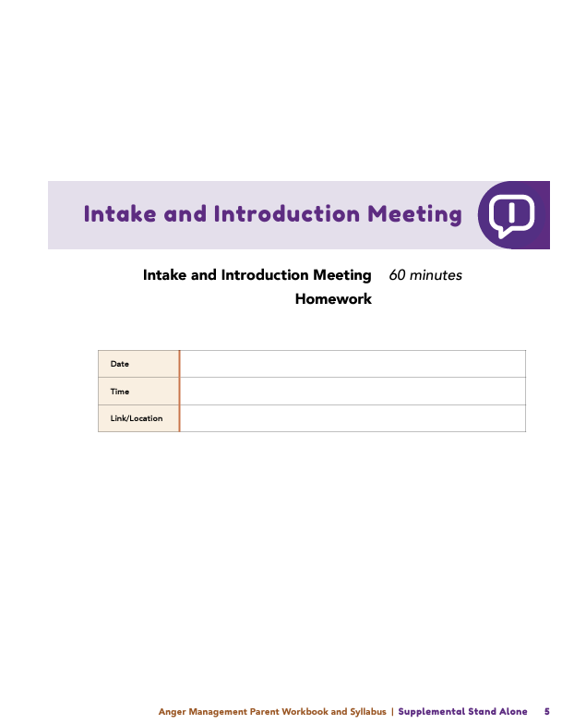
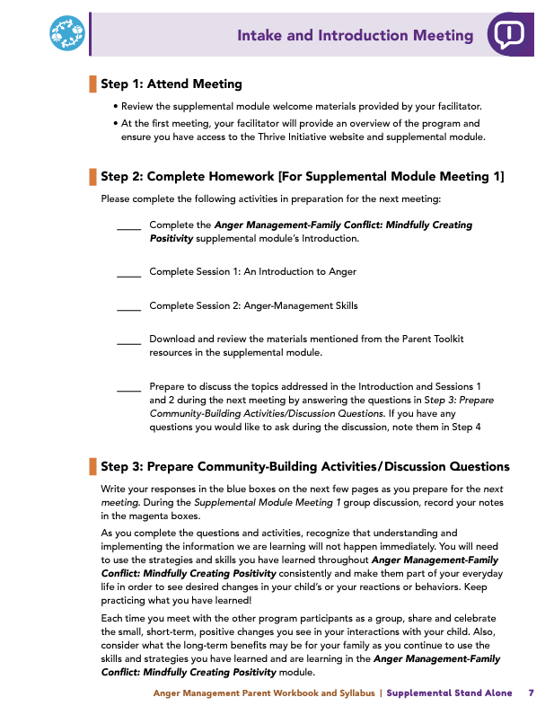

Parent Workbook
Syllabus
Notes:
Provide copies or screen share a copy of the Parent Workbook and Syllabus for the Anger Management-Family Conflict: Mindfully Creating Positivity module. Review the Summary of Training, and highlight the section where the participants can find pertinent information.

Slide 46
Expectations
Notes:
Overview of Expectations: Clearly define what is expected of participants in the Anger Management supplemental program.
Independent Completion: Inform families that they are expected to independently complete the online modules.
Full Engagement Required: Emphasize the importance of completing each module in full to maximize learning and benefit from the program.
Purpose of Meetings: Clarify that the in-person meetings are not for revisiting session content but for community building, reflecting on experiences, and discussing insights with other participants who are trying to successfully navigate anger and conflict.
Preparation for Discussions: Encourage participants to come to meetings prepared to share their thoughts and engage in discussions based on the content they've learned online.

Slide 47
REGISTER
Notes:
Complete any registration requirements for your organization. Then, explain how participants can access the supplemental module online. Offer support to help with any technological questions. All participants will have previously set up a Thrive Initiative account, but you need to ensure they can log in and find the information they need to get started or progress in the supplemental module.

Slide 48
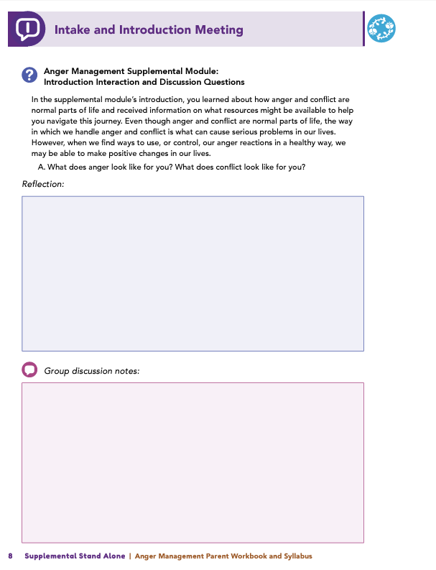
Homework
Complete the Introduction Module, Session 1: An Introduction to Anger, and
Session 2: Anger-Management Skills
View online modules
Complete workbook questions
Notes:
Homework Tasks: Assign Introduction Module, Session 1: An Introduction to Anger, and Session 2: Anger-Management Skills as homework.
Step 2 Clarification: Remind participants that this homework involves viewing online content and downloading necessary resources as part of Step 2. If time permits, show where to access these materials on the website.
Workbook Guidance: Show the specific pages in the Anger Management Parent Workbook and Syllabus related to these topics (D7)
Step 3 Clarification: Assign workbook discussion questions (beginning on page D8 in the parent workbook).
Format explanation: Explain the reason for 2 boxes per question (one for individual, one for group responses).
Encourage reflection and engagement: The more participants, think, reflect, and share the more meaningful the content becomes to each family.
Pro tip: Complete the workbook while viewing online modules.

Slide 49
Thank you for participating today.
Please reach out with any questions or concerns.
See you next week!
Notes:
Closing: Thank participants for their time and engagement.
Questions: Ask if there are any questions. (If someone needs personal assistance, ask them to speak with you individually after the group is dismissed).
Meeting 2: Remind participants of the date/time/location of the next meeting.
Homework: Remind participants to complete the homework.
Adjourn: Say goodbye to participants.

Slide 50
Meeting 1

Slide 51
Welcome back!
Please sign in and find a seat. We will begin soon.
If possible, please turn on your camera and enter your preferred name. We will begin soon.
Notes:
Choose one bullet point to display (the first bullet point is for in-person, the second is for virtual).
If in-person, greet participants as they come in the door and help them find a seat.
If virtual, give participants a heads up when you will be starting. For example, “Hi everyone, we will be starting in about one minute.”

Slide 52
  Conversation Starter
  Restate Ground Rules
  Group Discussion
  Homework
Notes:
Example language: Welcome back, families! We’re glad to see for our second meeting.
Review Meeting 2 Agenda:
Conversation Starters: We’ll get started with a quick question to get us all engaged and sharing.
Review of Ground Rules: A brief reminder of our ground rules to ensure our discussions remain respectful and productive.
Discussion and Homework: After our initial activities, we will discuss the workbook questions based on your experiences with the last set of homework followed by an explanation of the homework for our next meeting. Let’s get started!

Slide 53
Please answer one of the following questions:
  What is one aspect of your parent-child relationship that is working well?
  What is a skill you use effectively in your parenting?
Notes:
Example language: "Let's open our session with a fun question that will give us all a chance to share something about ourselves. Review the list of questions provided on the slide. Select one question that resonates with you, or that you feel comfortable sharing. This activity is designed to ease us into the meeting and build a friendly, open atmosphere.

Slide 54
Basic Ground Rules:
  Always start and end sessions on time.
  Cell phones should be on vibrate; members can quietly excuse themselves if a call must be taken.
  In virtual sessions, participants should mute themselves when taking calls outside the session.
Group-Specific Rules:
  Avoid judgment regarding other participants' parenting practices or knowledge gaps.
  One person speaks at a time to maintain order and clarity.
  Assume positive intent in all interactions to foster a positive atmosphere.
Confidentiality- Please be respectful and discrete with the personal stories being shared. This is a safe space to grow and learn.
Notes:
Introduction of Ground Rules: Start by stating some basic ground rules to create a supportive environment where families feel safe to share their parenting experiences.
Basic Ground Rules:
Always start and end sessions on time.
Cell phones should be on vibrate; members can quietly excuse themselves if a call must be taken.
In virtual sessions, participants should mute themself when taking calls outside the session.
Developing Group-Specific Rules:
Discuss and agree on additional rules as a group, such as:
Avoid judgment regarding other participants' parenting practices or knowledge gaps.
Ensure one person speaks at a time to maintain order and clarity.
Assume positive intent in all interactions to foster a positive atmosphere.
Confidentiality Discussion: Use this time to reinforce the importance of confidentiality, outlining your organization’s specific confidentiality clauses regarding statements related to abuse or neglect mandated reporting..
Example language:
As we begin, it's crucial to emphasize the importance of confidentiality within our group. We need to agree to keep all shared information within these sessions, including personal stories and sensitive details. This ensures a safe space where everyone feels comfortable sharing their experiences. Please remember that details shared by participants are given in trust and should be treated with respect and discretion.
Additionally, it’s important to note our mandated reporting clause for suspected abuse or neglect:
Legal Obligation: Our staff and facilitators are legally required to report any suspicions of child abuse or neglect.
Scope of Reporting: We must report any signs of potential harm to a child or vulnerable adult that arise during our sessions.
Procedure for Reporting: We handle these situations sensitively, informing involved individuals about necessary actions, unless it poses further risk.
Support for Affected Individuals: We provide support and resources to help those involved in a reporting situation.
Our primary concern is the safety and well-being of all individuals. If you have any questions or concerns about this policy, feel free to discuss them privately with me.

Slide 55
Anger
& Conflict
Self-Awareness
& Growth
Managing
Anger
Notes:
Provide an overview of the supplemental module using the following points that are taught in the supplemental module:
• Anger and conflict are normal parts of life, and every person will experience these emotions and challenges.
• When we experience anger and conflict, understanding how these emotions and the situation(s) that has created these emotions make us feel can help us realize certain characteristics or traits in ourselves. We may find that the emotional response we exhibit when we feel anger or conflict highlights issues, behaviors, or situations that we should consider changing, so we can be a positive role model for our children and be a loving and thoughtful parent.
• This module intends to support you as the parents and caregivers by helping you learn about anger management, what causes anger, and how to navigate your anger effectively.

Slide 56
An Introduction to Anger
  Think about the reasons that brought you here.
    What is your goal for managing anger and conflict?
    What does success look like for you?
Notes:
Review this section of the module with the participants by offering the following information:
• Even though anger and conflict are normal parts of life, how we handle our anger and conflict could cause serious problems in our lives. When we express our anger negatively—like yelling, throwing things, or using violence—we can make our lives, and the lives of our loved ones, unpleasant. However, when we find ways to use, or control, our anger reactions in a healthy way, we may be able to make positive changes in our lives.
• Managing anger and conflict in a positive way can be difficult. The stressors and challenges we encounter can make it hard for us to remain calm.
• Please look at the Action Plan Worksheet. You can use this worksheet to help you build and implement a plan and, then, use it as a tool as you complete the module.
Generate discussion among participants using the following questions:
Think about the reasons/situations that brought you here. What is your goal for yourself related to managing your anger and conflict?
Think about that goal. What does success look like?

Slide 57
Consequences of Anger
  What impact has your anger had on your life?
Notes:
Review this section of the module with the participants by offering the following information:
• Everyone experiences anger; however, when you negatively respond to the anger you feel, difficult consequences for you and for those around you may arise. The module talks about what uncontrolled or unhealthy anger may look like.
• Uncontrolled or unhealthy anger can produce negative reactions in people, and these reactions could produce consequences that may impact these individuals’ physical health, such as headaches or sleep problems; mental health, such as increased anxiety and/or depression; and relationships, such as yelling or shouting at others or name calling. In addition, consequences could affect finances, life stability, or sense of self.
Generate discussion among participants using the following questions:
What consequences have you experienced, or are you presently experiencing, due to your reactions from feeling anger? (Solicit responses such as physical health, mental health, relationship, and career consequences.)

Slide 58
Identifying Triggers
  What are some common anger triggers you’ve learned about?
  What are your personal triggers?
Notes:
Review this section of the module with the participants by offering the following information:
• Anger is often referred to as a “secondary emotion,” which means that anger is a reaction to a different, underlying emotion.
• In other words, we may show anger because we are trying to mask other emotions that we are experiencing, such as disappointment or humiliation. Consider this analogy: you can see the top of an iceberg, but most of the iceberg is below the surface of the water. Anger is like the top of the iceberg, and other feelings, such as sadness or embarrassment that drive the anger, lay under the surface.
• The Anger Cycle shows us the cyclical nature of anger. Understanding this cycle can help us manage our feelings of anger. (Facilitator Tip: See and/or share graphic of the Anger Cycle.)
Typically, the cycle begins with a triggering event. This is when you experience a situation or event that is unpleasant or that does not feel good or upsets you. You cannot avoid all situations that distress you.
After experiencing the trigger event, you may start to experience negative thoughts about yourself, other people, or the world in general.
When you focus on negative thoughts that have been generated by a triggering event, you may begin to feel an intense emotional response. This emotional response will likely be produced by secondary emotions.
Your reactions to your emotional responses can produce physical symptoms. Physical symptoms of feeling anger include experiencing an increased heart rate, shortness of breath, or feeling hot.
The last part of the cycle is your behavioral response. During this aspect of the cycle, you may exhibit negative behaviors, such as yelling, shouting, making poor choices, or frightening others. This is the part of the anger cycle you should avoid!
Generate discussion among participants using the following questions:
What are some examples of anger triggers that you learned about (Solicit responses such as encountering people who are rude, disrespectful, or loud; visiting places that are associated with bad memories; being stuck in traffic; having conversations about polarizing topics (e.g., politics; being late to an event; or having to clean up after others.)
What are some of your personal triggers (e.g., people, places, conversations, situations)?

Slide 59
Anger Warning Signs
  What were Ophelia’s anger warning signs?
  What are your anger warning signs?
  Do you notice negative thoughts, emotional responses, physical symptoms, or specific behaviors?
Notes:
Review this section of the module with the participants by offering the following information:
• One way to break the anger cycle is for you to identify when you are becoming angry before your emotions become too intense, and a blow-up or angry outburst (reaction) ensues. The first step in stopping an angry outburst or letting your anger take control of your actions and reactions is to identify that you are feeling angry.
• To do this, at each step in the Anger Cycle, you can stop and examine your thoughts and reactions. Are your thoughts negative? Are you having emotional responses or physical symptoms? Are you engaging in negative, distressing, or regrettable behaviors?
Facilitator Tip: Provide some of the following examples of what constitutes negative thoughts, emotional responses, physical symptoms, and behaviors.
• Negative thoughts: “Stupid,” “Worthless,” “Selfish,” “Bad Person,” “Horrible,” “Disgusting,” “Hate,” or “Evil.”
• Emotional Responses: Humiliated, Frustrated, Guilty, Jealous, Disrespected, Helpless, Powerless, Confused, Embarrassed, Anxious, Ashamed, Offended, Insecure, Hurt, Weak, Broken, Alone, or Betrayed.
• Physical Symptoms: increased heart rate, flushed cheeks, heavy breathing, sweating, light headedness, nausea, feeling hot, tense muscles, tearfulness, throat tightness, dizziness, or clenched jaw/grinding teeth.
• Behaviors: Pacing, yelling/talking loudly, arguing, only responding with short answers, becoming critical of others or yourself, crying, throwing things, clenching fists, increasing your use of curse words, or shutting down.
Generate discussion among participants using the following questions:
In the module, Ophelia initially had negative thoughts after her friends made a joke about her appearance, then she felt ashamed, her cheeks began to flush, and she shut down. What were her [Ophelia’s] anger warning signs? (Solicit the following responses: Negative Thoughts – I’m so disgusting; Emotional Response – ashamed; Physical symptoms – flushed cheeks; Behaviors – shut down.)
Think about yourself. Do you know your anger warning signs? What are some of the common experiences you have when you’re angry?
Do you have negative thoughts, emotional responses, or physical symptoms? Do you engage in certain behaviors?

Slide 60
Cognitive Distortions
Do you use any of these
cognitive distortions?
  All or Nothing Thinking
  Catastrophizing
  Minimizing
  Mind-Reading
  Overgeneralizing
  Disqualifying the Positive
  Labeling
  Fortune Telling
  Which ones show up most often in your thoughts?
Notes:
Review this section of the module with the participants by offering the following information:
• We all experience negative thoughts that can make us feel angry. There are tools and methods you can use to help you decrease the time you think about negative thoughts.
• To pick the right tool to overcome a negative thought, you need to recognize the negative thinking patterns you are having. These patterns are called cognitive distortions. There are several cognitive distortions discussed in the module, including All or Nothing Thinking, Catastrophizing, Minimizing, Disqualifying the Positive, Fortune Telling, Labeling, Mind Reading, and Overgeneralizing.
Facilitator Tip: Review one or two distortions to get the conversation going.
Generate discussion among participants using the following questions:
Do you tend to use any of the cognitive distortions discussed in the module?
Which ones pop up the most in your thought processes?

Slide 61
Challenging Negative Thoughts
Did you try any of the breathing, visualization, or relaxation techniques?
Notes:
Review this section of the module with the participants by offering the following information:
• Cognitive distortions have a common theme and are united in the following ways: they do not incorporate all of the available evidence, they do not look at multiple perspectives, and they do not look at the complexities of life or specific situations.
• If and when you have cognitive distortions, you need to focus on how to replace them with more helpful thoughts by thinking through the evidence, different perspectives, and the complexities to counteract the distortions.
• You can challenge your negative thoughts by identifying the thought and recognizing you’re having a negative cognition, challenging the validity of your thoughts, considering other perspectives, being fair to yourself, and validating your emotions.
Generate discussion among participants using all, or some, of the following questions:
In the module, you had a chance to examine some examples you could use to challenge negative thoughts. Practicing techniques, like mindfulness exercises or breathing exercises, can also help you relax, manage stress, and ultimately challenge those negative thoughts. Did anyone try a breathing technique—Box Breathing, Belly Breathing, Bumblebee Breathing, Alternative Nostril Breathing—that was mentioned in the module? If so, which one? When can you imagine yourself using that technique?
Did anyone try the guided imagery and visualization strategy or the Calm, Safe Place Visualization Technique? When can you imagine yourself using these techniques?
Did anyone try the Progressive Muscle Relaxation Technique? Did you like it? Why or why not?

Slide 62
Gratitude
  Do you use a Gratitude Journal or journal in general?
  How does it help you?
  Would you be interested in starting a Gratitude Journal?
Notes:
Review this section of the module with the participants by offering the following information:
• You may have heard individuals say that they “practice gratitude.” Practicing gratitude means that you make deliberate choices to focus on people or circumstances in your life for which you are grateful. Sometimes, when you are stressed, upset, unhappy, or angry, you may find it difficult to focus on the people or circumstances for which we are grateful.
• The feelings you can get from practicing gratitude may be useful to you as you manage your anger.
• Focusing on gratitude, or people or circumstances in your life that you are thankful for, can have positive benefits, such as improving your overall well-being; increasing your optimism, empathy, positivity, and self-esteem; and reducing your negative emotions, such as anxiety and depression. Practicing gratitude is also related to having lower levels of aggression, and the feelings gratitude generates may be useful in helping you manage anger.
Generate discussion among participants using all, or some, of the following questions:
The module mentioned that you could use a Gratitude Journal as a positive practice to help you alter your mindset.
Does anyone currently use a Gratitude Journal, or does anyone journal in general? How does it help you?
Is anyone who doesn’t already journal interested in starting a Gratitude Journal?

Slide 63
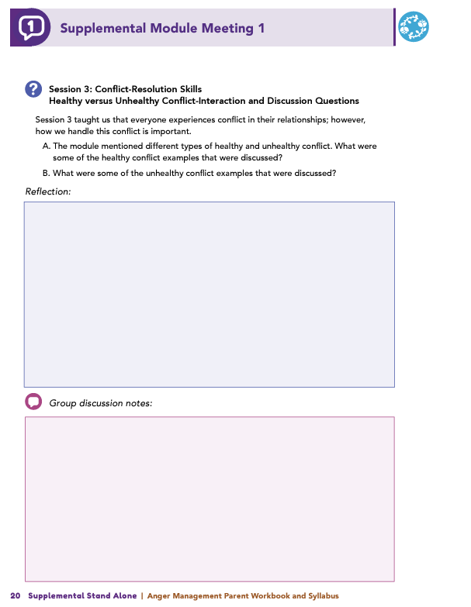
Homework
Complete Session 3: Conflict Resolution Skills and the Wrap Up
View online modules
Complete workbook questions
Notes:
Homework Tasks: Assign Session 3: Conflict Resolution Skills and Wrap Up Module as homework.
Step 2 Clarification: Remind participants that this homework involves viewing online content and downloading necessary resources as part of Step 2. If time permits, show where to access these materials on the website.
Workbook Guidance: Show the specific pages in the Anger Management Parent Workbook and Syllabus related to these topics (D21)
Step 3 Clarification: Assign workbook discussion questions (beginning on page D22 in the parent workbook).
Format explanation: Explain the reason for 2 boxes per question (one for individual, one for group responses).
Encourage reflection and engagement: The more participants, think, reflect, and share the more meaningful the content becomes to each family.
Pro tip: Complete the workbook while viewing online modules.

Slide 64
Thank you for participating today.
Please reach out with any questions or concerns.
See you next week!
Notes:
Closing: Thank participants for their time and engagement.
Questions: Ask if there are any questions. (If someone needs personal assistance, ask them to speak with you individually after the group is dismissed).
Meeting 2: Remind participants of the date/time/location of the next meeting.
Homework: Remind participants to complete the homework.
Adjourn: Say goodbye to participants.

Slide 65
Meeting 2

Slide 66
Please sign in and find a seat.
We will begin soon.
If possible, please turn on your camera.
We will begin soon.
Notes:
Choose one bullet point to display (the first bullet point is for in-person, the second is for virtual).
If in-person, greet participants as they come in the door and help them find a seat.
If virtual, give participants a heads up when you will be starting. For example, “Hi everyone, we will be starting in about one minute.”

Slide 67
Conversation Starters
Group Discussion
Thrive Programming
Notes:
Example language: Welcome back, everyone! We're glad to see you for our third and final meeting.
*Optional Sections: Please note that the conversation starters are optional. If you prefer to skip these, simply remove the first bullet point from this slide and proceed to the next relevant slide in the deck.
Example language if omitting: We'll dive straight into discussing the key questions from our last session’s homework. We’ll wrap up with a discussion on additional Thrive programs that may interest you
Example language if not omitting:
Conversation Starters: We’ll get started with a quick question to get us all engaged and sharing.
Review of Ground Rules: A brief reminder of our ground rules to ensure our discussions remain respectful and productive.
Discussion and Homework: After our initial activities, we will discuss the workbook questions based on your experiences with the last set of homework followed by an explanation of the homework for our next meeting. Let’s get started!

Slide 68
Please answer one of the following questions:
What is an activity you enjoy doing with your child?
If you could relive one moment with your child, what would it be?
Notes:
Example language: "Let's open our session with a fun question that will give us all a chance to share something about ourselves. Review the list of questions provided on the slide. Select one question that resonates with you, or that you feel comfortable sharing. This activity is designed to ease us into the meeting and build a friendly, open atmosphere.

Slide 69
Basic Ground Rules:
  Always start and end sessions on time.
  Cell phones should be on vibrate; members can quietly excuse themselves if a call must be taken.
  In virtual sessions, participants should mute themselves when taking calls outside the session.
Group-Specific Rules:
  Avoid judgment regarding other participants' parenting practices or knowledge gaps.
  One person speaks at a time to maintain order and clarity.
  Assume positive intent in all interactions to foster a positive atmosphere.
Confidentiality- Please be respectful and discrete with the personal stories being shared. This is a safe space to grow and learn.
Notes:
Introduction of Ground Rules: Start by stating some basic ground rules to create a supportive environment where families feel safe to share their parenting experiences.
Basic Ground Rules:
Always start and end sessions on time.
Cell phones should be on vibrate; members can quietly excuse themselves if a call must be taken.
In virtual sessions, participants should mute themself when taking calls outside the session.
Developing Group-Specific Rules:
Discuss and agree on additional rules as a group, such as:
Avoid judgment regarding other participants' parenting practices or knowledge gaps.
Ensure one person speaks at a time to maintain order and clarity.
Assume positive intent in all interactions to foster a positive atmosphere.
Confidentiality Discussion: Use this time to reinforce the importance of confidentiality, outlining your organization’s specific confidentiality clauses regarding statements related to abuse or neglect mandated reporting..
Example language:
As we begin, it's crucial to emphasize the importance of confidentiality within our group. We need to agree to keep all shared information within these sessions, including personal stories and sensitive details. This ensures a safe space where everyone feels comfortable sharing their experiences. Please remember that details shared by participants are given in trust and should be treated with respect and discretion.
Additionally, it’s important to note our mandated reporting clause for suspected abuse or neglect:
Legal Obligation: Our staff and facilitators are legally required to report any suspicions of child abuse or neglect.
Scope of Reporting: We must report any signs of potential harm to a child or vulnerable adult that arise during our sessions.
Procedure for Reporting: We handle these situations sensitively, informing involved individuals about necessary actions, unless it poses further risk.
Support for Affected Individuals: We provide support and resources to help those involved in a reporting situation.
Our primary concern is the safety and well-being of all individuals. If you have any questions or concerns about this policy, feel free to discuss them privately with me.

Slide 70
Healthy versus Unhealthy Conflict
  What are some examples of healthy conflict?
  What are some examples of unhealthy conflict?
Notes:
Review this section of the module with the participants by offering the following information:
• Everyone experiences conflict in their relationships; however, how we handle this conflict is important. Healthy conflict can look different in different relationships, but healthy conflict always includes both of the people involved working toward a positive outcome together.
• We may experience unhealthy conflict in our lives that can be damaging for our relationships. Although we can’t control how others handle conflict, we can work on how we handle conflict and how we can learn to resolve concerns in a healthy way.
Generate discussion among participants using the following questions:
The module mentioned different types of healthy and unhealthy conflict. What were some of the healthy conflict examples that were discussed? (Solicit the following responses: Compromising, trying to resolve a problem as a team, expressing emotions, finding a win-win solution, and sharing experiences.)
What were some of the unhealthy conflict examples that were discussed? (Solicit the following responses: Trying to make the other person look stupid, minimizing other’s experiences, viewing conflict as a battle, shouting or yelling, belittling someone, name calling, trying to “beat” the other person in the argument, or pushing or shoving.)

Slide 71
Consequences of Unhealthy Conflict
  What consequences have you experienced from conflict?
Notes:
Review this section of the module with the participants by offering the following information:
• Much like anger, participating in unhealthy conflict or conflict too frequently can have many negative consequences for you and your relationships. Unhealthy conflict can impact you in a variety of ways. For example, it can have physical and mental health consequences, relationship consequences, and other consequences. Some examples mentioned in the module include the following:
Physical Health Consequences: I struggle with high blood pressure because I am in constant conflict.
Mental Health Consequences: I often think of myself in a negative light because I am in constant conflict with my partner.
Relationship Consequences: When I was arguing with my partner, in anger, I said something I didn’t mean, and I hurt them. I think they may still be a bit upset with me.
Career Consequences: After that day when I was having a lot of problems and I exploded at Devon, it has been much harder to work with them.
Other Consequences: I yelled at our waiter one time at my favorite restaurant and got kicked out. My partner has been too embarrassed to go back.
Generate discussion among participants using the following questions:
When you’re in conflict with another, what are some of the consequences you have experienced? (Solicit responses like experiencing sleeping problems, having conflict take over thoughts, feeling unwell, or not talking to others.)

Slide 72
Consequences of Unhealthy Conflict
  Did any cognitive distortions resonate with you in past conflicts?
  Which ones do you tend to use?
  What is your plan for managing them next time?
"The next time I notice I am using [distortion], I will [strategy]."
Notes:
Review this section of the module with the participants by offering the following information:
• Earlier in the module, we identified some common cognitive distortions people experience in collaboration with feeling anger. Although cognitive distortions can be focused on ourselves, they can also be focused on other people in our lives. These cognitive distortions can increase our chances of becoming angry or experiencing unhealthy conflict with someone.
Generate discussion among participants using all, or some, of the following questions:
The module asked you to complete an activity in which you had to consider different cognitive distortions that you might experience and that could contribute to unhealthy conflict. (Facilitator Tip: Review one or two cognitive distortions to get the conversation going.) Did any of the cognitive distortions resonate with you as you thought about past conflicts in your life?
Are there any you tend to use?
Now that you know more about yourself and the cognitive distortion(s) you often use, would anyone like to share what their plan is for the next time they notice themselves using that distortion(s)?
The next time I notice I am using the distortion of___________, I will ________________________ (Example: The next time I notice I am using overgeneralization, I will try to remember a time when the generalization wasn’t true.)

Slide 73
Taking an Anger Time Out
Steps for Taking a Timeout
  Recognize your anger signs
  Acknowledge the need for a break
  Communicate your timeout
  Ensure understanding
  Set a time limit
  Relax during the break
  Return when ready
  Have you ever regretted something said in an argument?
  How might a timeout have changed the outcome?
Notes:
Review this section of the module with the participants by offering the following information:
Earlier in the module, you identified some of your personal anger warning signs. If you notice yourself experiencing any of your personal warning signs, an additional skill or strategy you could use is to take an anger timeout. The module discusses seven steps for taking the timeout.
• Step 1: Recognize your internal warning signs that indicate you are becoming angry.
• Step 2: Recognize the need for a timeout.
• Step 3: Communicate to the other person that you need a timeout.
• Step 4: Do your best to ensure the other individual understands you need to take a break.
• Step 5: Determine how long the timeout will be.
• Step 6: Use relaxation techniques during the break.
• Step 7: Return to the conversation.
Taking a timeout allows you time to work on managing your anger and behaviors, so you can return to the conversation in a calmer manner.
Generate discussion among participants using the following questions:
Have you ever had an argument and regretted something that you said in the heat of the moment?
How might that interaction have gone differently if you had paused and taken a timeout?

Slide 74
Positive Conflict Resolution Strategies
  Do you use any of these strategies?
  Which ones would you like to start?
  Which might be the most challenging and why?
    Reflective Listening – Show you truly understand.
    "I" Statements – Focus on your feelings, not blame.
    Understanding Emotions – Identify deeper issues behind conflicts.
    Setting Boundaries – Protect your well-being while respecting others.
    Changing Behaviors – Use strategies like waiting to talk, writing, therapy, or apologizing.
Notes:
Review this section of the module with the participants by offering the following information:
• Session 3 mentions additional positive conflict-resolution strategies that you can use when you are engaged in conflict with another person. Those strategies include reflective listening, using “I” Statements, understanding the underlying emotions of conflict, setting healthy boundaries, and changing your behaviors.
• Review each strategy as follows:
Reflective Listening. Reflective listening is not just repeating what the other person says, but it is also trying to demonstrate that you really listened and heard what the other person was trying to communicate to you.
“I” Statements. An “I” statement is when you start your sentence with “I” and focus on your emotions and experiences. The concept of using “I” statements can help you avoid using “you” statements during conflict. “You” statements can make others feel defensive or as if you are blaming them, which can halt positive conversations and stop healthy conflict.
Understanding the Underlying Emotions of Conflict. Have you ever found yourself very irritated over something seemingly small? We all have, and, typically, there is a deeper hurt, or the small action is part of a larger pattern that is causing you hurt or distress. You need to try to discover either the (1) underlying emotion of the conflict or (2) the larger pattern of behavior that is causing you distress. Taking these actions can help you engage in a healthy conversation about what is truly bothering you!
Setting Healthy Boundaries. A healthy boundary involves creating a limit or rule that protects yourself while also allowing the other person to make decisions about their life. Setting a healthy boundary is NOT telling another person what to do or how to live their life. A healthy boundary is when you determine a limit of what you will and won’t do or tolerate. You may express this limit or limits to others, and, if anyone does not respect a boundary you set, you need to be clear that consequences may occur.
Changing your Behaviors. There are many behavioral strategies that you can use to help reduce conflict in your life. Some of those mentioned in the module include waiting and talking in person, writing a letter to explore your feelings, attending therapy, practicing gratitude, communicating about issues before they grow, and apologizing when warranted.
Generate discussion among participants using all, or some, of the following questions:
Consider these strategies. Are there any you currently use?
Are there any strategies that you’d like to start using?
Which strategies might be the most challenging for you to use and why?

Slide 75
Wrap-Up
Questions
  What topic from the module was most helpful to you as a parent? Why?
  What strategies or skills will help you reach your parenting goals?
  Has anyone used an anger-management strategy from the module? How did it compare to before?
  What has changed in your interactions with your child?
  Have you noticed a difference in how your child responds to your parenting?
Notes:
Tell participants you are wrapping up, and generate discussion among participants using all, or some, of the following questions:
Which topic discussed in the supplemental module was the most beneficial to you as a parent? Why?
What strategies or skills did you learn in the supplemental module that will help you achieve the goals you have for yourself as a parent?
Would anyone like to share a moment when you used an anger-management strategy that you learned in the supplemental module and how your actions compared to your actions prior to engaging in the supplemental module?
What has changed in your interactions with your child since before completing the supplemental module?
Have you noticed a difference in the way your child is responding to your parenting?

Slide 76
Additional Thrive Programs
  Take Root is available for parents and caregivers of children who are between 0 and 3 years old.
  Sprout is available for parents and caregivers of children who are between 3 and 5 years old.
  Grow is available for parents and caregivers of children who are between 5 and 10 years old.
  Branch Out is available for parents and caregivers of children who are between 10 and 18 years old.
Notes:
Provide support and encouragement to your participants to explore other Thrive Initiative programming. Share and/or register participants for any additional hybrid implementation options that you plan to offer. Thrive Initiative programming may include any of the following:
Universal Programs
• Take Root is available for parents and caregivers of children who are between 0 and 3 years old.
• Sprout is available for parents and caregivers of children who are between 3 and 5 years old.
• Grow is available for parents and caregivers of children who are between 5 and 10 years old.
• Branch Out is available for parents and caregivers of children who are between the ages of 10 and 18 years old.

Slide 77
Notes:
Additional supplemental modules are available on a variety of topics and can be accessed online at https://thrive.psu.edu/modules/supplemental/.
Encourage participants to continue to visit the Thrive website, https://thrive.psu.edu, as their child develops and grows.
They can access additional resources and materials like mini-booster modules, blog postings, parenting handouts and guides, an inclusivity toolkit, and newsletters.

Slide 78
Thank you all for your dedication and participation. Every effort you make significantly impacts your child's future success.
Notes:
Example language:
Thank you, parents and caregivers, for your active participation. Please continue to visit the Thrive website as your child develops and grows—it's a valuable resource that can support you through every stage of their growth.

