Slide 1



As of February 24, 2025
Introduction
Notes:
Delivery Type 1: Supplemental Extension begins here, on slide 1.
Delivery Type 2 : Supplemental Stand Alone begins on slide 37.

Slide 2


Welcome!
Please sign in and find a seat. We will begin soon.
If possible, please turn on your camera and enter your preferred name. We will begin soon.
Notes:
Choose one bullet point to display (the first bullet point is for in-person, the second is for virtual).
If in-person, greet participants as they come in the door and help them find a seat.
If virtual, give participants a heads up when you will be starting. For example, “Hi everyone, we will be starting in about one minute.”

Slide 3

AGENDA
  Overview
  Syllabus
  Expectations
  Registration
  Homework
Notes:
Welcome: Introduce yourself and thank participants for choosing to be a part of the Coparenting Supplemental Parenting Program. Explain that Meeting 1 will provide an overview of the program, who is in our group, and what is expected of parents who participate. We will discuss the materials you received and provide instructions on how to use them.
Encourage participants to ask questions as they arise or to jot them down and ask at the end of the meeting.

Slide 4







  Target Audience
  Program Focus
  Skill Building
  Reflective Sharing
  Program Structure
  Goals
Notes:
Coparenting: Coordinated. Cooperative. United. is an online supplemental module for parents (and caregivers), of children of any age, who have completed at least one of the Thrive Initiative’s core, universal parenting program(s). The supplemental module focuses on building harmonious coparenting relationships.
Being able to coparent effectively depends, largely, on the teamwork of a child’s parents and/or caregivers. The online supplemental module’s sessions and the hybrid implementation meetings will explore factors that can positively impact the parents’/caregivers’ working relationships for the well-being of the child. Topics like coordination, cooperation, and presenting a united front to the child, are examined.
During the online supplemental module sessions and throughout the hybrid implementation meetings, information and parenting strategies that parents can use and adapt, as necessary, to fit their individual circumstances and family needs will be disseminated. The supplemental module content is designed to help parents build on their existing skills and strategies, so they can effectively coparent. Participants are encouraged to work with their coparenting partner(s) to nurture a relationship that centers around respect and promotes active coparenting collaboration for the well-being of the child.
Some of the content that is read and practiced in the supplemental module and discussed in the hybrid implementation meetings might be familiar to the parents, and they may already know about and use the disseminated information. Therefore, they may use the meeting time as an opportunity to realize, appreciate, and share what already works for them, their child, and their family.
Coparenting: Coordinated. Cooperative. United. is an online supplemental module for parents of children of any age. It includes an introduction and four sessions.
After participating in the online supplemental module sessions and the hybrid implementation meetings, parents and caregivers should be able to do the following:
• understand how their childhood experiences influence their coparenting (e.g., beliefs, values, expectations);
• recognize the benefits of coparents embracing an authoritative parenting style;
• discuss differences in parenting expectations and goals, and develop a coparenting plan that reflects compromise;
• know when and how to cooperatively establish developmentally appropriate boundaries and guidelines for a child;
• cultivate in and model positive relationships for a child;
• discuss and divide caregiving responsibilities to increase parental and partnering satisfaction;
• promote supportive coparenting behaviors like active cooperation, coordination, investment with the child, warmth in interactions, positive overt and covert coparenting, and mutual respect;
• identify and practice strategies for improving the coparenting relationship and parental unity such as self-care; mental and emotional support; marital/couples’ relationship quality, if applicable; and finding joy in parenting and time spent with the child;
• consider child development and what strategies can be used to adapt coparenting skills and plans as a child ages.

Slide 5
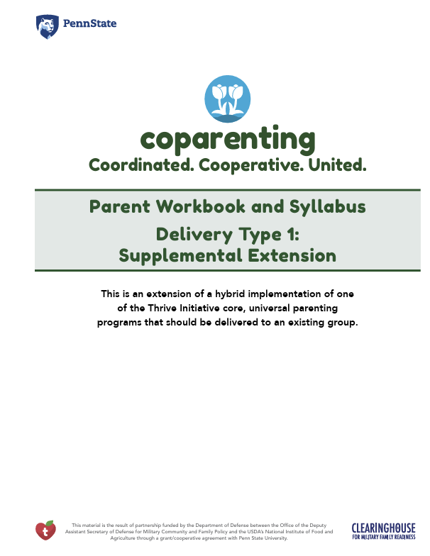
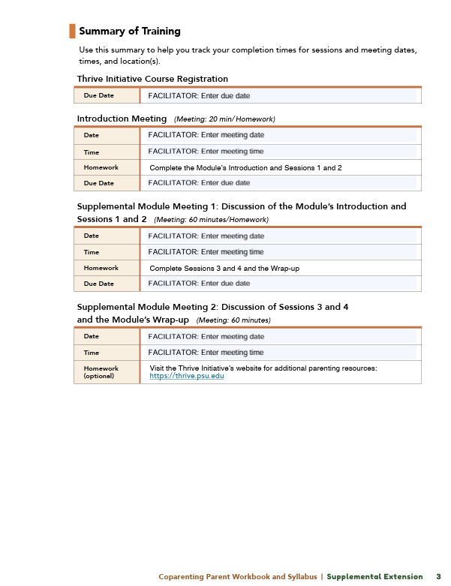

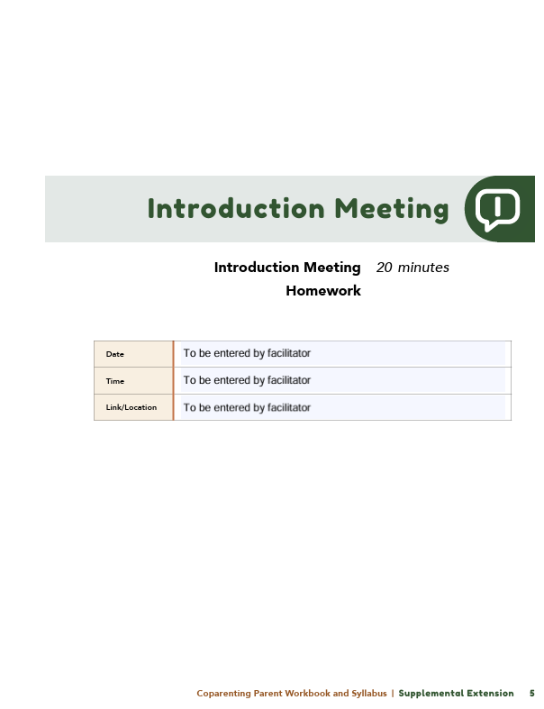
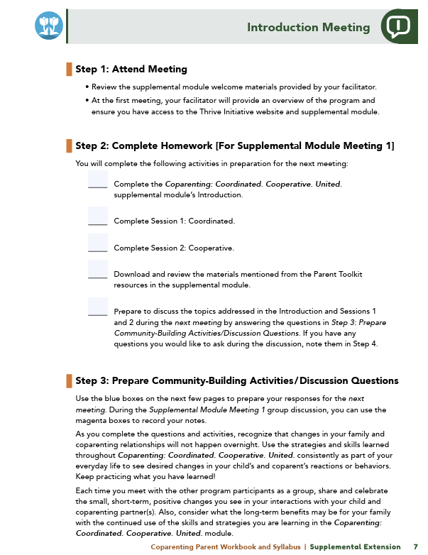

Parent Workbook
Syllabus
Notes:
Provide copies or screen share a copy of the Parent Workbook and Syllabus for the Coparenting: Coordinated. Cooperative. United. supplemental module. Review the Summary of Training, and highlight the section where the participants can find pertinent information.

Slide 6
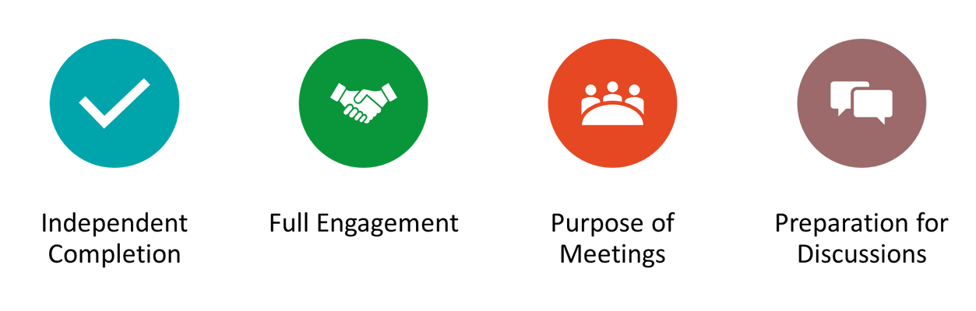
Expectations
Notes:
Overview of Expectations: Clearly define what is expected of participants in the Coparenting supplemental program.
Independent Completion: Inform families that they are expected to independently complete the online modules.
Full Engagement Required: Emphasize the importance of completing each module in full to maximize learning and benefit from the program.
Purpose of Meetings: Clarify that the in-person meetings are not for revisiting session content but for community building, reflecting on experiences, and discussing insights with other participants who are trying to successfully navigate coparenting.
Preparation for Discussions: Encourage participants to come to meetings prepared to share their thoughts and engage in discussions based on the content they've learned online.

Slide 7


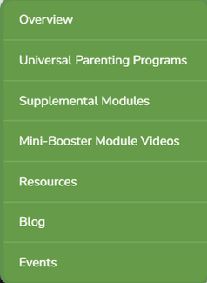
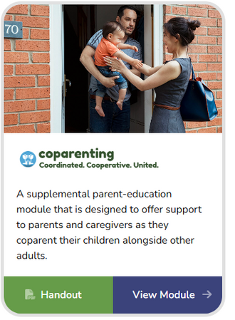

REGISTER
Notes:
Explain how participants can access the supplemental module online. Offer support to help with any technological questions. All participants will have previously set up a Thrive account, but you need to ensure they can log in and find the information they need to get started or progress in the supplemental module.

Slide 8
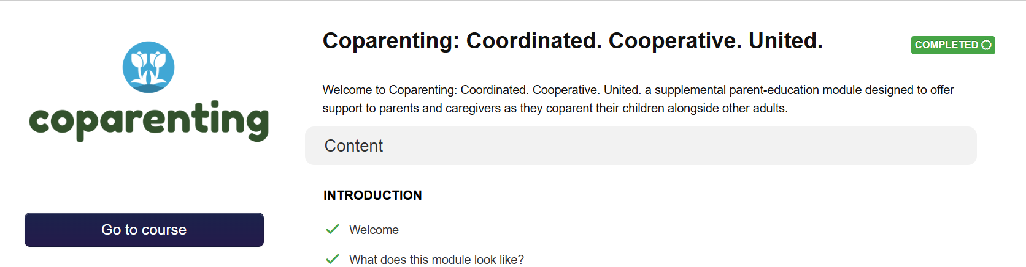
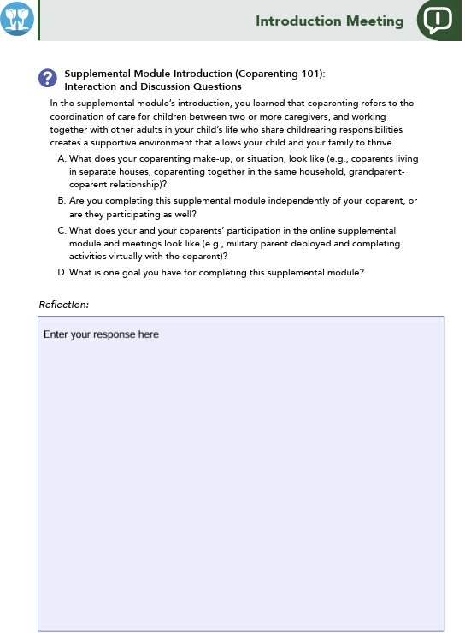





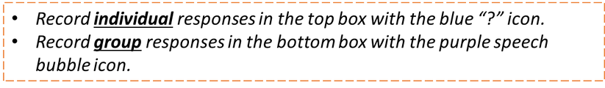
Homework
Complete the Introduction, Session 1: Coordinated, and Session 2: Cooperative
View online modules
Complete workbook questions
Notes:
Homework Tasks: Assign Introduction, Session 1: Coordinated, and Session 2: Cooperative as homework.
Step 2 Clarification: Remind participants that this homework involves viewing online content and downloading necessary resources as part of Step 2. If time permits, show where to access these materials on the website.
Workbook Guidance: Show the specific pages in the Coparenting Parent Workbook and Syllabus related to these topics (D7)
Step 3 Clarification: Assign workbook discussion questions (beginning on page D8 in the parent workbook).
Format explanation: Explain the reason for 2 boxes per question (one for individual, one for group responses).
Encourage reflection and engagement: The more participants, think, reflect, and share the more meaningful the content becomes to each family.
Pro tip: Complete the workbook while viewing online modules.

Slide 9


Thank you for participating today.
Please reach out with any questions or concerns.
See you next week!
Notes:
Closing: Thank participants for their time and engagement.
Questions: Ask if there are any questions. (If someone needs personal assistance, ask them to speak with you individually after the group is dismissed).
Meeting 2: Remind participants of the date/time/location of the next meeting.
Homework: Remind participants to complete the homework.
Adjourn: Say goodbye to participants.

Slide 10
Meeting 1

Slide 11

Welcome back!
Please sign in and find a seat. We will begin soon.
If possible, please turn on your camera and enter your preferred name. We will begin soon.
Notes:
Choose one bullet point to display (the first bullet point is for in-person, the second is for virtual).
If in-person, greet participants as they come in the door and help them find a seat.
If virtual, give participants a heads up when you will be starting. For example, “Hi everyone, we will be starting in about one minute.”

Slide 12

  Conversation Starter
  Restate Ground Rules
  Group Discussion
  Homework
Notes:
Example language: Welcome back, families! We’re glad to see for our second meeting.
Review Meeting 2 Agenda:
Conversation Starters: We’ll get started with a quick question to get us all engaged and sharing.
Review of Ground Rules: A brief reminder of our ground rules to ensure our discussions remain respectful and productive.
Discussion and Homework: After our initial activities, we will discuss the workbook questions based on your experiences with the last set of homework followed by an explanation of the homework for our next meeting. Let’s get started!

Slide 13

Please answer one of the following questions:
  What is one aspect of your parent-child relationship that is working well?
  What is a skill you use effectively in your parenting?
Notes:
Example language: "Let's open our session with a fun question that will give us all a chance to share something about ourselves. Review the list of questions provided on the slide. Select one question that resonates with you, or that you feel comfortable sharing. This activity is designed to ease us into the meeting and build a friendly, open atmosphere.

Slide 14


Basic Ground Rules:
  Always start and end sessions on time.
  Cell phones should be on vibrate; members can quietly excuse themselves if a call must be taken.
  In virtual sessions, participants should mute themselves when taking calls outside the session.
Group-Specific Rules:
  Avoid judgment regarding other participants' parenting practices or knowledge gaps.
  One person speaks at a time to maintain order and clarity.
  Assume positive intent in all interactions to foster a positive atmosphere.
Confidentiality- Please be respectful and discrete with the personal stories being shared. This is a safe space to grow and learn.
Notes:
Introduction of Ground Rules: Start by stating some basic ground rules to create a supportive environment where families feel safe to share their parenting experiences.
Basic Ground Rules:
Always start and end sessions on time.
Cell phones should be on vibrate; members can quietly excuse themselves if a call must be taken.
In virtual sessions, participants should mute themself when taking calls outside the session.
Developing Group-Specific Rules:
Discuss and agree on additional rules as a group, such as:
Avoid judgment regarding other participants' parenting practices or knowledge gaps.
Ensure one person speaks at a time to maintain order and clarity.
Assume positive intent in all interactions to foster a positive atmosphere.
Confidentiality Discussion: Use this time to reinforce the importance of confidentiality, outlining your organization’s specific confidentiality clauses regarding statements related to abuse or neglect mandated reporting..
Example language:
As we begin, it's crucial to emphasize the importance of confidentiality within our group. We need to agree to keep all shared information within these sessions, including personal stories and sensitive details. This ensures a safe space where everyone feels comfortable sharing their experiences. Please remember that details shared by participants are given in trust and should be treated with respect and discretion.
Additionally, it’s important to note our mandated reporting clause for suspected abuse or neglect:
Legal Obligation: Our staff and facilitators are legally required to report any suspicions of child abuse or neglect.
Scope of Reporting: We must report any signs of potential harm to a child or vulnerable adult that arise during our sessions.
Procedure for Reporting: We handle these situations sensitively, informing involved individuals about necessary actions, unless it poses further risk.
Support for Affected Individuals: We provide support and resources to help those involved in a reporting situation.
Our primary concern is the safety and well-being of all individuals. If you have any questions or concerns about this policy, feel free to discuss them privately with me.

Slide 15





Coparenting = teamwork
Coparenting
Every family is unique
Collaboration is key
Teamwork matters
Supportive partnership
Notes:
Provide an overview of the supplemental module using the following points that are taught in the supplemental module:
• Coparenting refers to the coordination of care for children between two or more caregivers. It is separate from parenting.
• Every family and its make-up are unique.
• You, the parent or caregiver, should work with other adults in your child’s life who share childrearing responsibilities in order to create a supportive environment that allows your child and your family to thrive.
• Being able to coparent effectively depends, largely, on the caregivers’ teamwork.
• When coparents are working well together, the coparenting is supportive and harmonious.

Slide 16



Introduction Questions
  What does your coparenting situation look like?
  Are you completing this module alone or with your coparent?
  How does each coparent participate?
  What is one goal you hope to achieve from this module?
Notes:
Ask the following questions of all of the participants, and highlight the variety of coparenting relationships:
What does your coparenting make-up, or situation, look like (e.g., coparents living in separate houses, coparenting together in the same household, grandparent-coparent relationship)?
Are you completing this module independently of your coparent, or are they participating as well? What does each coparents’ participation look like (e.g., military parent deployed and completing activities virtually with the coparent)?
Ask the following question and solicit answers from a few participants to generate discussion:
What is one goal you hope to achieve by completing this supplemental module?

Slide 17

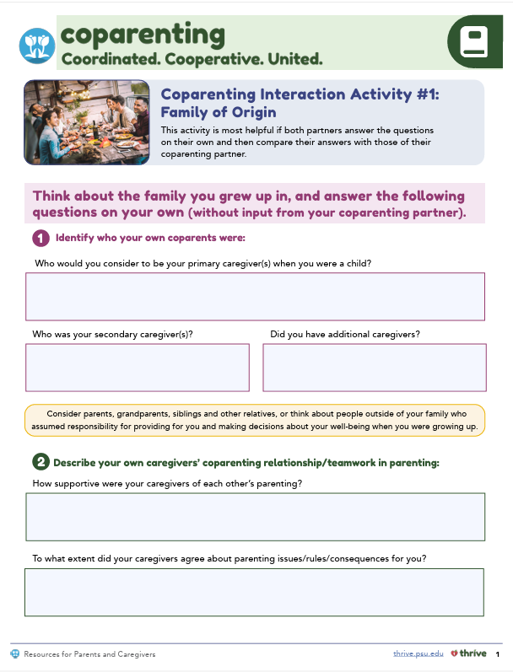



Family of
Origin
  What positive behaviors from your upbringing do you want to repeat?
  What did you learn from sharing with your coparent?
Notes:
Review this section of the module with the participants by offering the following information:
• As parents, we are sometimes unaware of how our experiences in our families of origin may have impacted ideas about and expectations regarding our coparenting relationships.
• A first step towards building a supportive coparenting relationship is to discuss how our childhood experiences may be shaping our expectations for the coparenting relationship.
• The supplemental module also explored strategies for effectively dividing parenting responsibilities. Your values and beliefs that are related to dividing parenting responsibilities might be influenced by your family of origin experiences. You reflected on this in the supplemental module.
Generate discussion among participants using the following questions:
Let’s think about positive experiences and consider what coparenting behaviors, from your family of origin, you would like to replicate or do the same in your own family?
When you shared your coparenting experiences from your family of origin with your coparent, what did you learn about each other?

Slide 18

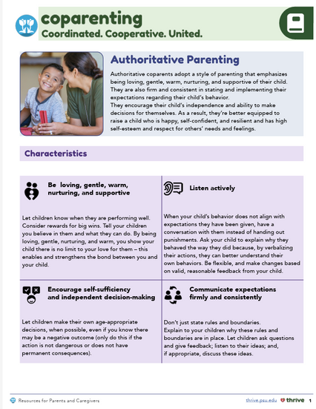
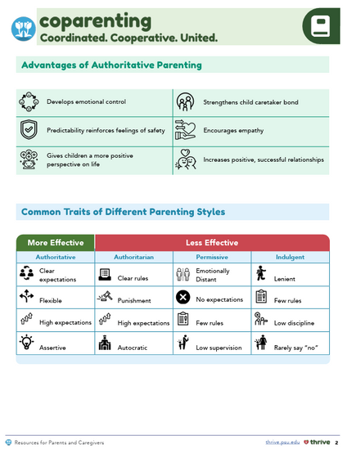

Comparing Parenting Styles and Attitudes
  What did you learn about your preferred parenting style?
  How do your views compare with your coparent’s?
Notes:
Review this section of the module with the participants by offering the following information:
• The three most common approaches to parenting are authoritarian, authoritative, and permissive or indulgent. You learned that adopting an authoritative parenting style, which balances setting limits with showing love, benefits the child and the coparent. You completed an interaction activity to see how much you agreed with statements that reflect your use of each parenting style.
Generate discussion among participants using the following questions:
What did you learn about the parenting style you endorsed the most?
Would anyone like to share how your and your coparent’s views on parenting styles are the same or different?
Review the following information with participants:
• Remember to show respect for your coparent’s differing views, and negotiate compromises in your approaches to parenting in order to create more supportive coparenting alliances.
• Some ways to improve your coparenting relationship are to coordinate parenting attitudes, goals for your child’s behavior, and the parenting strategies or approaches you both have. For example, coparents can agree on behavioral expectations and approaches to discipline, education, and standards of safety.
• Try to remain flexible, and, when you do not agree, be respectful and discuss differences outside of the presence of your child.

Slide 19

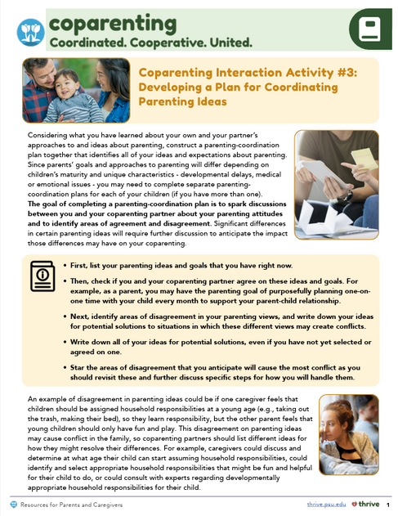

Developing a Parenting Coordination Plan
  What is one goal you and your coparent agreed on?
  What is one disagreement you had, and how did you resolve it?
Notes:
Review this section of the module with the participants by offering the following information:
• In the supplemental module, you completed a Plan for Coordinating Parenting Ideas in which you identified potential solutions to disagreements in your parenting ideas.
Example: An example of a disagreement in parenting ideas could be if one caregiver feels that children should be assigned household responsibilities at a young age (e.g., taking out the trash, making their bed), so they learn responsibility, but the other parent feels that young children should only have fun and play. This disagreement on parenting ideas may cause conflict in the family, so coparenting partners should list some ideas for how they might resolve their differences. For example, caregivers could discuss and determine at what age their child can start assuming household responsibilities, could identify and select appropriate household responsibilities that might be fun and helpful for their child to do, or could consult with experts regarding developmentally appropriate household responsibilities for their child.
Generate discussion among participants using the following questions:
Is anyone willing to share one parenting goal or idea that you and your coparent agreed on?
Is anyone willing to share one parenting goal or idea that you and your coparent disagreed on and what solutions you identified?
Review the following information with participants:
• Presenting a united front shows your child that you and your coparent agree on rules and consequences for behaviors, and your collaboration and consistency send a clear message to your child about what is expected of them.

Slide 20

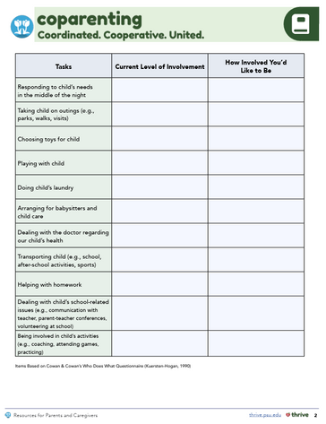
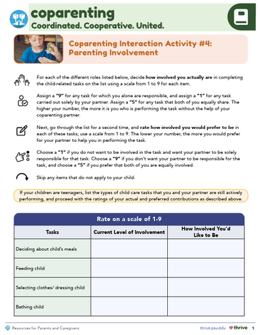

Cooperative Parenting Involvement
  Any tasks you want to do more or less?
  Has your coparent identified changes?
  How do you handle avoided tasks?
  How might you discuss responsibilities?
  What systems help prevent conflicts?
Notes:
Review this section of the module with the participants by offering the following information:
• Inequality in the division of responsibilities between partners can result in one (or more) coparent(s) feeling overburdened or overwhelmed.
• Satisfaction with the assignment of family or parenting responsibilities can lead to higher self-esteem, better marital quality, and lower parenting stress. In addition, when expectations for child care responsibilities are met, individuals generally perceive their coparenting as more positive.
• In the Parenting Involvement activity, you rated and discussed involvement in common parenting responsibilities like feeding and transportation.
Generate discussion among participants using all, or some, of the following questions:
Did you identify any caregiving tasks that you want to perform more or less often?
Has your coparent identified any areas they would like to change?
Would someone like to share a plan that you and your coparent developed to address either duties or tasks that cause conflict between you and your coparent or duties or tasks that are avoided or “forgotten” by you and your coparent?
If you haven’t done so already, how might you discuss concerns around the division of responsibilities with your coparent?
What systems have you established to address future conflicts that might arise related to performing various childrearing tasks?

Slide 21
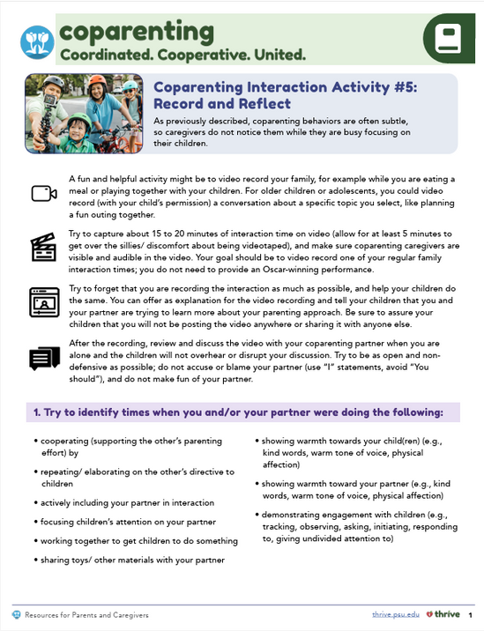


Record
and
Reflect
  How did the tone feel?
  How would your child describe it?
  How can you improve teamwork?
  What changes will you make?
  What promotes harmony?
Notes:
Review this section of the module with the participants by offering the following information:
• In Session 2, you learned about the importance of warmth, play, investment with your child, and cooperation and respect with your coparent. You were then asked to record a video of your family engaging in an activity or conversation. Then, you were instructed to watch and discuss the video with your coparent to identify times when you were and were not interacting in ways that benefited your coparenting relationship and your family.
Generate discussion among participants using all, or some, of the following questions:
How did you and your coparent feel regarding the tone you set in your family interaction?
How do you think your child would describe how the interaction went?
What could you and your partner have done differently to improve your teamwork as coparents?
What changes do you and your coparent plan to incorporate when you interact with each other or with your child?
What other strategies did you and your coparent identify to promote a sense of togetherness and harmony for everyone in your family?
Positive and active cooperation between you and your coparent, when interacting with your child or other individuals, will set a standard for your family’s values and help show your child what supportive behaviors look like as they begin to develop their own relationships. What are some of the harmony-promoting coparenting behaviors you learned about in the supplemental module?
[Seek responses from participants such as complimenting a coparents’ parenting; instilling positive images and feelings about the family and your coparent in the child; showing affection to your coparenting partner in front of the child; and promoting pleasant, positive exchanges between your child and your coparent.]

Slide 22
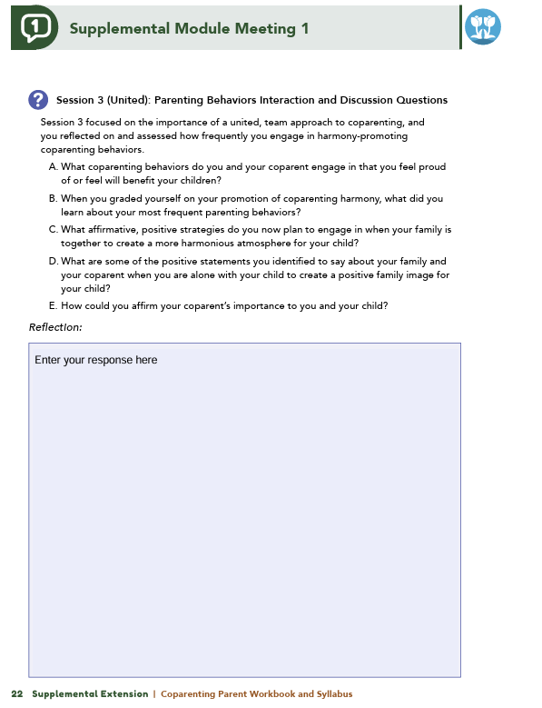


Homework
Complete Session 3: United and Session 4: Moving Forward
View online modules
Complete workbook questions
Notes:
Homework Tasks: Assign Session 3: United and Session 4: Moving Forward as homework.
Step 2 Clarification: Remind participants that this homework involves viewing online content and downloading necessary resources as part of Step 2. If time permits, show where to access these materials on the website.
Workbook Guidance: Show the specific pages in the Coparenting Parent Workbook and Syllabus related to these topics (D21)
Step 3 Clarification: Assign workbook discussion questions (beginning on page D22 in the parent workbook).
Format explanation: Explain the reason for 2 boxes per question (one for individual, one for group responses).
Encourage reflection and engagement: The more participants, think, reflect, and share the more meaningful the content becomes to each family.
Pro tip: Complete the workbook while viewing online modules.

Slide 23
Thank you for participating today.
Please reach out with any questions or concerns.
See you next week!
Notes:
Closing: Thank participants for their time and engagement.
Questions: Ask if there are any questions. (If someone needs personal assistance, ask them to speak with you individually after the group is dismissed).
Meeting 2: Remind participants of the date/time/location of the next meeting.
Homework: Remind participants to complete the homework.
Adjourn: Say goodbye to participants.

Slide 24
Meeting 2

Slide 25

Please sign in and find a seat.
We will begin soon.
If possible, please turn on your camera.
We will begin soon.
Notes:
Choose one bullet point to display (the first bullet point is for in-person, the second is for virtual).
If in-person, greet participants as they come in the door and help them find a seat.
If virtual, give participants a heads up when you will be starting. For example, “Hi everyone, we will be starting in about one minute.”

Slide 26

Conversation Starters
Group Discussion
Thrive Programming
Notes:
Example language: Welcome back, everyone! We're glad to see you for our third and final meeting.
*Optional Sections: Please note that the conversation starters are optional. If you prefer to skip these, simply remove the first bullet point from this slide and proceed to the next relevant slide in the deck.
Example language if omitting: We'll dive straight into discussing the key questions from our last session’s homework. We’ll wrap up with a discussion on additional Thrive programs that may interest you
Example language if not omitting:
Conversation Starters: We’ll get started with a quick question to get us all engaged and sharing.
Review of Ground Rules: A brief reminder of our ground rules to ensure our discussions remain respectful and productive.
Discussion and Homework: After our initial activities, we will discuss the workbook questions based on your experiences with the last set of homework followed by an explanation of the homework for our next meeting. Let’s get started!

Slide 27
Please answer one of the following questions:
What is an activity you enjoy doing with your child?
If you could relive one moment with your child, what would it be?
Notes:
Example language: "Let's open our session with a fun question that will give us all a chance to share something about ourselves. Review the list of questions provided on the slide. Select one question that resonates with you, or that you feel comfortable sharing. This activity is designed to ease us into the meeting and build a friendly, open atmosphere.

Slide 28
Basic Ground Rules:
  Always start and end sessions on time.
  Cell phones should be on vibrate; members can quietly excuse themselves if a call must be taken.
  In virtual sessions, participants should mute themselves when taking calls outside the session.
Group-Specific Rules:
  Avoid judgment regarding other participants' parenting practices or knowledge gaps.
  One person speaks at a time to maintain order and clarity.
  Assume positive intent in all interactions to foster a positive atmosphere.
Confidentiality- Please be respectful and discrete with the personal stories being shared. This is a safe space to grow and learn.
Notes:
Introduction of Ground Rules: Start by stating some basic ground rules to create a supportive environment where families feel safe to share their parenting experiences.
Basic Ground Rules:
Always start and end sessions on time.
Cell phones should be on vibrate; members can quietly excuse themselves if a call must be taken.
In virtual sessions, participants should mute themself when taking calls outside the session.
Developing Group-Specific Rules:
Discuss and agree on additional rules as a group, such as:
Avoid judgment regarding other participants' parenting practices or knowledge gaps.
Ensure one person speaks at a time to maintain order and clarity.
Assume positive intent in all interactions to foster a positive atmosphere.
Confidentiality Discussion: Use this time to reinforce the importance of confidentiality, outlining your organization’s specific confidentiality clauses regarding statements related to abuse or neglect mandated reporting..
Example language:
As we begin, it's crucial to emphasize the importance of confidentiality within our group. We need to agree to keep all shared information within these sessions, including personal stories and sensitive details. This ensures a safe space where everyone feels comfortable sharing their experiences. Please remember that details shared by participants are given in trust and should be treated with respect and discretion.
Additionally, it’s important to note our mandated reporting clause for suspected abuse or neglect:
Legal Obligation: Our staff and facilitators are legally required to report any suspicions of child abuse or neglect.
Scope of Reporting: We must report any signs of potential harm to a child or vulnerable adult that arise during our sessions.
Procedure for Reporting: We handle these situations sensitively, informing involved individuals about necessary actions, unless it poses further risk.
Support for Affected Individuals: We provide support and resources to help those involved in a reporting situation.
Our primary concern is the safety and well-being of all individuals. If you have any questions or concerns about this policy, feel free to discuss them privately with me.

Slide 29

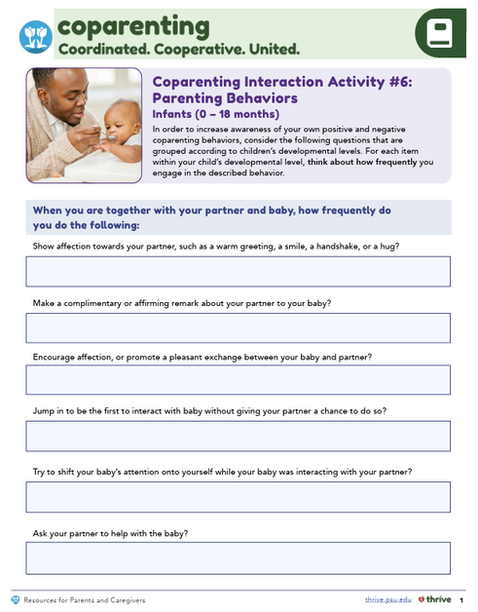

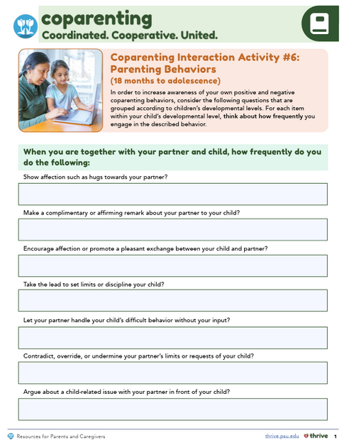



United Parenting Behaviors
  What behaviors are you proud of?
  What did you learn from grading yourself?
  What strategies will you use for harmony?
  What positive statements will you share?
  How can you affirm your coparent’s role?
Notes:
Review this section of the module with the participants by offering the following information:
• Session 3 focused on the importance of a united team approach to coparenting. If coparents engage in positive overt and covert coparenting behaviors, they can help their child develop a harmonious perspective regarding their family. Based on your child’s developmental age, you reflected on a list of positive and negative coparenting behaviors and assessed how frequently you engage in harmony-promoting coparenting behaviors.
Generate discussion among participants using all, or some, of the following questions:
What coparenting behaviors do you and your coparent engage in that you feel proud of or feel will benefit your children?
When you graded yourself on your promotion of coparenting harmony, what did you learn about your most frequent parenting behaviors?
What affirmative, positive strategies do you now plan to engage in when your family is together to create a more harmonious atmosphere for your child?
What are some of the positive statements you identified to say about your family and your coparent when you are alone with your child to create a positive family image for your child?
How could you affirm your coparent’s importance to you and your child?
[Seek responses from participants that reflect valuing the coparent’s parenting opinions and engaging them in making suggestions for child-related difficulties.]
**Facilitator Tip:
Definitions are listed below for your reference:
• Overt coparenting behaviors are behaviors that are explicit and observable. They can be positive, such as active facilitation and cooperation between coparents, or they can be negative, such as coparenting conflict aired in front of a child.
• Covert coparenting behaviors involve comments a parent makes to their child while a coparenting partner is absent. These comments may be affirmations or compliments that create positive images and feelings for a child, or they may be harmful, critical comments that evoke a child’s negative perceptions and feelings about the family. Even more subtle is a caregiver’s covert act of simply not focusing on the absent parent or not affirming them when alone with the child.

Slide 30
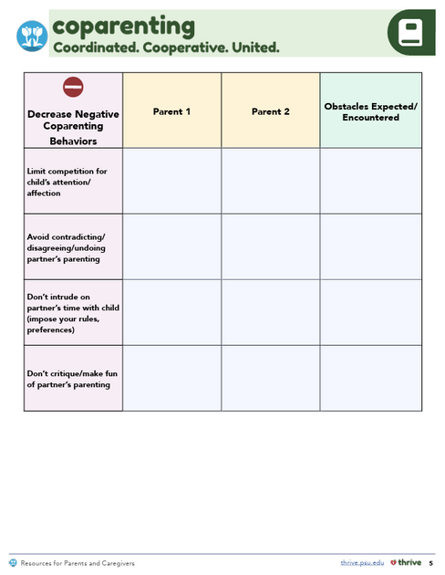
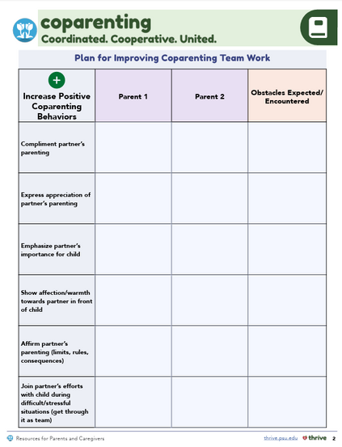

Developing a Coparenting Plan
  What behaviors will you practice more?
  What behaviors will you decrease?
  How will you overcome obstacles?
  What self-care strategies will you adopt?
  How will you support family well-being?
Notes:
Review this section of the module with the participants by offering the following information:
• In Session 3, you were introduced to a Coparenting Plan, which includes actionable steps to promote harmony and support, such as the following:
actively cooperating as coparents
expressing high levels of warmth,
making positive and complimentary remarks
being present and engaged with your child.
A Coparenting Plan also addresses unsupportive coparenting behaviors to limit the following:
competing for a child’s attention
contradicting or critiquing a coparent
undoing or overriding limits or consequences a coparent has imposed on a child
disagreeing with a coparent when a child is present.
As you created your own Coparenting Plan, you were instructed to consider previously discussed goals and aspirations for parenting and your understanding of your and your coparent’s parenting strengths.
Generate discussion among participants using some of the following questions:
What positive coparenting behaviors did you decide to practice more frequently?
What coparenting behaviors have you decided to decrease?
What solutions did you identify for overcoming any obstacles in modifying your selected parenting behaviors?
Session 3 also encourages coparents to engage in self-care and partner-care. Are there any strategies you plan to adopt to support mental well-being, relationship quality, and enjoyment with your family members?
Review the following information with participants:
• You may feel excited, or you may feel some anxiety about implementing your Coparenting Plan. It is normal for change to feel uncomfortable so start small and focus on only a few coparenting behavior changes at a time. This will help you be successful, and with time, you and your coparent can become a more united team!

Slide 31


Moving Forward and Wrap Up
  How have your responsibilities changed?
  How has your parenting approach shifted?
  What teamwork memories do you want your child to keep?
  What experiences do you hope they pass on?
Notes:
Review this section of the module with the participants by offering the following information:
• Session 4 highlighted that coparenting relationships evolve over the course of a child’s development. Examples were shared for what coparenting might look like at different age ranges for a child.
As a child ages, their needs change and their abilities—verbal, motor, and cognitive skills—expand, so their communications and interactions with their parents change.
Coparents must adapt their supervision, nurturance, and discipline style based on their child’s increasing maturity and independence.
Therefore, over time, changes in your parent-child relationship will influence changes in your coparenting relationship!
Generate discussion among participants using some of the following questions:
Consider the current age of your child. How have your responsibilities as a coparent changed in the last year or two?
In what ways has your parenting approach changed as your child has aged?
You were asked to imagine your child as an adult…. What about your coparenting teamwork would you like your child to remember from their childhood?
What childhood experiences or feelings do you hope your child will replicate with your grandchildren?

Slide 32


  Which topic was most beneficial and why?
  What strategies will help you reach family goals?
  Have you applied a new coparenting strategy? How did it compare to before?
  What has changed in your interactions?
  Have you noticed a difference in your child’s response?
Notes:
Review the following information with participants:
• You are commended for completing the supplemental module and participating in this group program. Your participation reflects a commitment to learning and being the best coparent you can be! Remember, as your child ages, communication is key to building a coparenting relationship that is coordinated, cooperative, and united. Throughout your coparenting journey, continue to reflect and dialogue with your coparent, so you can focus on using positive parenting behaviors.
Tell participants you are wrapping up, and generate discussion among participants using all, or some, of the following questions:
Which topic discussed in the supplemental module was the most beneficial to you as a coparent? Why?
What strategies or skills did you learn in the supplemental module that will help you achieve the goals you have for your family?
Would anyone like to share a moment when you used a coparenting strategy that you learned in the supplemental module and how your actions compared to your actions prior to engaging in the supplemental module?
What has changed in your interactions with your coparent or child since before completing the supplemental module?
Have you noticed a difference in the way your child is responding to your coparenting?

Slide 33
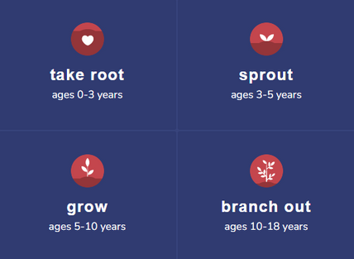
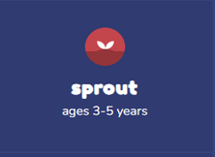
Additional Thrive Programs
  Take Root is available for parents and caregivers of children who are between 0 and 3 years old.
  Sprout is available for parents and caregivers of children who are between 3 and 5 years old.
  Grow is available for parents and caregivers of children who are between 5 and 10 years old.
  Branch Out is available for parents and caregivers of children who are between 10 and 18 years old.
Notes:
Provide support and encouragement to your participants to explore other Thrive Initiative programming. Share and/or register participants for any additional hybrid implementation options that you plan to offer. Thrive Initiative programming may include any of the following:
Universal Programs
• Take Root is available for parents and caregivers of children who are between 0 and 3 years old.
• Sprout is available for parents and caregivers of children who are between 3 and 5 years old.
• Grow is available for parents and caregivers of children who are between 5 and 10 years old.
• Branch Out is available for parents and caregivers of children who are between the ages of 10 and 18 years old.

Slide 34
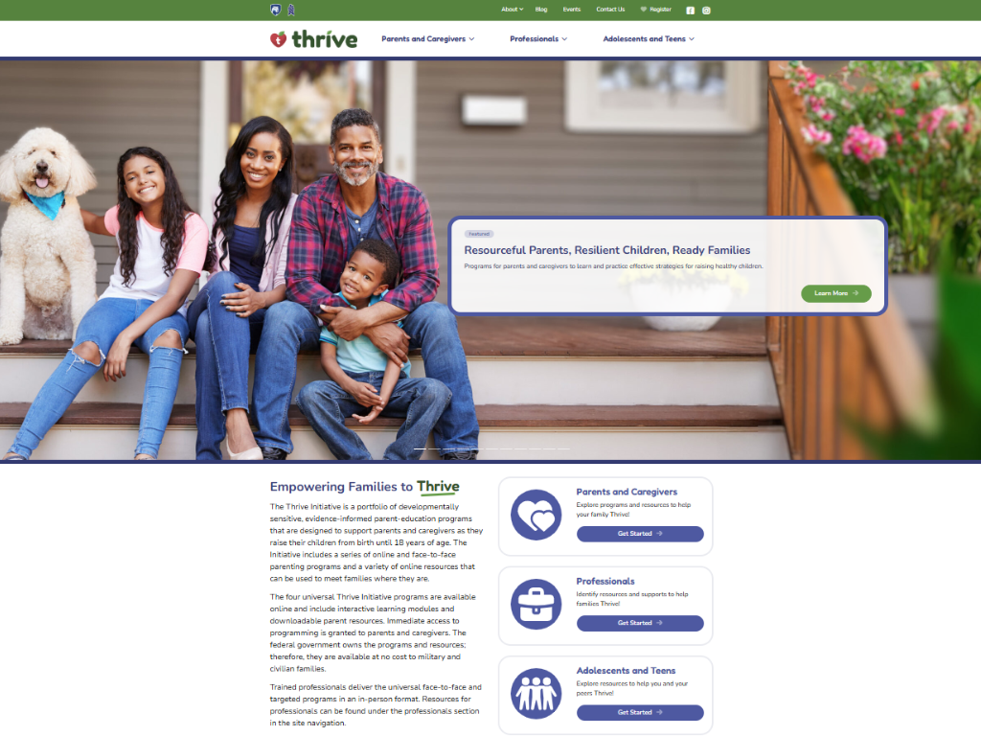
Notes:
Additional supplemental modules are available on a variety of topics and can be accessed online at https://thrive.psu.edu/modules/supplemental/.
Encourage participants to continue to visit the Thrive website, https://thrive.psu.edu, as their child develops and grows.
They can access additional resources and materials like mini-booster modules, blog postings, parenting handouts and guides, an inclusivity toolkit, and newsletters.

Slide 35


Thank you all for your dedication and participation. Every effort you make significantly impacts your child's future success.
Notes:
Example language:
Thank you, parents and caregivers, for your active participation. Please continue to visit the Thrive website as your child develops and grows—it's a valuable resource that can support you through every stage of their growth.
Supplemental Extension ENDS HERE.

Slide 36
Introduction
Notes:
Delivery Type 2: Supplemental Stand Alone begins here.

Slide 37
Welcome!
Please sign in and find a seat. We will begin soon.
If possible, please turn on your camera and enter your preferred name. We will begin soon.
Notes:
Choose one bullet point to display (the first bullet point is for in-person, the second is for virtual).
If in-person, greet participants as they come in the door and help them find a seat.
If virtual, give participants a heads up when you will be starting. For example, “Hi everyone, we will be starting in about one minute.”

Slide 38
AGENDA
  Overview
  Ice Breaker
  Ground Rules
  Syllabus
  Expectations
  Registration
  Homework
Notes:
Welcome: Introduce yourself and thank participants for choosing to be a part of the Coparenting Supplemental Parenting Program. Explain that Meeting 1 will provide an overview of the program, who is in our group, and what is expected of parents who participate. We will discuss the materials you received and provide instructions on how to use them.
Encourage participants to ask questions as they arise or to jot them down and ask at the end of the meeting.

Slide 39
  Target Audience
  Program Focus
  Skill Building
  Reflective Sharing
  Program Structure
  Goals
Notes:
Coparenting: Coordinated. Cooperative. United. is an online supplemental module for parents (and caregivers), of children of any age, who have completed at least one of the Thrive Initiative’s core, universal parenting program(s). The supplemental module focuses on building harmonious coparenting relationships.
Being able to coparent effectively depends, largely, on the teamwork of a child’s parents and/or caregivers. The online supplemental module’s sessions and the hybrid implementation meetings will explore factors that can positively impact the parents’/caregivers’ working relationships for the well-being of the child. Topics like coordination, cooperation, and presenting a united front to the child, are examined.
During the online supplemental module sessions and throughout the hybrid implementation meetings, information and parenting strategies that parents can use and adapt, as necessary, to fit their individual circumstances and family needs will be disseminated. The supplemental module content is designed to help parents build on their existing skills and strategies, so they can effectively coparent. Participants are encouraged to work with their coparenting partner(s) to nurture a relationship that centers around respect and promotes active coparenting collaboration for the well-being of the child.
Some of the content that is read and practiced in the supplemental module and discussed in the hybrid implementation meetings might be familiar to the parents, and they may already know about and use the disseminated information. Therefore, they may use the meeting time as an opportunity to realize, appreciate, and share what already works for them, their child, and their family.
Coparenting: Coordinated. Cooperative. United. is an online supplemental module for parents of children of any age. It includes an introduction and four sessions.
After participating in the online supplemental module sessions and the hybrid implementation meetings, parents and caregivers should be able to do the following:
• understand how their childhood experiences influence their coparenting (e.g., beliefs, values, expectations);
• recognize the benefits of coparents embracing an authoritative parenting style;
• discuss differences in parenting expectations and goals, and develop a coparenting plan that reflects compromise;
• know when and how to cooperatively establish developmentally appropriate boundaries and guidelines for a child;
• cultivate in and model positive relationships for a child;
• discuss and divide caregiving responsibilities to increase parental and partnering satisfaction;
• promote supportive coparenting behaviors like active cooperation, coordination, investment with the child, warmth in interactions, positive overt and covert coparenting, and mutual respect;
• identify and practice strategies for improving the coparenting relationship and parental unity such as self-care; mental and emotional support; marital/couples’ relationship quality, if applicable; and finding joy in parenting and time spent with the child;
• consider child development and what strategies can be used to adapt coparenting skills and plans as a child ages.

Slide 40



  Tell us your name, your coparent’s name, your child’s name(s), your child’s age(s), and one of the following:
  What you enjoy most about parenting
  A word you could use to describe one of your child’s strengths
Notes:
Personal Introduction: Start with a brief introduction of yourself, highlighting your expertise in child development and any personal affiliations (e.g., community, organization, military) that connect you to the audience.
Combining Introductions: Merge the participants' introductions with an icebreaker activity to create a more engaging and efficient session.
Icebreaker Questions: Ask each participant to share their name, their coparent’s name, their child’s name, and age. Additional questions to choose:
What you enjoy most about parenting
A word you could use to describe one of your child’s strengths
Future Use: Note the icebreaker questions used; consider revisiting unused ones in future sessions as needed.
You can also start each meeting with an icebreaker if you find your group is reserved. Use your judgment and avoid controversial topics.

Slide 41
Basic Ground Rules:
  Always start and end sessions on time.
  Cell phones should be on vibrate; members can quietly excuse themselves if a call must be taken.
  In virtual sessions, participants should mute themselves when taking calls outside the session.
Group-Specific Rules:
  Avoid judgment regarding other participants' parenting practices or knowledge gaps.
  One person speaks at a time to maintain order and clarity.
  Assume positive intent in all interactions to foster a positive atmosphere.
Confidentiality- Please be respectful and discrete with the personal stories being shared. This is a safe space to grow and learn.
Notes:
Introduction of Ground Rules: Start by stating some basic ground rules to create a supportive environment where families feel safe to share their parenting experiences.
Basic Ground Rules:
Always start and end sessions on time.
Cell phones should be on vibrate; members can quietly excuse themselves if a call must be taken.
In virtual sessions, participants should mute themself when taking calls outside the session.
Developing Group-Specific Rules:
Discuss and agree on additional rules as a group, such as:
Avoid judgment regarding other participants' parenting practices or knowledge gaps.
Ensure one person speaks at a time to maintain order and clarity.
Assume positive intent in all interactions to foster a positive atmosphere.
Confidentiality Discussion: Use this time to reinforce the importance of confidentiality, outlining your organization’s specific confidentiality clauses regarding statements related to abuse or neglect mandated reporting..
Example language:
As we begin, it's crucial to emphasize the importance of confidentiality within our group. We need to agree to keep all shared information within these sessions, including personal stories and sensitive details. This ensures a safe space where everyone feels comfortable sharing their experiences. Please remember that details shared by participants are given in trust and should be treated with respect and discretion.
Additionally, it’s important to note our mandated reporting clause for suspected abuse or neglect:
Legal Obligation: Our staff and facilitators are legally required to report any suspicions of child abuse or neglect.
Scope of Reporting: We must report any signs of potential harm to a child or vulnerable adult that arise during our sessions.
Procedure for Reporting: We handle these situations sensitively, informing involved individuals about necessary actions, unless it poses further risk.
Support for Affected Individuals: We provide support and resources to help those involved in a reporting situation.
Our primary concern is the safety and well-being of all individuals. If you have any questions or concerns about this policy, feel free to discuss them privately with me.

Slide 42
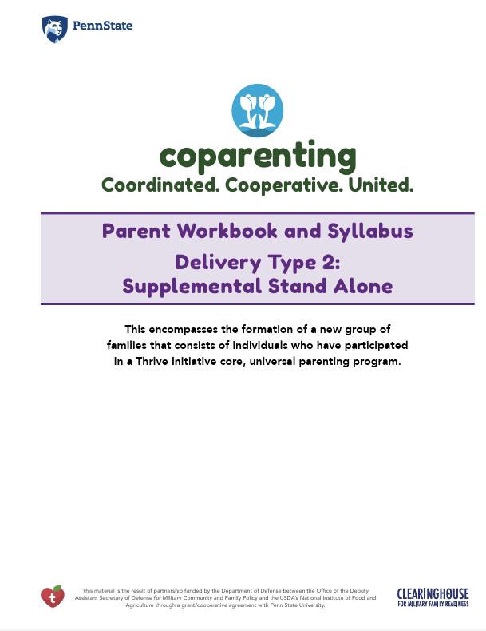
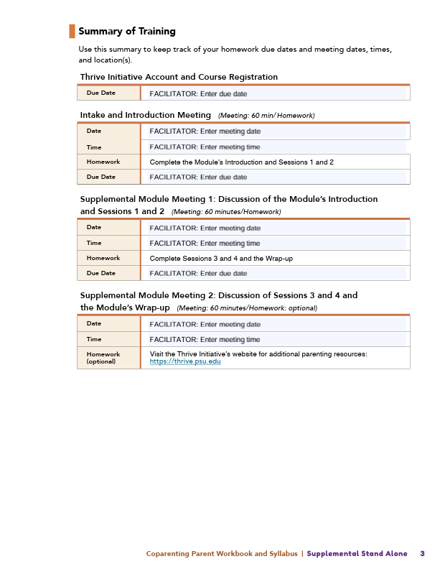
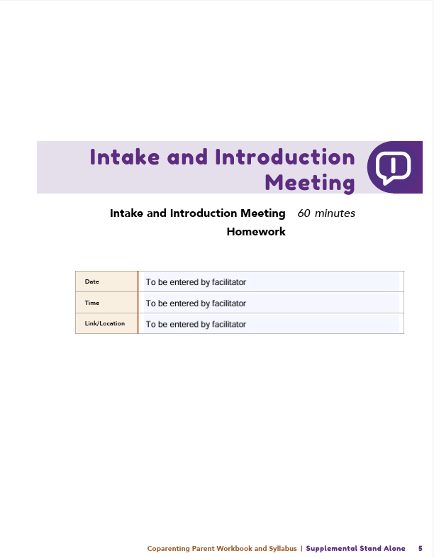
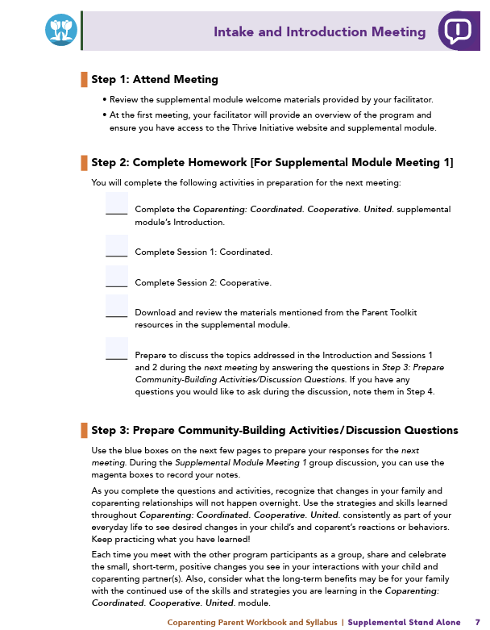

Parent Workbook
Syllabus
Notes:
Provide copies or screen share a copy of the Parent Workbook and Syllabus for the Coparenting: Coordinated. Cooperative. United. module. Review the Summary of Training, and highlight the section where the participants can find pertinent information.

Slide 43
Expectations
Notes:
Overview of Expectations: Clearly define what is expected of participants in the Coparenting supplemental program.
Independent Completion: Inform families that they are expected to independently complete the online modules.
Full Engagement Required: Emphasize the importance of completing each module in full to maximize learning and benefit from the program.
Purpose of Meetings: Clarify that the in-person meetings are not for revisiting session content but for community building, reflecting on experiences, and discussing insights with other participants who are trying to successfully navigate coparenting.
Preparation for Discussions: Encourage participants to come to meetings prepared to share their thoughts and engage in discussions based on the content they've learned online.

Slide 44
REGISTER
Notes:
Complete any registration requirements for your organization. Then, explain how participants can access the supplemental module online. Offer support to help with any technological questions. All participants will have previously set up a Thrive Initiative account, but you need to ensure they can log in and find the information they need to get started or progress in the supplemental module.

Slide 45
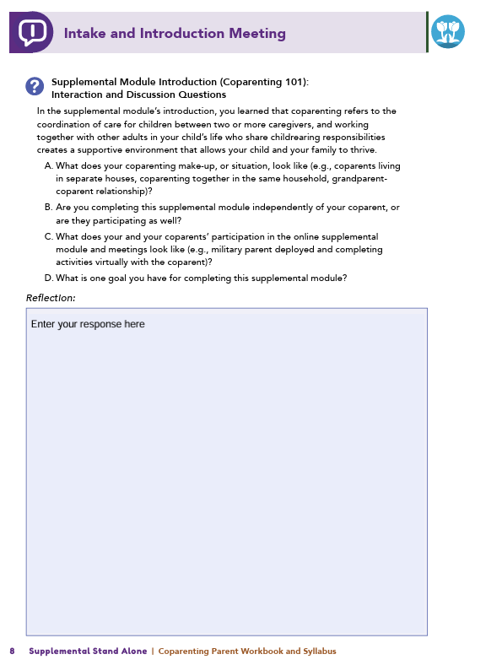
Homework
Complete the Introduction, Session 1: Coordinated, and Session 2: Cooperative
View online modules
Complete workbook questions
Notes:
Homework Tasks: Assign Introduction, Session 1: Coordinated, and Session 2: Cooperative as homework.
Step 2 Clarification: Remind participants that this homework involves viewing online content and downloading necessary resources as part of Step 2. If time permits, show where to access these materials on the website.
Workbook Guidance: Show the specific pages in the Coparenting Parent Workbook and Syllabus related to these topics (D7)
Step 3 Clarification: Assign workbook discussion questions (beginning on page D8 in the parent workbook).
Format explanation: Explain the reason for 2 boxes per question (one for individual, one for group responses).
Encourage reflection and engagement: The more participants, think, reflect, and share the more meaningful the content becomes to each family.
Pro tip: Complete the workbook while viewing online modules.

Slide 46
Thank you for participating today.
Please reach out with any questions or concerns.
See you next week!
Notes:
Closing: Thank participants for their time and engagement.
Questions: Ask if there are any questions. (If someone needs personal assistance, ask them to speak with you individually after the group is dismissed).
Meeting 2: Remind participants of the date/time/location of the next meeting.
Homework: Remind participants to complete the homework.
Adjourn: Say goodbye to participants.

Slide 47
Meeting 1

Slide 48
Welcome back!
Please sign in and find a seat. We will begin soon.
If possible, please turn on your camera and enter your preferred name. We will begin soon.
Notes:
Choose one bullet point to display (the first bullet point is for in-person, the second is for virtual).
If in-person, greet participants as they come in the door and help them find a seat.
If virtual, give participants a heads up when you will be starting. For example, “Hi everyone, we will be starting in about one minute.”

Slide 49
  Conversation Starter
  Restate Ground Rules
  Group Discussion
  Homework
Notes:
Example language: Welcome back, families! We’re glad to see for our second meeting.
Review Meeting 2 Agenda:
Conversation Starters: We’ll get started with a quick question to get us all engaged and sharing.
Review of Ground Rules: A brief reminder of our ground rules to ensure our discussions remain respectful and productive.
Discussion and Homework: After our initial activities, we will discuss the workbook questions based on your experiences with the last set of homework followed by an explanation of the homework for our next meeting. Let’s get started!

Slide 50
Please answer one of the following questions:
  What is one aspect of your parent-child relationship that is working well?
  What is a skill you use effectively in your parenting?
Notes:
Example language: "Let's open our session with a fun question that will give us all a chance to share something about ourselves. Review the list of questions provided on the slide. Select one question that resonates with you, or that you feel comfortable sharing. This activity is designed to ease us into the meeting and build a friendly, open atmosphere.

Slide 51
Basic Ground Rules:
  Always start and end sessions on time.
  Cell phones should be on vibrate; members can quietly excuse themselves if a call must be taken.
  In virtual sessions, participants should mute themselves when taking calls outside the session.
Group-Specific Rules:
  Avoid judgment regarding other participants' parenting practices or knowledge gaps.
  One person speaks at a time to maintain order and clarity.
  Assume positive intent in all interactions to foster a positive atmosphere.
Confidentiality- Please be respectful and discrete with the personal stories being shared. This is a safe space to grow and learn.
Notes:
Introduction of Ground Rules: Start by stating some basic ground rules to create a supportive environment where families feel safe to share their parenting experiences.
Basic Ground Rules:
Always start and end sessions on time.
Cell phones should be on vibrate; members can quietly excuse themselves if a call must be taken.
In virtual sessions, participants should mute themself when taking calls outside the session.
Developing Group-Specific Rules:
Discuss and agree on additional rules as a group, such as:
Avoid judgment regarding other participants' parenting practices or knowledge gaps.
Ensure one person speaks at a time to maintain order and clarity.
Assume positive intent in all interactions to foster a positive atmosphere.
Confidentiality Discussion: Use this time to reinforce the importance of confidentiality, outlining your organization’s specific confidentiality clauses regarding statements related to abuse or neglect mandated reporting..
Example language:
As we begin, it's crucial to emphasize the importance of confidentiality within our group. We need to agree to keep all shared information within these sessions, including personal stories and sensitive details. This ensures a safe space where everyone feels comfortable sharing their experiences. Please remember that details shared by participants are given in trust and should be treated with respect and discretion.
Additionally, it’s important to note our mandated reporting clause for suspected abuse or neglect:
Legal Obligation: Our staff and facilitators are legally required to report any suspicions of child abuse or neglect.
Scope of Reporting: We must report any signs of potential harm to a child or vulnerable adult that arise during our sessions.
Procedure for Reporting: We handle these situations sensitively, informing involved individuals about necessary actions, unless it poses further risk.
Support for Affected Individuals: We provide support and resources to help those involved in a reporting situation.
Our primary concern is the safety and well-being of all individuals. If you have any questions or concerns about this policy, feel free to discuss them privately with me.

Slide 52
Coparenting = teamwork
Coparenting
Every family is unique
Collaboration is key
Teamwork matters
Supportive partnership
Notes:
Provide an overview of the supplemental module using the following points that are taught in the supplemental module:
• Coparenting refers to the coordination of care for children between two or more caregivers. It is separate from parenting.
• Every family and its make-up are unique.
• You, the parent or caregiver, should work with other adults in your child’s life who share childrearing responsibilities in order to create a supportive environment that allows your child and your family to thrive.
• Being able to coparent effectively depends, largely, on the caregivers’ teamwork.
• When coparents are working well together, the coparenting is supportive and harmonious.

Slide 53
Introduction Questions
  What does your coparenting situation look like?
  Are you completing this module alone or with your coparent?
  How does each coparent participate?
  What is one goal you hope to achieve from this module?
Notes:
Ask the following questions of all of the participants, and highlight the variety of coparenting relationships:
What does your coparenting make-up, or situation, look like (e.g., coparents living in separate houses, coparenting together in the same household, grandparent-coparent relationship)?
Are you completing this module independently of your coparent, or are they participating as well? What does each coparents’ participation look like (e.g., military parent deployed and completing activities virtually with the coparent)?
Ask the following question and solicit answers from a few participants to generate discussion:
What is one goal you hope to achieve by completing this supplemental module?

Slide 54
Family of
Origin
  What positive behaviors from your upbringing do you want to repeat?
  What did you learn from sharing with your coparent?
Notes:
Review this section of the module with the participants by offering the following information:
• As parents, we are sometimes unaware of how our experiences in our families of origin may have impacted ideas about and expectations regarding our coparenting relationships.
• A first step towards building a supportive coparenting relationship is to discuss how our childhood experiences may be shaping our expectations for the coparenting relationship.
• The supplemental module also explored strategies for effectively dividing parenting responsibilities. Your values and beliefs that are related to dividing parenting responsibilities might be influenced by your family of origin experiences. You reflected on this in the supplemental module.
Generate discussion among participants using the following questions:
Let’s think about positive experiences and consider what coparenting behaviors, from your family of origin, you would like to replicate or do the same in your own family?
When you shared your coparenting experiences from your family of origin with your coparent, what did you learn about each other?

Slide 55
Comparing Parenting Styles and Attitudes
  What did you learn about your preferred parenting style?
  How do your views compare with your coparent’s?
Notes:
Review this section of the module with the participants by offering the following information:
• The three most common approaches to parenting are authoritarian, authoritative, and permissive or indulgent. You learned that adopting an authoritative parenting style, which balances setting limits with showing love, benefits the child and the coparent. You completed an interaction activity to see how much you agreed with statements that reflect your use of each parenting style.
Generate discussion among participants using the following questions:
What did you learn about the parenting style you endorsed the most?
Would anyone like to share how your and your coparent’s views on parenting styles are the same or different?
Review the following information with participants:
• Remember to show respect for your coparent’s differing views, and negotiate compromises in your approaches to parenting in order to create more supportive coparenting alliances.
• Some ways to improve your coparenting relationship are to coordinate parenting attitudes, goals for your child’s behavior, and the parenting strategies or approaches you both have. For example, coparents can agree on behavioral expectations and approaches to discipline, education, and standards of safety.
• Try to remain flexible, and, when you do not agree, be respectful and discuss differences outside of the presence of your child.

Slide 56
Developing a Parenting Coordination Plan
  What is one goal you and your coparent agreed on?
  What is one disagreement you had, and how did you resolve it?
Notes:
Review this section of the module with the participants by offering the following information:
• In the supplemental module, you completed a Plan for Coordinating Parenting Ideas in which you identified potential solutions to disagreements in your parenting ideas.
Example: An example of a disagreement in parenting ideas could be if one caregiver feels that children should be assigned household responsibilities at a young age (e.g., taking out the trash, making their bed), so they learn responsibility, but the other parent feels that young children should only have fun and play. This disagreement on parenting ideas may cause conflict in the family, so coparenting partners should list some ideas for how they might resolve their differences. For example, caregivers could discuss and determine at what age their child can start assuming household responsibilities, could identify and select appropriate household responsibilities that might be fun and helpful for their child to do, or could consult with experts regarding developmentally appropriate household responsibilities for their child.
Generate discussion among participants using the following questions:
Is anyone willing to share one parenting goal or idea that you and your coparent agreed on?
Is anyone willing to share one parenting goal or idea that you and your coparent disagreed on and what solutions you identified?
Review the following information with participants:
• Presenting a united front shows your child that you and your coparent agree on rules and consequences for behaviors, and your collaboration and consistency send a clear message to your child about what is expected of them.

Slide 57
Cooperative Parenting Involvement
  Any tasks you want to do more or less?
  Has your coparent identified changes?
  How do you handle avoided tasks?
  How might you discuss responsibilities?
  What systems help prevent conflicts?
Notes:
Review this section of the module with the participants by offering the following information:
• Inequality in the division of responsibilities between partners can result in one (or more) coparent(s) feeling overburdened or overwhelmed.
• Satisfaction with the assignment of family or parenting responsibilities can lead to higher self-esteem, better marital quality, and lower parenting stress. In addition, when expectations for child care responsibilities are met, individuals generally perceive their coparenting as more positive.
• In the Parenting Involvement activity, you rated and discussed involvement in common parenting responsibilities like feeding and transportation.
Generate discussion among participants using all, or some, of the following questions:
Did you identify any caregiving tasks that you want to perform more or less often?
Has your coparent identified any areas they would like to change?
Would someone like to share a plan that you and your coparent developed to address either duties or tasks that cause conflict between you and your coparent or duties or tasks that are avoided or “forgotten” by you and your coparent?
If you haven’t done so already, how might you discuss concerns around the division of responsibilities with your coparent?
What systems have you established to address future conflicts that might arise related to performing various childrearing tasks?

Slide 58
Record
and
Reflect
  How did the tone feel?
  How would your child describe it?
  How can you improve teamwork?
  What changes will you make?
  What promotes harmony?
Notes:
Review this section of the module with the participants by offering the following information:
• In Session 2, you learned about the importance of warmth, play, investment with your child, and cooperation and respect with your coparent. You were then asked to record a video of your family engaging in an activity or conversation. Then, you were instructed to watch and discuss the video with your coparent to identify times when you were and were not interacting in ways that benefited your coparenting relationship and your family.
Generate discussion among participants using all, or some, of the following questions:
How did you and your coparent feel regarding the tone you set in your family interaction?
How do you think your child would describe how the interaction went?
What could you and your partner have done differently to improve your teamwork as coparents?
What changes do you and your coparent plan to incorporate when you interact with each other or with your child?
What other strategies did you and your coparent identify to promote a sense of togetherness and harmony for everyone in your family?
Positive and active cooperation between you and your coparent, when interacting with your child or other individuals, will set a standard for your family’s values and help show your child what supportive behaviors look like as they begin to develop their own relationships. What are some of the harmony-promoting coparenting behaviors you learned about in the supplemental module?
[Seek responses from participants such as complimenting a coparents’ parenting; instilling positive images and feelings about the family and your coparent in the child; showing affection to your coparenting partner in front of the child; and promoting pleasant, positive exchanges between your child and your coparent.]

Slide 59
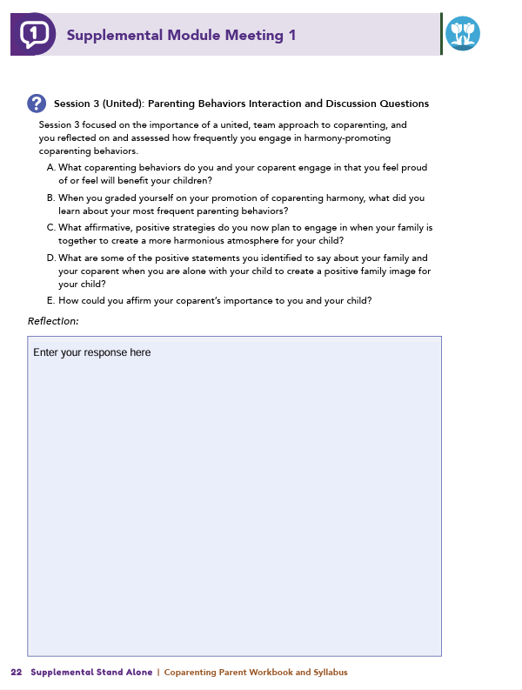
Homework
Complete Session 3: United and Session 4: Moving Forward
View online modules
Complete workbook questions
Notes:
Homework Tasks: Assign Session 3: United and Session 4: Moving Forward as homework.
Step 2 Clarification: Remind participants that this homework involves viewing online content and downloading necessary resources as part of Step 2. If time permits, show where to access these materials on the website.
Workbook Guidance: Show the specific pages in the Coparenting Parent Workbook and Syllabus related to these topics (D21)
Step 3 Clarification: Assign workbook discussion questions (beginning on page D22 in the parent workbook).
Format explanation: Explain the reason for 2 boxes per question (one for individual, one for group responses).
Encourage reflection and engagement: The more participants, think, reflect, and share the more meaningful the content becomes to each family.
Pro tip: Complete the workbook while viewing online modules.

Slide 60
Thank you for participating today.
Please reach out with any questions or concerns.
See you next week!
Notes:
Closing: Thank participants for their time and engagement.
Questions: Ask if there are any questions. (If someone needs personal assistance, ask them to speak with you individually after the group is dismissed).
Meeting 2: Remind participants of the date/time/location of the next meeting.
Homework: Remind participants to complete the homework.
Adjourn: Say goodbye to participants.

Slide 61
Meeting 2

Slide 62
Please sign in and find a seat.
We will begin soon.
If possible, please turn on your camera.
We will begin soon.
Notes:
Choose one bullet point to display (the first bullet point is for in-person, the second is for virtual).
If in-person, greet participants as they come in the door and help them find a seat.
If virtual, give participants a heads up when you will be starting. For example, “Hi everyone, we will be starting in about one minute.”

Slide 63
Conversation Starters
Group Discussion
Thrive Programming
Notes:
Example language: Welcome back, everyone! We're glad to see you for our third and final meeting.
*Optional Sections: Please note that the conversation starters are optional. If you prefer to skip these, simply remove the first bullet point from this slide and proceed to the next relevant slide in the deck.
Example language if omitting: We'll dive straight into discussing the key questions from our last session’s homework. We’ll wrap up with a discussion on additional Thrive programs that may interest you
Example language if not omitting:
Conversation Starters: We’ll get started with a quick question to get us all engaged and sharing.
Review of Ground Rules: A brief reminder of our ground rules to ensure our discussions remain respectful and productive.
Discussion and Homework: After our initial activities, we will discuss the workbook questions based on your experiences with the last set of homework followed by an explanation of the homework for our next meeting. Let’s get started!

Slide 64
Please answer one of the following questions:
What is an activity you enjoy doing with your child?
If you could relive one moment with your child, what would it be?
Notes:
Example language: "Let's open our session with a fun question that will give us all a chance to share something about ourselves. Review the list of questions provided on the slide. Select one question that resonates with you, or that you feel comfortable sharing. This activity is designed to ease us into the meeting and build a friendly, open atmosphere.

Slide 65
Basic Ground Rules:
  Always start and end sessions on time.
  Cell phones should be on vibrate; members can quietly excuse themselves if a call must be taken.
  In virtual sessions, participants should mute themselves when taking calls outside the session.
Group-Specific Rules:
  Avoid judgment regarding other participants' parenting practices or knowledge gaps.
  One person speaks at a time to maintain order and clarity.
  Assume positive intent in all interactions to foster a positive atmosphere.
Confidentiality- Please be respectful and discrete with the personal stories being shared. This is a safe space to grow and learn.
Notes:
Introduction of Ground Rules: Start by stating some basic ground rules to create a supportive environment where families feel safe to share their parenting experiences.
Basic Ground Rules:
Always start and end sessions on time.
Cell phones should be on vibrate; members can quietly excuse themselves if a call must be taken.
In virtual sessions, participants should mute themself when taking calls outside the session.
Developing Group-Specific Rules:
Discuss and agree on additional rules as a group, such as:
Avoid judgment regarding other participants' parenting practices or knowledge gaps.
Ensure one person speaks at a time to maintain order and clarity.
Assume positive intent in all interactions to foster a positive atmosphere.
Confidentiality Discussion: Use this time to reinforce the importance of confidentiality, outlining your organization’s specific confidentiality clauses regarding statements related to abuse or neglect mandated reporting..
Example language:
As we begin, it's crucial to emphasize the importance of confidentiality within our group. We need to agree to keep all shared information within these sessions, including personal stories and sensitive details. This ensures a safe space where everyone feels comfortable sharing their experiences. Please remember that details shared by participants are given in trust and should be treated with respect and discretion.
Additionally, it’s important to note our mandated reporting clause for suspected abuse or neglect:
Legal Obligation: Our staff and facilitators are legally required to report any suspicions of child abuse or neglect.
Scope of Reporting: We must report any signs of potential harm to a child or vulnerable adult that arise during our sessions.
Procedure for Reporting: We handle these situations sensitively, informing involved individuals about necessary actions, unless it poses further risk.
Support for Affected Individuals: We provide support and resources to help those involved in a reporting situation.
Our primary concern is the safety and well-being of all individuals. If you have any questions or concerns about this policy, feel free to discuss them privately with me.

Slide 66
United Parenting Behaviors
  What behaviors are you proud of?
  What did you learn from grading yourself?
  What strategies will you use for harmony?
  What positive statements will you share?
  How can you affirm your coparent’s role?
Notes:
Review this section of the module with the participants by offering the following information:
• Session 3 focused on the importance of a united team approach to coparenting. If coparents engage in positive overt and covert coparenting behaviors, they can help their child develop a harmonious perspective regarding their family. Based on your child’s developmental age, you reflected on a list of positive and negative coparenting behaviors and assessed how frequently you engage in harmony-promoting coparenting behaviors.
Generate discussion among participants using all, or some, of the following questions:
What coparenting behaviors do you and your coparent engage in that you feel proud of or feel will benefit your children?
When you graded yourself on your promotion of coparenting harmony, what did you learn about your most frequent parenting behaviors?
What affirmative, positive strategies do you now plan to engage in when your family is together to create a more harmonious atmosphere for your child?
What are some of the positive statements you identified to say about your family and your coparent when you are alone with your child to create a positive family image for your child?
How could you affirm your coparent’s importance to you and your child?
[Seek responses from participants that reflect valuing the coparent’s parenting opinions and engaging them in making suggestions for child-related difficulties.]
**Facilitator Tip:
Definitions are listed below for your reference:
• Overt coparenting behaviors are behaviors that are explicit and observable. They can be positive, such as active facilitation and cooperation between coparents, or they can be negative, such as coparenting conflict aired in front of a child.
• Covert coparenting behaviors involve comments a parent makes to their child while a coparenting partner is absent. These comments may be affirmations or compliments that create positive images and feelings for a child, or they may be harmful, critical comments that evoke a child’s negative perceptions and feelings about the family. Even more subtle is a caregiver’s covert act of simply not focusing on the absent parent or not affirming them when alone with the child.

Slide 67
Developing a Coparenting Plan
  What behaviors will you practice more?
  What behaviors will you decrease?
  How will you overcome obstacles?
  What self-care strategies will you adopt?
  How will you support family well-being?
Notes:
Review this section of the module with the participants by offering the following information:
• In Session 3, you were introduced to a Coparenting Plan, which includes actionable steps to promote harmony and support, such as the following:
actively cooperating as coparents
expressing high levels of warmth,
making positive and complimentary remarks
being present and engaged with your child.
A Coparenting Plan also addresses unsupportive coparenting behaviors to limit the following:
competing for a child’s attention
contradicting or critiquing a coparent
undoing or overriding limits or consequences a coparent has imposed on a child
disagreeing with a coparent when a child is present.
As you created your own Coparenting Plan, you were instructed to consider previously discussed goals and aspirations for parenting and your understanding of your and your coparent’s parenting strengths.
Generate discussion among participants using some of the following questions:
What positive coparenting behaviors did you decide to practice more frequently?
What coparenting behaviors have you decided to decrease?
What solutions did you identify for overcoming any obstacles in modifying your selected parenting behaviors?
Session 3 also encourages coparents to engage in self-care and partner-care. Are there any strategies you plan to adopt to support mental well-being, relationship quality, and enjoyment with your family members?
Review the following information with participants:
• You may feel excited, or you may feel some anxiety about implementing your Coparenting Plan. It is normal for change to feel uncomfortable so start small and focus on only a few coparenting behavior changes at a time. This will help you be successful, and with time, you and your coparent can become a more united team!

Slide 68
Moving Forward and Wrap Up
  How have your responsibilities changed?
  How has your parenting approach shifted?
  What teamwork memories do you want your child to keep?
  What experiences do you hope they pass on?
Notes:
Review this section of the module with the participants by offering the following information:
• Session 4 highlighted that coparenting relationships evolve over the course of a child’s development. Examples were shared for what coparenting might look like at different age ranges for a child.
As a child ages, their needs change and their abilities—verbal, motor, and cognitive skills—expand, so their communications and interactions with their parents change.
Coparents must adapt their supervision, nurturance, and discipline style based on their child’s increasing maturity and independence.
Therefore, over time, changes in your parent-child relationship will influence changes in your coparenting relationship!
Generate discussion among participants using some of the following questions:
Consider the current age of your child. How have your responsibilities as a coparent changed in the last year or two?
In what ways has your parenting approach changed as your child has aged?
You were asked to imagine your child as an adult…. What about your coparenting teamwork would you like your child to remember from their childhood?
What childhood experiences or feelings do you hope your child will replicate with your grandchildren?

Slide 69
  Which topic was most beneficial and why?
  What strategies will help you reach family goals?
  Have you applied a new coparenting strategy? How did it compare to before?
  What has changed in your interactions?
  Have you noticed a difference in your child’s response?
Notes:
Review the following information with participants:
• You are commended for completing the supplemental module and participating in this group program. Your participation reflects a commitment to learning and being the best coparent you can be! Remember, as your child ages, communication is key to building a coparenting relationship that is coordinated, cooperative, and united. Throughout your coparenting journey, continue to reflect and dialogue with your coparent, so you can focus on using positive parenting behaviors.
Tell participants you are wrapping up, and generate discussion among participants using all, or some, of the following questions:
Which topic discussed in the supplemental module was the most beneficial to you as a coparent? Why?
What strategies or skills did you learn in the supplemental module that will help you achieve the goals you have for your family?
Would anyone like to share a moment when you used a coparenting strategy that you learned in the supplemental module and how your actions compared to your actions prior to engaging in the supplemental module?
What has changed in your interactions with your coparent or child since before completing the supplemental module?
Have you noticed a difference in the way your child is responding to your coparenting?

Slide 70
Additional Thrive Programs
  Take Root is available for parents and caregivers of children who are between 0 and 3 years old.
  Sprout is available for parents and caregivers of children who are between 3 and 5 years old.
  Grow is available for parents and caregivers of children who are between 5 and 10 years old.
  Branch Out is available for parents and caregivers of children who are between 10 and 18 years old.
Notes:
Provide support and encouragement to your participants to explore other Thrive Initiative programming. Share and/or register participants for any additional hybrid implementation options that you plan to offer. Thrive Initiative programming may include any of the following:
Universal Programs
• Take Root is available for parents and caregivers of children who are between 0 and 3 years old.
• Sprout is available for parents and caregivers of children who are between 3 and 5 years old.
• Grow is available for parents and caregivers of children who are between 5 and 10 years old.
• Branch Out is available for parents and caregivers of children who are between the ages of 10 and 18 years old.

Slide 71
Notes:
Additional supplemental modules are available on a variety of topics and can be accessed online at https://thrive.psu.edu/modules/supplemental/.
Encourage participants to continue to visit the Thrive website, https://thrive.psu.edu, as their child develops and grows.
They can access additional resources and materials like mini-booster modules, blog postings, parenting handouts and guides, an inclusivity toolkit, and newsletters.

Slide 72
Thank you all for your dedication and participation. Every effort you make significantly impacts your child's future success.
Notes:
Example language:
Thank you, parents and caregivers, for your active participation. Please continue to visit the Thrive website as your child develops and grows—it's a valuable resource that can support you through every stage of their growth.

