Slide 1



As of February 24, 2025
As of February 24, 2025
  A Universal Parenting Program for Parents of Children Ages 5-10
Meeting 1

Slide 2


Welcome!
Please sign in and find a seat. We will begin soon.
If possible, please turn on your camera and enter your preferred name. We will begin soon.
Notes:
Choose one bullet point to display (the first bullet point is for in-person, the second is for virtual).
If in-person, greet participants as they come in the door and help them find a seat.
If virtual, give participants a heads up when you will be starting. For example, “Hi everyone, we will be starting in about one minute.”

Slide 3

Agenda
Overview
Introductions
Ground Rules
Expectations
Review Syllabus
Homework
Q & A
Notes:
Welcome: Introduce yourself and thank participants for choosing to be a part of the Grow Parenting Program. Explain that Meeting 1 will provide an overview of the program, who is in our group, and what is expected of parents who participate. We will discuss the materials you received and provide instructions on how to use them.
Encourage participants to ask questions as they arise or to jot them down and ask at the end of the meeting.

Slide 4




Overview
Target Audience
Program Focus
Structure
Group Discussions
Notes:
Take time to discuss the following topics with your participants:
Grow is an online parenting program for parents and caregivers of children who are ages 5 to 10 years old.
Grow helps parents learn positive parenting techniques, stress management strategies, and health-promotion skills that can be used to help children be happy and healthy.
Grow is divided into 8 sessions, and each one covers a different topic. By the end of the program, parents and caregivers will be able to do the following:
appropriately praise and encourage their child;
understand how to help their child manage emotions;
set healthy routines and schedules in their home;
manage stress and reactions due to anger;
and promote physical health for themselves and their child.
After participants complete each online session independently, your group will meet and discuss some questions related to the content.

Slide 5



Tell us your name, partner’s name, child’s name, and one of the following:
The hospital/state/country where your child was born.
Your child’s birthday.
Your child’s favorite book.
A favorite thing about your child.
Notes:
Personal Introduction: Start with a brief introduction of yourself, highlighting your expertise in child development and any personal affiliations (e.g., community, organization, military) that connect you to the audience.
Combining Introductions: Merge the participants' introductions with an icebreaker activity to create a more engaging and efficient session.
Icebreaker Questions: Ask each participant to share their name, their partner’s name, their child’s name, and age. Additional questions to choose:
The location of their child’s birth (hospital/state/country),
child’s birthday,
child’s favorite book,
or a favorite thing about their child.
Future Use: Note the icebreaker questions used; consider revisiting unused ones in future sessions as needed.
Additional icebreaker questions:
What was your least favorite food as a child? Do you still dislike it?
What’s the best piece of advice you’ve ever been given?
What is your favorite item that you’ve purchased this year?
What fictional family would you like to be a member of?
What’s your favorite tradition or holiday?
What was your favorite game to play as a child?
If you could rename yourself, what name would you pick?
Would you rather be able to run at 100 miles per hour or fly at 10 miles per hour?
What are you most excited about this year?
You can also start each meeting with an icebreaker if you find your group is reserved. Use your judgment and avoid controversial topics.

Slide 6


Basic Ground Rules:
  Always start and end sessions on time.
  Cell phones should be on vibrate; members can quietly excuse themselves if a call must be taken.
  In virtual sessions, participants should mute themselves when taking calls outside the session.
Group-Specific Rules:
  Avoid judgment regarding other participants' parenting practices or knowledge gaps.
  One person speaks at a time to maintain order and clarity.
  Assume positive intent in all interactions to foster a positive atmosphere.
Confidentiality- Please be respectful and discrete with the personal stories being shared. This is a safe space to grow and learn.
Notes:
Introduction of Ground Rules: Start by stating some basic ground rules to create a supportive environment where families feel safe to share their parenting experiences.
Basic Ground Rules:
Always start and end sessions on time.
Cell phones should be on vibrate; members can quietly excuse themselves if a call must be taken.
In virtual sessions, participants should mute themselves when taking calls outside the session.
Developing Group-Specific Rules:
Discuss and agree on additional rules as a group, such as:
Avoid judgment regarding other participants' parenting practices or knowledge gaps.
Ensure one person speaks at a time to maintain order and clarity.
Assume positive intent in all interactions to foster a positive atmosphere.
Confidentiality Discussion: Use this time to reinforce the importance of confidentiality, outlining your organization’s specific confidentiality clauses regarding statements related to abuse or neglect mandated reporting..
Example language:
As we begin, it's crucial to emphasize the importance of confidentiality within our group. We need to agree to keep all shared information within these sessions, including personal stories and sensitive details. This ensures a safe space where everyone feels comfortable sharing their experiences. Please remember that details shared by participants are given in trust and should be treated with respect and discretion.
Additionally, it’s important to note our mandated reporting clause for suspected abuse or neglect:
Legal Obligation: Our staff and facilitators are legally required to report any suspicions of child abuse or neglect.
Scope of Reporting: We must report any signs of potential harm to a child or vulnerable adult that arise during our sessions.
Procedure for Reporting: We handle these situations sensitively, informing involved individuals about necessary actions, unless it poses further risk.
Support for Affected Individuals: We provide support and resources to help those involved in a reporting situation.
Our primary concern is the safety and well-being of all individuals. If you have any questions or concerns about this policy, feel free to discuss them privately with me.

Slide 7
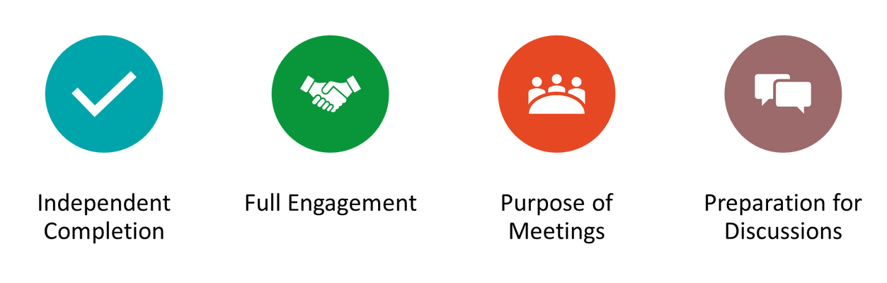
Expectations
Notes:
Overview of Expectations: Clearly define what is expected of participants in the Grow program.
Independent Completion: Inform families that they are expected to independently complete the online modules.
Full Engagement Required: Emphasize the importance of completing each module in full to maximize learning and benefit from the program.
Purpose of Meetings: Clarify that the in-person meetings are not for revisiting session content but for community building, reflecting on experiences, and discussing insights with other parents and caregivers of adolescents ages 5-10 years old.
Preparation for Discussions: Encourage participants to come to meetings prepared to share their thoughts and engage in discussions based on the content they've learned online.

Slide 8
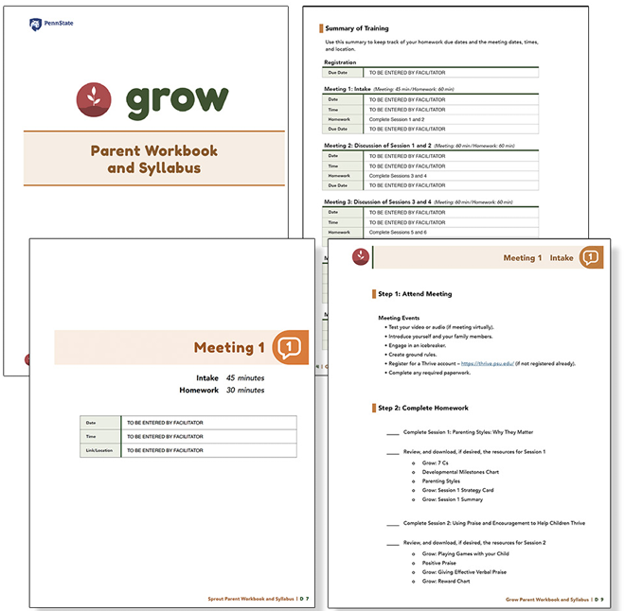

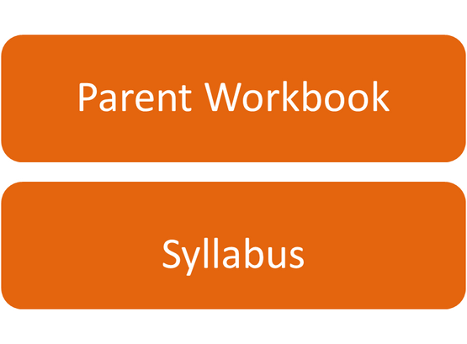
Notes:
Distribute Materials: Provide copies or screen share the Grow Parent Workbook and Syllabus to all participants.
Syllabus Overview: Review the Summary of Training, focusing on sections with pertinent information for families (homework due dates, meeting dates, times, and location).
Engagement Encouragement: Urge families to complete all exercises and discussion questions provided for each meeting session.
Example language: I encourage everyone to complete all the exercises and discussion questions in your workbooks before each session. These activities are designed to deepen your understanding and enhance our group discussions. Active participation is essential for maximizing the benefits of our meetings. Please do your best to come prepared to share and learn from each other’s experiences!

Slide 9
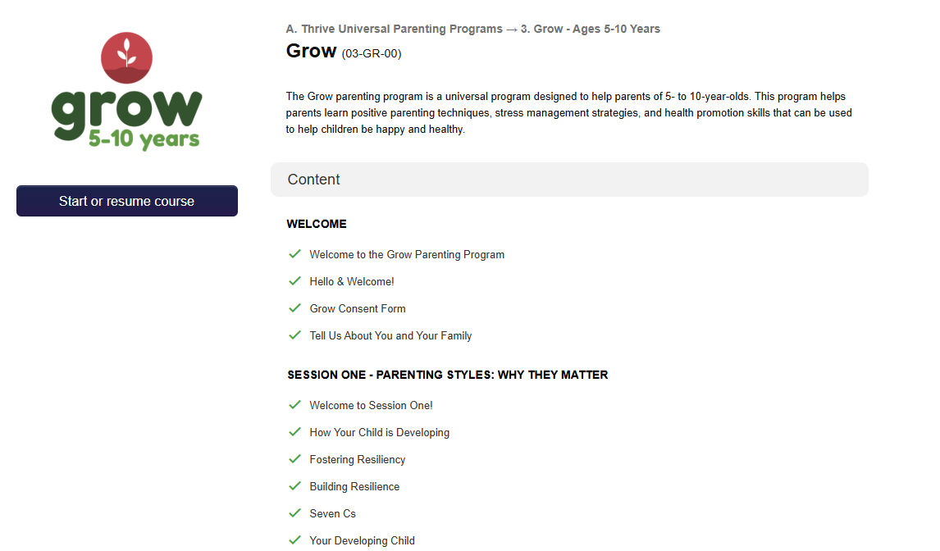
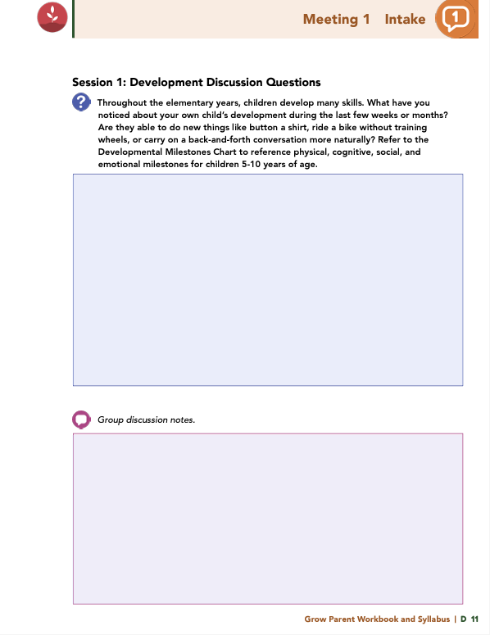

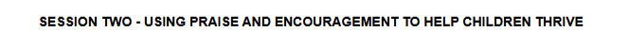

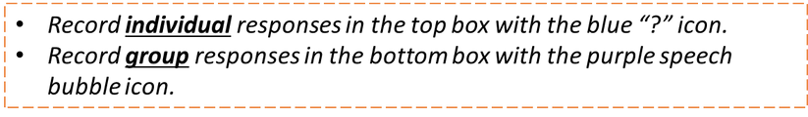
Homework
Complete Sessions 1 and 2: Parenting Styles: Why They Matter & Using Praise and Encouragement to Help Children Thrive
View online modules
Complete workbook questions
Notes:
Homework Tasks: Assign Sessions 1 & 2, “Parenting Styles: Why They Matter & Using Praise and Encouragement to Help Children Thrive," as homework.
Step 2 Clarification: Remind participants that this homework involves viewing online content and downloading necessary resources as part of Step 2. If time permits, show where to access these materials on the website.
Workbook Guidance: Show the specific pages in the Grow Parent Workbook and Syllabus related to these topics (D9, D10)
Step 3 Clarification: Assign workbook discussion questions (beginning on page D 11 in the parent workbook).
Format explanation: Explain the reason for 2 boxes per question (one for individual, one for group responses).
Encourage reflection and engagement: The more participants, think, reflect, and share the more meaningful the content becomes to each family.
Pro tip: Complete the workbook while viewing online modules.

Slide 10


Thank you for participating today.
Please reach out with any questions or concerns.
See you next week!
Notes:
Closing: Thank participants for their time and engagement.
Questions: Ask if there are any questions. (If someone needs personal assistance, ask them to speak with you individually after the group is dismissed).
Meeting 2: Remind participants of the date/time/location of the next meeting.
Homework: Remind participants to complete the homework.
Adjourn: Say goodbye to participants.
*If any of your participants are not registered, walk them through the process. Ensure they can log in and find the information they need to get started. Detailed instructions for creating a Thrive account and registering for Grow are in Appendix D: Grow Parent Workbook and Syllabus.

Slide 11
  A Universal Parenting Program for Parents of Children Ages 5-10
Meeting 2

Slide 12

Welcome back!
Please sign in and find a seat. We will begin soon.
If possible, please turn on your camera and enter your preferred name. We will begin soon.
Notes:
Choose one bullet point to display (the first bullet point is for in-person, the second is for virtual).
If in-person, greet participants as they come in the door and help them find a seat.
If virtual, give participants a heads up when you will be starting. For example, “Hi everyone, we will be starting in about one minute.”

Slide 13

  Conversation Starter
  Restate Ground Rules
  Group Discussion
  Homework
Notes:
Example language: Welcome back, families! We’re glad to see for our second meeting.
Review Meeting 2 Agenda:
Conversation Starters: We’ll get started with a quick question to get us all engaged and sharing.
Review of Ground Rules: A brief reminder of our ground rules to ensure our discussions remain respectful and productive.
Discussion and Homework: After our initial activities, we will discuss the workbook questions based on your experiences with the last set of homework followed by an explanation of the homework for our next meeting. Let’s get started!

Slide 14

Please answer one of the following questions:
  What was your least favorite food as a child? Do you still dislike it?
  What’s the best piece of advice you’ve ever been given?
  What is your favorite item that you’ve purchased this year?
Notes:
Example language: "Let's open our session with a fun question that will give us all a chance to share something about ourselves. Review the list of questions provided on the slide. Select one question that resonates with you, or that you feel comfortable sharing. This activity is designed to ease us into the meeting and build a friendly, open atmosphere.

Slide 15
Basic Ground Rules:
  Always start and end sessions on time.
  Cell phones should be on vibrate; members can quietly excuse themselves if a call must be taken.
  In virtual sessions, participants should mute themselves when taking calls outside the session.
Group-Specific Rules:
  Avoid judgment regarding other participants' parenting practices or knowledge gaps.
  One person speaks at a time to maintain order and clarity.
  Assume positive intent in all interactions to foster a positive atmosphere.
Confidentiality- Please be respectful and discrete with the personal stories being shared. This is a safe space to grow and learn.
Notes:
Example language:
Before we dive into today’s discussion, let’s quickly review our ground rules to ensure our meeting runs smoothly and everyone feels comfortable sharing. (Restate rules). Does anyone want to add anything or suggest another rule?

Slide 16


  Patience is Essential
  Consistency is key
  Explore Alternatives
Notes:
Example language: Before we begin, let’s take a moment to remind ourselves of three important principles:
Patience is essential: Meaningful changes take time to manifest. Behaviors do not change overnight, which is why (move to next point)
Consistency is key: Regularly applying the strategies ensures the best chance for success.
Explore alternatives: If one approach isn’t working, try something else. We will discuss many strategies throughout the program, some may work better than others for you.
The best thing to do is keep trying!

Slide 17

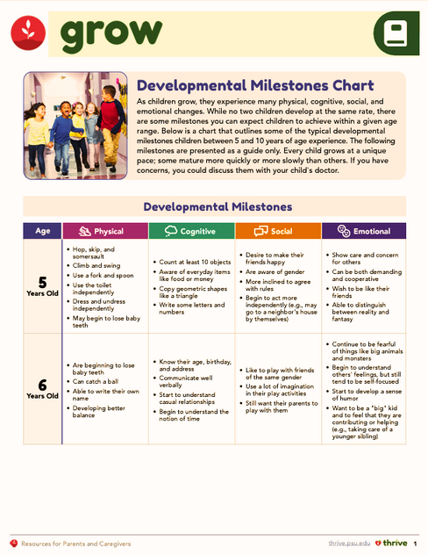



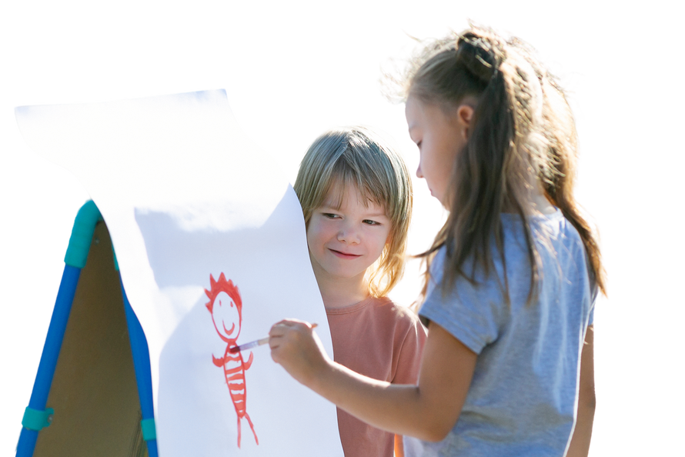
Development
Discussion Questions
  What changes have you noticed in your child’s development recently?
  Are they learning new skills?
Notes:
Throughout the elementary years, children develop many skills.
What have you noticed about your own child’s development during the last few weeks or months?
Are they able to do new things like button a shirt, ride a bike without training wheels, or carry on a back-and-forth conversation more naturally?

Slide 18

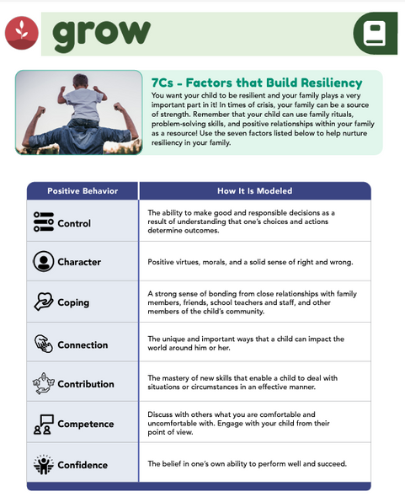

Resiliency
Discussion Questions
  Can you identify past situations in which you showed resilience?
  What strengths or knowledge did you gain from those experiences?
Notes:
Resiliency is the ability to bounce back after experiencing stress, enduring a crisis, or encountering a setback. Families can be a source of strength, and they can grow stronger and better in the face of challenges.
Can you identify past situations in which you showed resiliency?
What strengths or knowledge did you gain from those situations?

Slide 19
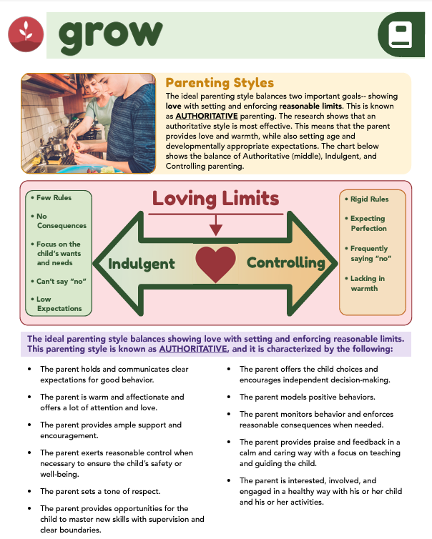


Parenting Styles
Discussion Questions
  Which parenting style did your parents use, and how does it affect your parenting?
  How do you show love and attention to your child?
  What new skills can you help your child develop while setting clear boundaries?
  What behaviors are you modeling, and are there any you want to change?
  Did you set a goal to parent with more warmth and structure?
Notes:
In this session, you witnessed three parenting styles. Think about your interactions with your own parents when you were a child, and reflect on the following questions: Which parenting style do you think your parent or caregiver displayed with you, and how do you think that may impact the way you enforce limits with your child?
Research shows that an authoritative style is most effective. Authoritative parenting balances two important goals - showing love and setting and enforcing reasonable limits. Based on this information, let’s discuss the following questions:
What are some ways in which you show affection, love, and attention to your child?
What new skills can you help your child master as you continue to supervise and maintain clear boundaries?
What behaviors are you positively modeling for your child? Are there any behaviors you would like to change that may allow you to be a more positive role model?
In this session, you were asked to set a goal for how you can parent with more warmth and structure during a challenging situation.
Did you set a goal?
Does anyone want to share information about their goal?

Slide 20

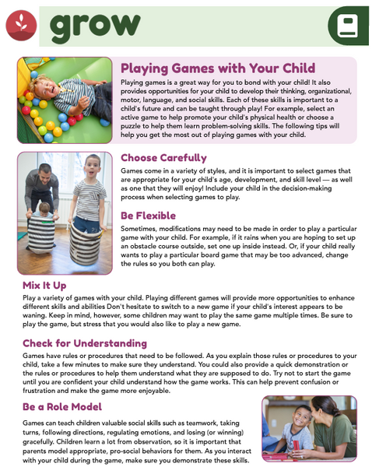

Child-Directed Play
Discussion Questions
  What activities or interests does your child have?
  How could you increase or enhance your involvement in those activities?
Notes:
One of the best ways to create a loving and nurturing home environment is to play with your child.
What activities or interests does your child have?
In what ways could you increase or enhance your involvement with your child in those activities?

Slide 21

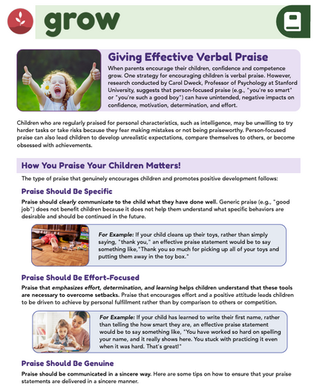

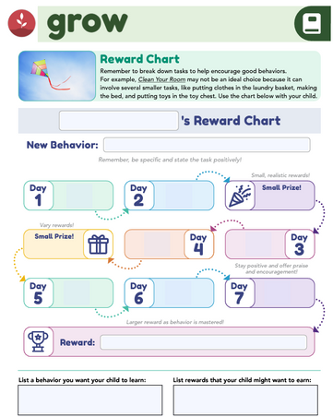
  Share a recent example of positive praise you gave your child.
  How did your child respond?
Positive Praise Discussion Questions
Notes:
When parents encourage their children, their children’s confidence and competence grow. Praise that genuinely encourages children and promotes positive development is specific, effort-focused, genuine, timely, and fitting.
Share a recent example of positive praise that you have given to your child.
How did your child respond?

Slide 22
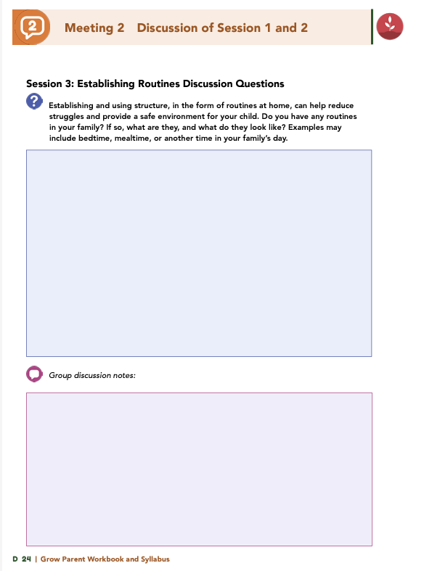


Homework
Complete Sessions 3 and 4: Your Daily Routine Matters & Promoting Health at Home
View online modules
Complete workbook questions
Notes:
Homework Tasks: Assign Sessions 3 & 4, “Your Daily Routine Matters & Promoting Health at Home," as homework.
Step 2 Clarification: Remind participants that this homework involves viewing online content and downloading necessary resources as part of Step 2. If time permits, show where to access these materials on the website.
Workbook Guidance: Show the specific pages in the Grow Parent Workbook and Syllabus related to these topics (D22, D23)
Step 3 Clarification: Assign workbook discussion questions (beginning on page D 24 in the parent workbook).
Format explanation: Explain the reason for 2 boxes per question (one for individual, one for group responses).
Encourage reflection and engagement: The more participants, think, reflect, and share the more meaningful the content becomes to each family.
Pro tip: Complete the workbook while viewing online modules.

Slide 23
Thank you for participating today.
Please reach out with any questions or concerns.
See you next week!
Notes:
Closing: Thank participants for their time and engagement.
Questions: Ask if there are any questions. (If someone needs personal assistance, ask them to speak with you individually after the group is dismissed).
Meeting 2: Remind participants of the date/time/location of the next meeting.
Homework: Remind participants to complete the homework.
Adjourn: Say goodbye to participants.

Slide 24
  A Universal Parenting Program for Parents of Children Ages 5-10
Meeting 3

Slide 25

Please sign in and find a seat.
We will begin soon.
If possible, please turn on your camera.
We will begin soon.
Notes:
Choose one bullet point to display (the first bullet point is for in-person, the second is for virtual).
If in-person, greet participants as they come in the door and help them find a seat.
If virtual, give participants a heads up when you will be starting. For example, “Hi everyone, we will be starting in about one minute.”

Slide 26

  Conversation Starters
  Review Ground Rules
  Group Discussion
  Homework
Notes:
Example language: Welcome back, everyone! We're glad to see you for our third meeting.
*Optional Sections: Please note that the conversation starters and review of ground rules are optional for today's session. If you prefer to skip these, simply remove the first bullet points from this slide and proceed to the next relevant slide in the deck.
Example language if omitting: We'll dive straight into discussing the key questions from our last session’s homework. We'll also outline and assign the homework for our next meeting, ensuring everyone is prepared and clear on the expectations.
Example language if not omitting:
Conversation Starters: We’ll get started with a quick question to get us all engaged and sharing.
Review of Ground Rules: A brief reminder of our ground rules to ensure our discussions remain respectful and productive.
Today's Agenda: After our initial activities, we will discuss the workbook questions based on your experiences with the last set of homework followed by an explanation of the homework for our next meeting. Let’s get started!

Slide 27
Please answer one of the following questions:
  What fictional family would you like to be a member of?
  What’s your favorite tradition or holiday?
  What was your favorite game to play as a child?
Notes:
Example language: "Let's open our session with a fun question that will give us all a chance to share something about ourselves. Review the list of questions provided on the slide. Select one question that resonates with you, or that you feel comfortable sharing. This activity is designed to ease us into the meeting and build a friendly, open atmosphere.

Slide 28
Basic Ground Rules:
  Always start and end sessions on time.
  Cell phones should be on vibrate; members can quietly excuse themselves if a call must be taken.
  In virtual sessions, participants should mute themselves when taking calls outside the session.
Group-Specific Rules:
  Avoid judgment regarding other participants' parenting practices or knowledge gaps.
  One person speaks at a time to maintain order and clarity.
  Assume positive intent in all interactions to foster a positive atmosphere.
Confidentiality- Please be respectful and discrete with the personal stories being shared. This is a safe space to grow and learn.
Notes:
Example language:
Before we dive into today’s discussion, let’s quickly review our ground rules to ensure our meeting runs smoothly and everyone feels comfortable sharing. (Restate rules). Does anyone want to add anything or suggest another rule?

Slide 29
  Patience is Essential
  Consistency is key
  Explore Alternatives
Notes:
Example language: Before we begin, let’s take a moment to remind ourselves of three important principles:
Patience is essential: Meaningful changes take time to manifest. Behaviors do not change overnight, which is why (move to next point)
Consistency is key: Regularly applying the strategies ensures the best chance for success.
Explore alternatives: If one approach isn’t working, try something else. We will discuss many strategies throughout the program, some may work better than others for you.
The best thing to do is keep trying!

Slide 30

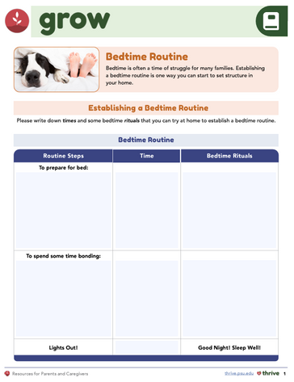
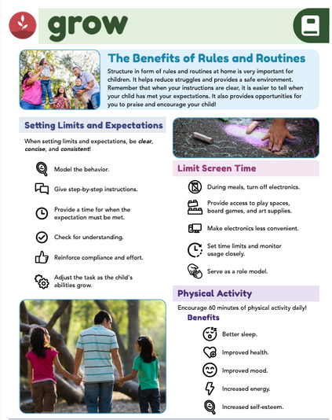

  What routines does your family have?
  Did you practice a new routine this week?
  What worked well with establishing this routine?
  What challenges did you face?
  Do you think this routine will become a regular part of your family’s day?
Establishing Routines Discussion Questions
Notes:
Establishing and using structure, in the form of routines at home, can help reduce struggles and provide a safe environment for your child.
Do you have any routines in your family?
If so, what are they, and what do they look like?
Examples of routines may include bedtime routines, mealtime routines, or another structured time in your family’s day.
You were asked to select a new routine to implement with your family and practice the routine over the course of the week. Let’s share about those experiences.
What worked well with establishing the routine?
What challenges did you face?
Do you think this routine will become a common practice in your family?

Slide 31





  How did your child respond to the fun family chore?
  Do you think you’ll continue this new way of doing the chore?
Family Chores Discussion Questions
Notes:
During Session 3, you watched a video about one parent who shared with another parent how she makes family chores fun. You were then asked to select a chore you would like to make more fun for your family and try it out during the week. Let’s share about this experience.
How did your child respond to your fun family chore?
Do you think you will continue with this new way of completing this chore?

Slide 32
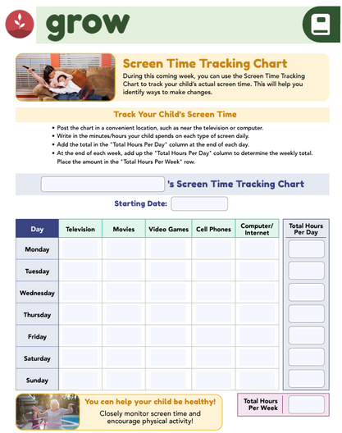




Screen Time Discussion Questions
  Do you encourage daily physical activity?
  Do you limit screen time to under 2 hours?
  Do you restrict screens in your child’s bedroom?
  What activities can replace screen time?
Notes:
Research has identified many negative consequences of screen time, and these include attention problems, school difficulties, sleep and eating disorders, obesity, and an increased risk for a variety of unhealthy and risky behaviors. Parents can help decrease screen time by practicing the following strategies:
Ensure your child has 1 hour of physical activity each day
Limit recreational screen time to less than 2 hours per day
Remove all screens from your child’s bedroom 4. Encourage physical activity
You were asked to put a star next to each strategy that you practiced with your family and circle the strategy or strategies you want to incorporate into your family life.
Raise your hand if you encourage physical activity with or for your child or if you ensure your child engages in 1 hour of physical activity each day.
Raise your hand if you limit screen time to less than 2 hours per day in your home.
How many of you also restrict screens in your child’s bedroom?
What activities did you brainstorm that can do with your child to replace screen time?
After participating in this session, what changes might you make to screen time usage in your home?

Slide 33



Physical Activity Discussion Questions
  What activities did you list, and which new ones would you like to try with your child?
  Did anyone try a new activity and want to share their experience?
Notes:
You were asked to list the aerobic, bone-strengthening, and muscle-strengthening activities you can or already participate in as a family.
What activities did you list?
What new activities would you like to participate in with your child?
Did anyone try out any of the new activities?
Does anyone want to share about this experience?

Slide 34


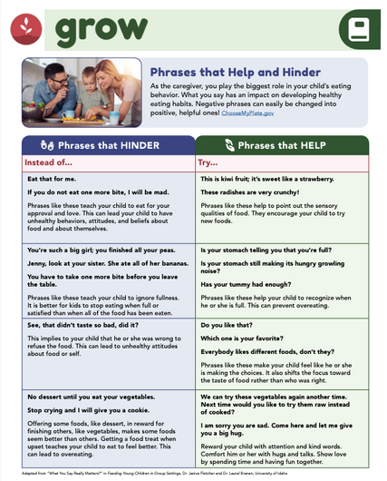
  What statements can you use to encourage your child’s internal cues?
  Did you practice focusing on internal and external hunger cues during a meal?
  Does anyone want to share their experience?
Eating Behaviors Discussion Questions
Notes:
You were asked to brainstorm a few phrases your child typically says during mealtimes.
An example response to a common statement such as “I’m full” is “Great job paying attention to your belly. Let’s wrap that up and you can finish it later if you get hungry after our walk.”
What statements can you use with your child to encourage internal cues?
You were also asked to actively think about what you are saying to your child about their internal and external hunger cues during a family meal. Did anyone practice using statements that draw attention to internal cues?
Does anyone want to share about their experience?

Slide 35



Promoting Healthy Behaviors
Discussion Questions
What non-food rewards can you use to positively reinforce your child?
Notes:
A strategy that can promote healthy eating behaviors is to avoid restricting foods or using food as a reward.
What rewards did you list, which are not food-related, that would create positive reinforcement for your child?

Slide 36
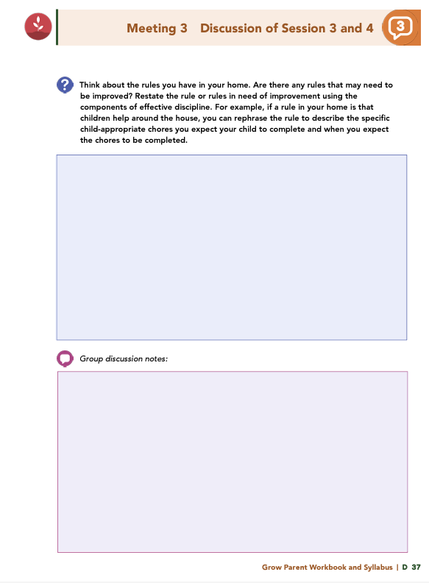


Homework
Complete Sessions 5 and 6: Preventing Misbehavior & Positively Managing Misbehavior
View online modules
Complete workbook questions
Notes:
Homework Tasks: Assign Sessions 5 & 6, “Preventing Misbehavior & Positively Managing Misbehavior ," as homework.
Step 2 Clarification: Remind participants that this homework involves viewing online content and downloading necessary resources as part of Step 2. If time permits, show where to access these materials on the website.
Workbook Guidance: Show the specific pages in the Grow Parent Workbook and Syllabus related to these topics (D 35, D 36)
Step 3 Clarification: Assign workbook discussion questions (beginning on page D 37 in the parent workbook).
Format explanation: Explain the reason for 2 boxes per question (one for individual, one for group responses).
Encourage reflection and engagement: The more participants, think, reflect, and share the more meaningful the content becomes to each family.
Pro tip: Complete the workbook while viewing online modules.

Slide 37
Thank you for participating today.
Please reach out with any questions or concerns.
See you next week!
Notes:
Closing: Thank participants for their time and engagement.
Questions: Ask if there are any questions. (If someone needs personal assistance, ask them to speak with you individually after the group is dismissed).
Meeting 2: Remind participants of the date/time/location of the next meeting.
Homework: Remind participants to complete the homework.
Adjourn: Say goodbye to participants.

Slide 38
  A Universal Parenting Program for Parents of Children Ages 5-10
Meeting 4

Slide 39

Please sign in and find a seat.
We will begin soon.
Notes:
If in-person, greet participants as they come in the door and help them find a seat.
If virtual, give participants a heads up when you will be starting. For example, “Hi everyone, we will be starting in about one minute.”
Replace text on screen with : If possible, please turn on your camera and enter your preferred name. We will begin soon.

Slide 40

  Conversation Starters
  Review of Ground Rules
  Group Discussion
  Homework
Notes:
Example language: Welcome back, everyone! We're glad to see you for our fourth meeting.
*Optional Sections: Please note that the conversation starters and review of ground rules are optional for today's session. If you prefer to skip these, simply remove the first bullet points from this slide and proceed to the next relevant slide in the deck.
Example language if omitting: We'll dive straight into discussing the key questions from our last session’s homework. We'll also outline and assign the homework for our next meeting, ensuring everyone is prepared and clear on the expectations.
Example language if not omitting:
Conversation Starters: We’ll get started with a quick question to get us all engaged and sharing.
Review of Ground Rules: A brief reminder of our ground rules to ensure our discussions remain respectful and productive.
Discussion and Homework: After our initial activities, we will discuss the workbook questions based on your experiences with the last set of homework followed by an explanation of the homework for our next meeting. Let’s get started!

Slide 41
Please answer one of the following questions:
  If you could rename yourself, what name would you pick?
  Would you rather be able to run at 100 miles per hour or fly at 10 miles per hour?
  What are you most excited about this year?
Notes:
Example language: "Let's open our session with a fun question that will give us all a chance to share something about ourselves. Review the list of questions provided on the slide. Select one question that resonates with you, or that you feel comfortable sharing. This activity is designed to ease us into the meeting and build a friendly, open atmosphere.

Slide 42
Basic Ground Rules:
  Always start and end sessions on time.
  Cell phones should be on vibrate; members can quietly excuse themselves if a call must be taken.
  In virtual sessions, participants should mute themselves when taking calls outside the session.
Group-Specific Rules:
  Avoid judgment regarding other participants' parenting practices or knowledge gaps.
  One person speaks at a time to maintain order and clarity.
  Assume positive intent in all interactions to foster a positive atmosphere.
Confidentiality- Please be respectful and discrete with the personal stories being shared. This is a safe space to grow and learn.
Notes:
Example language:
Before we dive into today’s discussion, let’s quickly review our ground rules to ensure our meeting runs smoothly and everyone feels comfortable sharing. (Restate rules). Does anyone want to add anything or suggest another rule?

Slide 43
  Patience is Essential
  Consistency is key
  Explore Alternatives
Notes:
Example language: Before we begin, let’s take a moment to remind ourselves of three important principles:
Patience is essential: Meaningful changes take time to manifest. Behaviors do not change overnight, which is why (move to next point)
Consistency is key: Regularly applying the strategies ensures the best chance for success.
Explore alternatives: If one approach isn’t working, try something else. We will discuss many strategies throughout the program, some may work better than others for you.
The best thing to do is keep trying!

Slide 44


Effective Discipline
Discussion Questions
  What rules do you have in your home that may need improvement?
  How can you restate the rule using effective discipline components?
    Be proactive, not reactive
    Consider needs, temperament, and strengths
    Communicate clearly and positively
    Give with respect, empathy, and support
    Teach the reason for the rule
Notes:
The first step in understanding and using effective discipline is defining the behaviors you desire. The components of effective discipline follow:
• Be proactive rather than reactive
• Recognize needs, temperament, and strengths
• Communicate clearly, concisely, and positively
• Give with respect, empathy, and support
• Teach the reason for the rule
Think about the rules you have in your home.
Are there any rules that may need to be improved?
Restate the rule that needs to be improved using the components of effective discipline. For example, if a rule in your home is that children help around the house, you can rephrase the rule to describe the specific child-appropriate chores you expect your child to complete and when you expect the chores to be completed.

Slide 45



Preventing Misbehavior
Discussion Questions
Think about an upcoming event or scenario.
What actions can you plan ahead to prevent misbehavior?
Notes:
Sometimes, you can prevent the need for discipline by simply planning ahead. Think about a scenario or actual event you have coming up.
What actions or activities could you plan ahead and initiate to prevent misbehavior?
Examples:
Scenario: A trip to the grocery store.
Plan: Before going, explain the rules (e.g., staying close to the cart), involve your child by giving them a small task (like picking an item), and bring a healthy snack to avoid hunger-related meltdowns.
Scenario: Leaving the park.
Plan: Give a 5-minute warning before it’s time to leave. Offer a choice (e.g., “Do you want to go down the slide one more time or swing one last time?”). Praise cooperation and discuss something fun planned for later to ease the transition.

Slide 46
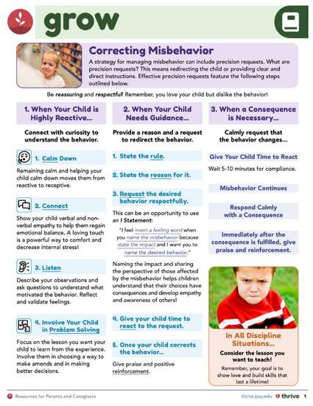



Discipline
Discussion Questions
What three words would you like your child to use to describe you?
  Think about a recent discipline situation—would your child use those words to describe you?
  If not, what could you have done differently?
Notes:
During Session 5, you were introduced to a discipline plan. You were also asked to write three words that you would like your child to use to describe you. Think about a recent situation in which you had to discipline your child.
Based on your behavior and actions, do you think your child would use those same words to describe you?
If not, what could you have done differently?

Slide 47
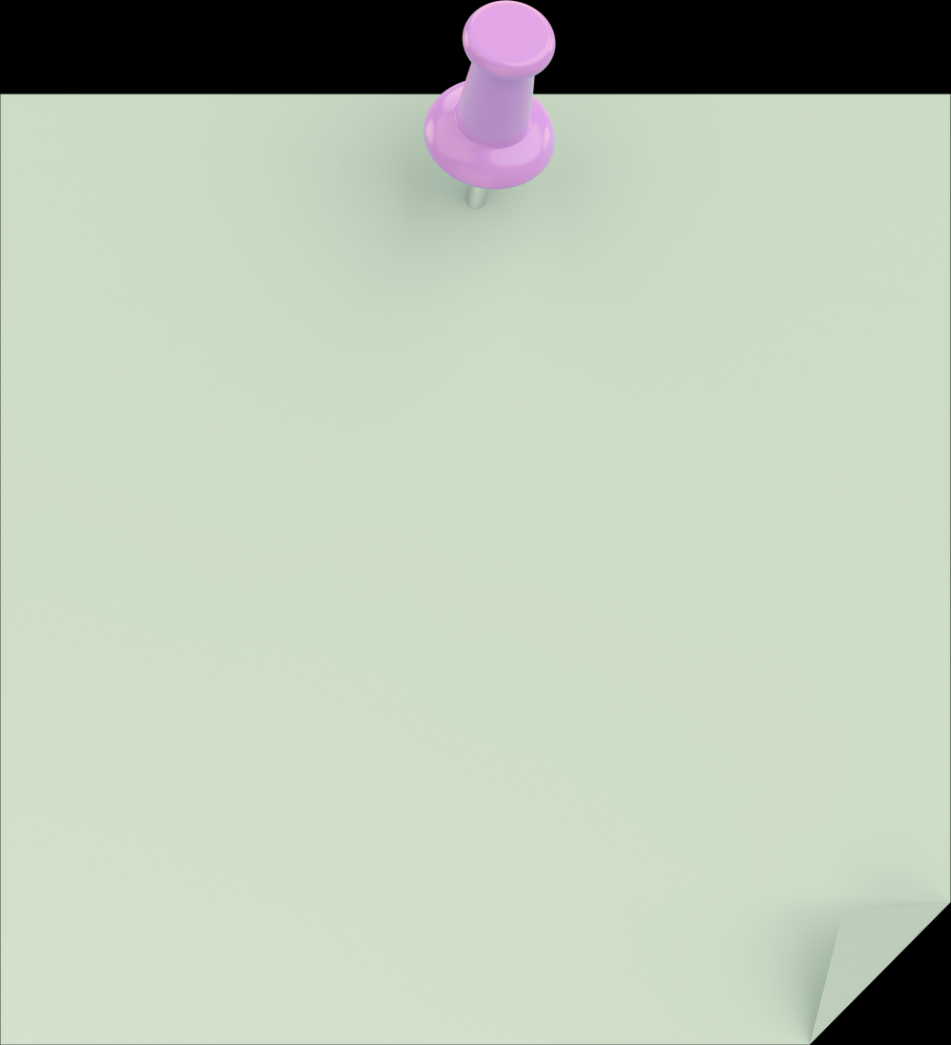
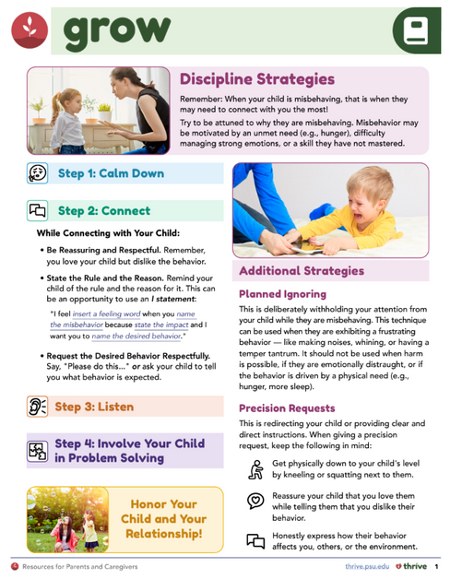

Consequences
Discussion Questions
Can you think of a natural or logical consequence for these scenarios?
  9-year-old leaves her diary on the couch; it gets damaged by the dog.
  7-year-old forgets to put his plate and cup in the sink after breakfast.
  8-year-old twins are found playing in the street instead of staying on the sidewalk.
  6-year-old whines for a candy bar at the store after being told no snacks off the list.
  What consequences could you use in a situation you struggle with?
  Did anyone try these consequences and want to share their experience?
Notes:
You were presented with some common childhood situations and were asked to think about what you would do in each situation.
Can you think of a natural or logical consequence for each scenario, or would you use planned ignoring?
A 9-year-old child leaves her diary on the couch, which she has been told repeatedly not to do, and it gets damaged by the family dog. Now there is a mess, the dog is sick, and the diary is unusable.
A 7-year-old child knows he is expected to put his dirty cup and plate in the sink after breakfast, but he forgot…again.
Eight-year-old twins are allowed to walk on the sidewalk on their street without supervision. When their mom checks on them, she finds them both in the street instead of on the sidewalk.
A 6-year-old child is whining and begging for a candy bar in the check out at the grocery store. The parent just gave him two healthy snacks in the car and told him, before going in the store, they were not going to get anything that was not on the list.
You were asked to think about a situation that you and your child continuously struggle with, or a situation that you might have struggled with more in the past few days than usual.
What consequences could you use in that situation?
Did any of you get the opportunity to try out these consequences?
Does anyone want to share about their experience?

Slide 48
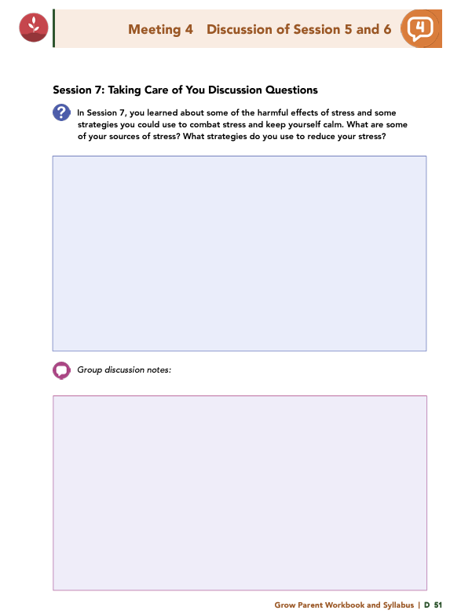

Homework
Complete Sessions 7 and 8: Listening: A Stress-Reduction Strategy & Say What? Effective Communication & Healthy Thoughts
View online modules
Complete workbook questions
Notes:
Homework Tasks: Assign Sessions 7 & 8, “Listening: A Stress-Reduction Strategy & Say What? Effective Communication & Healthy Thoughts," as homework.
Step 2 Clarification: Remind participants that this homework involves viewing online content and downloading necessary resources as part of Step 2. If time permits, show where to access these materials on the website.
Workbook Guidance: Show the specific pages in the Grow Parent Workbook and Syllabus related to these topics (D 49, D 50)
Step 3 Clarification: Assign workbook discussion questions (beginning on page D 51 in the parent workbook).
Format explanation: Explain the reason for 2 boxes per question (one for individual, one for group responses).
Encourage reflection and engagement: The more participants, think, reflect, and share the more meaningful the content becomes to each family.
Pro tip: Complete the workbook while viewing online modules.

Slide 49
Thank you for participating today.
Please reach out with any questions or concerns.
See you next week!
Notes:
Closing: Thank participants for their time and engagement.
Questions: Ask if there are any questions. (If someone needs personal assistance, ask them to speak with you individually after the group is dismissed).
Meeting 2: Remind participants of the date/time/location of the next meeting.
Homework: Remind participants to complete the homework.
Adjourn: Say goodbye to participants.

Slide 50
  A Universal Parenting Program for Parents of Children Ages 5-10
Meeting 5

Slide 51

Please sign in and find a seat.
We will begin soon.
Notes:
If in-person, greet participants as they come in the door and help them find a seat.
If virtual, give participants a heads up when you will be starting. For example, “Hi everyone, we will be starting in about one minute.”
Replace text on screen with : If possible, please turn on your camera and enter your preferred name. We will begin soon.

Slide 52

  Conversation Starters
  Review of Ground Rules
  Group Discussion
  Homework
Notes:
Example language: Welcome back, everyone! We're glad to see you for our fifth meeting.
*Optional Sections: Please note that the conversation starters are optional. If you prefer to skip these, simply remove the first bullet point from this slide and proceed to the next relevant slide in the deck.
Example language if omitting: We'll dive straight into discussing the key questions from our last session’s homework. We'll also outline and assign the homework for our next meeting, ensuring everyone is prepared and clear on the expectations.
Example language if not omitting:
Conversation Starters: We’ll get started with a quick question to get us all engaged and sharing.
Review of Ground Rules: A brief reminder of our ground rules to ensure our discussions remain respectful and productive.
Discussion and Homework: After our initial activities, we will discuss the workbook questions based on your experiences with the last set of homework followed by an explanation of the homework for our next meeting. Let’s get started!

Slide 53
Please answer one of the following questions:
  What is your favorite time of the day and why?
  Where would you time travel, if it were possible?
  What movie can you rewatch over and over again?
Notes:
Example language: "Let's open our session with a fun question that will give us all a chance to share something about ourselves. Review the list of questions provided on the slide. Select one question that resonates with you, or that you feel comfortable sharing. This activity is designed to ease us into the meeting and build a friendly, open atmosphere.

Slide 54
Basic Ground Rules:
  Always start and end sessions on time.
  Cell phones should be on vibrate; members can quietly excuse themselves if a call must be taken.
  In virtual sessions, participants should mute themselves when taking calls outside the session.
Group-Specific Rules:
  Avoid judgment regarding other participants' parenting practices or knowledge gaps.
  One person speaks at a time to maintain order and clarity.
  Assume positive intent in all interactions to foster a positive atmosphere.
Confidentiality- Please be respectful and discrete with the personal stories being shared. This is a safe space to grow and learn.
Notes:
Example language:
Before we dive into today’s discussion, let’s quickly review our ground rules to ensure our meeting runs smoothly and everyone feels comfortable sharing. (Restate rules). Does anyone want to add anything or suggest another rule?

Slide 55
  Patience is Essential
  Consistency is key
  Explore Alternatives
Notes:
Example language: Before we begin, let’s take a moment to remind ourselves of three important principles:
Patience is essential: Meaningful changes take time to manifest. Behaviors do not change overnight, which is why (move to next point)
Consistency is key: Regularly applying the strategies ensures the best chance for success.
Explore alternatives: If one approach isn’t working, try something else. We will discuss many strategies throughout the program, some may work better than others for you.
The best thing to do is keep trying!

Slide 56
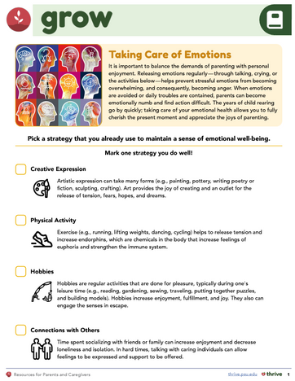





Taking Care of You
Discussion Questions
  What are some of your sources of stress?
  What strategies do you use to reduce stress?
  Describe a strategy you recently tried to reduce stress.
  What worked well, and what didn’t?
Notes:
In Session 7, you learned about some of the harmful effects of stress and some strategies you could use to combat stress and keep yourself calm.
What are some of your sources of stress?
What strategies do you use to reduce your stress?
Describe a strategy or activity you have tried recently to reduce your stress, and explain how that worked for you (e.g., what did you like or not like about the strategy or activity).

Slide 57


  What experiences of childhood stress have you observed?
  How have you responded when your child showed signs of stress?
  How might you respond differently after completing Session 7?
When Children Feel Stressed
Discussion Questions
Notes:
During Session 7, you were provided examples of things that could cause stress for a child. The examples include the following:
• Overscheduling
• Disruptions such as divorce or moving
• Concern about their own or loved ones’ safety
• Temporary or long-term separation from a parent or caretaker
• Unrealistic expectations
What similar experiences have you had?
How have you responded when your child has exhibited signs of stress?
How might you respond differently now that you’ve completed Session 7?

Slide 58
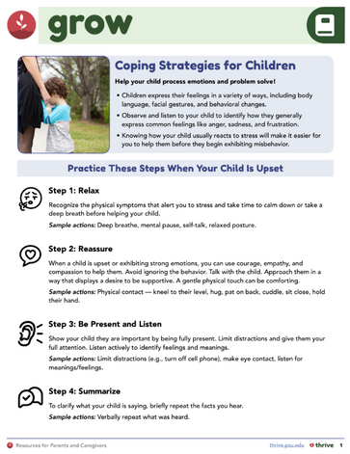


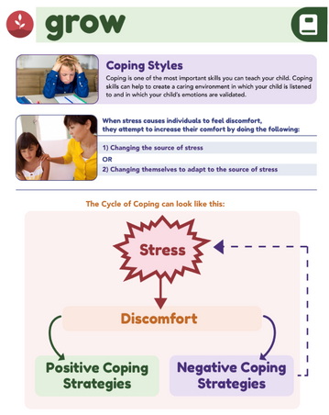

Coping
Discussion Questions
What statements can you use to start a conversation when your child is upset or stressed?
Notes:
Coping is one of the most important skills you can teach your child. Coping skills can help to create a caring environment in which your child is listened to and in which your child's emotions are validated. Statements like, “Tell me how you feel,” can help a child feel comfortable sharing.
What are some statements you can say to initiate a conversation when your child is upset or exhibiting stress?

Slide 59

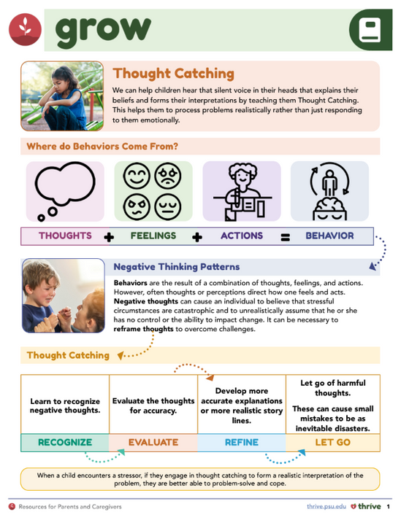

Healthy Thinking Patterns
Discussion Questions
  Have you ever noticed negative thinking patterns in your child?
  How can you help your child use thought catching to reframe these patterns?
Notes:
Healthy thinking patterns promote the confidence and competency that a child needs to overcome challenges. Children who are resilient may use thought catching to help manage their emotions and behaviors before their story becomes catastrophic.
What negative thinking patterns have you seen in your child?
How can you help your child use thought catching to reframe their thought patterns?

Slide 60



  Have you practiced these 6 steps of active listening?
  Can you describe a recent situation where you used these steps?
  How did it feel, and did your child respond differently?
Active Listening
Discussion Questions
Active Listening Steps
  Relax yourself
  Reassure your child
  Be present
  Summarize what you heard
  Reflect your child’s feelings
  Empower your child
Notes:
Session 8 introduced you to 6 steps that will lead you through actively listening to your child.
The steps follow:
Relax yourself
Reassure your child
Be present
Summarize what you just heard
State the child’s feelings back to them
Empower the child
Describe a recent situation in which you went through each of the steps and practiced actively listening to your child.
How did it feel?
Did your child respond differently to you?

Slide 61



  Did you try these steps to calm your child in the past week?
    Move to a quiet place
    Explain that the behavior is disliked, but their feelings matter
    Name their feelings
    Help release strong emotions
    Practice deep breathing
    Problem-solve when calm
Calming Your Child
Discussion Questions
  How did it work for you? How did your child respond?
Notes:
In Session 8, you learned the steps needed to calm your child.
Remove your child to a quiet place.
Explain to your child that the behavior is disliked but you care about them, and their feelings matter.
Name your child’s feelings.
Guide your child in releasing strong emotions, if needed.
Practice deep breathing exercises after the energy has been released.
Engage your child in a conversation when they are calm to help them problem solve.
In the last week, did the opportunity present for you to try this strategy with your child?
How did it work for you?
How did your child respond?

Slide 62
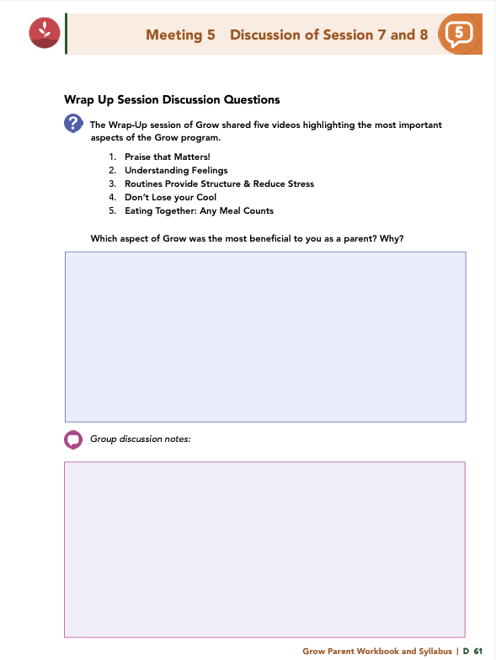

Homework
Complete Session 9: It’s a Wrap: Let’s Review What You Have Learned
View online modules
Complete workbook questions
Notes:
Homework Tasks: Assign Session 9, “It’s a Wrap: Let’s Review What You Have Learned," as homework.
Step 2 Clarification: Remind participants that this homework involves viewing online content and downloading necessary resources as part of Step 2. If time permits, show where to access these materials on the website.
Workbook Guidance: Show the specific pages in the Grow Parent Workbook and Syllabus related to these topics (D 60)
Step 3 Clarification: Assign workbook discussion questions (beginning on page D 61 in the parent workbook).
Format explanation: Explain the reason for 2 boxes per question (one for individual, one for group responses).
Encourage reflection and engagement: The more participants, think, reflect, and share the more meaningful the content becomes to each family.
Pro tip: Complete the workbook while viewing online modules.

Slide 63
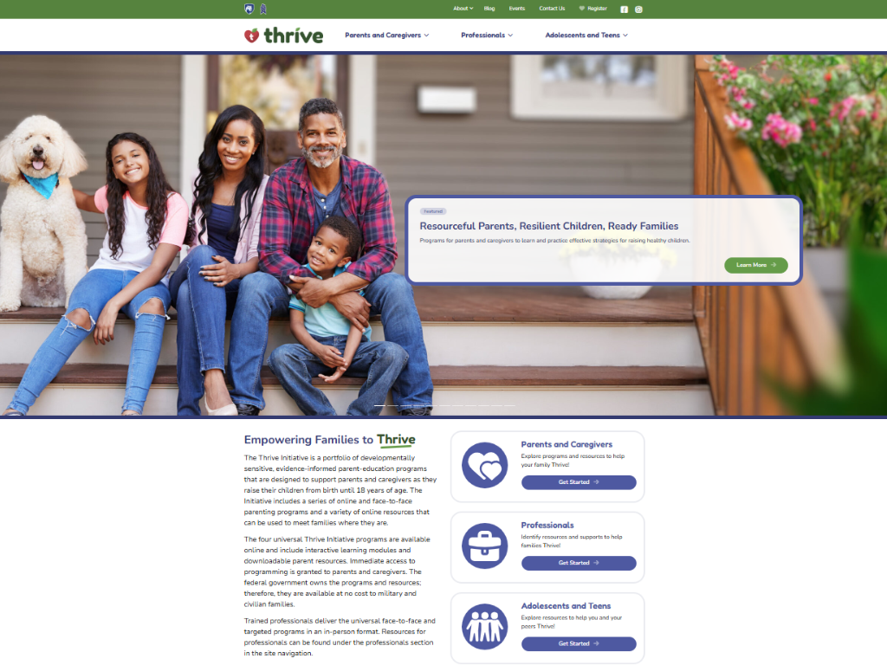
Notes:
Website Walkthrough: Guide participants through the Thrive website, highlighting key resources like mini video modules, supplemental modules, and additional program options.
Program Exploration: Encourage parents to explore other programs that may benefit another child or support different age groups.
Planning for Growth: Emphasize the value of these resources for ongoing planning in their child’s development.
Adolescent Focus: Point out supplemental modules specific to teens and adolescents and suggest families review these for targeted support.

Slide 64
Thank you for participating today.
Please reach out with any questions or concerns.
See you next week!
Notes:
Closing: Thank participants for their time and engagement.
Questions: Ask if there are any questions. (If someone needs personal assistance, ask them to speak with you individually after the group is dismissed).
Meeting 2: Remind participants of the date/time/location of the next meeting.
Homework: Remind participants to complete the homework.
Adjourn: Say goodbye to participants.

Slide 65
  A Universal Parenting Program for Parents of Children Ages 5-10
Meeting 6

Slide 66

Please sign in and find a seat.
We will begin soon.
Notes:
If in-person, greet participants as they come in the door and help them find a seat.
If virtual, give participants a heads up when you will be starting. For example, “Hi everyone, we will be starting in about one minute.”
Replace text on screen with : If possible, please turn on your camera and enter your preferred name. We will begin soon.

Slide 67

Conversation Starters
Group Discussion
Thrive Programming
Notes:
Example language: Welcome back, everyone! We're glad to see you for our sixth meeting.
*Optional Sections: Please note that the conversation starters are optional. If you prefer to skip these, simply remove the first bullet point from this slide and proceed to the next relevant slide in the deck.
Example language if omitting: We'll dive straight into discussing the key questions from our last session’s homework. We’ll wrap up with a discussion on additional Thrive programs that may interest you.
Example language if not omitting:
Conversation Starters: We’ll get started with a quick question to get us all engaged and sharing.
Review of Ground Rules: A brief reminder of our ground rules to ensure our discussions remain respectful and productive.
Discussion and Homework: After our initial activities, we will discuss the workbook questions based on your experiences with the last set of homework followed by an explanation of the homework for our next meeting. Let’s get started!

Slide 68
Please answer one of the following questions:
  What is your favorite time of the day and why?
  Where would you time travel, if it were possible?
  What movie can you rewatch over and over again?
Notes:
Example language: "Let's open our session with a fun question that will give us all a chance to share something about ourselves. Review the list of questions provided on the slide. Select one question that resonates with you, or that you feel comfortable sharing. This activity is designed to ease us into the meeting and build a friendly, open atmosphere.

Slide 69
Basic Ground Rules:
  Always start and end sessions on time.
  Cell phones should be on vibrate; members can quietly excuse themselves if a call must be taken.
  In virtual sessions, participants should mute themselves when taking calls outside the session.
Group-Specific Rules:
  Avoid judgment regarding other participants' parenting practices or knowledge gaps.
  One person speaks at a time to maintain order and clarity.
  Assume positive intent in all interactions to foster a positive atmosphere.
Confidentiality- Please be respectful and discrete with the personal stories being shared. This is a safe space to grow and learn.
Notes:
Example language:
Before we dive into today’s discussion, let’s quickly review our ground rules to ensure our meeting runs smoothly and everyone feels comfortable sharing. (Restate rules). Does anyone want to add anything or suggest another rule?

Slide 70
  Patience is Essential
  Consistency is key
  Explore Alternatives
Notes:
Example language: Before we begin, let’s take a moment to remind ourselves of three important principles:
Patience is essential: Meaningful changes take time to manifest. Behaviors do not change overnight, which is why (move to next point)
Consistency is key: Regularly applying the strategies ensures the best chance for success.
Explore alternatives: If one approach isn’t working, try something else. We will discuss many strategies throughout the program, some may work better than others for you.
The best thing to do is keep trying!

Slide 71


  Which aspect of Grow was most beneficial to you as a parent? Why?
  Has anything changed in your interactions or responses to your child’s behaviors?
  Would anyone like to share a moment when you used a Grow strategy?
  How did your reaction differ from before Grow training?
  How did your child respond?
Wrap-Up
Discussion Questions
Notes:
The Wrap-Up session of Grow shared five videos that highlighted the most important aspects of the Grow program.
• Praise that Matters!
• Understanding Feelings
• Routines Provide Structure & Reduce Stress
• Don’t Lose your Cool
• Eating Together: Any Meal Counts
Which aspect of Grow was the most beneficial to you as a parent? Why?
Has anything changed about your interactions with your child since we started?
Do you notice a difference in the way you respond to your child’s behaviors?
Would anyone like to talk about a moment when you used a strategy you learned in Grow and discuss how your current reaction compared to how you may have reacted prior to engaging in Grow training?
What was different?
How did your child respond?

Slide 72
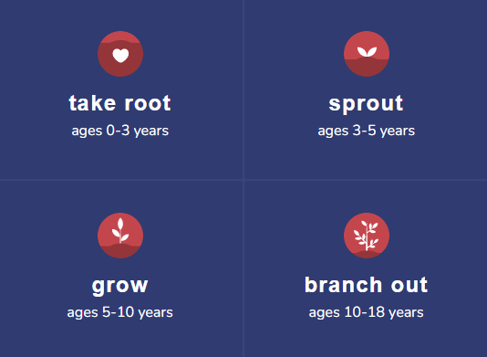
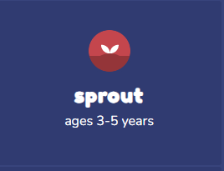
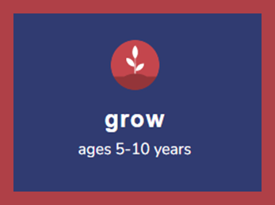
Additional Thrive Programs
  Take Root is available for parents and caregivers of children who are between 0 and 3 years old.
  Sprout is available for parents and caregivers of children who are between 3 and 5 years old.
  Branch Out is available for parents and caregivers of children who are between 10 and 18 years old.
  .
Notes:
Additional Thrive Program Options for Different Ages:
Take Root: For parents and caregivers of children aged 0 to 3 years.
Sprout: Designed for parents and caregivers of children aged 3 to 5 years.
Branch Out: Suitable for parents and caregivers of children aged 10 to 18 years.
Next Steps: Encourage participants to explore these programs to continue supporting their children's development at various stages.

Slide 73
Notes:
Thrive Website: Encourage participants to visit the Thrive website for additional resources.
Program Exploration: Suggest exploring other programs that may be beneficial for another child.
Continued Growth: Encourage using these resources to plan the next steps in their child’s growth and development.
For an in-depth exploration of specified topics related to teens and adolescents, suggest families visit the Thrive website (https://thrive.psu.edu/supplemental-modules/), and review the supplemental module content for the most up-to-date offerings.

Slide 74


Thank you all for your dedication and participation. Every effort you make significantly impacts your child's future success.
Notes:
Example language:
Thank you, parents and caregivers, for your active participation. Please continue to visit the Thrive website as your child develops and grows—it's a valuable resource that can support you through every stage of their growth.

