Slide 1



As of February 24, 2025
  A Universal Parenting Program for Parents of Children Ages 3-5
Meeting 1

Slide 2


Welcome!
Please sign in and find a seat. We will begin soon.
If possible, please turn on your camera and enter your preferred name. We will begin soon.
Notes:
Choose one bullet point to display (the first bullet point is for in-person, the second is for virtual).
If in-person, greet participants as they come in the door and help them find a seat.
If virtual, give participants a heads up when you will be starting. For example, “Hi everyone, we will be starting in about one minute.”

Slide 3

Agenda
Overview
Introductions
Ground Rules
Expectations
Review Syllabus
Homework
Q & A
Notes:
Welcome: Introduce yourself and thank participants for choosing to be a part of the Sprout Parenting Program. Explain that Meeting 1 will provide an overview of the program, who is in the group, and what is expected of parents who participate. We will discuss the materials you received and provide instructions on how to use them.
Encourage participants to ask questions as they arise or to jot them down and ask at the end of the meeting.

Slide 4


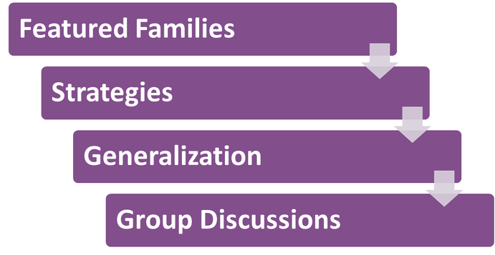
Notes:
Take time to discuss the following topics with your participants:
Sprout is an online parenting program for parents and caregivers of children who are 3 to 5 years old.
Sprout features four families in the Everyday Moments. Participants share moments in these families' everyday lives, such as mealtimes; morning and bedtime routines; and activities that take them out of the house, such as play dates or shopping at the grocery store.
By reading the featured families’ Everyday Moments, parents and caregivers will gain information about holding developmentally appropriate expectations for their child and will explore ways in which each family uses different strategies to make these moments more enjoyable. One great aspect of Sprout is that the lessons learned throughout the 6 Everyday Moments can be generalized across various daily happenings in a family’s life.
After participants complete sessions independently, your group will meet and discuss some questions related to the content.

Slide 5



Tell us your name, partner’s name, child’s name, and one of the following:
The hospital/state/country where your child was born.
Your child’s birthday.
Your child’s favorite book.
A favorite thing about your child.
Notes:
Personal Introduction: Start with a brief introduction of yourself, highlighting your expertise in child development and any personal affiliations (e.g., community, organization, military) that connect you to the audience.
Combining Introductions: Merge the participants' introductions with an icebreaker activity to create a more engaging and efficient session.
Icebreaker Questions: Ask each participant to share their name, their partner’s name, their child’s name, and age. Consider also asking one of the additional questions:
The location of their child’s birth (hospital/state/country),
child’s birthday,
child’s favorite book,
or a favorite thing about their child.
Future Use: Note the icebreaker questions used; consider revisiting unused questions in future sessions as needed.
Additional icebreaker questions:
What was your least favorite food as a child? Do you still dislike it?
What’s the best piece of advice you’ve ever been given?
What is your favorite item that you’ve purchased this year?
What fictional family would you like to be a member of?
What’s your favorite tradition or holiday?
What was your favorite game to play as a child?
If you could rename yourself, what name would you pick?
Would you rather be able to run at 100 miles per hour or fly at 10 miles per hour?
What are you most excited about this year?
You can also start each meeting with an icebreaker if you find your group is reserved. Use your judgment and avoid controversial topics.

Slide 6


Basic Ground Rules:
  Always start and end sessions on time.
  Cell phones should be on vibrate; members can quietly excuse themselves if a call must be taken.
  In virtual sessions, participants should mute themselves when not speaking or taking calls outside the session.
Group-Specific Rules:
  Avoid judgment regarding other participants' parenting practices or knowledge gaps.
  One person speaks at a time to maintain order and clarity.
  Assume positive intent in all interactions to foster a positive atmosphere.
Confidentiality- Please be respectful and discrete with any personal stories being shared. This is a safe space to grow and learn.
Notes:
Introduction of Ground Rules: Start by stating some basic ground rules to create a supportive environment where families feel safe to share their parenting experiences.
Basic Ground Rules:
Always start and end sessions on time.
Cell phones should be on vibrate; members can quietly excuse themselves if a call must be taken.
In virtual sessions, participants should mute themselves when not talking or taking calls outside the session.
Developing Group-Specific Rules:
Discuss and agree on additional rules as a group, such as:
Avoid judgment regarding other participants' parenting practices or knowledge gaps.
Ensure one person speaks at a time to maintain order and clarity.
Assume positive intent in all interactions to foster a positive atmosphere.
Confidentiality Discussion: Use this time to reinforce the importance of confidentiality, outlining your organization’s specific confidentiality clauses regarding statements related to abuse or neglect mandated reporting..
Example language:
As we begin, it's crucial to emphasize the importance of confidentiality within our group. We need to agree to keep all shared information within these sessions, including personal stories and sensitive details. This ensures a safe space where everyone feels comfortable sharing their experiences. Please remember that details shared by participants are given in trust and should be treated with respect and discretion.
Additionally, it’s important to note our mandated reporting clause for suspected abuse or neglect:
Legal Obligation: Our staff and facilitators are legally required to report any suspicions of child abuse or neglect.
Scope of Reporting: We must report any signs of potential harm to a child or vulnerable adult that arise during our sessions.
Procedure for Reporting: We handle these situations sensitively, informing involved individuals about necessary actions, unless it poses further risk.
Support for Affected Individuals: We provide support and resources to help those involved in a reporting situation.
Our primary concern is the safety and well-being of all individuals. If you have any questions or concerns about this policy, feel free to discuss them privately with me.

Slide 7
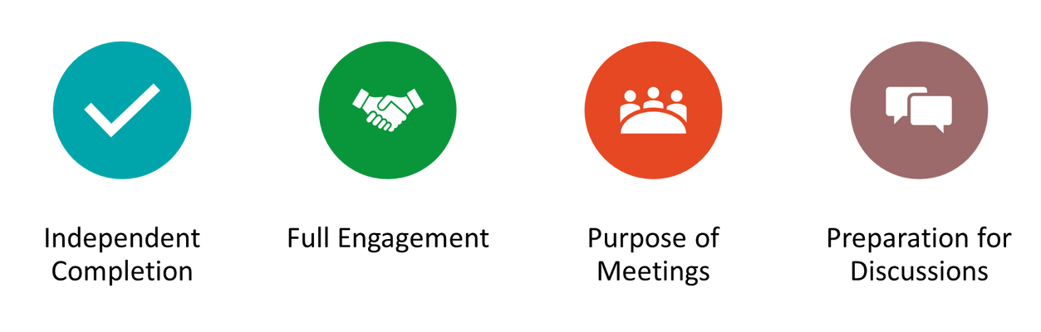
Expectations
Notes:
Overview of Expectations: Clearly define what is expected of participants in the Sprout program.
Independent Completion: Inform families that they are expected to independently complete the online sessions of the Sprout program, titled 'Everyday Moments.’
Full Engagement Required: Emphasize the importance of completing each Everyday Moment session in full to maximize learning and benefit from the program.
Purpose of Meetings: Clarify that the in-person meetings are not for revisiting session content but for making connections with the content via community building, reflecting on experiences, and discussing insights with other parents and caregivers of children aged 3 to 5.
Preparation for Discussions: Encourage participants to come to meetings prepared to share their thoughts and engage in discussions based on the content they've learned online.

Slide 8
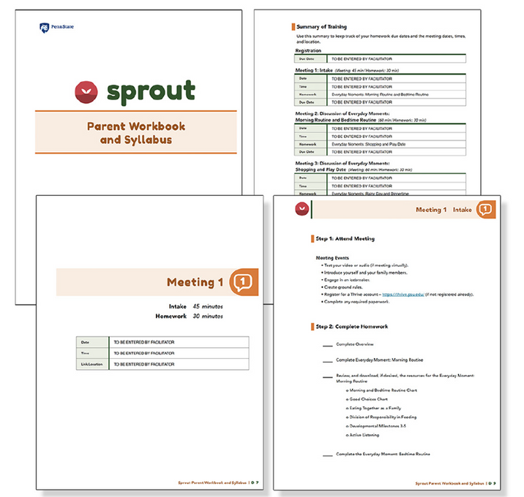

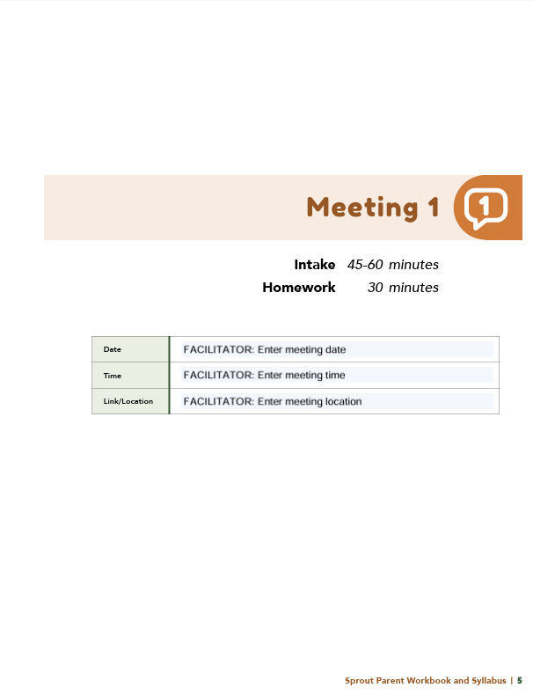
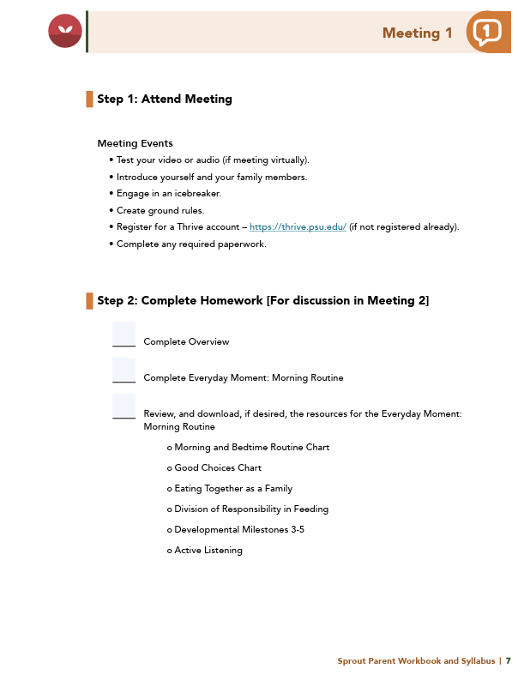
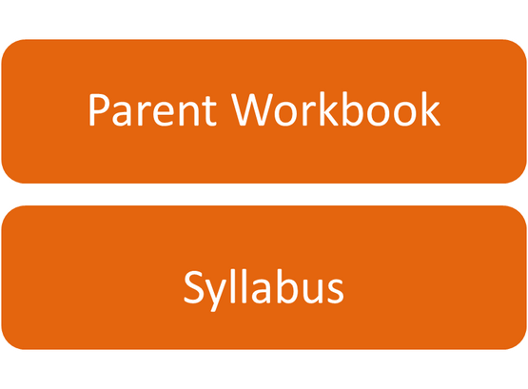
Notes:
Distribute Materials: Provide copies or screen share the Sprout Parent Workbook and Syllabus to all participants.
Syllabus Overview: Review the Summary of Training, focusing on sections with pertinent information for families (homework due dates, meeting dates, times, and location).
Engagement Encouragement: Encourage families to complete all exercises and discussion questions provided for each meeting session.
Example language: I encourage everyone to complete all the exercises and discussion questions in your workbooks before each session. These activities are designed to deepen your understanding and enhance our group discussions. Active participation is essential for maximizing the benefits of our meetings. Please do your best to come prepared to share and learn from each other’s experiences!

Slide 9

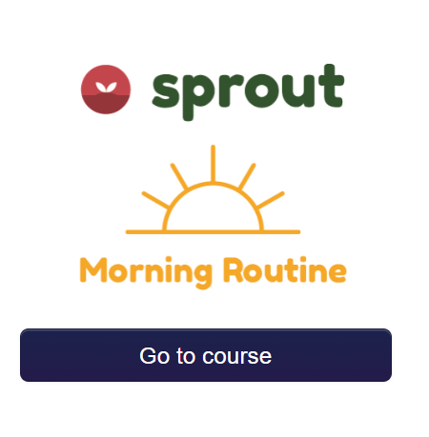
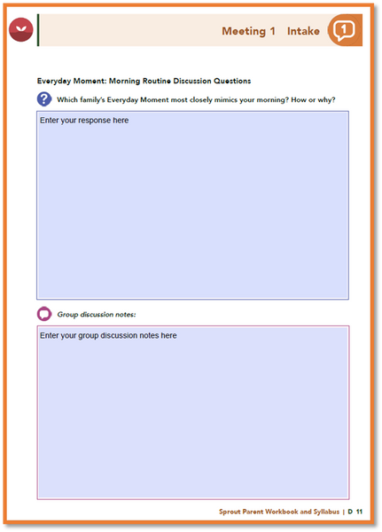
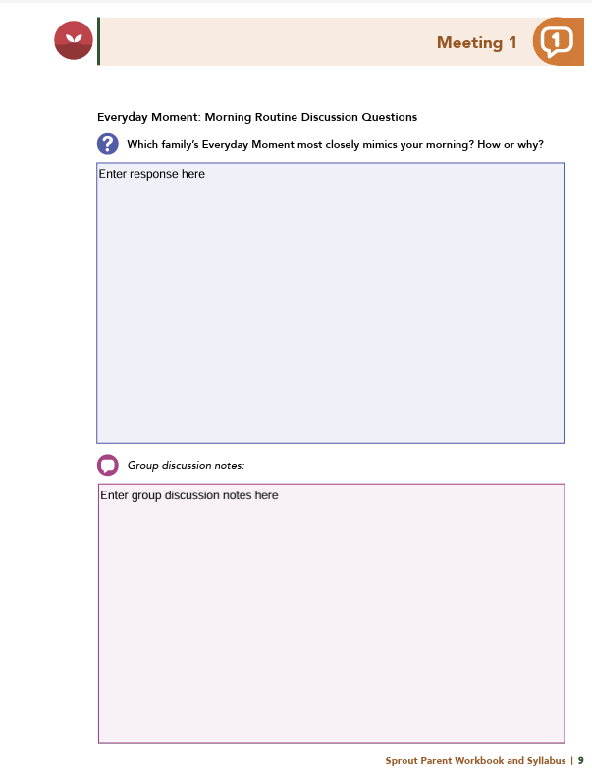
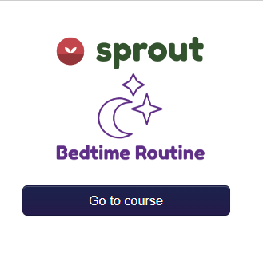


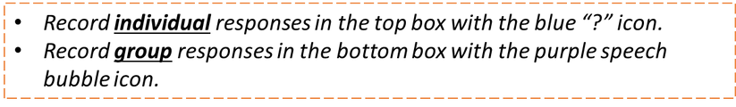
Homework
Everyday Moments: Overview, Morning Routine and Bedtime Routine
View online modules
Complete workbook questions
Notes:
Homework Tasks: Assign "Everyday Moments: Overview, Morning Routine and Bedtime Routine" as homework.
Step 2 Clarification: Remind participants that this homework involves viewing online content and downloading necessary resources as part of Step 2. If time permits, show where to access these materials on the website.
Workbook Guidance: Show the specific pages in the Sprout Parent Workbook and Syllabus related to these topics.
Step 3 Clarification: Assign workbook discussion questions.
Format explanation: Explain the reason for 2 boxes per question (one for individual, one for group responses).
Encourage reflection and engagement: The more participants, think, reflect, and share the more meaningful the content becomes to each family.
Pro tip: Complete the workbook while viewing online modules.

Slide 10


Thank you for participating today.
Please reach out with any questions or concerns.
See you next week!
Notes:
Closing: Thank participants for their time and engagement.
Questions: Ask if there are any questions. (If someone needs personal assistance, ask them to speak with you individually after the group is dismissed).
Meeting 2: Remind participants of the date/time/location of the next meeting.
Homework: Remind participants to complete the homework.
Adjourn: Say goodbye to participants.
*If any of your participants are not registered, walk them through the process. Ensure they can log in and find the information they need to get started. Detailed instructions for creating a Thrive account and registering for Sprout are in Appendix D: Sprout Parent Workbook and Syllabus.

Slide 11
  A Universal Parenting Program for Parents of Children Ages 3-5
Meeting 2

Slide 12

Welcome back!
Please sign in and find a seat. We will begin soon.
If possible, please turn on your camera and enter your preferred name. We will begin soon.
Notes:
Choose one bullet point to display (the first bullet point is for in-person, the second is for virtual).
If in-person, greet participants as they come in the door and help them find a seat.
If virtual, give participants a heads up when you will be starting. For example, “Hi everyone, we will be starting in about one minute.”

Slide 13

  Conversation Starter
  Restate Ground Rules
  Group Discussion
  Homework
Notes:
Example language: Welcome back, families! We’re glad to see for our second meeting.
Review Meeting 2 Agenda:
Conversation Starters: We’ll get started with a quick question to get us all engaged and sharing.
Review of Ground Rules: A brief reminder of our ground rules to ensure our discussions remain respectful and productive.
Discussion and Homework: After our initial activities, we will discuss the workbook questions based on your experiences with the last set of homework followed by an explanation of the homework for our next meeting. Let’s get started!

Slide 14

Please answer one of the following questions:
  What was your least favorite food as a child? Do you still dislike it?
  What’s the best piece of advice you’ve ever been given?
  What is your favorite item that you’ve purchased this year?
Notes:
Example language: "Let's open our session with a fun question that will give us all a chance to share something about ourselves. Review the list of questions provided on the slide. Select one question that resonates with you, or that you feel comfortable sharing. This activity is designed to ease us into the meeting and build a friendly, open atmosphere.

Slide 15
Basic Ground Rules:
  Always start and end sessions on time.
  Cell phones should be on vibrate; members can quietly excuse themselves if a call must be taken.
  In virtual sessions, participants should mute themselves when taking calls outside the session.
Group-Specific Rules:
  Avoid judgment regarding other participants' parenting practices or knowledge gaps.
  One person speaks at a time to maintain order and clarity.
  Assume positive intent in all interactions to foster a positive atmosphere.
Confidentiality- Please be respectful and discrete with the personal stories being shared. This is a safe space to grow and learn.
Notes:
Example language:
Before we dive into today’s discussion, let’s quickly review our ground rules to ensure our meeting runs smoothly and everyone feels comfortable sharing. (Restate rules). Does anyone want to add anything or suggest another rule?

Slide 16


  Patience is Essential
  Consistency is key
  Explore Alternatives
Notes:
Example language: Before we begin, let’s take a moment to remind ourselves of three important principles:
Patience is essential: Meaningful changes take time to manifest. Behaviors do not change overnight, which is why (move to next point)
Consistency is key: Regularly applying the strategies ensures the best chance for success.
Explore alternatives: If one approach isn’t working, try something else. We will discuss many strategies throughout the program, some may work better than others for you.
The best thing to do is keep trying!

Slide 17

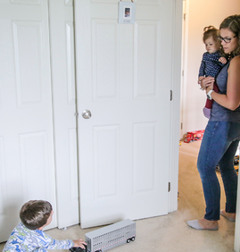
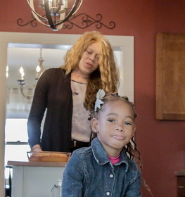
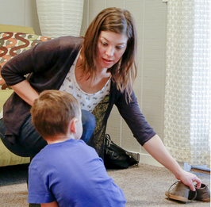
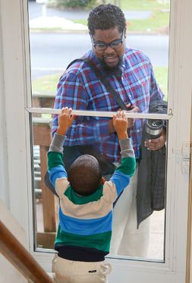

Morning Routine Discussion Questions
The Jones Family
The Jackson Family
The Kym Family
The Smith Family
Why didn’t you...
Let’s have cake for every meal!
Why does it take so long to get out the door?
But I want to come too!
  Which family’s Everyday Moment most closely mimics your morning? How or why?
  Do you have any morning routines that you are already using in your everyday family life?
    If yes, what are they?
Notes:
Everyday Moments: Morning Routine Discussion Questions:
Which family’s Everyday Moment most closely mimics your morning? How or why?
Do you have any morning routines that you are already using in your everyday family life? If yes, what are they?

Slide 18

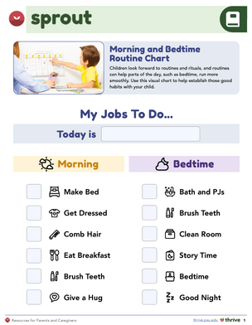
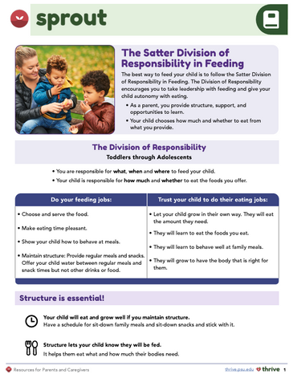
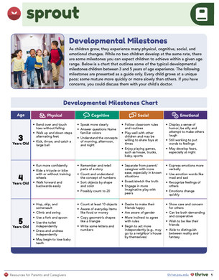



Did any of these strategies seem like they would work for you?
Use a visual chart to support routines
Offer choices to support feeding roles
Give age-appropriate tasks
Did you try any of these suggestions or strategies?
Active listening
  What was the outcome?
  Do you plan to try any other strategies or suggestions?
Notes:
Did any of the suggestions provided throughout the family’s Everyday Moments seem like they would work for you?
Examples include the following:
Providing structure with a routine using a visual chart;
Offering appropriate choices for the division of responsibility in feeding;
Providing one or two clear, concise, and developmentally appropriate tasks at a time;
Practicing active listening.
Did you try any of these suggestions or strategies?
What was the outcome?
Do you plan to try any other strategies or suggestions?

Slide 19




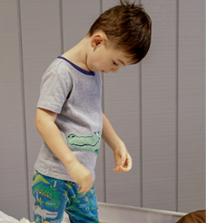
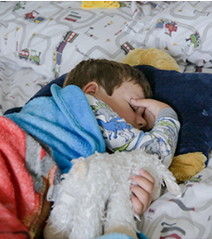


Bedtime Routine Discussion Questions
The Jackson Family
The Smith Family
The Kym Family
The Jones Family
I don’t want to go to bed!
I’m thirsty, I have to pee, I see a bug...
Not again?!
Let’s go, it’s time for bed!
  Which family’s Everyday Moment most closely mimics your bedtime or nighttime routine?
    How or why?
  Do you have any nighttime routines that you are already using in your everyday family life?
    If yes, what are they?
Notes:
Everyday Moments: Bedtime Routine Discussion Questions
Which family’s Everyday Moment most closely mimics your bedtime or nighttime routine? How or why?
Do you have any nighttime routines that you are already using in your everyday family life? If yes, what are they?

Slide 20


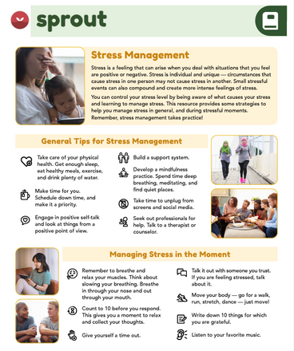

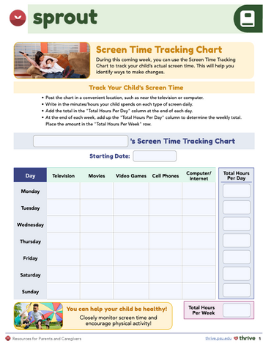


Did any of these strategies seem like they would work for you?
Practice stress relief
Follow a consistent bedtime routine
Screen time: limit, co-view, and pause before bed
Did you try any of these suggestions or strategies?
  What was the outcome?
  Do you plan to try any other strategies or suggestions?
Notes:
Did any of the suggestions provided throughout the family’s Everyday Moments seem like they would work for you?
Examples include the following:
Limiting screen time, co-viewing shows or videos, and providing time between screen time and bedtime;
Sticking with a bedtime routine, including hygiene or story time;
Practicing a stress management technique, such as deep breathing?
Did you try any of these suggestions or strategies?
What was the outcome?
Do you plan to try any other strategies or suggestions?
*Remind parents about the downloadable files (handouts pictured on screen) that supplement the videos and curriculum.

Slide 21
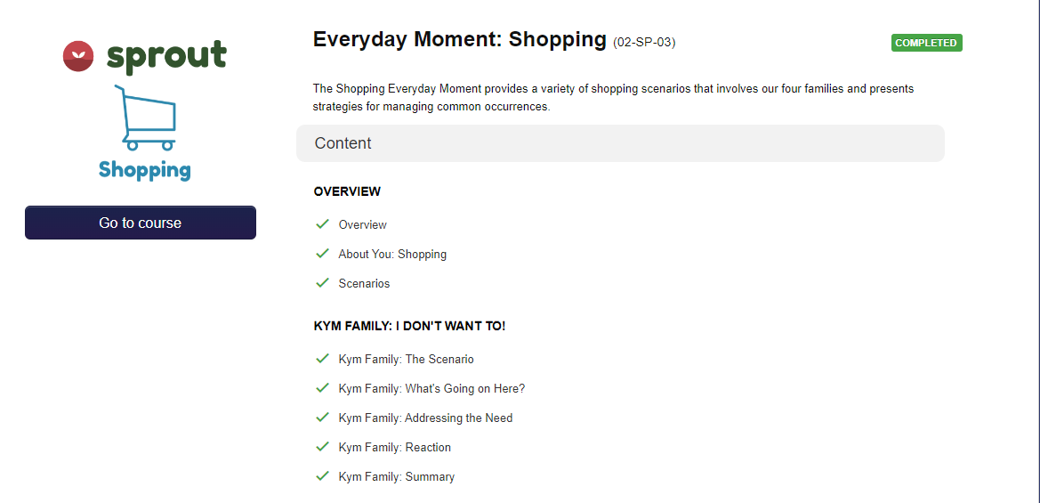
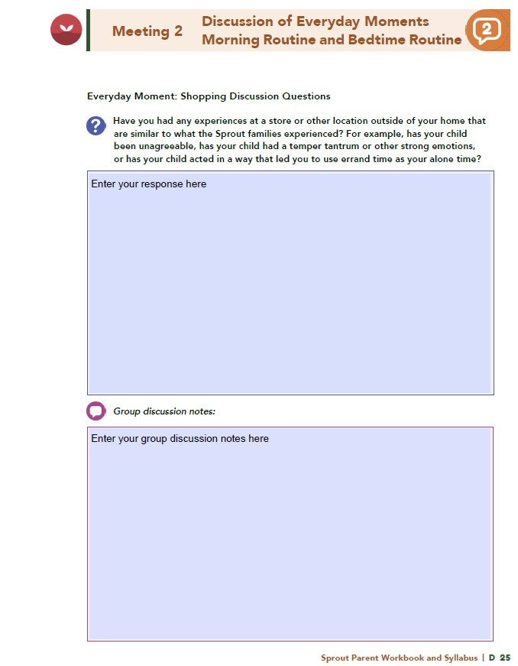
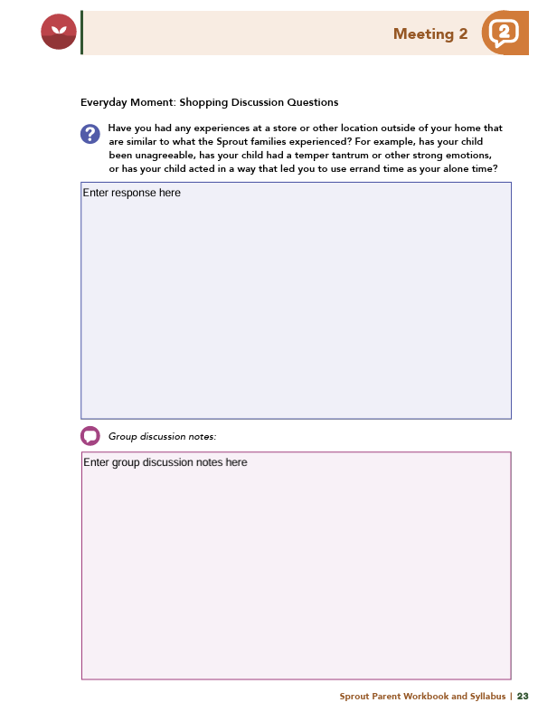
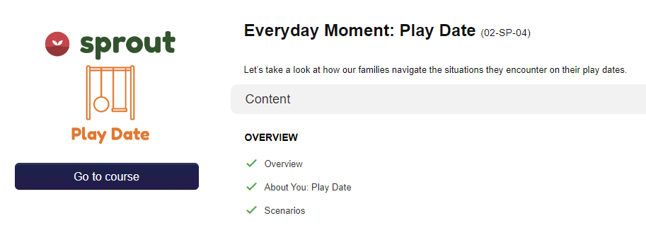
Homework
Everyday Moment: Shopping and Play Date
View online modules
Complete workbook questions
Notes:
Homework Tasks: Assign "Everyday Moments: Shopping and Play Date" as homework.
Step 2 Clarification: Remind participants that this homework involves viewing online content and downloading necessary resources as part of Step 2. If time permits, show where to access these materials on the website.
Workbook Guidance: Show the specific pages in the Sprout Parent Workbook and Syllabus related to these topics
Step 3 Clarification: Assign workbook discussion questions . Remind participants that there are two modules to complete (Shopping and Play Date).
Format explanation: Explain the reason for 2 boxes per question (one for individual, one for group responses).
Encourage reflection and engagement: The more participants think, reflect, and share the more meaningful the content becomes to each family.
Pro tip: Complete the workbook while viewing online modules.

Slide 22
Thank you for participating today.
Please reach out with any questions or concerns.
See you next week!
Notes:
Closing: Thank participants for their time and engagement.
Questions: Ask if there are any questions. (If someone needs personal assistance, ask them to speak with you individually after the group is dismissed).
Meeting 2: Remind participants of the date/time/location of the next meeting.
Homework: Remind participants to complete the homework.
Adjourn: Say goodbye to participants.

Slide 23
  A Universal Parenting Program for Parents of Children Ages 3-5
Meeting 3

Slide 24

Please sign in and find a seat.
We will begin soon.
If possible, please turn on your camera.
We will begin soon.
Notes:
Choose one bullet point to display (the first bullet point is for in-person, the second is for virtual).
If in-person, greet participants as they come in the door and help them find a seat.
If virtual, give participants a heads up when you will be starting. For example, “Hi everyone, we will be starting in about one minute.”

Slide 25

  Conversation Starters
  Review Ground Rules
  Group Discussion
  Homework
Notes:
Example language: Welcome back, everyone! We're glad to see you for our third meeting.
*Optional Sections: Please note that the conversation starters and review of ground rules are optional for today's session. If you prefer to skip these, simply remove the first bullet points from this slide and proceed to the next relevant slide in the deck.
Example language if omitting: We'll dive straight into discussing the key questions from our last session’s homework. We'll also outline and assign the homework for our next meeting, ensuring everyone is prepared and clear on the expectations.
Example language if not omitting:
Conversation Starters: We’ll get started with a quick question to get us all engaged and sharing.
Review of Ground Rules: A brief reminder of our ground rules to ensure our discussions remain respectful and productive.
Today's Agenda: After our initial activities, we will discuss the workbook questions based on your experiences with the last set of homework followed by an explanation of the homework for our next meeting. Let’s get started!

Slide 26
Please answer one of the following questions:
  What fictional family would you like to be a member of?
  What’s your favorite tradition or holiday?
  What was your favorite game to play as a child?
Notes:
Example language: "Let's open our session with a fun question that will give us all a chance to share something about ourselves. Review the list of questions provided on the slide. Select one question that resonates with you, or that you feel comfortable sharing. This activity is designed to ease us into the meeting and build a friendly, open atmosphere.

Slide 27
Basic Ground Rules:
  Always start and end sessions on time.
  Cell phones should be on vibrate; members can quietly excuse themselves if a call must be taken.
  In virtual sessions, participants should mute themselves when taking calls outside the session.
Group-Specific Rules:
  Avoid judgment regarding other participants' parenting practices or knowledge gaps.
  One person speaks at a time to maintain order and clarity.
  Assume positive intent in all interactions to foster a positive atmosphere.
Confidentiality- Please be respectful and discrete with the personal stories being shared. This is a safe space to grow and learn.
Notes:
Example language:
Before we dive into today’s discussion, let’s quickly review our ground rules to ensure our meeting runs smoothly and everyone feels comfortable sharing. (Restate rules). Does anyone want to add anything or suggest another rule?

Slide 28
  Patience is Essential
  Consistency is key
  Explore Alternatives
Notes:
Example language: Before we begin, let’s take a moment to remind ourselves of three important principles:
Patience is essential: Meaningful changes take time to manifest. Behaviors do not change overnight, which is why (move to next point)
Consistency is key: Regularly applying the strategies ensures the best chance for success.
Explore alternatives: If one approach isn’t working, try something else. We will discuss many strategies throughout the program, some may work better than others for you.
The best thing to do is keep trying!

Slide 29
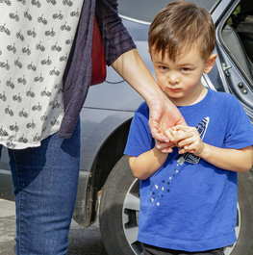
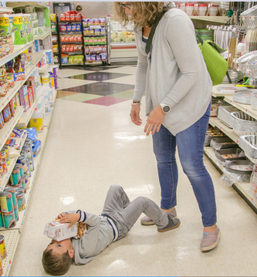
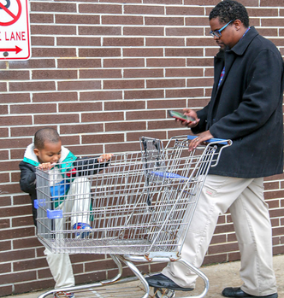
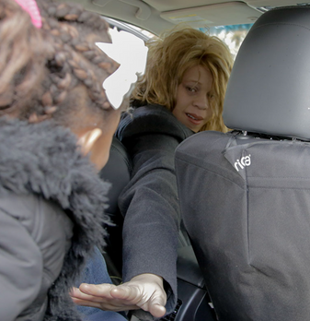

Shopping Discussion Questions
The Kym Family
The Jones Family
The Smith Family
The Jackson Family
I don’t want to go....
I want cookies...
I’d rather be playing....
I need time to myself...
  Have you had store or outing experiences like the Sprout families?
  Has your child had a tantrum, shown big emotions, or made you use errands as alone time?
  Do you already use any routines for shopping or outings?
Notes:
Everyday Moment: Shopping Discussion Questions
Have you had any experiences at a store or other location outside of your home that are like the experiences of the Sprout families? For example, has your child been unagreeable, has your child experienced a temper tantrum or other strong emotions, or has your child acted in a way that led you to use errand time as your alone time?
Do you have any routines that you are already using in your everyday family life for shopping-style events or other related activities outside of the home? What were they, and were they successful?

Slide 30


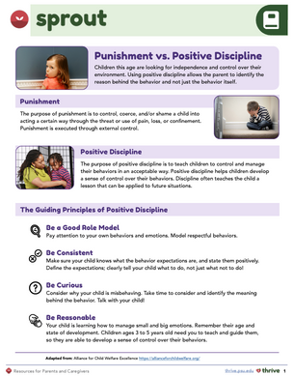
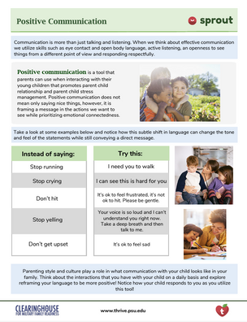
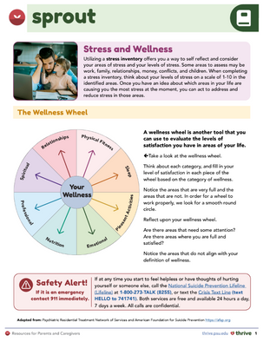

Did any of these strategies seem like they would work for you?
Assessing if your child is Hungry, Angry, Lonely, or Tired (HALT)
Offering appropriate choices
Communicating clearly and positively with age-appropriate language
Practicing self-care or carving out personal time, even during errands
Did you try any of these suggestions or strategies?
  What was the outcome?
  Do you plan to try any other strategies or suggestions?
Notes:
Did any of the suggestions provided throughout the family’s Everyday Moments seem like they would work for you?
Examples include the following:
Assessing whether your child is Hungry, Angry, Lonely, or Tired and then addressing the need;
Providing other appropriate choices for your child;
Communicating with clear, positive, concise, and developmentally appropriate language;
Practicing self-care or stress management techniques;
Carving out time for yourself, even if you use the time to do errands.
Did you try any of these suggestions or strategies? What was the outcome? Do you pan to try any other strategies or suggestions?

Slide 31

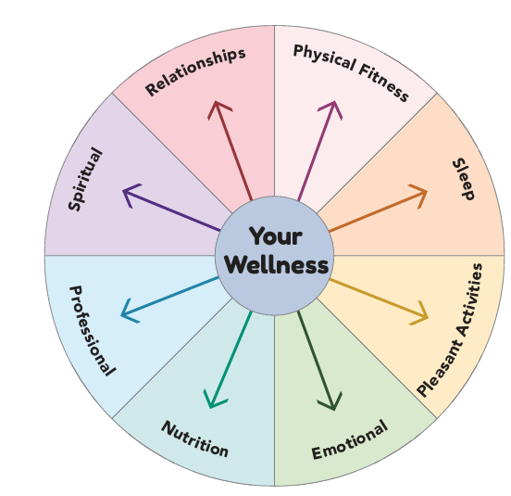
As you complete your Wellness Wheel, consider these additional uses:
  If you co-parent or get help from family, what do their Wellness Wheels look like?
  Can your family do anything to improve areas needing attention?
  Are there resources that could support your wellness where it's lacking?
Notes:
As you complete your Wellness Wheel, consider these additional uses for the activity:
If you are co-parenting or receiving help from another family member as you raise your child(ren), what do their Wellness Wheels look like?
Is there anything you can do within your family unit to increase areas that need attention?
Are there any additional resources that can help you increase your wellness in areas where you perceive it to be lacking?
Note to facilitator- If the family identifies a need, try to provide a resource in follow-up or during the Wrap-Up.

Slide 32

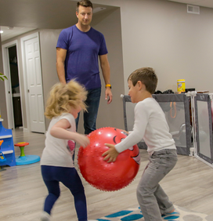
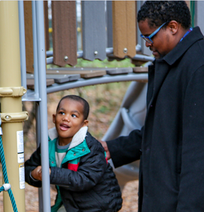
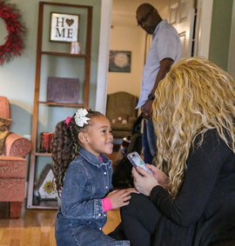


Play Date Discussion Questions
The Jones Family
The Smith Family
The Jackson Family
The Kym Family
It’s my turn!
I have superhero powers!
Be active!
Do I have to play with him?
  Have you experienced any play date or play-related woes like the Sprout families did in these Everyday Moments?
    If yes, what are they?
Notes:
Everyday Moment: Shopping Discussion Questions
Have you experienced any play date or play-related woes like the Sprout families did in these Everyday Moments?
If yes, what are they?

Slide 33




Did any of these strategies seem like they would work for you?
Supporting children in resolving conflict independently
Giving specific, timely praise focused on effort
Making physical activity a priority;
Did you try any of these suggestions or strategies? What was the outcome?
Do you plan to try any other strategies or suggestions?
Notes:
Did any of the suggestions provided throughout the family’s Everyday Moments seem like they would work for you?
Examples include the following:
Allowing children to resolve the conflict with appropriate support and guidance
Providing praise that is specific, in the moment, and about the effort
Making physical activity a priority
Did you try any of these suggestions or strategies? What was the outcome?
Do you plan to try any other strategies or suggestions?

Slide 34





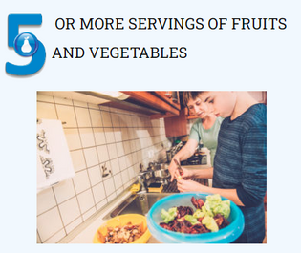





Notes:
Example language:
The 5210 program is a public health initiative designed to promote healthy lifestyles among children. The numbers in 5210 stand for daily health goals. Can anyone tell me what the numbers represent?
5 stands for eating at least five servings of fruits and vegetables.
2 encourages limiting recreational screen time to no more than two hours.
1 represents engaging in at least one hour of physical activity.
0 advises consuming zero sweetened beverages.
This simple framework aims to make it easier for families to adopt healthier habits in their daily lives.
For more information and resources, please visit, 5210.psu.edu

Slide 35
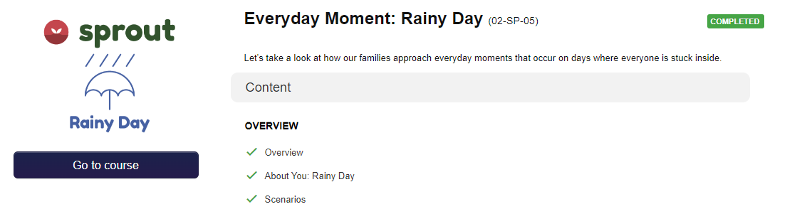
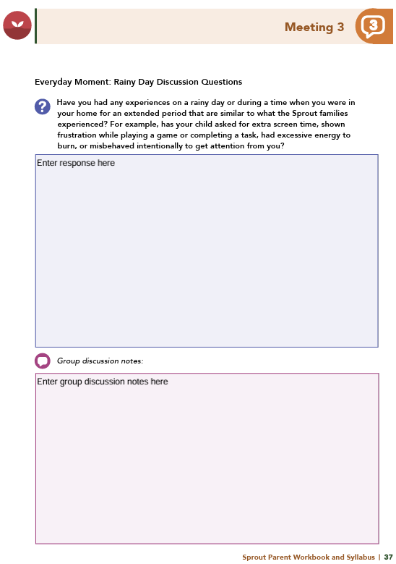
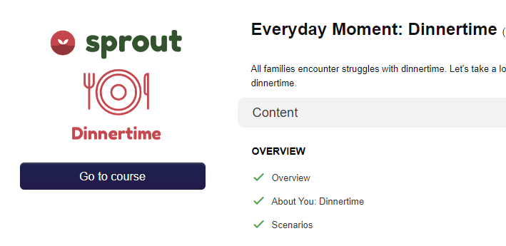
Homework
Everyday Moment: Rainy Day and Dinnertime
View online modules
Complete workbook questions
Notes:
Homework Tasks: Assign "Everyday Moments: Rainy Day and Dinnertime" as homework.
Step 2 Clarification: Remind participants that this homework involves viewing online content and downloading necessary resources as part of Step 2. If time permits, show where to access these materials on the website.
Workbook Guidance: Show the specific pages in the Sprout Parent Workbook and Syllabus related to these topics
Step 3 Clarification: Assign workbook discussion questions. Remind participants that there are two modules to complete (Rainy Day and Dinnertime).
Format explanation: Explain the reason for 2 boxes per question (one for individual, one for group responses).
Encourage reflection and engagement: The more participants think, reflect, and share the more meaningful the content becomes to each family.
Pro tip: Complete the workbook while viewing online modules.

Slide 36
Thank you for participating today.
Please reach out with any questions or concerns.
See you next week!
Notes:
Closing: Thank participants for their time and engagement.
Questions: Ask if there are any questions. (If someone needs personal assistance, ask them to speak with you individually after the group is dismissed).
Meeting 2: Remind participants of the date/time/location of the next meeting.
Homework: Remind participants to complete the homework.
Adjourn: Say goodbye to participants.

Slide 37
  A Universal Parenting Program for Parents of Children Ages 3-5
Meeting 4

Slide 38

Please sign in and find a seat.
We will begin soon.
Notes:
If in-person, greet participants as they come in the door and help them find a seat.
If virtual, give participants a heads up when you will be starting. For example, “Hi everyone, we will be starting in about one minute.”
Replace text on screen with : If possible, please turn on your camera and enter your preferred name. We will begin soon.

Slide 39

  Conversation Starters
  Review of Ground Rules
  Group Discussion
  Homework
Notes:
Example language: Welcome back, everyone! We're glad to see you for our fourth meeting.
*Optional Sections: Please note that the conversation starters and review of ground rules are optional for today's session. If you prefer to skip these, simply remove the first bullet points from this slide and proceed to the next relevant slide in the deck.
Example language if omitting: We'll dive straight into discussing the key questions from our last session’s homework. We'll also outline and assign the homework for our next meeting, ensuring everyone is prepared and clear on the expectations.
Example language if not omitting:
Conversation Starters: We’ll get started with a quick question to get us all engaged and sharing.
Review of Ground Rules: A brief reminder of our ground rules to ensure our discussions remain respectful and productive.
Discussion and Homework: After our initial activities, we will discuss the workbook questions based on your experiences with the last set of homework followed by an explanation of the homework for our next meeting. Let’s get started!

Slide 40
Please answer one of the following questions:
  If you could rename yourself, what name would you pick?
  Would you rather be able to run at 100 miles per hour or fly at 10 miles per hour?
  What are you most excited about this year?
Notes:
Example language: "Let's open our session with a fun question that will give us all a chance to share something about ourselves. Review the list of questions provided on the slide. Select one question that resonates with you, or that you feel comfortable sharing. This activity is designed to ease us into the meeting and build a friendly, open atmosphere.

Slide 41
Basic Ground Rules:
  Always start and end sessions on time.
  Cell phones should be on vibrate; members can quietly excuse themselves if a call must be taken.
  In virtual sessions, participants should mute themselves when taking calls outside the session.
Group-Specific Rules:
  Avoid judgment regarding other participants' parenting practices or knowledge gaps.
  One person speaks at a time to maintain order and clarity.
  Assume positive intent in all interactions to foster a positive atmosphere.
Confidentiality- Please be respectful and discrete with the personal stories being shared. This is a safe space to grow and learn.
Notes:
Example language:
Before we dive into today’s discussion, let’s quickly review our ground rules to ensure our meeting runs smoothly and everyone feels comfortable sharing. (Restate rules). Does anyone want to add anything or suggest another rule?

Slide 42
  Patience is Essential
  Consistency is key
  Explore Alternatives
Notes:
Example language: Before we begin, let’s take a moment to remind ourselves of three important principles:
Patience is essential: Meaningful changes take time to manifest. Behaviors do not change overnight, which is why (move to next point)
Consistency is key: Regularly applying the strategies ensures the best chance for success.
Explore alternatives: If one approach isn’t working, try something else. We will discuss many strategies throughout the program, some may work better than others for you.
The best thing to do is keep trying!

Slide 43



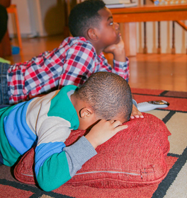
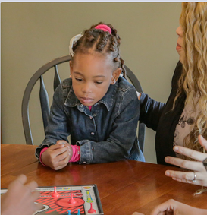

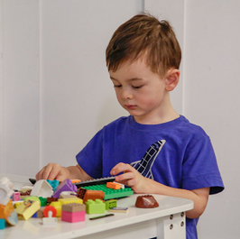


Rainy Day Discussion Questions
The Smith Family
The Jackson Family
The Jones Family
The Kym Family
What are you watching?
It’s my turn!
JUMP!
Nobody wants to play with me.
  Have you had rainy day or extended time-at-home experiences like the Sprout families?
  Has your child asked for more screen time, shown frustration, had extra energy, or acted out for attention?
Notes:
Everyday Moment: Rainy Day Discussion Questions
Have you had any experiences on a rainy day or during a time when you were in your home for an extended period that are similar to what the Sprout families experienced?
For example, has your child asked for extra screen time, shown frustration while playing a game or completing a task, had excessive energy to burn, or misbehaved intentionally to get attention from you?

Slide 44

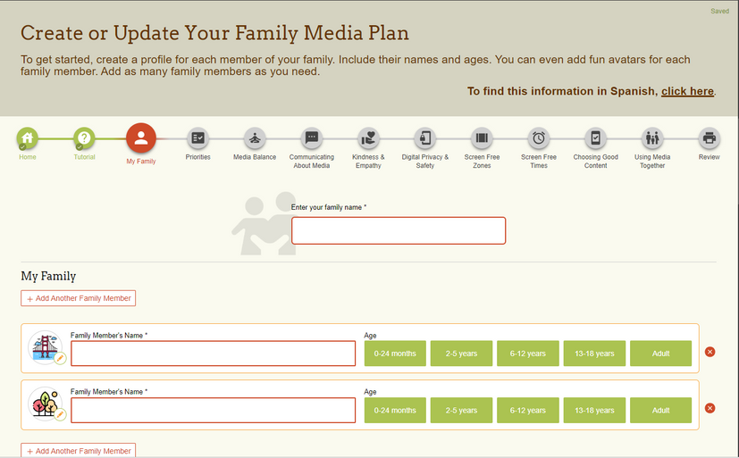
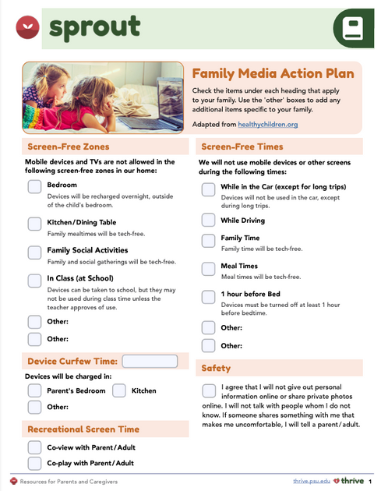

There were two resources shared to create a Family-Media Action Plan, one
from Thrive and one from the American Academy of Pediatrics.
Do you plan to use these family-media resources?
What are your thoughts on the plan?
How might your child respond?
Notes:
There were two resources shared to create a Family-Media Action Plan, one from Thrive and one from the American Academy of Pediatrics.
Do you anticipate using either of these resources to create a family-media plan?
What are your thoughts about the family-media plan?
How do you think your child react?

Slide 45



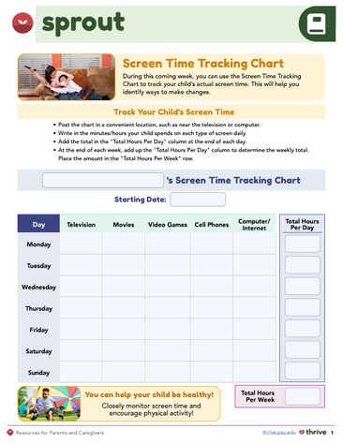



Did any of these strategies seem like they would work for you?
  Monitoring screen time or creating a Family Media Plan
  Providing emotion coaching during challenges
  Offering safe, indoor physical activities
  Validating your child’s feelings and offering support
Notes:
Did any of the suggestions provided throughout the family’s Everyday Moments seem like they would work for you?
Examples include the following:
Monitoring screen time or developing a Family-Media Action Plan
Providing emotion coaching during a time of struggle
Providing physical activities that are safe and appropriate for inside or a small environment
Acknowledging and validating your child’s feelings and providing attention and support.

Slide 46
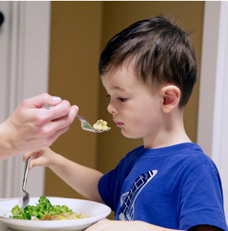

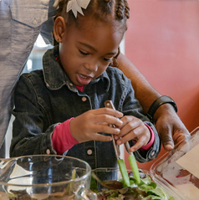
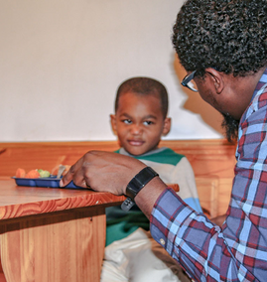



Dinnertime Discussion Questions
The Kym Family
The Jones Family
The Jackson Family
The Smith Family
Why do I have to eat this?
I only eat chicken nuggets!
I want to help too!
I am not eating that!
  Have you experienced dinnertime or mealtime challenges like the Sprout families?
  Does your child resist new foods, want to help prepare meals, or decide when they’re full?
  Do you expect them to clean their plate?
  How do they react to meals they don’t prefer?
Notes:
Have you experienced similar dinnertime- or family mealtime-related woes like the Sprout families did in these Everyday Moments?
For example, do you like your child to clean their plate before being excused, or do you allow them to determine when they feel full?
Is your child resistant to trying new foods, or do they want to help with meal preparation?
What happens when you serve your child a non-preferred meal?

Slide 47








Did any of these strategies seem like they would work for you?
  Communicating using Division of Responsibility in Feeding
  Establishing consistent mealtimes
  Modeling healthy eating and offering new foods with preferred ones
  Encouraging food prep skills, praising new tries, and using the ABC Method to problem-solve
Did you try any of these suggestions or strategies?
  What was the outcome?
  Do you plan to try any other strategies or suggestions?
Notes:
Did any of the suggestions provided throughout the family’s Everyday Moments seem like they would work for you?
Examples include the following:
Using what you know about the Division of Responsibility in Feeding to communicate with your child
Establishing consistent mealtimes; oModeling healthy eating behaviors
Offering a new food with a preferred food; oProviding praise or encouragement for trying new foods
Providing opportunities to learn life skills related to food preparation
Analyzing a troublesome situation using the ABC Method.
Did you try any of these suggestions or strategies?
What was the outcome?
Do you plan to try any other strategies or suggestions?

Slide 48


Homework
Sprout: Wrap Up
View online module
Complete workbook questions
Notes:
Homework Tasks: Assign “Sprout: Wrap Up" as homework.
Step 2 Clarification: Remind participants that this homework involves viewing online content and downloading necessary resources as part of Step 2. If time permits, show where to access these materials on the website.
Workbook Guidance: Show the specific pages in the Sprout Parent Workbook and Syllabus related to these topics
Step 3 Clarification: Assign workbook discussion questions. Remind participants that there is only one module to complete (Wrap Up).
Format explanation: Explain the reason for 2 boxes per question (one for individual, one for group responses).
Encourage reflection and engagement: The more participants think, reflect, and share the more meaningful the content becomes to each family.
Pro tip: Complete the workbook while viewing online modules.

Slide 49

Notes:
Website Walkthrough: Guide participants through the Thrive website, highlighting key resources like mini video modules, supplemental modules, and additional program options.
Program Exploration: Encourage parents to explore other programs that may benefit another child or support different age groups.
Planning for Growth: Emphasize the value of these resources for ongoing planning in their child’s development.
Adolescent Focus: Point out supplemental modules specific to teens and adolescents and suggest families review these for targeted support.

Slide 50
Thank you for participating today.
Please reach out with any questions or concerns.
See you next week!
Notes:
Closing: Thank participants for their time and engagement.
Questions: Ask if there are any questions. (If someone needs personal assistance, ask them to speak with you individually after the group is dismissed).
Meeting 2: Remind participants of the date/time/location of the next meeting.
Homework: Remind participants to complete the homework.
Adjourn: Say goodbye to participants.

Slide 51
  A Universal Parenting Program for Parents of Children Ages 3-5
Meeting 5

Slide 52

Please sign in and find a seat.
We will begin soon.
Notes:
If in-person, greet participants as they come in the door and help them find a seat.
If virtual, give participants a heads up when you will be starting. For example, “Hi everyone, we will be starting in about one minute.”
Replace text on screen with : If possible, please turn on your camera and enter your preferred name. We will begin soon.

Slide 53

  Conversation Starters
  Group Discussion
  Thrive programming
Notes:
Example language: Welcome back, everyone! We're glad to see you for our fifth and final meeting.
*Optional Sections: Please note that the conversation starters are optional. If you prefer to skip these, simply remove the first bullet point from this slide and proceed to the next relevant slide in the deck.
Example language if omitting: We'll dive straight into discussing the key questions from our last session’s homework. We’ll wrap up with a discussion on additional Thrive programs that may interest you.
Example language if not omitting:
Conversation Starters: We’ll get started with a quick question to get us all engaged and sharing.
Discussion: After our initial activities, we will discuss the workbook questions based on your experiences with the last set of homework followed by an explanation of additional Thrive programs that may interest you.

Slide 54
Please answer one of the following questions:
  What is your favorite time of the day and why?
  Where would you time travel, if it were possible?
  What movie can you rewatch over and over again?
Notes:
Example language: "Let's open our session with a fun question that will give us all a chance to share something about ourselves. Review the list of questions provided on the slide. Select one question that resonates with you, or that you feel comfortable sharing. This activity is designed to ease us into the meeting and build a friendly, open atmosphere.

Slide 55
  Patience is Essential
  Consistency is key
  Explore Alternatives
Notes:
Example language: Before we begin, let’s take a moment to remind ourselves of three important principles:
Patience is essential: Meaningful changes take time to manifest. Behaviors do not change overnight, which is why (move to next point)
Consistency is key: Regularly applying the strategies ensures the best chance for success.
Explore alternatives: If one approach isn’t working, try something else. We will discuss many strategies throughout the program, some may work better than others for you.
The best thing to do is keep trying!

Slide 56














How can you apply SPROUT strategies across different scenarios?
Notes:
Example language: Let's take a moment to reflect on the strategies we’ve learned these past few weeks. I’d love to hear about the specific topic each of you chose to focus on. Can you share one strategy you revisited and describe a scenario where you can imagine applying this strategy? For example, if you chose the Division of Responsibility in Feeding, tell us how you might apply this approach during different mealtimes or settings.

Slide 57

  Has anything changed regarding your interactions with your child since we started?
    Do you notice a difference in the way you respond to your child’s behaviors?
    Can anyone share an example of how using a Sprout strategy changed their reaction compared to before the training?
Notes:
Changes in Interactions: Ask participants to share any changes in how they interact with their child since starting the Sprout program.
Do they see a difference in their responses to their child’s behaviors?
Sharing Success Stories: Invite participants to share a specific instance where they applied a Sprout strategy.
Discuss how this reaction differed from prior approaches before the training.
What was different in their approach?
How did their child respond to this new way of handling the situation?
Example language: Would anyone like to share a moment when they used a strategy learned in Sprout and discuss how their current reaction compares to how they may have reacted prior to engaging in the Sprout training?

Slide 58

Additional Thrive Programs
  Take Root is available for parents and caregivers of children who are between 0 and 3 years old.
  Grow is available for parents and caregivers of children who are between 5 and 10 years old.
  Branch Out is available for parents and caregivers of children who are between 10 and 18 years old.
Notes:
Additional Thrive Program Options for Different Ages:
Take Root: For parents and caregivers of children aged 0 to 3 years.
Grow: Designed for parents and caregivers of children aged 5 to 10 years.
Branch Out: Suitable for parents and caregivers of children aged 10 to 18 years.
Next Steps: Encourage participants to explore these programs to continue supporting their children's development at various stages.

Slide 59
Notes:
Thrive Website: Encourage participants to visit the Thrive website for additional resources.
Program Exploration: Suggest exploring other programs that may be beneficial for another child.
Continued Growth: Encourage using these resources to plan the next steps in their child’s growth and development.
For an in-depth exploration of specified topics related to teens and adolescents, suggest families visit the Thrive website (https://thrive.psu.edu/supplemental-modules/), and review the supplemental module content for the most up-to-date offerings.

Slide 60


Thank you all for your dedication and participation. Every effort you make significantly impacts your child's future success.
Notes:
Example language:
Thank you, parents and caregivers, for your active participation. Please continue to visit the Thrive website as your child develops and grows—it's a valuable resource that can support you through every stage of their growth.

