Slide 1
As of February 24, 2025
Introduction
Notes:
Delivery Type 1: Supplemental Extension begins here, on slide 1.
Delivery Type 2 : Supplemental Stand Alone begins on slide 43.

Slide 2
Welcome!
Please sign in and find a seat. We will begin soon.
If possible, please turn on your camera and enter your preferred name. We will begin soon.
Notes:
Choose one bullet point to display (the first bullet point is for in-person, the second is for virtual).
If in-person, greet participants as they come in the door and help them find a seat.
If virtual, give participants a heads up when you will be starting. For example, “Hi everyone, we will be starting in about one minute.”

Slide 3
AGENDA
Overview
Syllabus
Expectations
Registration
Homework
Notes:
Welcome: Introduce yourself and thank participants for choosing to be a part of the Exceptional Families Supplemental Parenting Program. Explain that Meeting 1 will provide an overview of the program, who is in our group, and what is expected of parents who participate. We will discuss the materials you received and provide instructions on how to use them.
Encourage participants to ask questions as they arise or to jot them down and ask at the end of the meeting.

Slide 4
Target Audience
Program Focus
Skill Building
Reflective Sharing
Program Structure
Goals
Notes:
Exceptional Families. Embracing Differences. Flourishing Together is an online supplemental module for parents (and caregivers), of children who have a disability. This supplemental module focuses on addressing specific concerns caregivers may have regarding a child who has a disability and offering them support.
Parenting a child who has a disability can be difficult sometimes. You may feel lonely. Throughout this program, we will provide information and offer tools and resources that you can use to help you maximize the rewarding times while facing challenges head-on. Remember, we want you to know that you are not alone. We will also provide parenting strategies that you can add to your “toolkit.” You may already be using some of these strategies, or some of them may be new to you. Whatever your circumstances, we hope you will use the information we offer in these modules as an opportunity to learn, grow, and become a more confident and informed parent or caregiver.
During the online supplemental module sessions and throughout the hybrid implementation meetings, information and parenting strategies that parents can use and adapt, as necessary, to fit their individual circumstances and family needs will be disseminated. The supplemental module content is designed to help parents build on their existing skills and strategies, so they can effectively parent a child with a disability.
Some of the content that is read and practiced in the supplemental module and discussed in the hybrid implementation meetings might be familiar to the parents, and they may already know about and use the disseminated information. Therefore, they may use the meeting time as an opportunity to realize, appreciate, and share what already works for them, their child, and their family.
Exceptional Families. Embracing Differences. Flourishing Together includes an overview, three sessions, and a wrap-up.
After participating in the online supplemental module sessions and the hybrid implementation meetings, parents and caregivers should be able to do the following:
• Connect with your feelings
• Understand that taking time for yourself is necessary and appropriate
• Build social-support systems. • Find ways to give your child a voice
• Understand your child’s behaviors, and use positive strategies to meet their needs
• Work on building your child’s gross and fine motor skills
• Discover resources and technologies that are available for you and your child
• Support your child’s sexual learning and development
• Plan for transitions and the future.

Slide 5
Parent Workbook
Syllabus
Notes:
Provide copies or screen share a copy of the Parent Workbook and Syllabus for the Exceptional Families. Embracing Differences. Flourishing Together. supplemental module. Review the Summary of Training, and highlight the section where the participants can find pertinent information.

Slide 6
Expectations
Notes:
Overview of Expectations: Clearly define what is expected of participants in the Exceptional Families supplemental program.
Independent Completion: Inform families that they are expected to independently complete the online modules.
Full Engagement Required: Emphasize the importance of completing each module in full to maximize learning and benefit from the program.
Purpose of Meetings: Clarify that the in-person meetings are not for revisiting session content but for community building, reflecting on experiences, and discussing insights with other parents and caregivers who are trying to successfully navigate parenting a child with a disability.
Preparation for Discussions: Encourage participants to come to meetings prepared to share their thoughts and engage in discussions based on the content they've learned online.

Slide 7
REGISTER
Notes:
Explain how participants can access the supplemental module online. Offer support to help with any technological questions. All participants will have previously set up a Thrive account, but you need to ensure they can log in and find the information they need to get started or progress in the supplemental module.

Slide 8
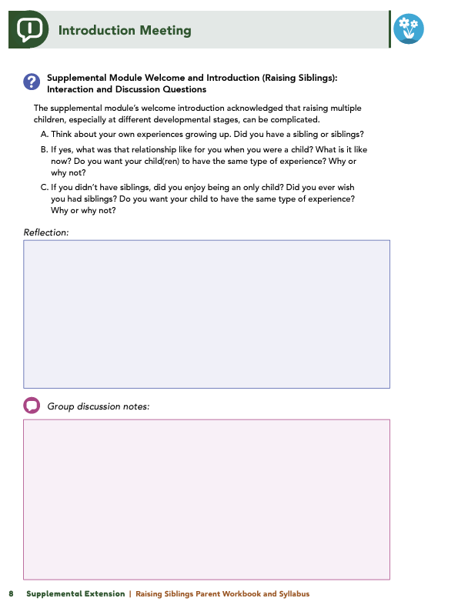
Homework
Complete the Introduction Module and Session 1: Disability and You
View online modules
Complete workbook questions
Notes:
Homework Tasks: Assign Introduction Module and Session 1: Disability and You as homework.
Step 2 Clarification: Remind participants that this homework involves viewing online content and downloading necessary resources as part of Step 2. If time permits, show where to access these materials on the website.
Workbook Guidance: Show the specific pages in the Exceptional Families Parent Workbook and Syllabus related to these topics (D7)
Step 3 Clarification: Assign workbook discussion questions (beginning on page D8 in the parent workbook).
Format explanation: Explain the reason for 2 boxes per question (one for individual, one for group responses).
Encourage reflection and engagement: The more participants, think, reflect, and share the more meaningful the content becomes to each family.
Pro tip: Complete the workbook while viewing online modules.

Slide 9
Thank you for participating today.
Please reach out with any questions or concerns.
See you next week!
Notes:
Closing: Thank participants for their time and engagement.
Questions: Ask if there are any questions. (If someone needs personal assistance, ask them to speak with you individually after the group is dismissed).
Meeting 2: Remind participants of the date/time/location of the next meeting.
Homework: Remind participants to complete the homework.
Adjourn: Say goodbye to participants.

Slide 10
Meeting 1

Slide 11
Welcome back!
Please sign in and find a seat. We will begin soon.
If possible, please turn on your camera and enter your preferred name. We will begin soon.
Notes:
Choose one bullet point to display (the first bullet point is for in-person, the second is for virtual).
If in-person, greet participants as they come in the door and help them find a seat.
If virtual, give participants a heads up when you will be starting. For example, “Hi everyone, we will be starting in about one minute.”

Slide 12
Conversation Starter
Restate Ground Rules
Group Discussion
Homework
Notes:
Example language: Welcome back, families! We’re glad to see for our second meeting.
Review Meeting 2 Agenda:
Conversation Starters: We’ll get started with a quick question to get us all engaged and sharing.
Review of Ground Rules: A brief reminder of our ground rules to ensure our discussions remain respectful and productive.
Discussion and Homework: After our initial activities, we will discuss the workbook questions based on your experiences with the last set of homework followed by an explanation of the homework for our next meeting. Let’s get started!

Slide 13
Please answer one of the following questions:
What is one aspect of your parent-child relationship that is working well?
What is a skill you use effectively in your parenting?
Notes:
Example language: "Let's open our session with a fun question that will give us all a chance to share something about ourselves. Review the list of questions provided on the slide. Select one question that resonates with you, or that you feel comfortable sharing. This activity is designed to ease us into the meeting and build a friendly, open atmosphere.

Slide 14
Basic Ground Rules:
Always start and end sessions on time.
Cell phones should be on vibrate; members can quietly excuse themselves if a call must be taken.
In virtual sessions, participants should mute themselves when taking calls outside the session.
Group-Specific Rules:
Avoid judgment regarding other participants' parenting practices or knowledge gaps.
One person speaks at a time to maintain order and clarity.
Assume positive intent in all interactions to foster a positive atmosphere.
Confidentiality- Please be respectful and discrete with the personal stories being shared. This is a safe space to grow and learn.
Notes:
Introduction of Ground Rules: Start by stating some basic ground rules to create a supportive environment where families feel safe to share their parenting experiences.
Basic Ground Rules:
Always start and end sessions on time.
Cell phones should be on vibrate; members can quietly excuse themselves if a call must be taken.
In virtual sessions, participants should mute themself when taking calls outside the session.
Developing Group-Specific Rules:
Discuss and agree on additional rules as a group, such as:
Avoid judgment regarding other participants' parenting practices or knowledge gaps.
Ensure one person speaks at a time to maintain order and clarity.
Assume positive intent in all interactions to foster a positive atmosphere.
Confidentiality Discussion: Use this time to reinforce the importance of confidentiality, outlining your organization’s specific confidentiality clauses regarding statements related to abuse or neglect mandated reporting..
Example language:
As we begin, it's crucial to emphasize the importance of confidentiality within our group. We need to agree to keep all shared information within these sessions, including personal stories and sensitive details. This ensures a safe space where everyone feels comfortable sharing their experiences. Please remember that details shared by participants are given in trust and should be treated with respect and discretion.
Additionally, it’s important to note our mandated reporting clause for suspected abuse or neglect:
Legal Obligation: Our staff and facilitators are legally required to report any suspicions of child abuse or neglect.
Scope of Reporting: We must report any signs of potential harm to a child or vulnerable adult that arise during our sessions.
Procedure for Reporting: We handle these situations sensitively, informing involved individuals about necessary actions, unless it poses further risk.
Support for Affected Individuals: We provide support and resources to help those involved in a reporting situation.
Our primary concern is the safety and well-being of all individuals. If you have any questions or concerns about this policy, feel free to discuss them privately with me.

Slide 15
What dreams do you have for your child?
What do you hope to gain from this course?
Notes:
Provide an overview of the supplemental module using the following points that are taught in the supplemental module:
• Parenting a child with a disability can be difficult sometimes. You may feel lonely. Always remember that you are not alone.
• Whatever your circumstances, we hope the information that is offered in these modules can provide you with an opportunity to learn, grow, and become a more confident and informed parent or caregiver.
Ask the following questions and solicit answers from a few participants to generate discussion:
In the module, you were asked to consider what dreams you have for your child and what you hope to gain from this course. Who would like to share their thoughts?

Slide 16
Understanding
How did you feel when you first learned about your child’s diagnosis?
What were your initial concerns about their delays?
How have you supported your child in reaching developmental milestones?
What feelings do you have about raising your child?
Notes:
Review this section of the module with the participants by offering the following information:
• As outlined in the module, let’s think about what disability IS and IS NOT.
Disability IS NOT a label, a box to fit into, or a reflection of your parenting.
Disability IS natural and diverse and can be a pathway that allows for connection to resources.
If you have a child with a disability, your child will still go through many of the typical developmental stages. However, they may not go through these phases in the same way or in the same timeframe as other children who do not have disabilities experience them. In the end, your child will reach their own milestones throughout the course of life.
The distinctiveness of this parenting journey may cause you to reflect on your own parenting skills, whether you are a new parent or have older children. That reflection may cause you to have a variety of feelings. All of those feelings are valid.
Ask some or all of the following questions, and solicit answers from participants to generate discussion:
Session 1 asked you to consider your feelings about your child’s delays or diagnoses. Would anyone like to share any or all of the following:
What were your initial feelings when you received your child’s diagnosis?
What were your first concerns as you considered what your child’s delays may be and what they may mean for your family?
What are some unique pathways that your child has taken to reach developmental milestones and how you’ve assisted your child in accomplishing those goals (e.g., learned sign language for better communication, received physical therapy services to enhance gross motor skill or occupational therapy for fine motor skill development)?
What are some feelings that you associate with raising your child.
Why do you think you feel that way?

Slide 17
The Importance of Self Care
Do you often prioritize others over yourself?
Why?
Notes:
Review this section of the module with the participants by offering the following information:
Taking care of a child with disability can be difficult. However, to be the best parent you can be, you must also allow yourself to be cared for and engage in self-care. You are filling roles in addition to just caring for your child; you are acting as a teacher, therapist, and nurse—just to name a few. Taking time to care for yourself can involve watching a sporting event, getting a manicure, reading a book, having someone bring you a meal, or enjoying a night out.
• Let’s review the 6 R’s from the module.
Remember: Parenting can be difficult.
Recognize: You are not perfect, and that is okay.
Relax: Take a minute and take a breath!
Recharge: Enjoy guilt-free time away from parenting responsibilities.
Reconnect: Establish and maintain support systems.
Relish: Be sure to celebrate!
Ask the following question, and solicit answers from participants to generate discussion:
Who here tends to put themselves last? Why do you think you do that?

Slide 18
Remember
What is a difficult decision that you have made regarding your child’s care?
What did you learn from making that decision?
Notes:
Review this section of the module with the participants by offering the following information:
• Parenting is challenging, and challenges may reach new heights when you are parenting a child with a disability.
• You may experience moments when you need to make decisions that leave you questioning everything you thought you knew about parenting.
• Trust yourself to have made the best decision, be confident in that decision, and take comfort in moving on. Doing this may be easier said than done, but taking these steps is worth trying!
Ask the following question, and solicit answers from a few participants to generate discussion:
What is a difficult decision that you have made regarding your child’s care? What did you learn from making that decision?

Slide 19
Recognize
Can you share a time when you made a parenting mistake? How did it feel?
Did you write the Letter of Forgiveness to yourself? How was that experience?
What do you think someone else would say is one of your greatest strengths as a parent?
Notes:
Review this section of the module with the participants by offering the following information:
• Nobody is perfect, and all parents make mistakes. Be sure you acknowledge the strengths you possess as a parent and recognize your willingness to learn new skills and strategies. Appreciate the uniqueness of your child, and know your child’s strengths and challenges.
Ask the following questions, and solicit answers from participants to generate discussion:
Would anyone like to discuss a time, or times, when they made a parenting mistake? How did that experience feel?
Did anyone write the Letter of Forgiveness to themself? How did that activity go?
What would someone else say is one of your greatest strengths as a parent?

Slide 20
Relax
Did anyone try a new technique?
What did you try? How did it feel?
Notes:
Review this section of the module with the participants by offering the following information:
• The module provided two techniques for taking time to relax and focus and a resource that contains information on additional techniques and strategies for taking a breath.
Ask the following question, and solicit answers from participants to generate discussion:
Did anyone try a new technique? What did you try? How did it feel?

Slide 21
Recharge
How do you practice self-care?
What activities help you recharge?
What tips do you have for making time to recharge?
What challenges stop you, and how can you overcome them?
Notes:
Review this section of the module with the participants by offering the following information:
• As a parent, sometimes you need to take a break from childrearing responsibilities. Leaving your child with a trusted caregiver is okay; so, go ahead and enjoy life outside of your home and away from your child. This might include a spa day, a date night, or a weekend getaway.
Ask the following questions, and solicit answers from participants to generate discussion:
In what ways have you been able to practice self-care? What activities do you enjoy doing and that recharge you?
Do you have any tips that you’ve used for taking time and recharging yourself that you can discuss with the group?
What challenges prevent you from engaging in activities that refresh or rejuvenate you? How can you overcome those barriers?

Slide 22
Reconnect
Who is in your Circle of Support?
Notes:
Review this section of the module with the participants by offering the following information:
• Having a Circle of Support network for you and your family that includes in-person and virtual support systems is essential to healthy parenting. While every journey is unique, surrounding ourselves with others reminds us that we are not alone.
Ask the following question, and solicit answers from participants to generate discussion:
Who completed the Circle of Support activity? Who is part of your Circle of Support?
Facilitator Tip : If participants mention they have no Circle of Support, encourage them to think about how they can make connections with others in their community [e.g., parents, spiritual leaders] and whom those “others” could be.

Slide 23
Relish
What do you and your family like to celebrate? How do you celebrate?
If you don’t celebrate achievements now, how could you start including them in your routines?
Notes:
Review this section of the module with the participants by offering the following information:
• Remember, take the time to celebrate all of the accomplishments you and your child make as you navigate steps in your journey!
Ask the following questions, and solicit answers from participants to generate discussion:
What do you, your child, and your family like to celebrate? How do you celebrate?
If you don’t currently celebrate achievements and milestones, how might you consider building these accomplishments into your family routines?

Slide 24
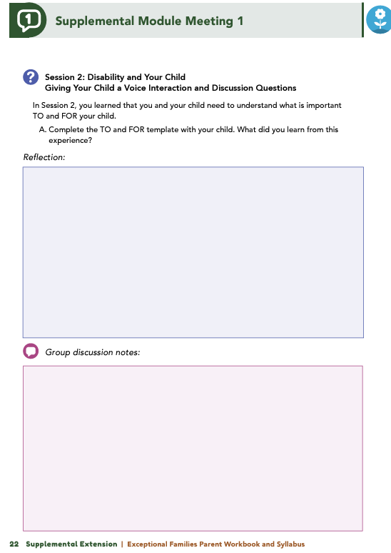
Homework
Complete Session 2: Disability and Your Child, Session 3: Disability Services and Your Child, and the Wrap Up
View online modules
Complete workbook questions
Notes:
Homework Tasks: Assign Session 2 & 3: Disability and Your Child, Disability Services and Your Child, and Wrap Up Module as homework.
Step 2 Clarification: Remind participants that this homework involves viewing online content and downloading necessary resources as part of Step 2. If time permits, show where to access these materials on the website.
Workbook Guidance: Show the specific pages in the Exceptional Families Parent Workbook and Syllabus related to these topics (D21)
Step 3 Clarification: Assign workbook discussion questions (beginning on page D22 in the parent workbook).
Format explanation: Explain the reason for 2 boxes per question (one for individual, one for group responses).
Encourage reflection and engagement: The more participants, think, reflect, and share the more meaningful the content becomes to each family.
Pro tip: Complete the workbook while viewing online modules.

Slide 25
Thank you for participating today.
Please reach out with any questions or concerns.
See you next week!
Notes:
Closing: Thank participants for their time and engagement.
Questions: Ask if there are any questions. (If someone needs personal assistance, ask them to speak with you individually after the group is dismissed).
Meeting 2: Remind participants of the date/time/location of the next meeting.
Homework: Remind participants to complete the homework.
Adjourn: Say goodbye to participants.

Slide 26
Meeting 2

Slide 27
Please sign in and find a seat.
We will begin soon.
If possible, please turn on your camera.
We will begin soon.
Notes:
Choose one bullet point to display (the first bullet point is for in-person, the second is for virtual).
If in-person, greet participants as they come in the door and help them find a seat.
If virtual, give participants a heads up when you will be starting. For example, “Hi everyone, we will be starting in about one minute.”

Slide 28
Conversation Starters
Group Discussion
Thrive Programming
Notes:
Example language: Welcome back, everyone! We're glad to see you for our third and final meeting.
*Optional Sections: Please note that the conversation starters are optional. If you prefer to skip these, simply remove the first bullet point from this slide and proceed to the next relevant slide in the deck.
Example language if omitting: We'll dive straight into discussing the key questions from our last session’s homework. We’ll wrap up with a discussion on additional Thrive programs that may interest you
Example language if not omitting:
Conversation Starters: We’ll get started with a quick question to get us all engaged and sharing.
Review of Ground Rules: A brief reminder of our ground rules to ensure our discussions remain respectful and productive.
Discussion and Homework: After our initial activities, we will discuss the workbook questions based on your experiences with the last set of homework followed by an explanation of the homework for our next meeting. Let’s get started!

Slide 29
Please answer one of the following questions:
What is an activity you enjoy doing with your child?
If you could relive one moment with your child, what would it be?
Notes:
Example language: "Let's open our session with a fun question that will give us all a chance to share something about ourselves. Review the list of questions provided on the slide. Select one question that resonates with you, or that you feel comfortable sharing. This activity is designed to ease us into the meeting and build a friendly, open atmosphere.

Slide 30
Basic Ground Rules:
Always start and end sessions on time.
Cell phones should be on vibrate; members can quietly excuse themselves if a call must be taken.
In virtual sessions, participants should mute themselves when taking calls outside the session.
Group-Specific Rules:
Avoid judgment regarding other participants' parenting practices or knowledge gaps.
One person speaks at a time to maintain order and clarity.
Assume positive intent in all interactions to foster a positive atmosphere.
Confidentiality- Please be respectful and discrete with the personal stories being shared. This is a safe space to grow and learn.
Notes:
Introduction of Ground Rules: Start by stating some basic ground rules to create a supportive environment where families feel safe to share their parenting experiences.
Basic Ground Rules:
Always start and end sessions on time.
Cell phones should be on vibrate; members can quietly excuse themselves if a call must be taken.
In virtual sessions, participants should mute themself when taking calls outside the session.
Developing Group-Specific Rules:
Discuss and agree on additional rules as a group, such as:
Avoid judgment regarding other participants' parenting practices or knowledge gaps.
Ensure one person speaks at a time to maintain order and clarity.
Assume positive intent in all interactions to foster a positive atmosphere.
Confidentiality Discussion: Use this time to reinforce the importance of confidentiality, outlining your organization’s specific confidentiality clauses regarding statements related to abuse or neglect mandated reporting..
Example language:
As we begin, it's crucial to emphasize the importance of confidentiality within our group. We need to agree to keep all shared information within these sessions, including personal stories and sensitive details. This ensures a safe space where everyone feels comfortable sharing their experiences. Please remember that details shared by participants are given in trust and should be treated with respect and discretion.
Additionally, it’s important to note our mandated reporting clause for suspected abuse or neglect:
Legal Obligation: Our staff and facilitators are legally required to report any suspicions of child abuse or neglect.
Scope of Reporting: We must report any signs of potential harm to a child or vulnerable adult that arise during our sessions.
Procedure for Reporting: We handle these situations sensitively, informing involved individuals about necessary actions, unless it poses further risk.
Support for Affected Individuals: We provide support and resources to help those involved in a reporting situation.
Our primary concern is the safety and well-being of all individuals. If you have any questions or concerns about this policy, feel free to discuss them privately with me.

Slide 31
Giving your child a voice
Has anyone used the TO and FOR template? How did it go, and what did you learn?
Has anyone created a One-Pager? How did it go, and who did you share it with?
Notes:
Review this section of the module with the participants by offering the following information:
• As your child’s caregiver, you help guide the direction of your child’s development. During all stages of your child’s life, you will be your child’s best advocate and, in turn, will teach your child to advocate successfully for themself. As you learned in the module, you can help your child champion for themself by teaching them how to have a voice and how to use that voice. In order to do this, you and your child need to understand what is important TO and FOR your child.
Ask the following questions, and solicit answers from participants to generate discussion:
Has anyone used the TO and FOR template to outline what goals, accommodations, or activities are important to your child versus what goals, accommodations, or activities are important for your child? If so, would you like to discuss how using the template worked and what you learned from the experience?
Has anyone created a One-Pager with their child? If so, would you like to talk about how that experience went and with whom you shared the One-Pager?

Slide 32
Behavioral Supports
In Session 2, you completed a grocery store family scenario. What did you learn from it?
What tools might help you understand your child’s behavior during challenges?
Notes:
Review this section of the module with the participants by offering the following information:
• Identifying supports for and with your child can be useful as you determine what supports are currently available and what supports will address specific needs, goals, and desires.
• You may find that you are often frustrated when others continually focus on perceived behavior issues that your child demonstrates. Remember, behavior is a way for your child to communicate. Typically, when a perceived behavior issue arises, your child is communicating that their needs are not being met at that time. Step back, and evaluate the entire situation.
Ask the following questions, and solicit answers from participants to generate discussion:
In Session 2, you completed an activity that was based on a family scenario that took place at the grocery store. What did you learn from completing this scenario?
What tools (e.g., Communication Chart: Listen to Behavior, Learning Log, Working and Not Working Sorter, 4+1 Questions) might you use to better understand what your child may be telling you when behavior challenges arise?

Slide 33
Social Supports
What did you learn from using the Relationship Circle tool?
Who does your child interact with?
Did you identify any casual relationships to explore or any that could be strengthened?
Notes:
Review this section of the module with the participants by offering the following information:
• Your child will experience many relationships throughout the course of their life. Finding a supportive and inclusive community is as important as connecting with medical professionals and therapists. In Session 2, you reviewed the Relationship Circle and completed an activity related to your child.
Ask the following questions, and solicit answers from participants to generate discussion:
What did you discover from completing the activity and using the Relationship Circle tool? Who are the people with whom your child interacts?
Were you able to identify any casual relationships that you feel are worth exploring or any relationships that could be strengthened?

Slide 34
Educational Supports
Has anyone made an IEP for their child?
Would you like to share any challenges or successes with it?
Notes:
Review this section of the module with the participants by offering the following information:
• Your child’s education is one of the most important areas of your child’s life where you can advocate for your child. According to current laws, you are entitled to the following:
A quality education for your child – you and your child’s school should collaborate to ensure your child receives an education that is suited to your child’s needs and is offered in an environment that supports and encourages your child’s development and well-being. This may mean that your child will learn in general education classrooms as much as possible.
A role in decision-making – you have a right to be informed and make comments or appeals regarding any major change that affects your child’s educational programming.
Access to records – you have a right to examine your child’s school records, including test results and explanations at any time.
An Individualized Education Program (IEP) is a document that describes the special services your child will receive to help them meet their educational needs. The IEP acts as a contract that explicitly states the support(s) your child will receive to increase their school-related success.
Ask the following questions, and solicit answers from participants to generate discussion:
Has anyone created an IEP for their child?
Would anyone like to discuss any of the obstacles or successes they encountered during the processes of developing and carrying out their child’s IEP?

Slide 35
Assistive Technologies
Does your child use any assistive technology (AT)?
What do they use, and when do they use it?
How is it working for them?
Notes:
Review this section of the module with the participants by offering the following information:
• One support service that your child may need to utilize is assistive technology (AT). Examples of AT include the following: communication boards, special-purpose computers, prosthetics, wheelchairs, educational software, and screen readers.
Ask the following questions, and solicit answers from participants to generate discussion:
Does anyone use any type of AT for their child?
What does your child use, and when do they use it?
How is that AT working for your child?

Slide 36
Early Intervention Services
Any successes or challenges with accessing EIS?
Any tips for accessing benefits, especially for military families?
What resources helped you with services or benefits?
Notes:
Review this section of the module with the participants by offering the following information:
• The search for support services can be challenging for parents, and it may seem like a daunting task. Remember, services are available at the local level or state level or both. Services you can access right after your child is born are the Early Intervention Services (EIS). These EIS are support services that are specifically designed to meet the needs of infants and toddlers with disabilities. The goal of EIS is to help your child develop basic skills (i.e., physical, cognitive, social, and emotional) that typically evolve within the first 3 years of life.
Facilitator Tip: Reference the EIS Fact Sheet.
Ask the following questions, and solicit answers from participants to generate discussion:
Would anyone like to talk about any successes or challenges they experienced when accessing EIS for their child?
Did anyone find and use any helpful tips regarding how to access benefits?
Were there any tips that were specific for a military family? Were there any available resources you found useful as you navigated specific services or benefits?

Slide 37
Home Practice with Therapeutic Activities Services
Do you do any therapies at home?
What therapies do you work on with your child?
Did you review the module’s resources? Will you use any?
Notes:
Review this section of the module with the participants by offering the following information:
• When transitioning to a new location, parents may find that wait times to receive services can be long. Therefore, parents can practice a variety of therapies with their children while they are searching for service options in their new location. In fact, many physical, occupational, and speech/language therapists encourage at-home practice with therapeutic activities in order to realize gains.
Ask the following questions, and solicit answers from participants to generate discussion:
Does anyone engage in any physical, occupational, or speech/language therapies at home? If so, what therapies do you work on with your child, and how does participating in those therapies work within the constructs of your family?
Did anyone review the resources that are available in the module for the different types of therapies? Do you think you might try to use any of the resources and which ones?

Slide 38
Planning for the Future
What hopes and goals do you have for your child?
What hopes and goals does your child have for themself?
Has your family started transition planning? Any tips to share?
Are you worried about transitions for your child?
What challenges have you faced in planning for their future?
Notes:
Review this section of the module with the participants by offering the following information: As your child gets older, you will start to think about and wonder what steps are next for them. From learning how to choose and then engage in activities to determining transition planning to postsecondary education or employment, parents need to remember that decisions should be planned WITH your child and not FOR your child.
Ask the following questions, and solicit answers from participants to generate discussion:
What are some of the hopes and goals you have for your child? What are some of the hopes and goals your child has for themself?
Has anyone begun the transition planning process in their family? If so, could you share tips on how to make this process move forward smoothly? Is anyone worried about transitions for their child?
What challenges have you encountered in planning for your child’s future?

Slide 39
What topic from the supplemental module was most helpful to you as a parent? Why?
What strategies or skills did you learn to help achieve your family goals?
What has changed in how you interact with your child since completing the module?
Have you noticed a difference in how your child responds to your parenting?
Notes:
Review this section of the module with the participants by offering the following information:
• We hope you will continue to build on what you have learned in this module by developing goals and creating a plan with your child for their life. Include aspirations, ideas, and goals that are important to your child now. Incorporate lessons they have learned from the past and dreams they have for their future. Remember, this is a process. These tools are meant to act as visual aids for you and your child as your child discovers what it means to live their best life. Many of these activities are meant to be living documents, which means they will grow and change as your child grows and changes. We hope you will continue to use these tools, activities, and resources to support your child’s development.
Tell participants you are wrapping up, and generate discussion among participants using all, or some, of the following questions:
Which topic discussed in the supplemental module was the most beneficial to you as a parent? Why?
What strategies or skills did you learn in the supplemental module that will help you achieve the goals you have for your child or your family?
What has changed in your interactions with your child since before completing the supplemental module?
Have you noticed a difference in the way your child is responding to your parenting?

Slide 40
Additional Thrive Programs
Take Root is available for parents and caregivers of children who are between 0 and 3 years old.
Sprout is available for parents and caregivers of children who are between 3 and 5 years old.
Grow is available for parents and caregivers of children who are between 5 and 10 years old.
Branch Out is available for parents and caregivers of children who are between 10 and 18 years old.
Notes:
Provide support and encouragement to your participants to explore other Thrive Initiative programming. Share and/or register participants for any additional hybrid implementation options that you plan to offer. Thrive Initiative programming may include any of the following:
Universal Programs
• Take Root is available for parents and caregivers of children who are between 0 and 3 years old.
• Sprout is available for parents and caregivers of children who are between 3 and 5 years old.
• Grow is available for parents and caregivers of children who are between 5 and 10 years old.
• Branch Out is available for parents and caregivers of children who are between the ages of 10 and 18 years old.

Slide 41
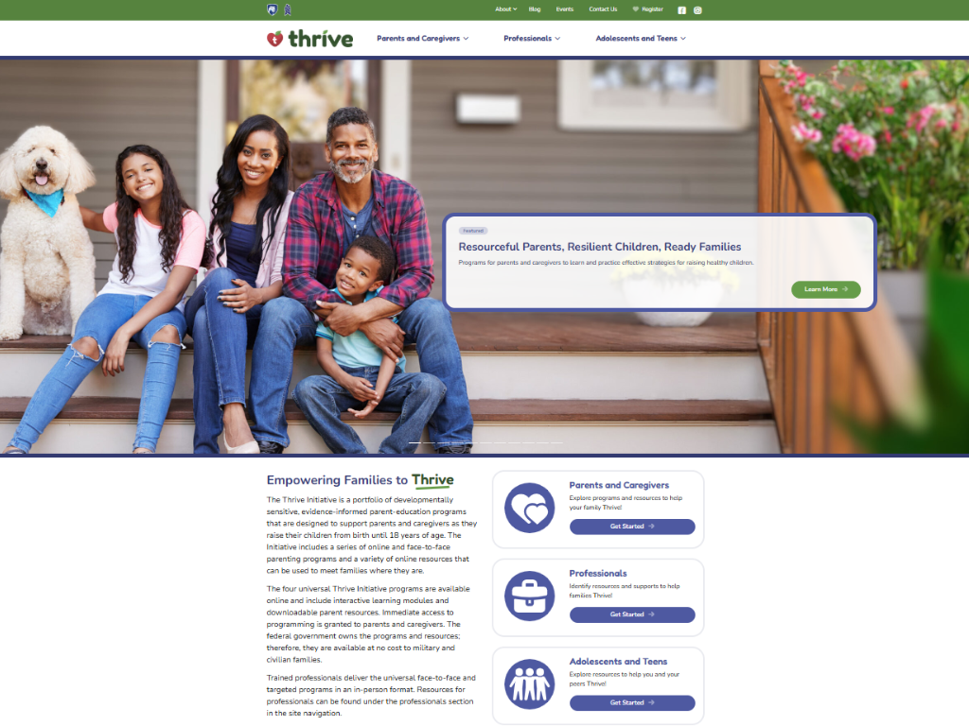
Notes:
Additional supplemental modules are available on a variety of topics and can be accessed online at https://thrive.psu.edu/modules/supplemental/.
Encourage participants to continue to visit the Thrive website, https://thrive.psu.edu, as their child develops and grows.
They can access additional resources and materials like mini-booster modules, blog postings, parenting handouts and guides, an inclusivity toolkit, and newsletters.

Slide 42
Thank you all for your dedication and participation. Every effort you make significantly impacts your child's future success.
Notes:
Example language:
Thank you, parents and caregivers, for your active participation. Please continue to visit the Thrive website as your child develops and grows—it's a valuable resource that can support you through every stage of their growth.
Supplemental Extension ENDS HERE.

Slide 43
Introduction
Notes:
Delivery Type 2: Supplemental Stand Alone begins here.

Slide 44
Welcome!
Please sign in and find a seat. We will begin soon.
If possible, please turn on your camera and enter your preferred name. We will begin soon.
Notes:
Choose one bullet point to display (the first bullet point is for in-person, the second is for virtual).
If in-person, greet participants as they come in the door and help them find a seat.
If virtual, give participants a heads up when you will be starting. For example, “Hi everyone, we will be starting in about one minute.”

Slide 45
AGENDA
Overview
Ice Breaker
Ground Rules
Syllabus
Expectations
Registration
Homework
Notes:
Welcome: Introduce yourself and thank participants for choosing to be a part of the Exceptional Families Supplemental Parenting Program. Explain that Meeting 1 will provide an overview of the program, who is in our group, and what is expected of parents who participate. We will discuss the materials you received and provide instructions on how to use them.
Encourage participants to ask questions as they arise or to jot them down and ask at the end of the meeting.

Slide 46
Target Audience
Program Focus
Skill Building
Reflective Sharing
Program Structure
Goals
Notes:
Exceptional Families. Embracing Differences. Flourishing Together is an online supplemental module for parents (and caregivers), of children who have a disability. This supplemental module focuses on addressing specific concerns caregivers may have regarding a child who has a disability and offering them support.
Parenting a child who has a disability can be difficult sometimes. You may feel lonely. Throughout this program, we will provide information and offer tools and resources that you can use to help you maximize the rewarding times while facing challenges head-on. Remember, we want you to know that you are not alone. We will also provide parenting strategies that you can add to your “toolkit.” You may already be using some of these strategies, or some of them may be new to you. Whatever your circumstances, we hope you will use the information we offer in these modules as an opportunity to learn, grow, and become a more confident and informed parent or caregiver.
During the online supplemental module sessions and throughout the hybrid implementation meetings, information and parenting strategies that parents can use and adapt, as necessary, to fit their individual circumstances and family needs will be disseminated. The supplemental module content is designed to help parents build on their existing skills and strategies, so they can effectively parent a child with a disability.
Some of the content that is read and practiced in the supplemental module and discussed in the hybrid implementation meetings might be familiar to the parents, and they may already know about and use the disseminated information. Therefore, they may use the meeting time as an opportunity to realize, appreciate, and share what already works for them, their child, and their family.
Exceptional Families. Embracing Differences. Flourishing Together includes an overview, three sessions, and a wrap-up.
After participating in the online supplemental module sessions and the hybrid implementation meetings, parents and caregivers should be able to do the following:
• Connect with your feelings
• Understand that taking time for yourself is necessary and appropriate
• Build social-support systems. • Find ways to give your child a voice
• Understand your child’s behaviors, and use positive strategies to meet their needs
• Work on building your child’s gross and fine motor skills
• Discover resources and technologies that are available for you and your child
• Support your child’s sexual learning and development
• Plan for transitions and the future.

Slide 47
Tell us your name, your coparent’s name, your child’s name(s), your child’s age(s), and one of the following:
What you enjoy most about parenting
A word you could use to describe one of your child’s strengths
Notes:
Personal Introduction: Start with a brief introduction of yourself, highlighting your expertise in child development and any personal affiliations (e.g., community, organization, military) that connect you to the audience.
Combining Introductions: Merge the participants' introductions with an icebreaker activity to create a more engaging and efficient session.
Icebreaker Questions: Ask each participant to share their name, their coparent’s name, their child’s name, and age. Additional questions to choose:
What you enjoy most about parenting
A word you could use to describe one of your child’s strengths
Future Use: Note the icebreaker questions used; consider revisiting unused ones in future sessions as needed.
You can also start each meeting with an icebreaker if you find your group is reserved. Use your judgment and avoid controversial topics.

Slide 48
Basic Ground Rules:
Always start and end sessions on time.
Cell phones should be on vibrate; members can quietly excuse themselves if a call must be taken.
In virtual sessions, participants should mute themselves when taking calls outside the session.
Group-Specific Rules:
Avoid judgment regarding other participants' parenting practices or knowledge gaps.
One person speaks at a time to maintain order and clarity.
Assume positive intent in all interactions to foster a positive atmosphere.
Confidentiality- Please be respectful and discrete with the personal stories being shared. This is a safe space to grow and learn.
Notes:
Introduction of Ground Rules: Start by stating some basic ground rules to create a supportive environment where families feel safe to share their parenting experiences.
Basic Ground Rules:
Always start and end sessions on time.
Cell phones should be on vibrate; members can quietly excuse themselves if a call must be taken.
In virtual sessions, participants should mute themself when taking calls outside the session.
Developing Group-Specific Rules:
Discuss and agree on additional rules as a group, such as:
Avoid judgment regarding other participants' parenting practices or knowledge gaps.
Ensure one person speaks at a time to maintain order and clarity.
Assume positive intent in all interactions to foster a positive atmosphere.
Confidentiality Discussion: Use this time to reinforce the importance of confidentiality, outlining your organization’s specific confidentiality clauses regarding statements related to abuse or neglect mandated reporting..
Example language:
As we begin, it's crucial to emphasize the importance of confidentiality within our group. We need to agree to keep all shared information within these sessions, including personal stories and sensitive details. This ensures a safe space where everyone feels comfortable sharing their experiences. Please remember that details shared by participants are given in trust and should be treated with respect and discretion.
Additionally, it’s important to note our mandated reporting clause for suspected abuse or neglect:
Legal Obligation: Our staff and facilitators are legally required to report any suspicions of child abuse or neglect.
Scope of Reporting: We must report any signs of potential harm to a child or vulnerable adult that arise during our sessions.
Procedure for Reporting: We handle these situations sensitively, informing involved individuals about necessary actions, unless it poses further risk.
Support for Affected Individuals: We provide support and resources to help those involved in a reporting situation.
Our primary concern is the safety and well-being of all individuals. If you have any questions or concerns about this policy, feel free to discuss them privately with me.

Slide 49
Parent Workbook
Syllabus
Notes:
Provide copies or screen share a copy of the Parent Workbook and Syllabus for the Exceptional Families. Embracing Differences. Flourishing Together. module. Review the Summary of Training, and highlight the section where the participants can find pertinent information.

Slide 50
Expectations
Notes:
Overview of Expectations: Clearly define what is expected of participants in the Exceptional Families supplemental program.
Independent Completion: Inform families that they are expected to independently complete the online modules.
Full Engagement Required: Emphasize the importance of completing each module in full to maximize learning and benefit from the program.
Purpose of Meetings: Clarify that the in-person meetings are not for revisiting session content but for community building, reflecting on experiences, and discussing insights with other parents and caregivers who are trying to successfully navigate parenting a child with a disability.
Preparation for Discussions: Encourage participants to come to meetings prepared to share their thoughts and engage in discussions based on the content they've learned online.

Slide 51
REGISTER
Notes:
Complete any registration requirements for your organization. Then, explain how participants can access the supplemental module online. Offer support to help with any technological questions. All participants will have previously set up a Thrive Initiative account, but you need to ensure they can log in and find the information they need to get started or progress in the supplemental module.

Slide 52
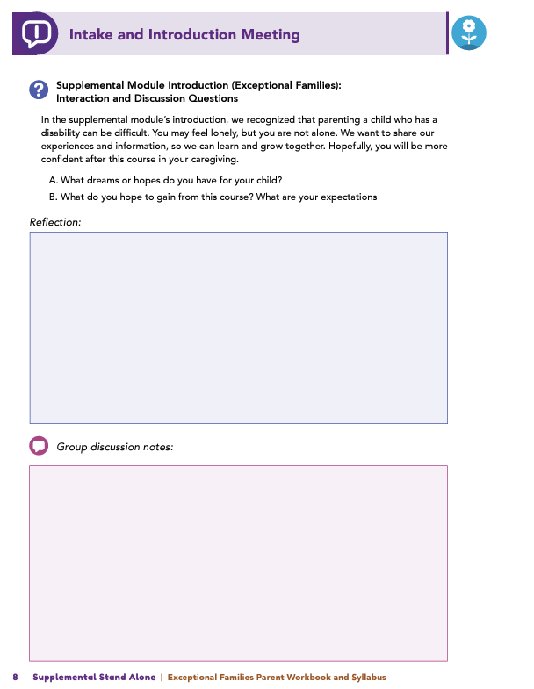
Homework
Complete the Introduction Module and Session 1: Disability and You
View online modules
Complete workbook questions
Notes:
Homework Tasks: Assign Introduction Module and Session 1: Disability and You as homework.
Step 2 Clarification: Remind participants that this homework involves viewing online content and downloading necessary resources as part of Step 2. If time permits, show where to access these materials on the website.
Workbook Guidance: Show the specific pages in the Exceptional Families Parent Workbook and Syllabus related to these topics (D7)
Step 3 Clarification: Assign workbook discussion questions (beginning on page D8 in the parent workbook).
Format explanation: Explain the reason for 2 boxes per question (one for individual, one for group responses).
Encourage reflection and engagement: The more participants, think, reflect, and share the more meaningful the content becomes to each family.
Pro tip: Complete the workbook while viewing online modules.

Slide 53
Thank you for participating today.
Please reach out with any questions or concerns.
See you next week!
Notes:
Closing: Thank participants for their time and engagement.
Questions: Ask if there are any questions. (If someone needs personal assistance, ask them to speak with you individually after the group is dismissed).
Meeting 2: Remind participants of the date/time/location of the next meeting.
Homework: Remind participants to complete the homework.
Adjourn: Say goodbye to participants.

Slide 54
Meeting 1

Slide 55
Welcome back!
Please sign in and find a seat. We will begin soon.
If possible, please turn on your camera and enter your preferred name. We will begin soon.
Notes:
Choose one bullet point to display (the first bullet point is for in-person, the second is for virtual).
If in-person, greet participants as they come in the door and help them find a seat.
If virtual, give participants a heads up when you will be starting. For example, “Hi everyone, we will be starting in about one minute.”

Slide 56
Conversation Starter
Restate Ground Rules
Group Discussion
Homework
Notes:
Example language: Welcome back, families! We’re glad to see for our second meeting.
Review Meeting 2 Agenda:
Conversation Starters: We’ll get started with a quick question to get us all engaged and sharing.
Review of Ground Rules: A brief reminder of our ground rules to ensure our discussions remain respectful and productive.
Discussion and Homework: After our initial activities, we will discuss the workbook questions based on your experiences with the last set of homework followed by an explanation of the homework for our next meeting. Let’s get started!

Slide 57
Please answer one of the following questions:
What is one aspect of your parent-child relationship that is working well?
What is a skill you use effectively in your parenting?
Notes:
Example language: "Let's open our session with a fun question that will give us all a chance to share something about ourselves. Review the list of questions provided on the slide. Select one question that resonates with you, or that you feel comfortable sharing. This activity is designed to ease us into the meeting and build a friendly, open atmosphere.

Slide 58
Basic Ground Rules:
Always start and end sessions on time.
Cell phones should be on vibrate; members can quietly excuse themselves if a call must be taken.
In virtual sessions, participants should mute themselves when taking calls outside the session.
Group-Specific Rules:
Avoid judgment regarding other participants' parenting practices or knowledge gaps.
One person speaks at a time to maintain order and clarity.
Assume positive intent in all interactions to foster a positive atmosphere.
Confidentiality- Please be respectful and discrete with the personal stories being shared. This is a safe space to grow and learn.
Notes:
Introduction of Ground Rules: Start by stating some basic ground rules to create a supportive environment where families feel safe to share their parenting experiences.
Basic Ground Rules:
Always start and end sessions on time.
Cell phones should be on vibrate; members can quietly excuse themselves if a call must be taken.
In virtual sessions, participants should mute themself when taking calls outside the session.
Developing Group-Specific Rules:
Discuss and agree on additional rules as a group, such as:
Avoid judgment regarding other participants' parenting practices or knowledge gaps.
Ensure one person speaks at a time to maintain order and clarity.
Assume positive intent in all interactions to foster a positive atmosphere.
Confidentiality Discussion: Use this time to reinforce the importance of confidentiality, outlining your organization’s specific confidentiality clauses regarding statements related to abuse or neglect mandated reporting..
Example language:
As we begin, it's crucial to emphasize the importance of confidentiality within our group. We need to agree to keep all shared information within these sessions, including personal stories and sensitive details. This ensures a safe space where everyone feels comfortable sharing their experiences. Please remember that details shared by participants are given in trust and should be treated with respect and discretion.
Additionally, it’s important to note our mandated reporting clause for suspected abuse or neglect:
Legal Obligation: Our staff and facilitators are legally required to report any suspicions of child abuse or neglect.
Scope of Reporting: We must report any signs of potential harm to a child or vulnerable adult that arise during our sessions.
Procedure for Reporting: We handle these situations sensitively, informing involved individuals about necessary actions, unless it poses further risk.
Support for Affected Individuals: We provide support and resources to help those involved in a reporting situation.
Our primary concern is the safety and well-being of all individuals. If you have any questions or concerns about this policy, feel free to discuss them privately with me.

Slide 59
What dreams do you have for your child?
What do you hope to gain from this course?
Notes:
Provide an overview of the supplemental module using the following points that are taught in the supplemental module:
• Parenting a child with a disability can be difficult sometimes. You may feel lonely. Always remember that you are not alone.
• Whatever your circumstances, we hope the information that is offered in these modules can provide you with an opportunity to learn, grow, and become a more confident and informed parent or caregiver.
Ask the following questions and solicit answers from a few participants to generate discussion:
In the module, you were asked to consider what dreams you have for your child and what you hope to gain from this course. Who would like to share their thoughts?

Slide 60
Understanding
How did you feel when you first learned about your child’s diagnosis?
What were your initial concerns about their delays?
How have you supported your child in reaching developmental milestones?
What feelings do you have about raising your child?
Notes:
Review this section of the module with the participants by offering the following information:
• As outlined in the module, let’s think about what disability IS and IS NOT.
Disability IS NOT a label, a box to fit into, or a reflection of your parenting.
Disability IS natural and diverse and can be a pathway that allows for connection to resources.
If you have a child with a disability, your child will still go through many of the typical developmental stages. However, they may not go through these phases in the same way or in the same timeframe as other children who do not have disabilities experience them. In the end, your child will reach their own milestones throughout the course of life.
The distinctiveness of this parenting journey may cause you to reflect on your own parenting skills, whether you are a new parent or have older children. That reflection may cause you to have a variety of feelings. All of those feelings are valid.
Ask some or all of the following questions, and solicit answers from participants to generate discussion:
Session 1 asked you to consider your feelings about your child’s delays or diagnoses. Would anyone like to share any or all of the following:
What were your initial feelings when you received your child’s diagnosis?
What were your first concerns as you considered what your child’s delays may be and what they may mean for your family?
What are some unique pathways that your child has taken to reach developmental milestones and how you’ve assisted your child in accomplishing those goals (e.g., learned sign language for better communication, received physical therapy services to enhance gross motor skill or occupational therapy for fine motor skill development)?
What are some feelings that you associate with raising your child.
Why do you think you feel that way?

Slide 61
The Importance of Self Care
Do you often prioritize others over yourself?
Why?
Notes:
Review this section of the module with the participants by offering the following information:
Taking care of a child with disability can be difficult. However, to be the best parent you can be, you must also allow yourself to be cared for and engage in self-care. You are filling roles in addition to just caring for your child; you are acting as a teacher, therapist, and nurse—just to name a few. Taking time to care for yourself can involve watching a sporting event, getting a manicure, reading a book, having someone bring you a meal, or enjoying a night out.
• Let’s review the 6 R’s from the module.
Remember: Parenting can be difficult.
Recognize: You are not perfect, and that is okay.
Relax: Take a minute and take a breath!
Recharge: Enjoy guilt-free time away from parenting responsibilities.
Reconnect: Establish and maintain support systems.
Relish: Be sure to celebrate!
Ask the following question, and solicit answers from participants to generate discussion:
Who here tends to put themselves last? Why do you think you do that?

Slide 62
Remember
What is a difficult decision that you have made regarding your child’s care?
What did you learn from making that decision?
Notes:
Review this section of the module with the participants by offering the following information:
• Parenting is challenging, and challenges may reach new heights when you are parenting a child with a disability.
• You may experience moments when you need to make decisions that leave you questioning everything you thought you knew about parenting.
• Trust yourself to have made the best decision, be confident in that decision, and take comfort in moving on. Doing this may be easier said than done, but taking these steps is worth trying!
Ask the following question, and solicit answers from a few participants to generate discussion:
What is a difficult decision that you have made regarding your child’s care? What did you learn from making that decision?

Slide 63
Recognize
Can you share a time when you made a parenting mistake? How did it feel?
Did you write the Letter of Forgiveness to yourself? How was that experience?
What do you think someone else would say is one of your greatest strengths as a parent?
Notes:
Review this section of the module with the participants by offering the following information:
• Nobody is perfect, and all parents make mistakes. Be sure you acknowledge the strengths you possess as a parent and recognize your willingness to learn new skills and strategies. Appreciate the uniqueness of your child, and know your child’s strengths and challenges.
Ask the following questions, and solicit answers from participants to generate discussion:
Would anyone like to discuss a time, or times, when they made a parenting mistake? How did that experience feel?
Did anyone write the Letter of Forgiveness to themself? How did that activity go?
What would someone else say is one of your greatest strengths as a parent?

Slide 64
Relax
Did anyone try a new technique?
What did you try? How did it feel?
Notes:
Review this section of the module with the participants by offering the following information:
• The module provided two techniques for taking time to relax and focus and a resource that contains information on additional techniques and strategies for taking a breath.
Ask the following question, and solicit answers from participants to generate discussion:
Did anyone try a new technique? What did you try? How did it feel?

Slide 65
Recharge
How do you practice self-care?
What activities help you recharge?
What tips do you have for making time to recharge?
What challenges stop you, and how can you overcome them?
Notes:
Review this section of the module with the participants by offering the following information:
• As a parent, sometimes you need to take a break from childrearing responsibilities. Leaving your child with a trusted caregiver is okay; so, go ahead and enjoy life outside of your home and away from your child. This might include a spa day, a date night, or a weekend getaway.
Ask the following questions, and solicit answers from participants to generate discussion:
In what ways have you been able to practice self-care? What activities do you enjoy doing and that recharge you?
Do you have any tips that you’ve used for taking time and recharging yourself that you can discuss with the group?
What challenges prevent you from engaging in activities that refresh or rejuvenate you? How can you overcome those barriers?

Slide 66
Reconnect
Who is in your Circle of Support?
Notes:
Review this section of the module with the participants by offering the following information:
• Having a Circle of Support network for you and your family that includes in-person and virtual support systems is essential to healthy parenting. While every journey is unique, surrounding ourselves with others reminds us that we are not alone.
Ask the following question, and solicit answers from participants to generate discussion:
Who completed the Circle of Support activity? Who is part of your Circle of Support?
Facilitator Tip : If participants mention they have no Circle of Support, encourage them to think about how they can make connections with others in their community [e.g., parents, spiritual leaders] and whom those “others” could be.

Slide 67
Relish
What do you and your family like to celebrate? How do you celebrate?
If you don’t celebrate achievements now, how could you start including them in your routines?
Notes:
Review this section of the module with the participants by offering the following information:
• Remember, take the time to celebrate all of the accomplishments you and your child make as you navigate steps in your journey!
Ask the following questions, and solicit answers from participants to generate discussion:
What do you, your child, and your family like to celebrate? How do you celebrate?
If you don’t currently celebrate achievements and milestones, how might you consider building these accomplishments into your family routines?

Slide 68
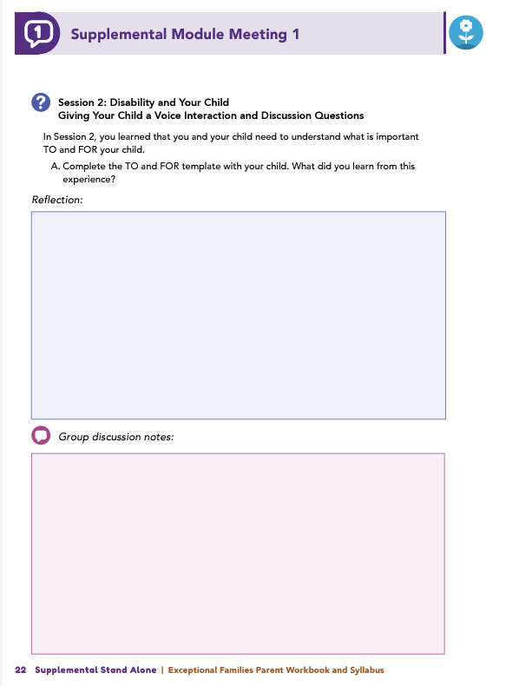
Homework
Complete Session 2: Disability and Your Child, Session 3: Disability Services and Your Child, and the Wrap Up
View online modules
Complete workbook questions
Notes:
Homework Tasks: Assign Session 2 & 3: Disability and Your Child, Disability Services and Your Child, and Wrap Up Module as homework.
Step 2 Clarification: Remind participants that this homework involves viewing online content and downloading necessary resources as part of Step 2. If time permits, show where to access these materials on the website.
Workbook Guidance: Show the specific pages in the Exceptional Families Parent Workbook and Syllabus related to these topics (D21)
Step 3 Clarification: Assign workbook discussion questions (beginning on page D22 in the parent workbook).
Format explanation: Explain the reason for 2 boxes per question (one for individual, one for group responses).
Encourage reflection and engagement: The more participants, think, reflect, and share the more meaningful the content becomes to each family.
Pro tip: Complete the workbook while viewing online modules.

Slide 69
Thank you for participating today.
Please reach out with any questions or concerns.
See you next week!
Notes:
Closing: Thank participants for their time and engagement.
Questions: Ask if there are any questions. (If someone needs personal assistance, ask them to speak with you individually after the group is dismissed).
Meeting 2: Remind participants of the date/time/location of the next meeting.
Homework: Remind participants to complete the homework.
Adjourn: Say goodbye to participants.

Slide 70
Meeting 2

Slide 71
Please sign in and find a seat.
We will begin soon.
If possible, please turn on your camera.
We will begin soon.
Notes:
Choose one bullet point to display (the first bullet point is for in-person, the second is for virtual).
If in-person, greet participants as they come in the door and help them find a seat.
If virtual, give participants a heads up when you will be starting. For example, “Hi everyone, we will be starting in about one minute.”

Slide 72
Conversation Starters
Group Discussion
Thrive Programming
Notes:
Example language: Welcome back, everyone! We're glad to see you for our third and final meeting.
*Optional Sections: Please note that the conversation starters are optional. If you prefer to skip these, simply remove the first bullet point from this slide and proceed to the next relevant slide in the deck.
Example language if omitting: We'll dive straight into discussing the key questions from our last session’s homework. We’ll wrap up with a discussion on additional Thrive programs that may interest you
Example language if not omitting:
Conversation Starters: We’ll get started with a quick question to get us all engaged and sharing.
Review of Ground Rules: A brief reminder of our ground rules to ensure our discussions remain respectful and productive.
Discussion and Homework: After our initial activities, we will discuss the workbook questions based on your experiences with the last set of homework followed by an explanation of the homework for our next meeting. Let’s get started!

Slide 73
Please answer one of the following questions:
What is an activity you enjoy doing with your child?
If you could relive one moment with your child, what would it be?
Notes:
Example language: "Let's open our session with a fun question that will give us all a chance to share something about ourselves. Review the list of questions provided on the slide. Select one question that resonates with you, or that you feel comfortable sharing. This activity is designed to ease us into the meeting and build a friendly, open atmosphere.

Slide 74
Basic Ground Rules:
Always start and end sessions on time.
Cell phones should be on vibrate; members can quietly excuse themselves if a call must be taken.
In virtual sessions, participants should mute themselves when taking calls outside the session.
Group-Specific Rules:
Avoid judgment regarding other participants' parenting practices or knowledge gaps.
One person speaks at a time to maintain order and clarity.
Assume positive intent in all interactions to foster a positive atmosphere.
Confidentiality- Please be respectful and discrete with the personal stories being shared. This is a safe space to grow and learn.
Notes:
Introduction of Ground Rules: Start by stating some basic ground rules to create a supportive environment where families feel safe to share their parenting experiences.
Basic Ground Rules:
Always start and end sessions on time.
Cell phones should be on vibrate; members can quietly excuse themselves if a call must be taken.
In virtual sessions, participants should mute themself when taking calls outside the session.
Developing Group-Specific Rules:
Discuss and agree on additional rules as a group, such as:
Avoid judgment regarding other participants' parenting practices or knowledge gaps.
Ensure one person speaks at a time to maintain order and clarity.
Assume positive intent in all interactions to foster a positive atmosphere.
Confidentiality Discussion: Use this time to reinforce the importance of confidentiality, outlining your organization’s specific confidentiality clauses regarding statements related to abuse or neglect mandated reporting..
Example language:
As we begin, it's crucial to emphasize the importance of confidentiality within our group. We need to agree to keep all shared information within these sessions, including personal stories and sensitive details. This ensures a safe space where everyone feels comfortable sharing their experiences. Please remember that details shared by participants are given in trust and should be treated with respect and discretion.
Additionally, it’s important to note our mandated reporting clause for suspected abuse or neglect:
Legal Obligation: Our staff and facilitators are legally required to report any suspicions of child abuse or neglect.
Scope of Reporting: We must report any signs of potential harm to a child or vulnerable adult that arise during our sessions.
Procedure for Reporting: We handle these situations sensitively, informing involved individuals about necessary actions, unless it poses further risk.
Support for Affected Individuals: We provide support and resources to help those involved in a reporting situation.
Our primary concern is the safety and well-being of all individuals. If you have any questions or concerns about this policy, feel free to discuss them privately with me.

Slide 75
Giving your child a voice
Has anyone used the TO and FOR template? How did it go, and what did you learn?
Has anyone created a One-Pager? How did it go, and who did you share it with?
Notes:
Review this section of the module with the participants by offering the following information:
• As your child’s caregiver, you help guide the direction of your child’s development. During all stages of your child’s life, you will be your child’s best advocate and, in turn, will teach your child to advocate successfully for themself. As you learned in the module, you can help your child champion for themself by teaching them how to have a voice and how to use that voice. In order to do this, you and your child need to understand what is important TO and FOR your child.
Ask the following questions, and solicit answers from participants to generate discussion:
Has anyone used the TO and FOR template to outline what goals, accommodations, or activities are important to your child versus what goals, accommodations, or activities are important for your child? If so, would you like to discuss how using the template worked and what you learned from the experience?
Has anyone created a One-Pager with their child? If so, would you like to talk about how that experience went and with whom you shared the One-Pager?

Slide 76
Behavioral Supports
In Session 2, you completed a grocery store family scenario. What did you learn from it?
What tools might help you understand your child’s behavior during challenges?
Notes:
Review this section of the module with the participants by offering the following information:
• Identifying supports for and with your child can be useful as you determine what supports are currently available and what supports will address specific needs, goals, and desires.
• You may find that you are often frustrated when others continually focus on perceived behavior issues that your child demonstrates. Remember, behavior is a way for your child to communicate. Typically, when a perceived behavior issue arises, your child is communicating that their needs are not being met at that time. Step back, and evaluate the entire situation.
Ask the following questions, and solicit answers from participants to generate discussion:
In Session 2, you completed an activity that was based on a family scenario that took place at the grocery store. What did you learn from completing this scenario?
What tools (e.g., Communication Chart: Listen to Behavior, Learning Log, Working and Not Working Sorter, 4+1 Questions) might you use to better understand what your child may be telling you when behavior challenges arise?

Slide 77
Social Supports
What did you learn from using the Relationship Circle tool?
Who does your child interact with?
Did you identify any casual relationships to explore or any that could be strengthened?
Notes:
Review this section of the module with the participants by offering the following information:
• Your child will experience many relationships throughout the course of their life. Finding a supportive and inclusive community is as important as connecting with medical professionals and therapists. In Session 2, you reviewed the Relationship Circle and completed an activity related to your child.
Ask the following questions, and solicit answers from participants to generate discussion:
What did you discover from completing the activity and using the Relationship Circle tool? Who are the people with whom your child interacts?
Were you able to identify any casual relationships that you feel are worth exploring or any relationships that could be strengthened?

Slide 78
Educational Supports
Has anyone made an IEP for their child?
Would you like to share any challenges or successes with it?
Notes:
Review this section of the module with the participants by offering the following information:
• Your child’s education is one of the most important areas of your child’s life where you can advocate for your child. According to current laws, you are entitled to the following:
A quality education for your child – you and your child’s school should collaborate to ensure your child receives an education that is suited to your child’s needs and is offered in an environment that supports and encourages your child’s development and well-being. This may mean that your child will learn in general education classrooms as much as possible.
A role in decision-making – you have a right to be informed and make comments or appeals regarding any major change that affects your child’s educational programming.
Access to records – you have a right to examine your child’s school records, including test results and explanations at any time.
An Individualized Education Program (IEP) is a document that describes the special services your child will receive to help them meet their educational needs. The IEP acts as a contract that explicitly states the support(s) your child will receive to increase their school-related success.
Ask the following questions, and solicit answers from participants to generate discussion:
Has anyone created an IEP for their child?
Would anyone like to discuss any of the obstacles or successes they encountered during the processes of developing and carrying out their child’s IEP?

Slide 79
Assistive Technologies
Does your child use any assistive technology (AT)?
What do they use, and when do they use it?
How is it working for them?
Notes:
Review this section of the module with the participants by offering the following information:
• One support service that your child may need to utilize is assistive technology (AT). Examples of AT include the following: communication boards, special-purpose computers, prosthetics, wheelchairs, educational software, and screen readers.
Ask the following questions, and solicit answers from participants to generate discussion:
Does anyone use any type of AT for their child?
What does your child use, and when do they use it?
How is that AT working for your child?

Slide 80
Early Intervention Services
Any successes or challenges with accessing EIS?
Any tips for accessing benefits, especially for military families?
What resources helped you with services or benefits?
Notes:
Review this section of the module with the participants by offering the following information:
• The search for support services can be challenging for parents, and it may seem like a daunting task. Remember, services are available at the local level or state level or both. Services you can access right after your child is born are the Early Intervention Services (EIS). These EIS are support services that are specifically designed to meet the needs of infants and toddlers with disabilities. The goal of EIS is to help your child develop basic skills (i.e., physical, cognitive, social, and emotional) that typically evolve within the first 3 years of life.
Facilitator Tip: Reference the EIS Fact Sheet.
Ask the following questions, and solicit answers from participants to generate discussion:
Would anyone like to talk about any successes or challenges they experienced when accessing EIS for their child?
Did anyone find and use any helpful tips regarding how to access benefits?
Were there any tips that were specific for a military family? Were there any available resources you found useful as you navigated specific services or benefits?

Slide 81
Home Practice with Therapeutic Activities Services
Do you do any therapies at home?
What therapies do you work on with your child?
Did you review the module’s resources? Will you use any?
Notes:
Review this section of the module with the participants by offering the following information:
• When transitioning to a new location, parents may find that wait times to receive services can be long. Therefore, parents can practice a variety of therapies with their children while they are searching for service options in their new location. In fact, many physical, occupational, and speech/language therapists encourage at-home practice with therapeutic activities in order to realize gains.
Ask the following questions, and solicit answers from participants to generate discussion:
Does anyone engage in any physical, occupational, or speech/language therapies at home? If so, what therapies do you work on with your child, and how does participating in those therapies work within the constructs of your family?
Did anyone review the resources that are available in the module for the different types of therapies? Do you think you might try to use any of the resources and which ones?

Slide 82
Planning for the Future
What hopes and goals do you have for your child?
What hopes and goals does your child have for themself?
Has your family started transition planning? Any tips to share?
Are you worried about transitions for your child?
What challenges have you faced in planning for their future?
Notes:
Review this section of the module with the participants by offering the following information: As your child gets older, you will start to think about and wonder what steps are next for them. From learning how to choose and then engage in activities to determining transition planning to postsecondary education or employment, parents need to remember that decisions should be planned WITH your child and not FOR your child.
Ask the following questions, and solicit answers from participants to generate discussion:
What are some of the hopes and goals you have for your child? What are some of the hopes and goals your child has for themself?
Has anyone begun the transition planning process in their family? If so, could you share tips on how to make this process move forward smoothly? Is anyone worried about transitions for their child?
What challenges have you encountered in planning for your child’s future?

Slide 83
What topic from the supplemental module was most helpful to you as a parent? Why?
What strategies or skills did you learn to help achieve your family goals?
What has changed in how you interact with your child since completing the module?
Have you noticed a difference in how your child responds to your parenting?
Notes:
Review this section of the module with the participants by offering the following information:
• We hope you will continue to build on what you have learned in this module by developing goals and creating a plan with your child for their life. Include aspirations, ideas, and goals that are important to your child now. Incorporate lessons they have learned from the past and dreams they have for their future. Remember, this is a process. These tools are meant to act as visual aids for you and your child as your child discovers what it means to live their best life. Many of these activities are meant to be living documents, which means they will grow and change as your child grows and changes. We hope you will continue to use these tools, activities, and resources to support your child’s development.
Tell participants you are wrapping up, and generate discussion among participants using all, or some, of the following questions:
Which topic discussed in the supplemental module was the most beneficial to you as a parent? Why?
What strategies or skills did you learn in the supplemental module that will help you achieve the goals you have for your child or your family?
What has changed in your interactions with your child since before completing the supplemental module?
Have you noticed a difference in the way your child is responding to your parenting?

Slide 84
Additional Thrive Programs
Take Root is available for parents and caregivers of children who are between 0 and 3 years old.
Sprout is available for parents and caregivers of children who are between 3 and 5 years old.
Grow is available for parents and caregivers of children who are between 5 and 10 years old.
Branch Out is available for parents and caregivers of children who are between 10 and 18 years old.
Notes:
Provide support and encouragement to your participants to explore other Thrive Initiative programming. Share and/or register participants for any additional hybrid implementation options that you plan to offer. Thrive Initiative programming may include any of the following:
Universal Programs
• Take Root is available for parents and caregivers of children who are between 0 and 3 years old.
• Sprout is available for parents and caregivers of children who are between 3 and 5 years old.
• Grow is available for parents and caregivers of children who are between 5 and 10 years old.
• Branch Out is available for parents and caregivers of children who are between the ages of 10 and 18 years old.

Slide 85
Notes:
Additional supplemental modules are available on a variety of topics and can be accessed online at https://thrive.psu.edu/modules/supplemental/.
Encourage participants to continue to visit the Thrive website, https://thrive.psu.edu, as their child develops and grows.
They can access additional resources and materials like mini-booster modules, blog postings, parenting handouts and guides, an inclusivity toolkit, and newsletters.

Slide 86
Thank you all for your dedication and participation. Every effort you make significantly impacts your child's future success.
Notes:
Example language:
Thank you, parents and caregivers, for your active participation. Please continue to visit the Thrive website as your child develops and grows—it's a valuable resource that can support you through every stage of their growth.

